Slide 1
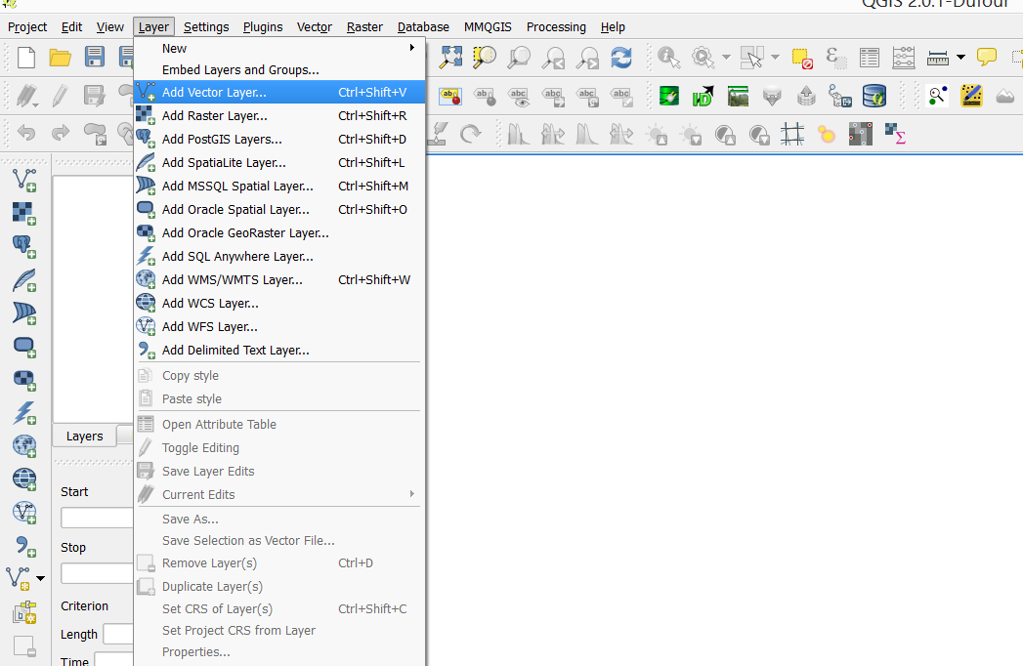
Add your existing spatial data – here we are using shape files

Slide 2
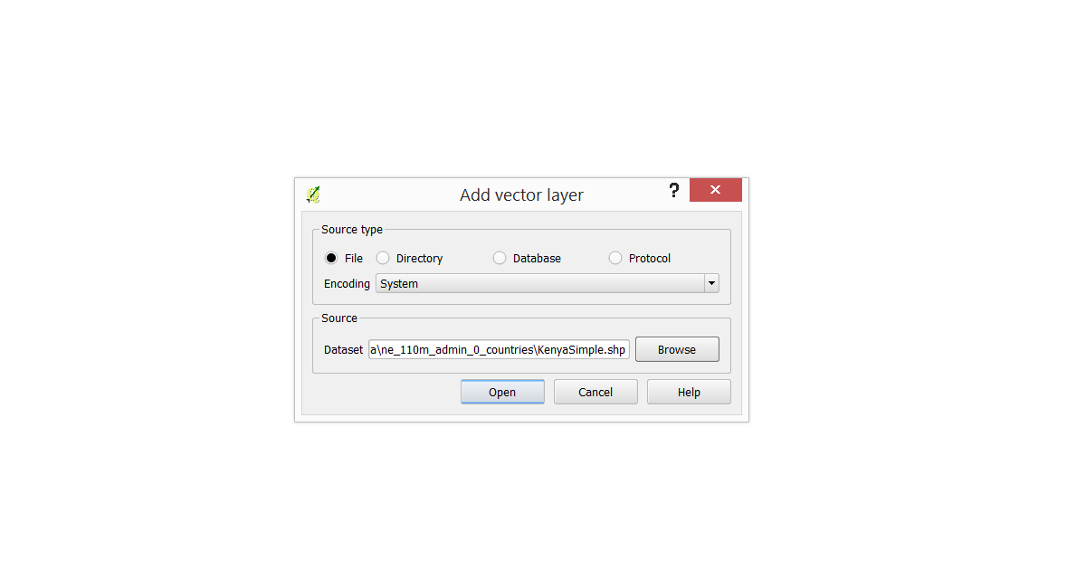
Browse to find your file

Slide 3
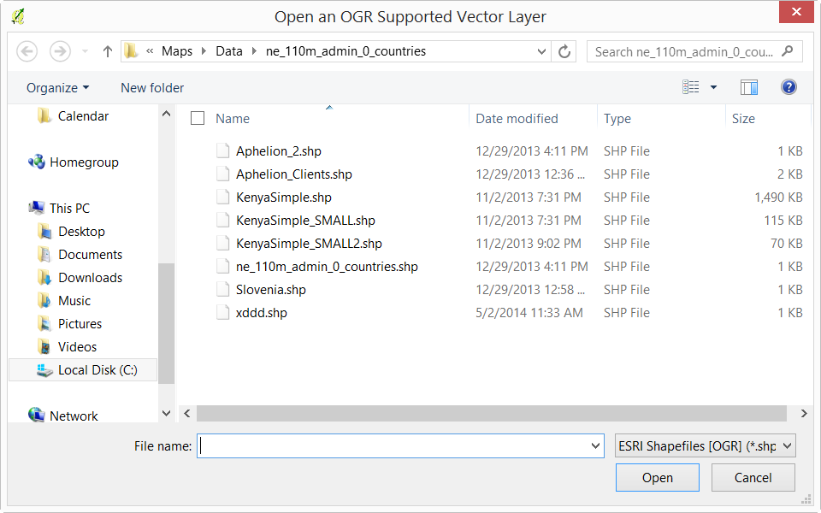
Choose the appropriate file

Slide 4
Hit OK

Slide 5
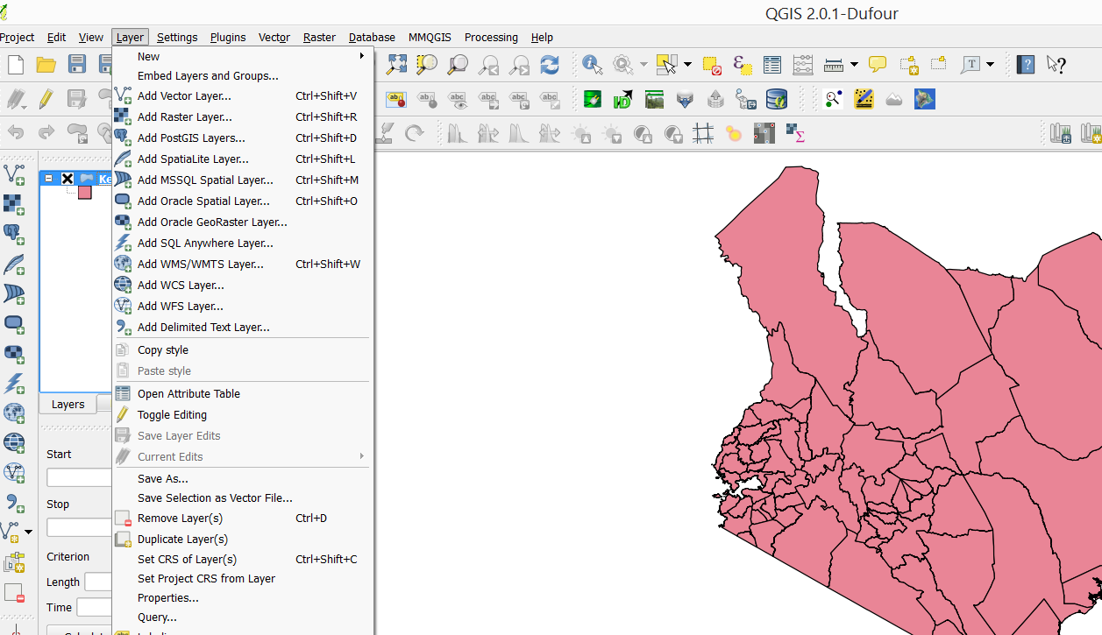
Add a SQL layer to get the shape into our DB

Slide 6
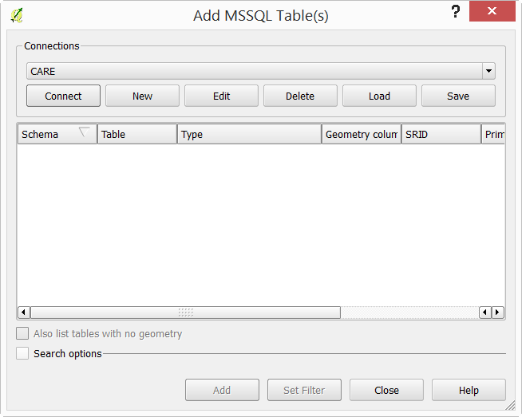
If this is the first time, create a new connection

Slide 7
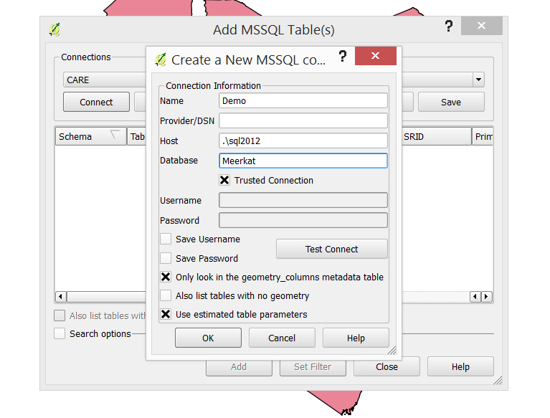

Enter the DB settings
text

Slide 8
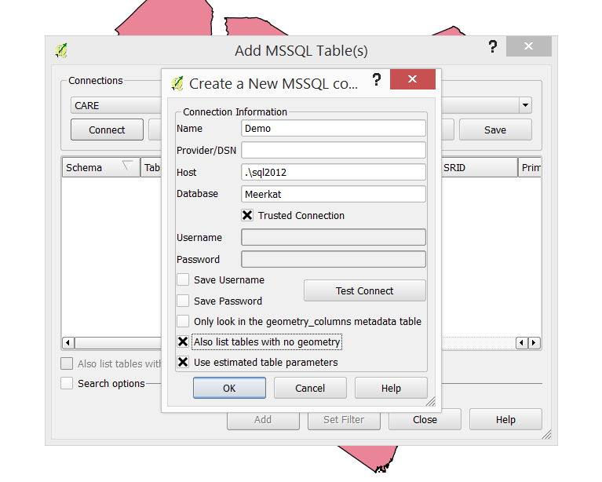
Two check boxes need to be changed

Slide 9
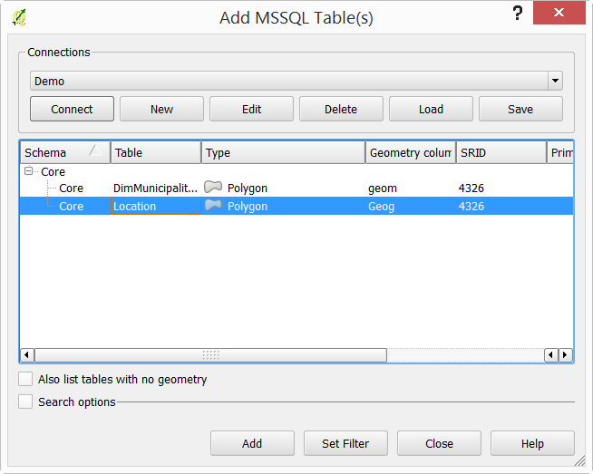
Choose the locations table

Slide 10
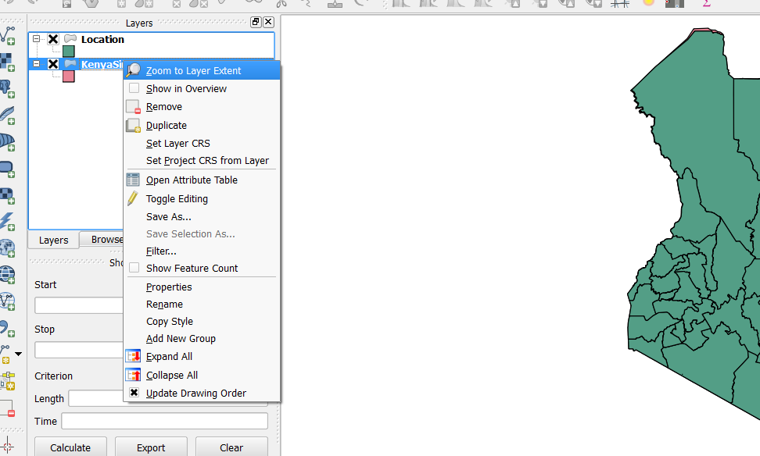
You may need to use the Zoom extent button to show your shapes

Slide 11
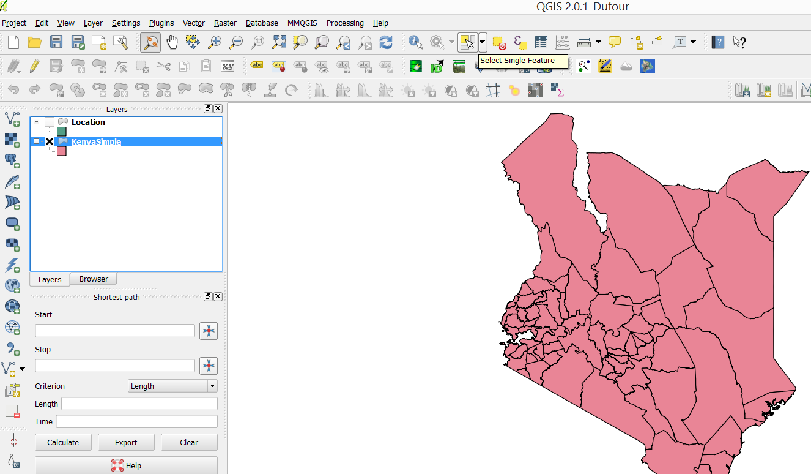
Make sure to select only the layer you want to work with, both in the check box and highlighted. Then choose the “select single feature” command

Slide 12
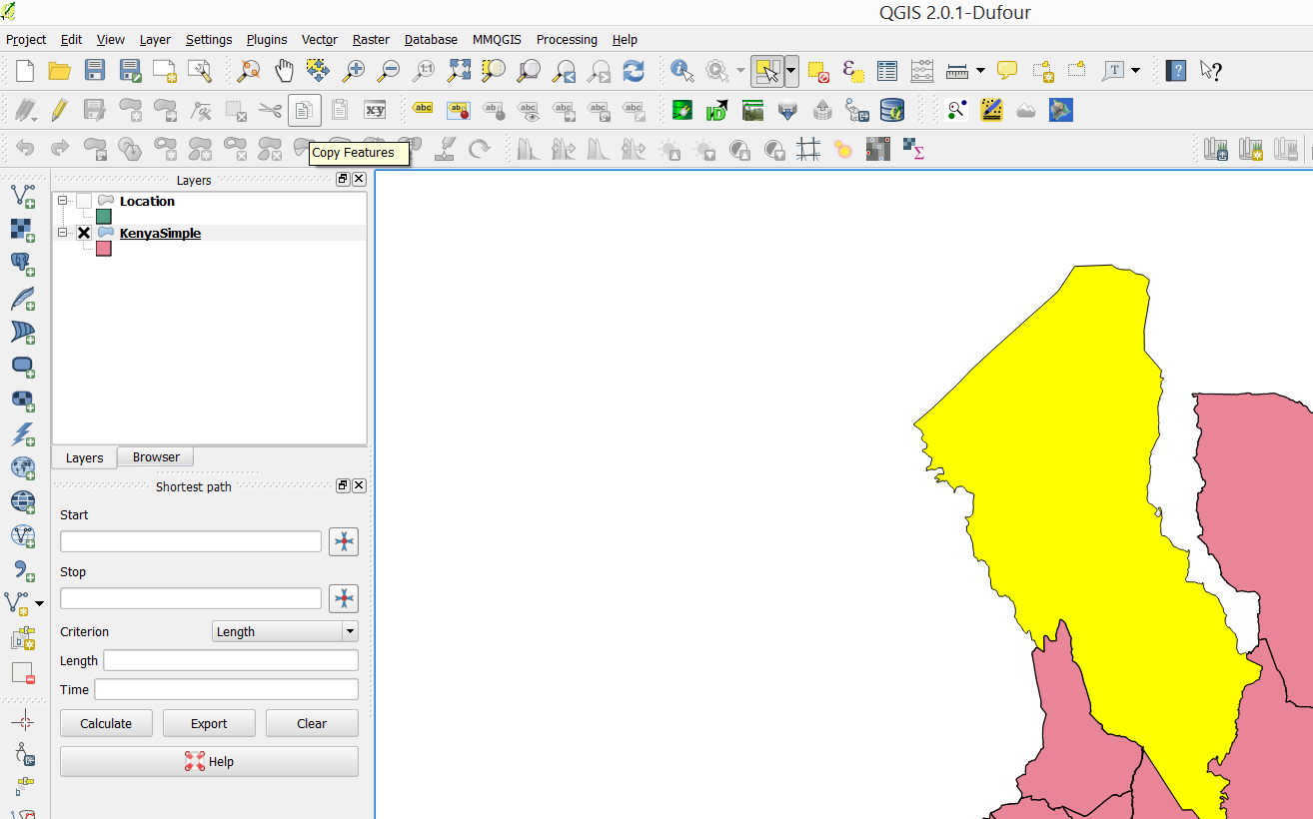
Select your feature, then copy it

Slide 13
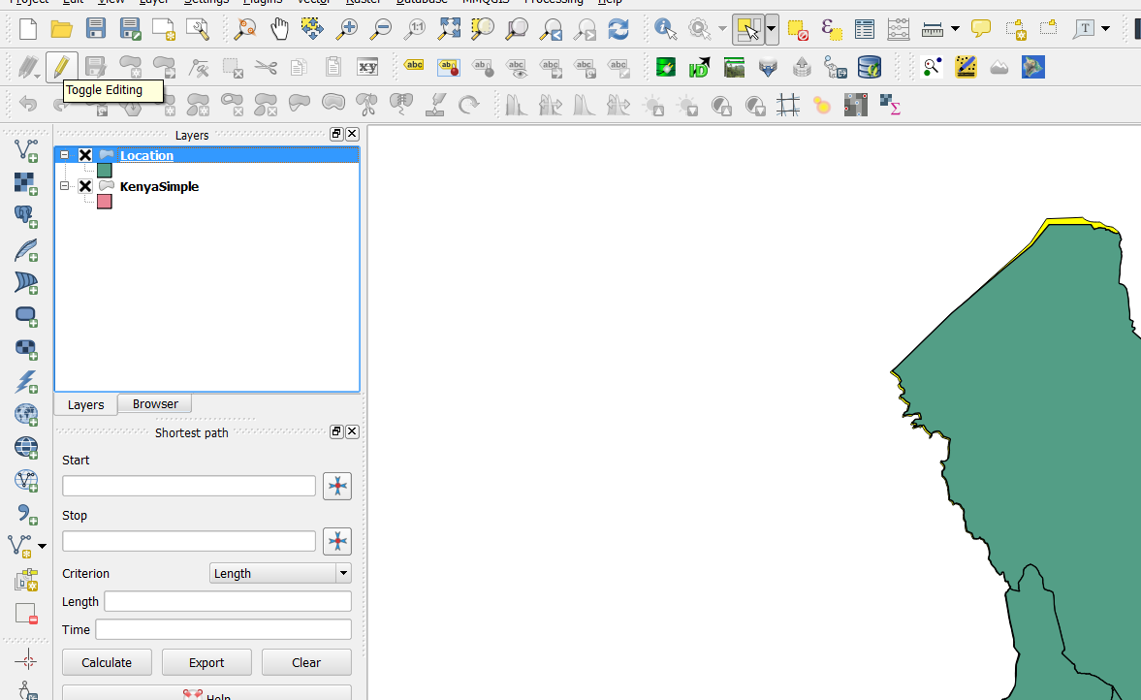
Select the location layer, then toggle editing

Slide 14


Slide 15
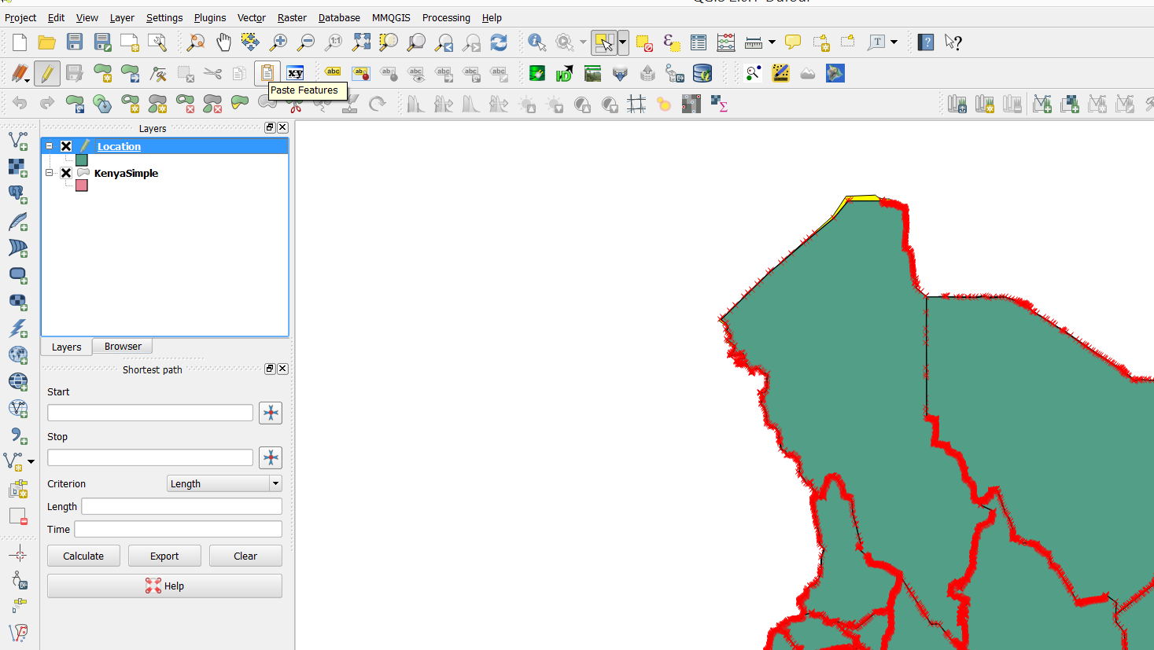
Paste the new feature

Slide 16
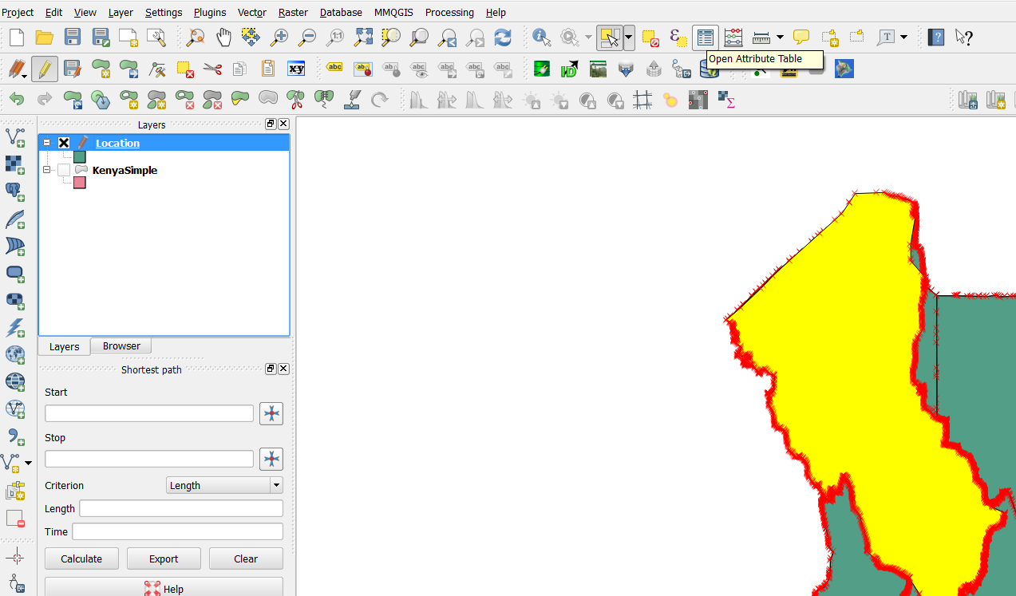
Name and code etc. are edited in the attribute table

Slide 17
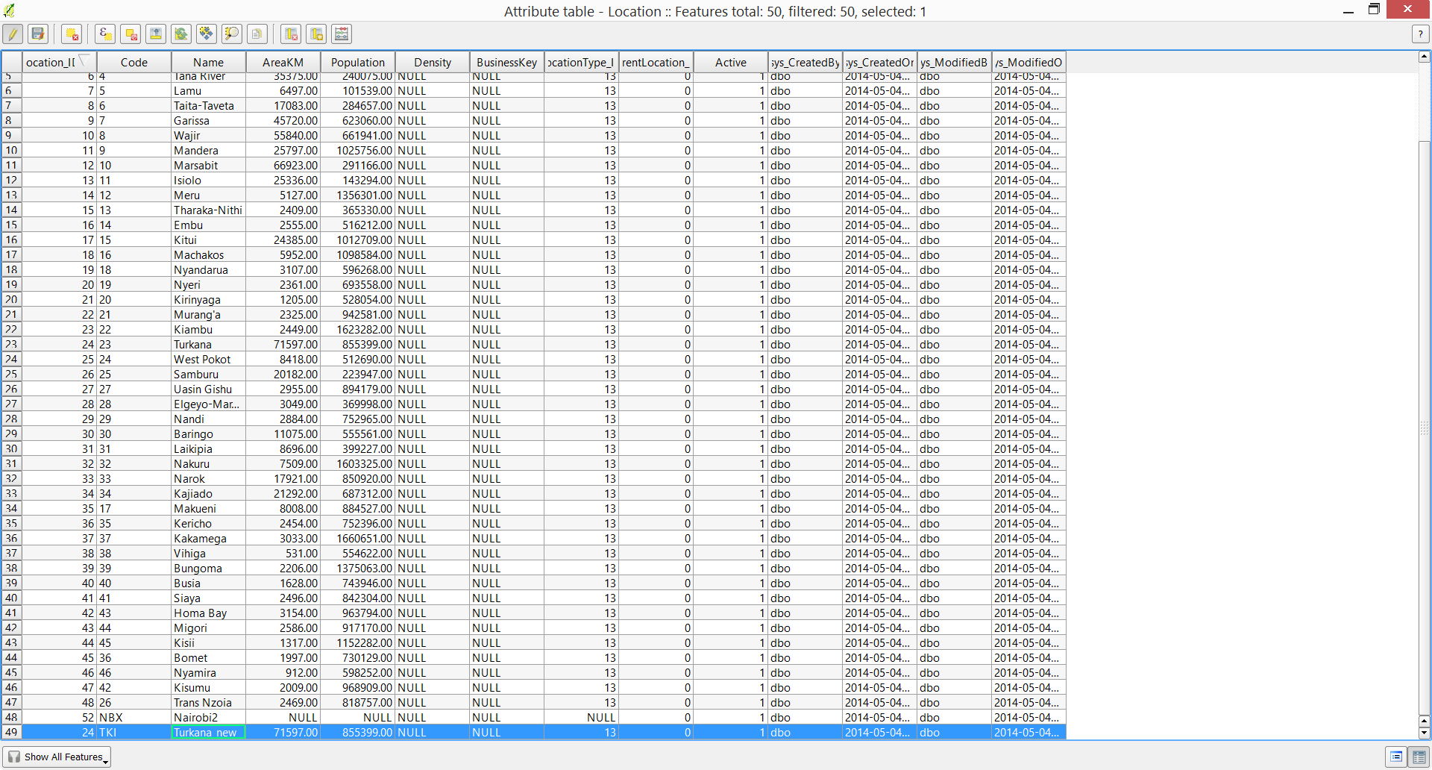

Slide 18
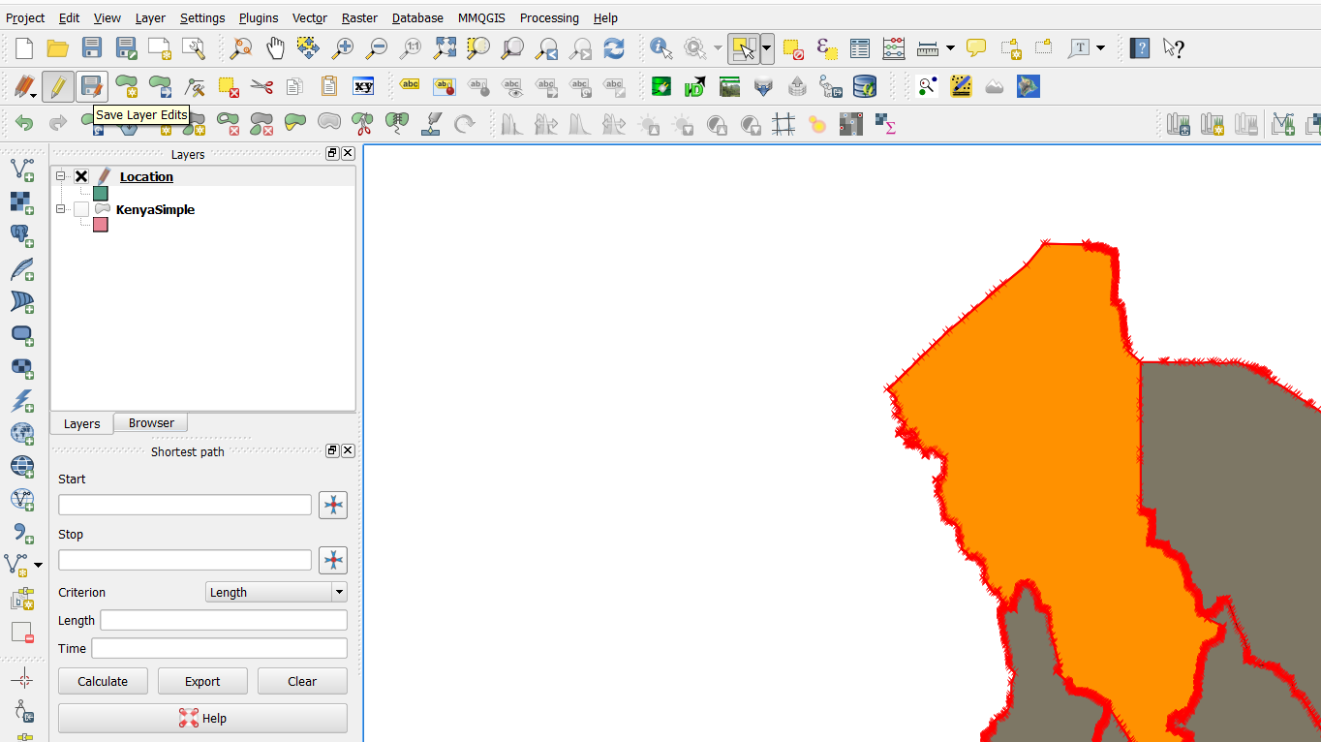
Save your changes

Slide 19
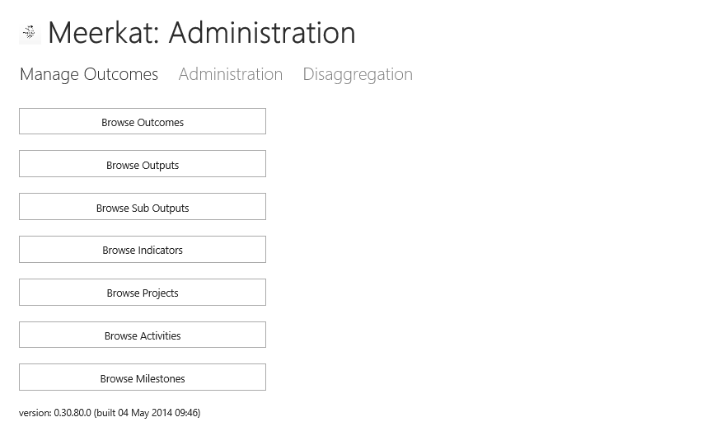
While all attributes can be edited in QGIS, it is often easier to edit the text through Meerkat

Slide 20
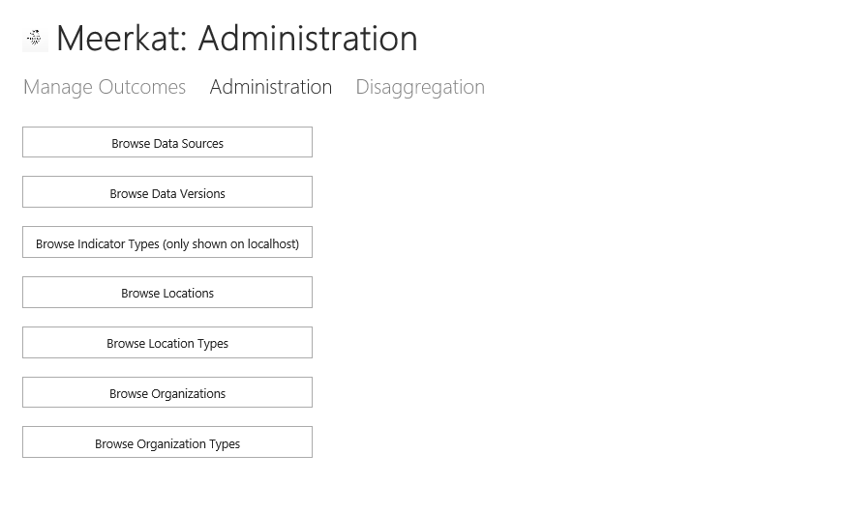

Slide 21
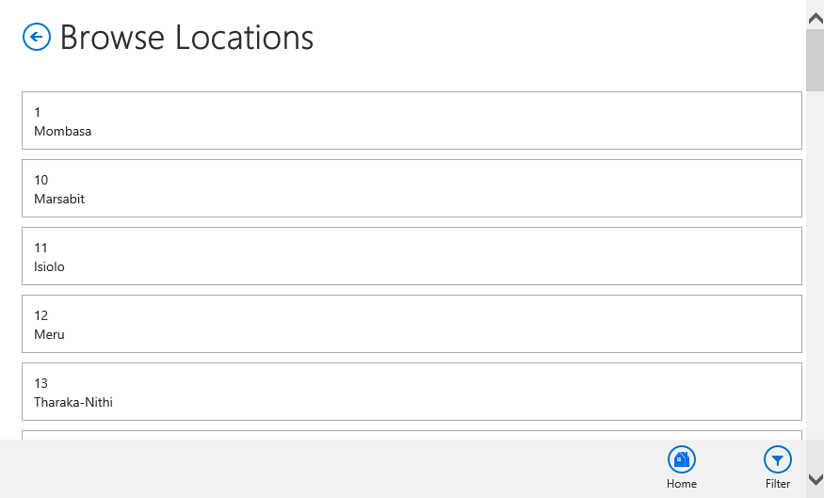
Filtering will make finding your location much quicker

Slide 22
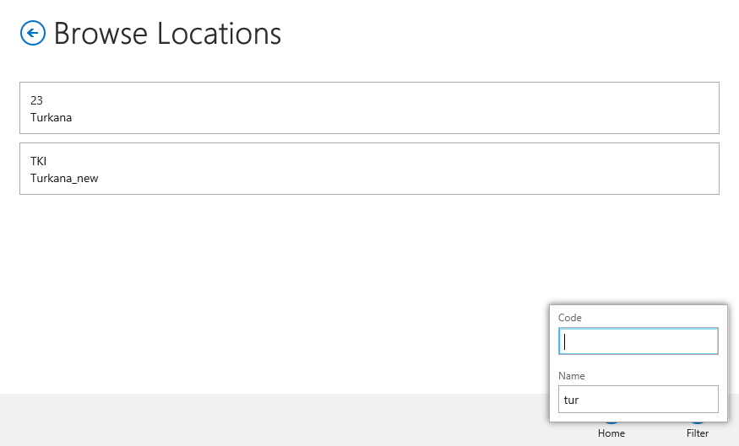
Select the field you wish to filter on, then press tab to filter. Click the location you want to edit

Slide 23
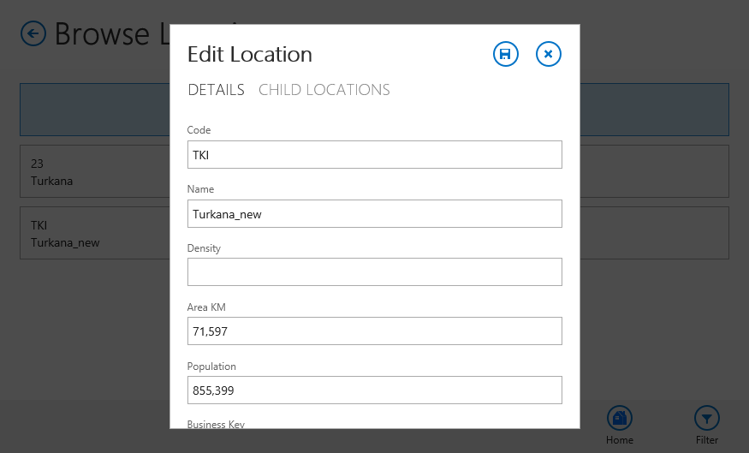
All details can be edited here

Slide 24
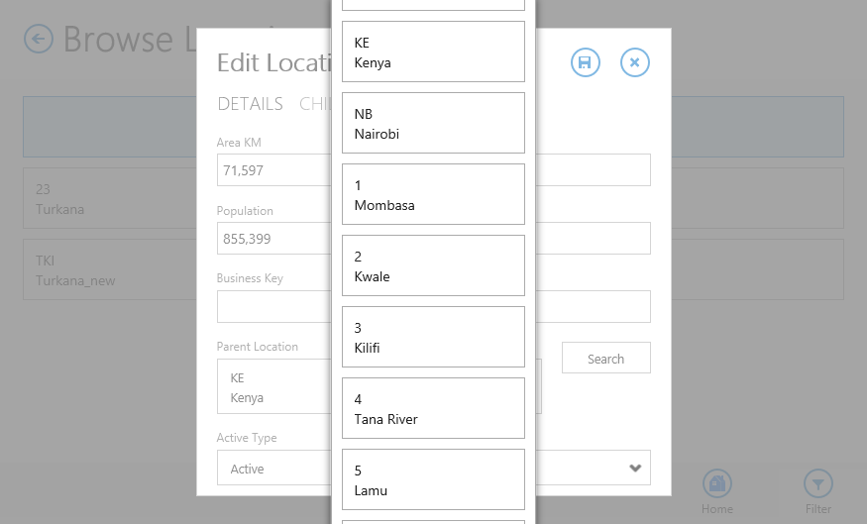
The most common edit will be to choose a parent location, as the default will put the parent at the top level

