Slide 1
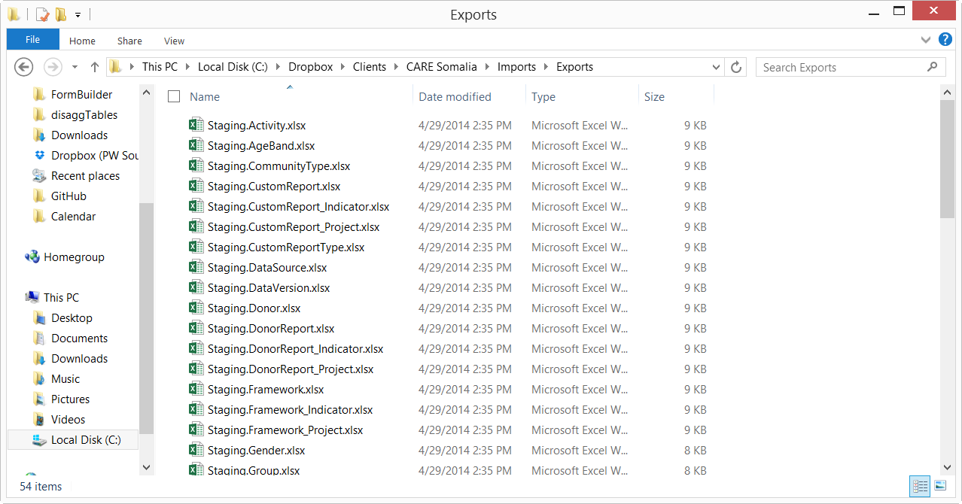
Data is automatically exported for bulk edit. Choose a file to edit, in this example we’re using INdicator

Slide 2
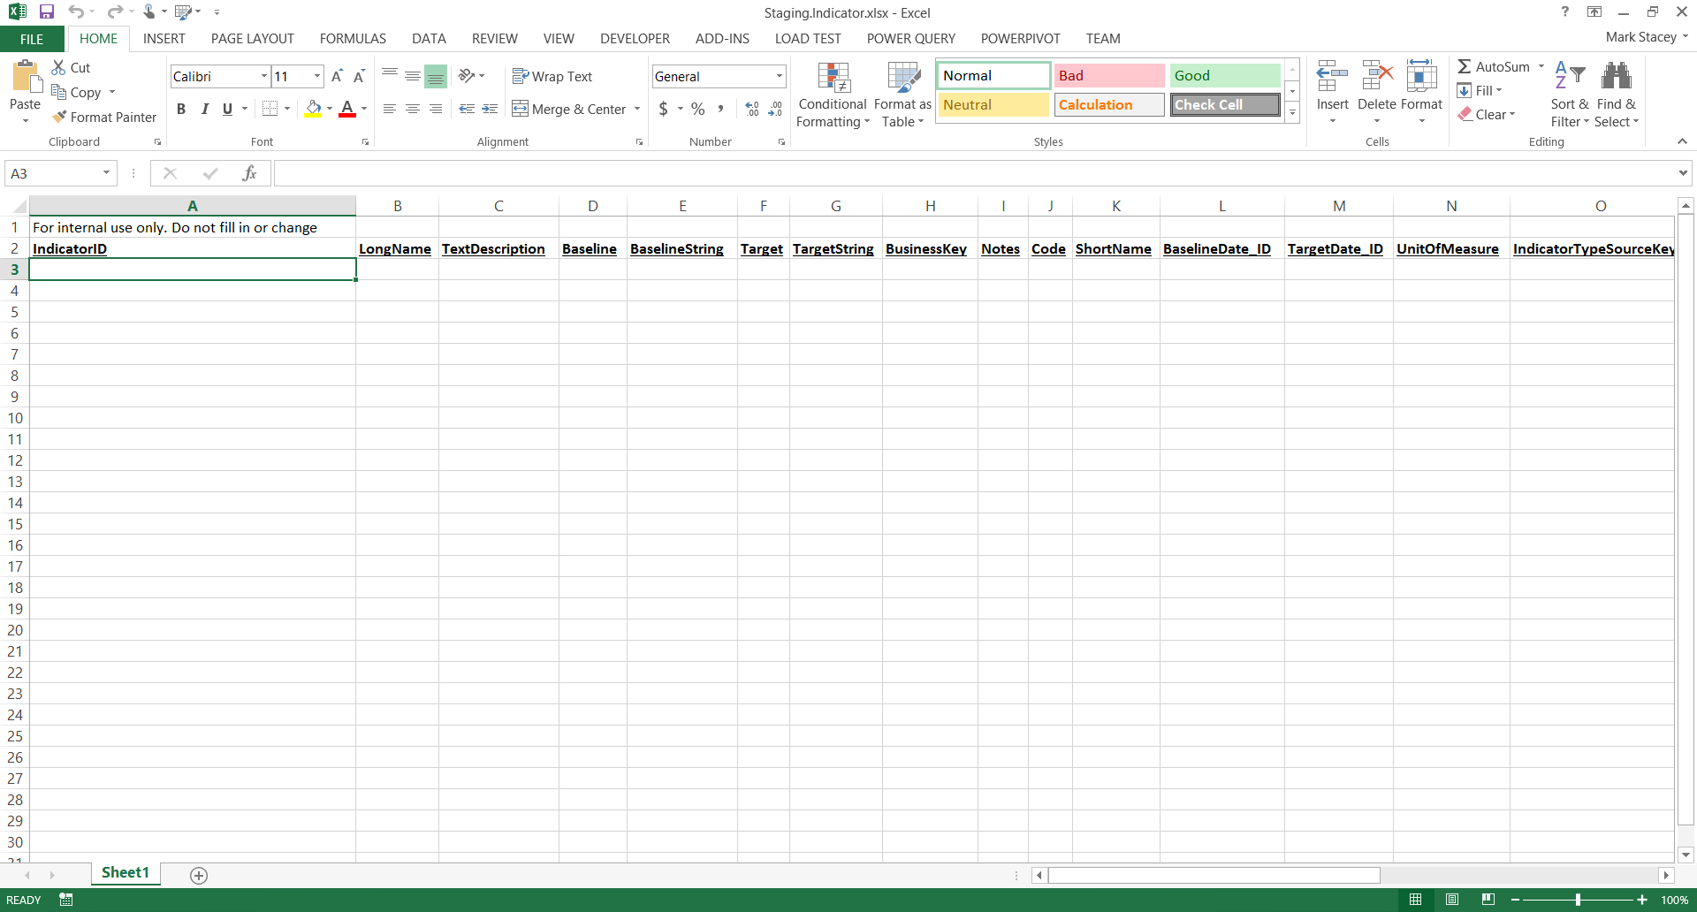
If no data exists, file will be empty. Always leave out the first column!

Slide 3
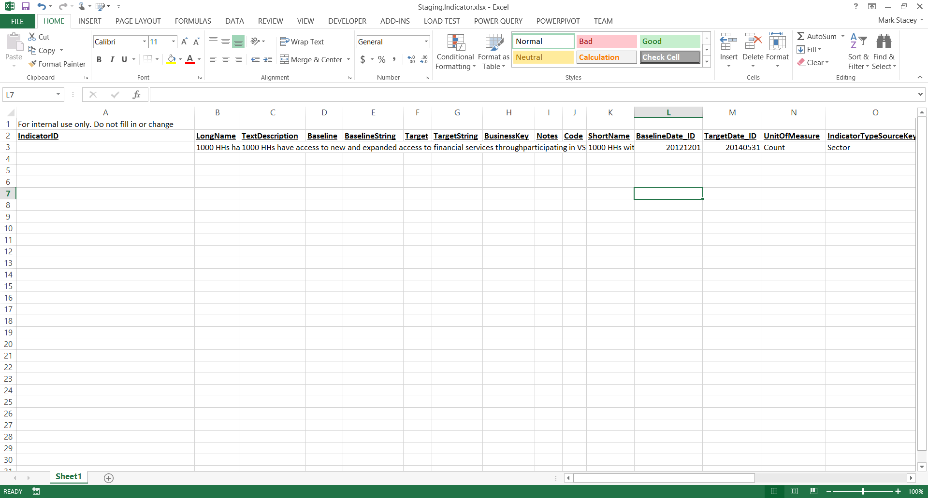
Fill in the obvious names, name. etc.
All dates are in form YYYYMMDD

Slide 4
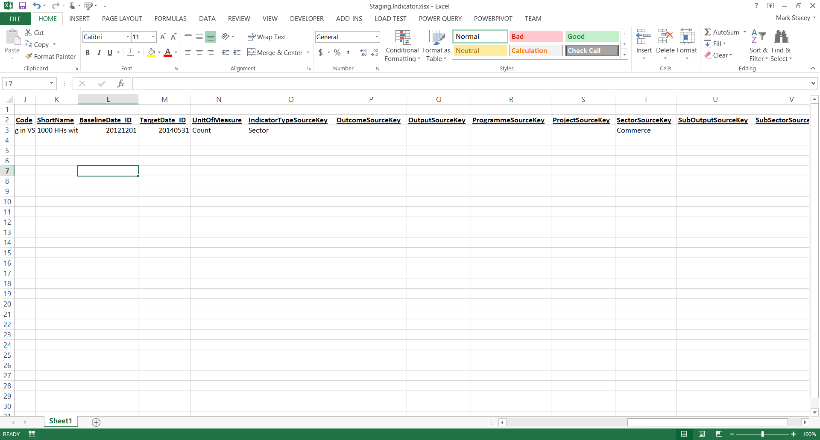
Indicator is special as it can be linked to multiple levels. The level key (such as sector) needs to correspond to the level chosen

Slide 5
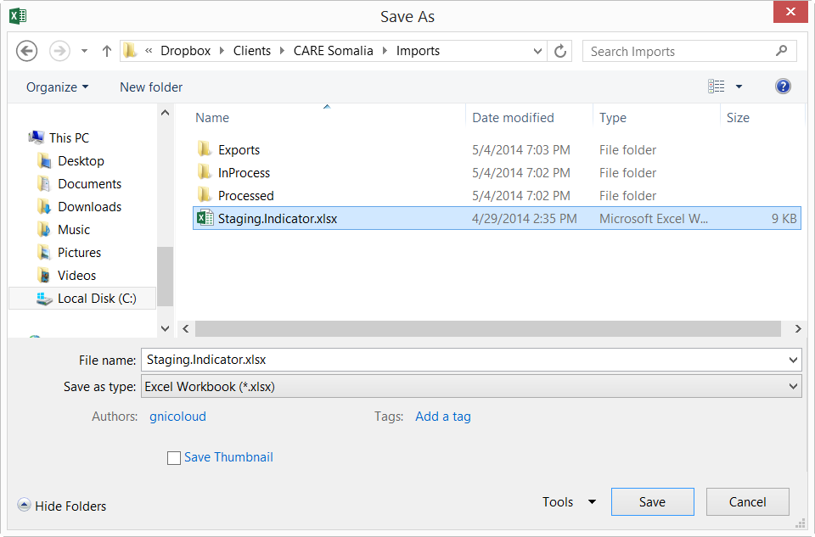
Save to the root file, and the next run will automatically pick it up. You will know it’s done so when the file has been moved to “Processed”

Slide 6
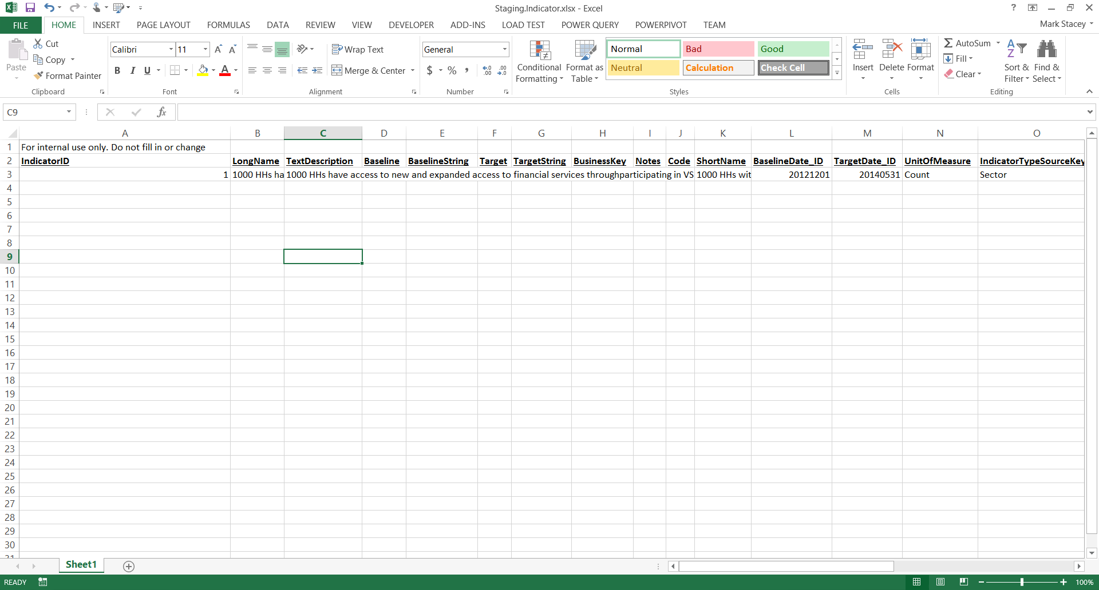
If you open the export file again later, you will see that the ID field is now populated

