Slide 1
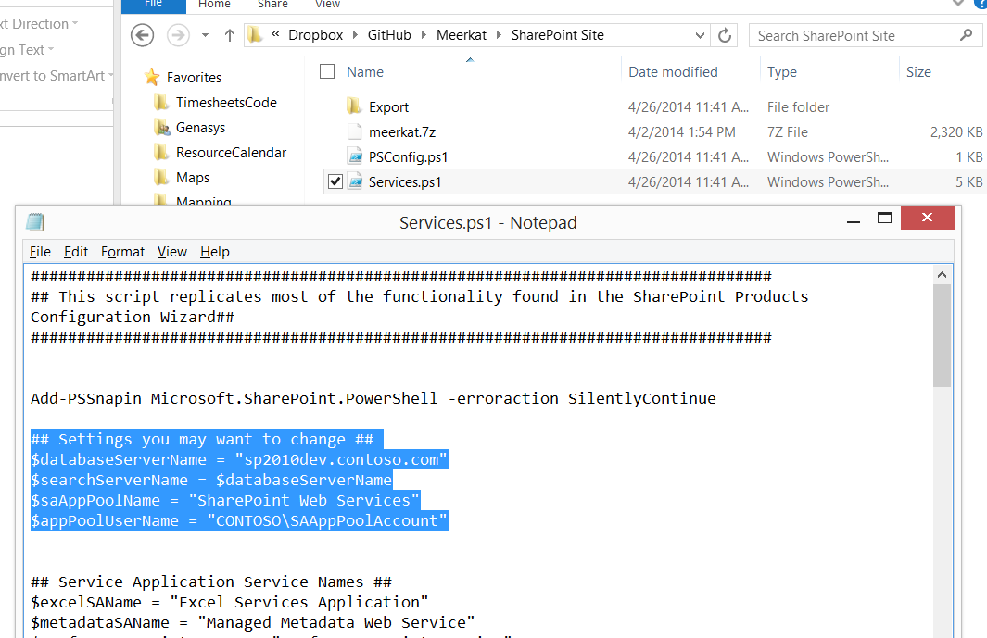
Set these to the appropriate…. lXXXXXX
Notes:
More detailed notes here.
EG \GitHub\Meerkat\SharePoint Site for URL

