Slide 1
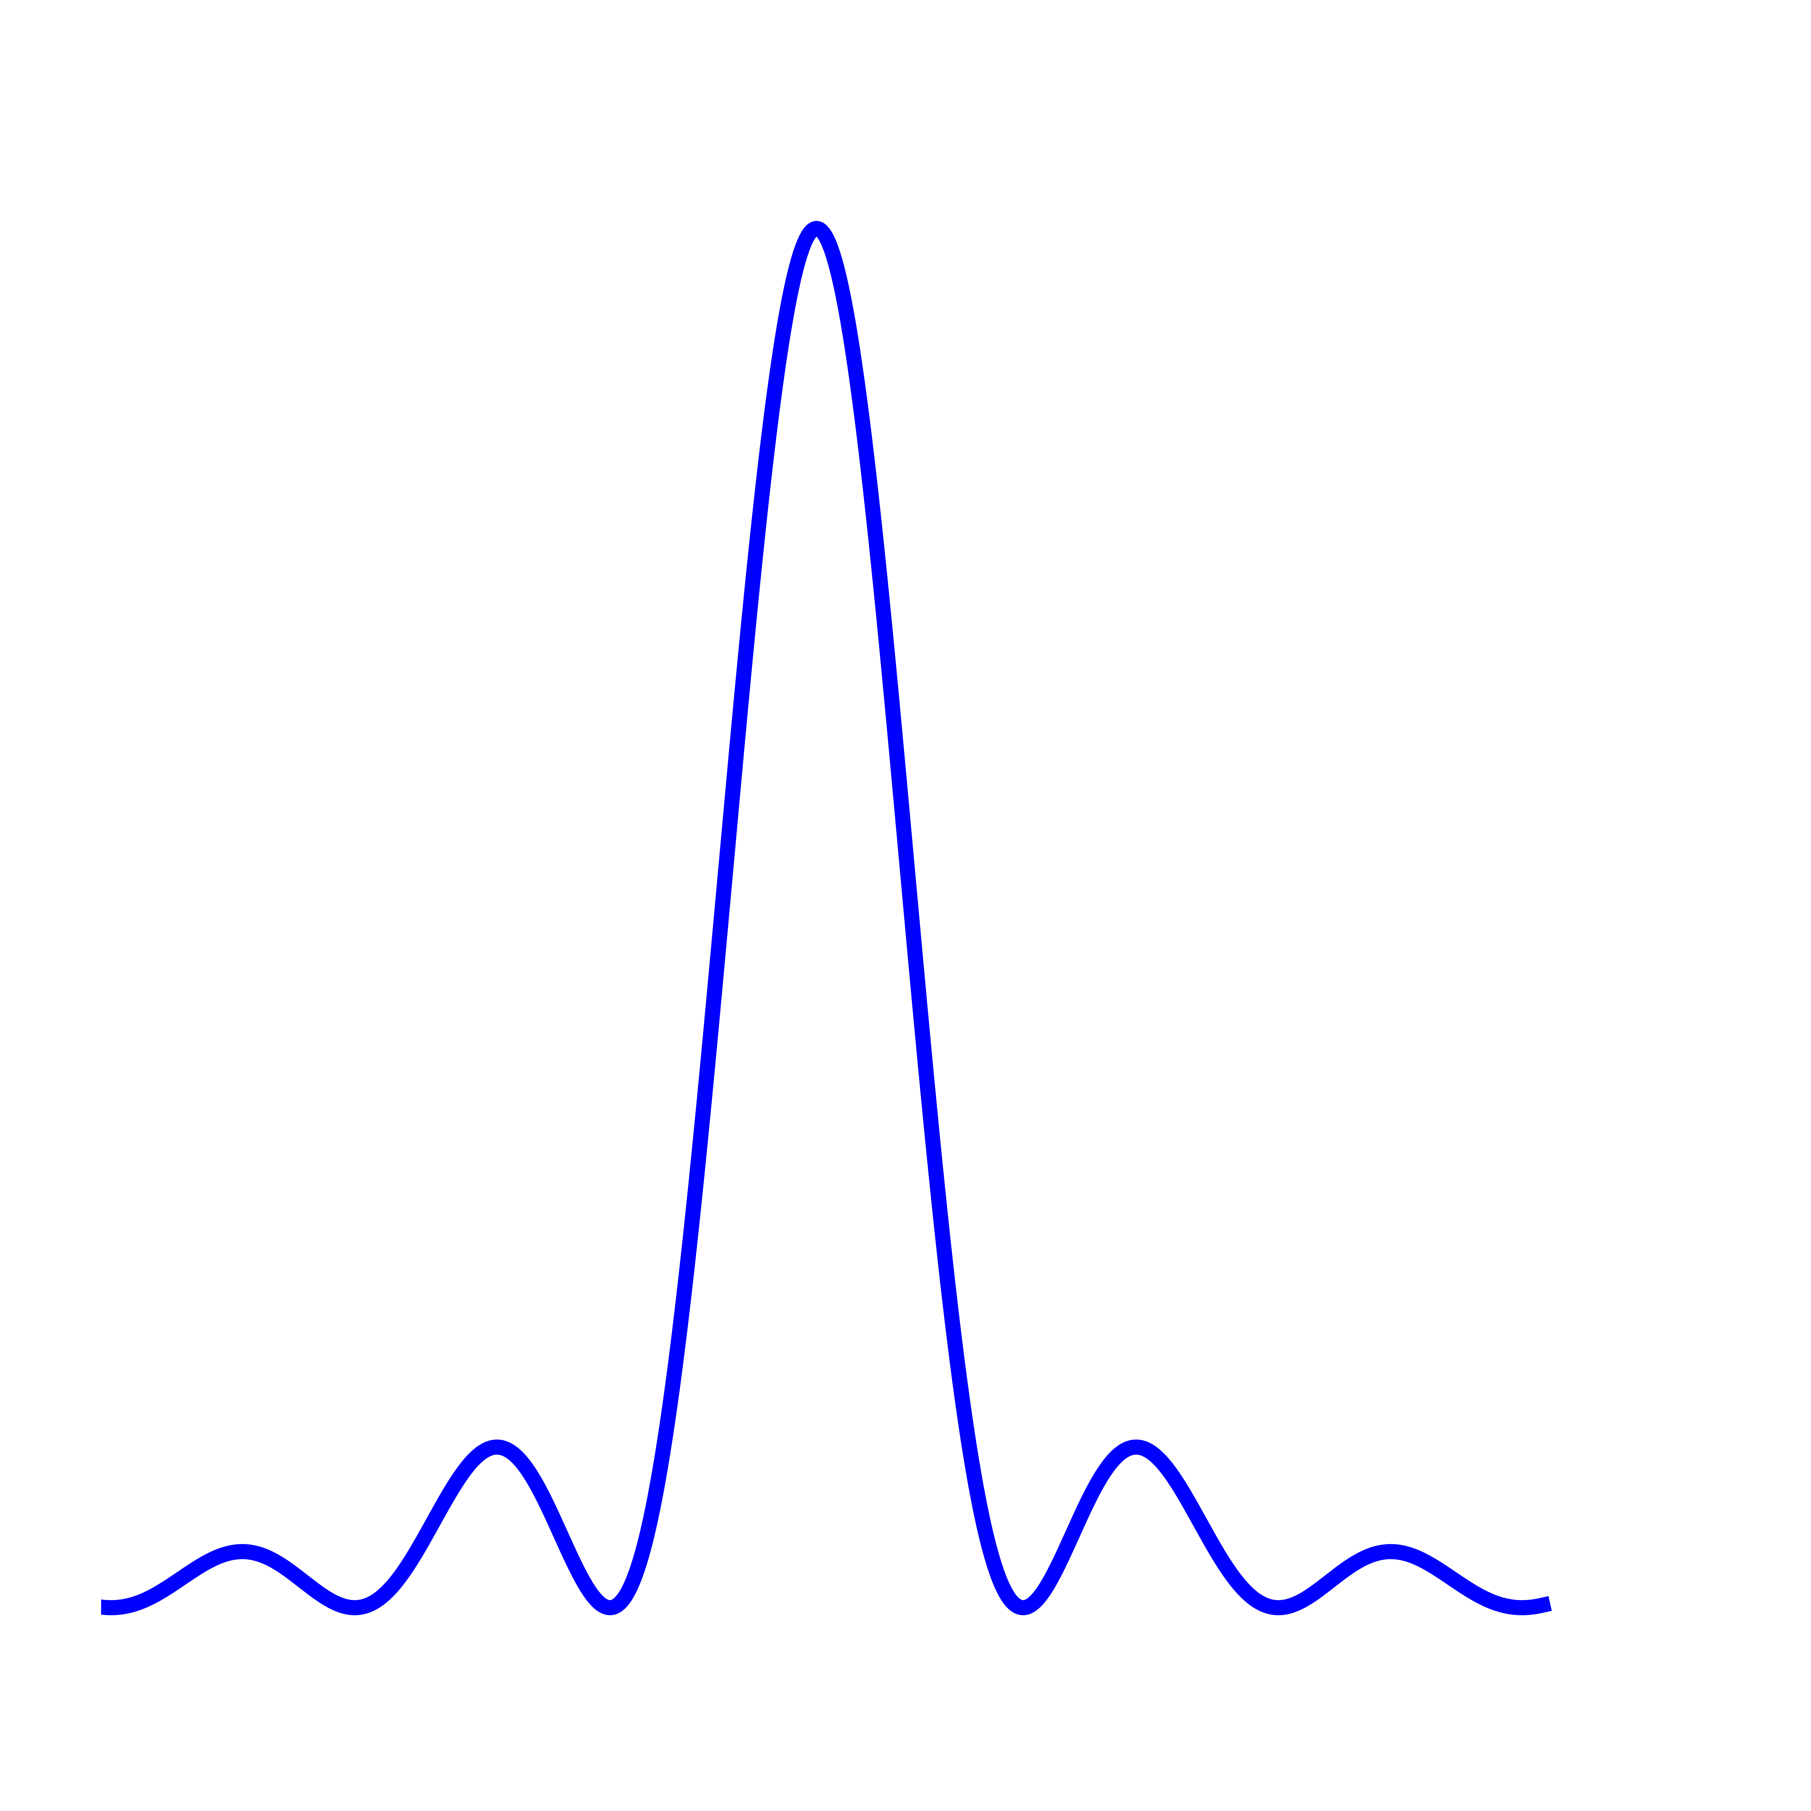
Optical clocks
cavity
L
Laser
switch
Atom

Slide 2
First order
f
(f + γ)
Zeroth order
f
Sound wave
γ
transducer
LPF
I
RF Signal
Local Oscillator
90⁰ phase shift
LPF
Q

Slide 3
How to measure the phase
Reference path
L
Laser
path of interest
Reflected beam on the path of interest is frequency shifted twice resulting in a beat signal at the detector at
A Michelson Interferometer

Slide 4
102 MHz
120 MHz (DDS)
1b
1a
retroreflect
2b
USRP
701 nm
2a
retroreflect
118 MHz
84 MHz (VCO)
Switch
72 MHz (DDS)
Mixer

Slide 5
ω₀
ω
ω_{e}
_{ϴ}
_{Δ}
ω_{π}
_{I}
z
y
x

