Slide 1
Parallel Connected Components
By Gustavo Segovia, Fabian Meier, Seraiah Walter

Slide 2
Overview
Gustavo

Slide 3
MPI version
Fabian stuff

Slide 4
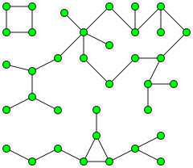
OpenMP
Take advantage of Shared-Memory
First approach:
each Core starts at a different Node BFS
mark visited nodes to prevent duplicate work.
Second approach
Union find

Slide 5
OpenMP
How to make sure each cache has the same data?
Don’t! (Hardware will take care of it eventually)
Might lead to duplicate work.
Use atomic operations
Might be slow.
Use Locks
Which one is fastest?

