Slide 1
Parallel Connected Components
By Gustavo Segovia, Fabian Meier, Seraiah Walter

Slide 2
Overview
Gustavo

Slide 3
MPI version
Fabian stuff

Slide 4
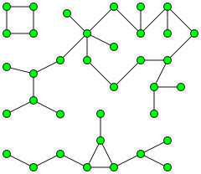
OpenMP
Take advantage of Shared-Memory
Possible approach:
each Core starts at a different Node
mark visited nodes to prevent duplicate work.

Slide 5
OpenMP
How to make sure each cache has the same data?
Don’t! (Hardware will take care of it eventually)
Might lead to duplicate work.
Use atomic operations
Might be slow.
Use Locks
Which one is fastest?

