Slide 1
Parallel Connected Components
By Gustavo Segovia, Fabian Meier, Seraiah Walter

Slide 2
Overview
Gustavo

Slide 3
MPI version
Fabian stuff

Slide 4
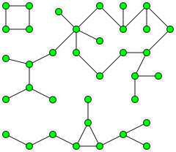
OpenMP
Take advantage of Shared-Memory
First approach: each Core starts at a different Node, mark visited nodes to prevent duplicate work.
Atomic operations vs. no lock

