Slide 1
Week-7: Simpson’s Rule

Slide 2
Introduction
Simpson’s 1/3rd Rule

Slide 3
Introduction
Simpson’s 1/3rd Rule

Slide 4
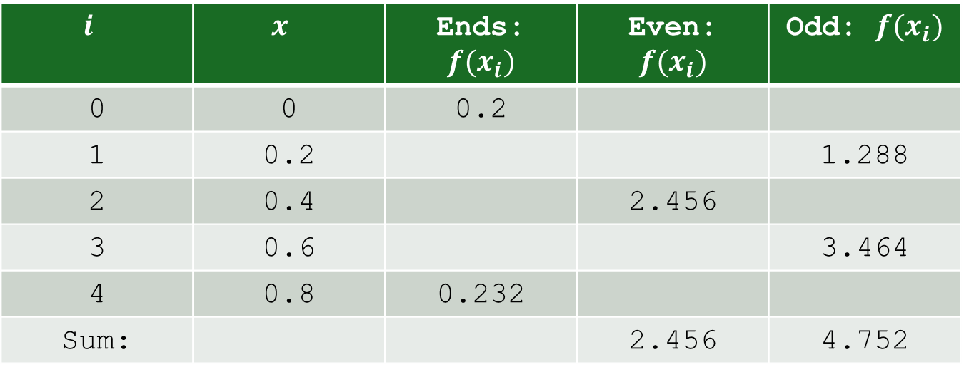
Introduction
Using:
$$i$$ | $$x$$ | Ends: $f(x_{i})$ | Even: $f(x_{i})$ | Odd: $f(x_{i})$
0 | 0 | 0.2
1 | 0.2 |  |  | 1.288
2 | 0.4 |  | 2.456
3 | 0.6 |  |  | 3.464
4 | 0.8 | 0.232
Sum: |  |  | 2.456 | 4.752

Slide 5
Simpson’s 3/8th Rule

Slide 6
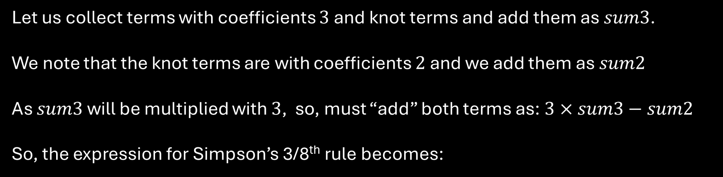
Introduction
Example: Find $I=\int_{0}^{π}{sin⁡(x)} dx$, using $n=9$ with Simpson’s 3/8th Rule.
Let us collect terms with coefficients $3$ and knot terms and add them as $sum3$.
We note that the knot terms are with coefficients $2$ and we add them as $sum2$
As $sum3$ will be multiplied with $3$, so, must “add” both terms as: $3×sum3−sum2$
So, the expression for Simpson’s 3/8th rule becomes:

Slide 7
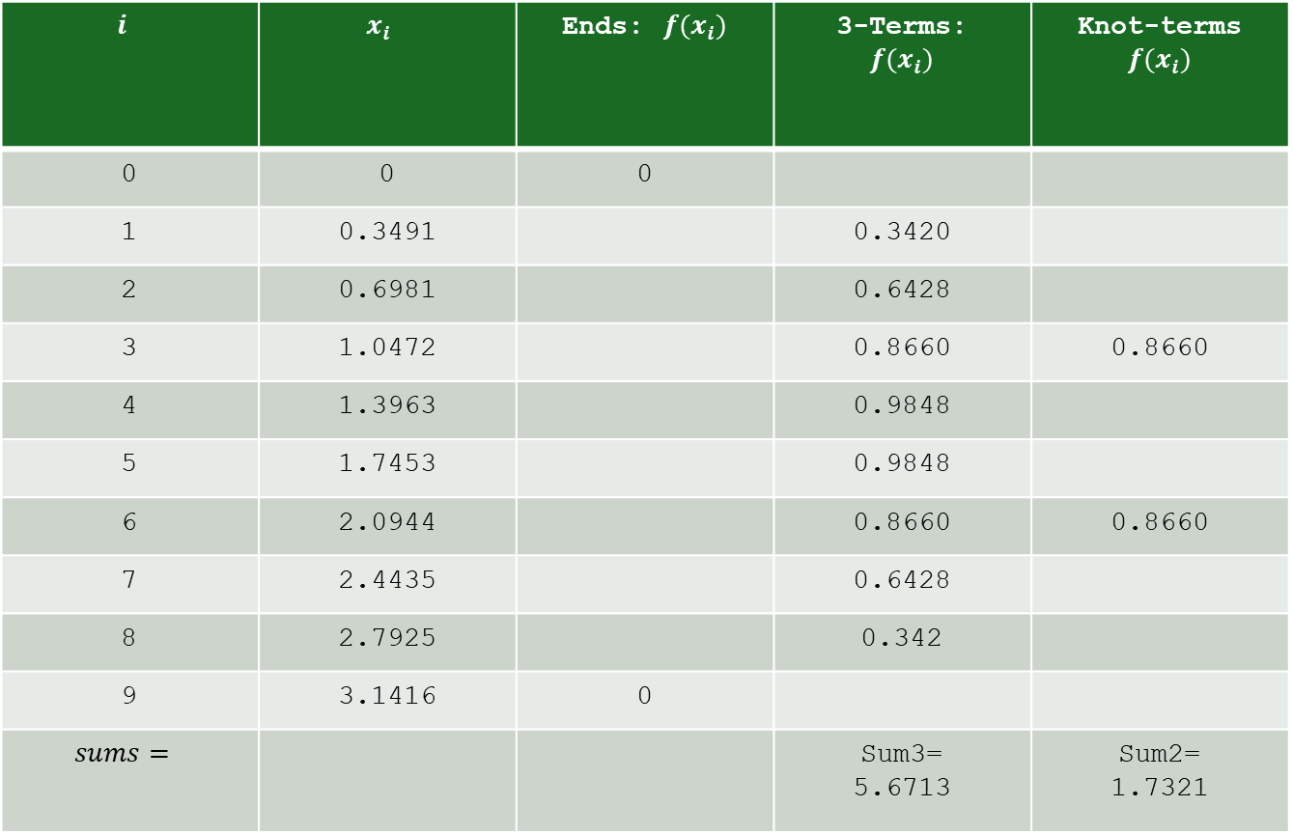
Introduction
Continued…
$$i$$ | $$x_{i}$$ | Ends: $f(x_{i})$ | 3-Terms: $$f(x_{i})$$ | Knot-terms $$f(x_{i})$$
0 | 0 | 0
1 | 0.3491 |  | 0.3420
2 | 0.6981 |  | 0.6428
3 | 1.0472 |  | 0.8660 | 0.8660
4 | 1.3963 |  | 0.9848
5 | 1.7453 |  | 0.9848
6 | 2.0944 |  | 0.8660 | 0.8660
7 | 2.4435 |  | 0.6428
8 | 2.7925 |  | 0.342
9 | 3.1416 | 0
$$sums=$$ |  |  | Sum3= 5.6713 | Sum2= 1.7321

Slide 8
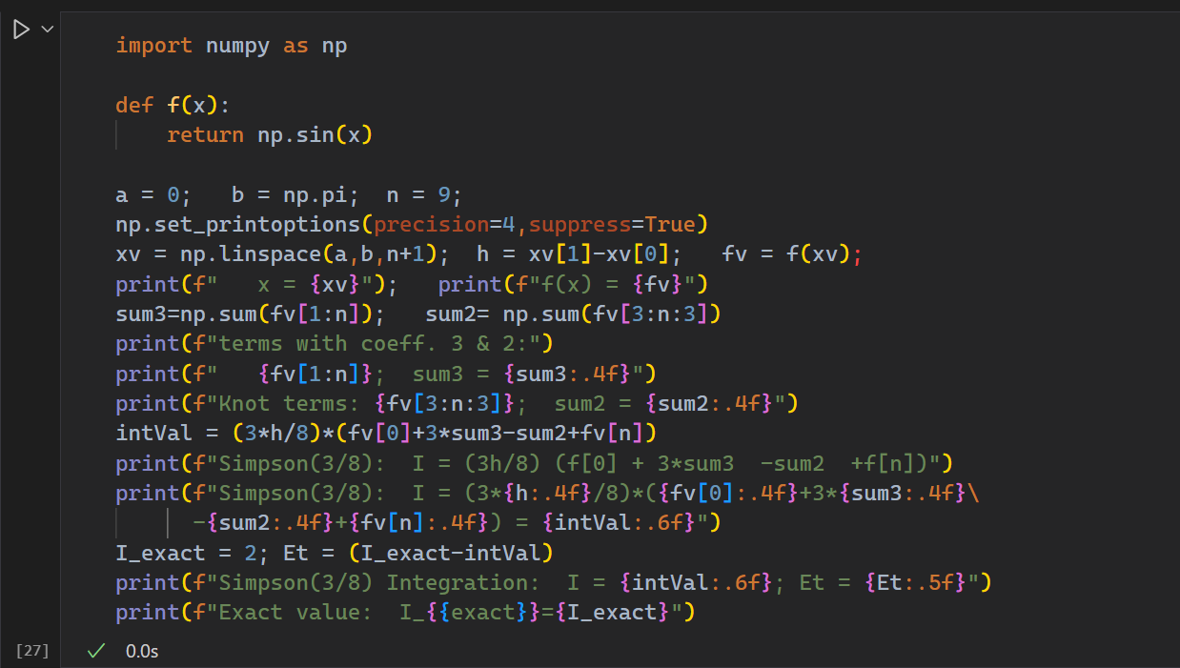
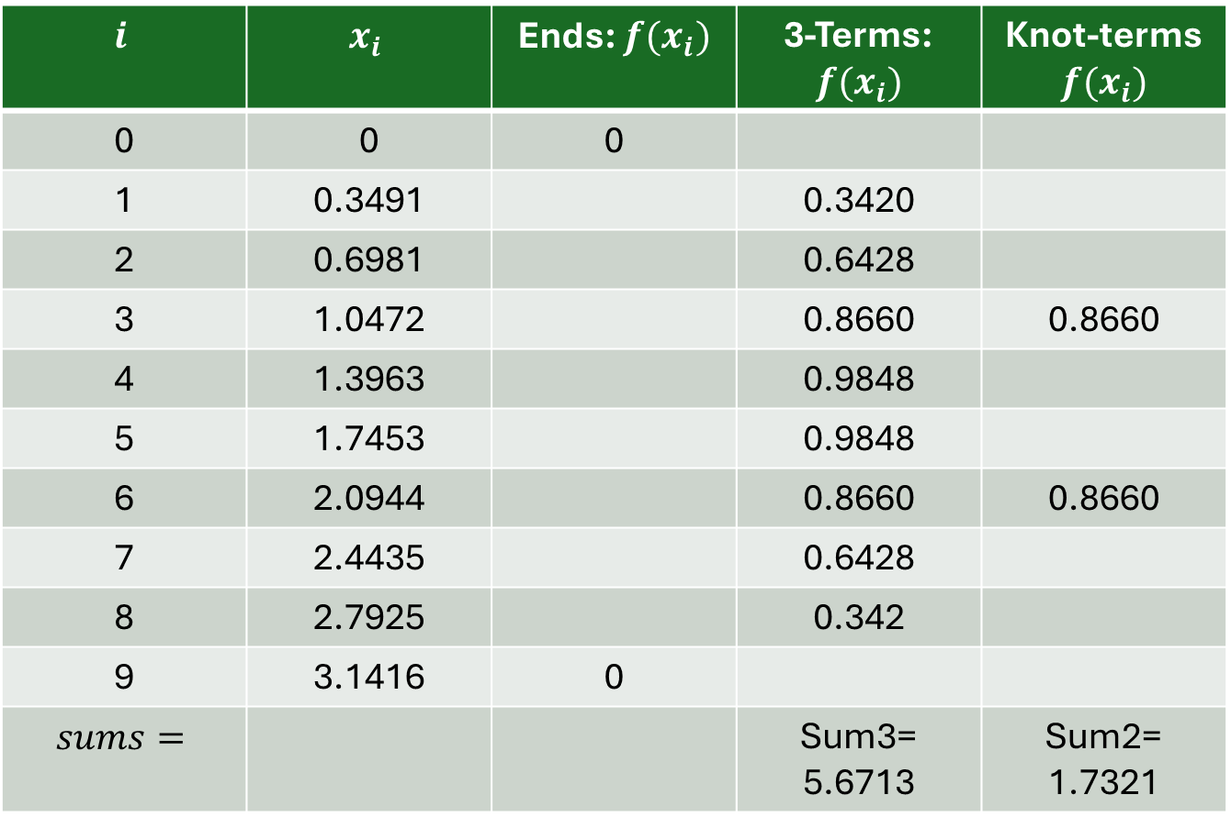
Introduction
Continued…
$$i$$ | $$x_{i}$$ | Ends: $f(x_{i})$ | 3-Terms: $$f(x_{i})$$ | Knot-terms $$f(x_{i})$$
0 | 0 | 0
1 | 0.3491 |  | 0.3420
2 | 0.6981 |  | 0.6428
3 | 1.0472 |  | 0.8660 | 0.8660
4 | 1.3963 |  | 0.9848
5 | 1.7453 |  | 0.9848
6 | 2.0944 |  | 0.8660 | 0.8660
7 | 2.4435 |  | 0.6428
8 | 2.7925 |  | 0.342
9 | 3.1416 | 0
$$sums=$$ |  |  | Sum3= 5.6713 | Sum2= 1.7321

Slide 9
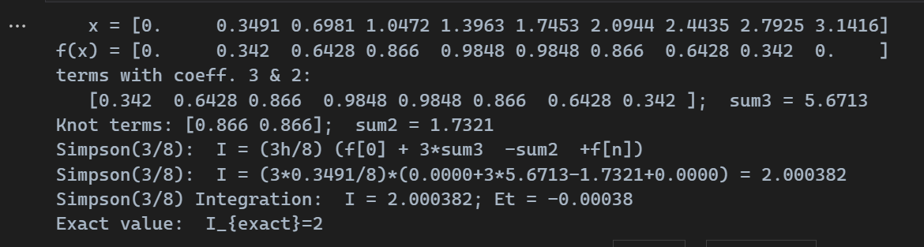
Introduction
Output:

Slide 10
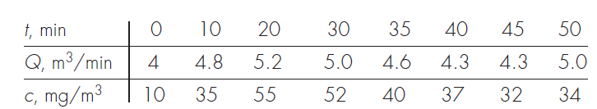
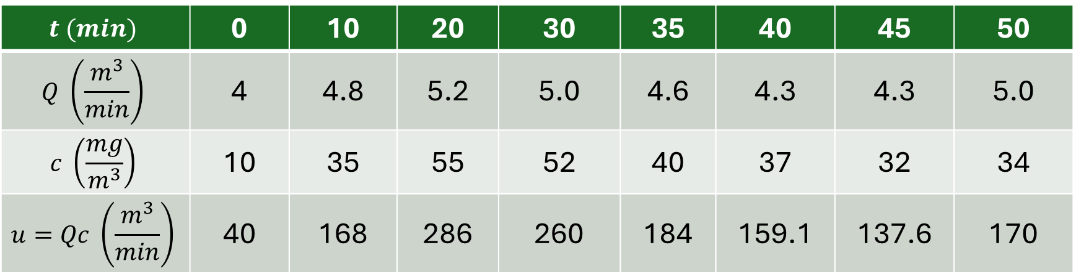
Introduction
Example: Use numerical integration to compute how much mass leaves a reactor based on the following measurements
$$t (min)$$ | 0 | 10 | 20 | 30 | 35 | 40 | 45 | 50
$$Q \left(\frac{m^{3}}{min}\right)$$ | 4 | 4.8 | 5.2 | 5.0 | 4.6 | 4.3 | 4.3 | 5.0
$$c \left(\frac{mg}{m^{3}}\right)$$ | 10 | 35 | 55 | 52 | 40 | 37 | 32 | 34
$$u=Qc \left(\frac{m^{3}}{min}\right)$$ | 40 | 168 | 286 | 260 | 184 | 159.1 | 137.6 | 170

