Slide 1
Numerical Differentiation: Newton’s Difference Formulae

Slide 2

Introduction
Basic Concept:
Consider a set of $n$ data points $(x_{i}, y_{i})$ such that $x_{i+1}=x_{i}+h.$
Then, by Taylor expansion, we can write:
$$y_{i+1}=f\left(x_{i+1}\right)=f\left(x_{i}+h\right)=f\left(x_{i}\right)+\frac{h}{1!} f^{′}\left(x_{i}\right)+ \frac{h^{2}}{2!} f^{′′}\left(x_{i}\right)+ …$$
And for $x_{i−1}$, we have:
$$y_{i−1}=f\left(x_{i−1}\right)=f\left(x_{i}−h\right)=f\left(x_{i}\right)−\frac{h}{1!} f^{′}\left(x_{i}\right)+ \frac{h^{2}}{2!} f^{′′}\left(x_{i}\right)− …$$
So, Taylor Forward difference formula:
$$f\left(x_{i+1}\right)−f\left(x_{i}\right)=\frac{h}{1!} f^{′}\left(x_{i}\right)+ \frac{h^{2}}{2!} f^{′′}\left(x_{i}\right)+ …$$
$$f^{′}\left(x_{i}\right)= \frac{f(x_{i+1})−f(x_{i})}{h}−\frac{h}{2!} f^{′′}\left(x_{i}\right)−…$$

Slide 3

Introduction
Basic Concept:
$$f^{′}\left(x_{i}\right)= \frac{f(x_{i+1})−f(x_{i})}{h}−\frac{h}{2!} f^{′′}\left(x_{i}\right)−…$$
Or
$$f^{′}\left(x_{i}\right)= \frac{y_{i+1}−y_{i}}{h}−\frac{h}{2!} f^{′′}\left(x_{i}\right)−…$$
Newton’s Forward Difference Formula:

Slide 4

Introduction
Basic Concept:
Now, consider , Taylor Backward difference formula:
$$y_{i−1}=f\left(x_{i−1}\right)=f\left(x_{i}−h\right)=f\left(x_{i}\right)−\frac{h}{1!} f^{′}\left(x_{i}\right)+ \frac{h^{2}}{2!} f^{′′}\left(x_{i}\right)− …$$
$$f\left(x_{i}\right)−f\left(x_{i−1}\right)=\frac{h}{1!} f^{′}\left(x_{i}\right)− \frac{h^{2}}{2!} f^{′′}\left(x_{i}\right)+ …$$
$$f^{′}\left(x_{i}\right)= \frac{f(x_{i})−f(x_{i−1})}{h}+\frac{h}{2!} f^{′′}\left(x_{i}\right)−…$$
Newton’s Backward Difference Formula:

Slide 5



Introduction
Basic Concept:
We note that by halving the sampling interval $h$, the accuracy of the numerical derivative doubles for both Forward and Backward formula.
Now, we consider both Taylor expansions:
$$y_{i−1}=f\left(x_{i−1}\right)=f\left(x_{i}−h\right)=f\left(x_{i}\right)−\frac{h}{1!} f^{′}\left(x_{i}\right)+ \frac{h^{2}}{2!} f^{′′}\left(x_{i}\right)− …$$
$$y_{i+1}=f\left(x_{i+1}\right)=f\left(x_{i}+h\right)=f\left(x_{i}\right)+\frac{h}{1!} f^{′}\left(x_{i}\right)+ \frac{h^{2}}{2!} f^{′′}\left(x_{i}\right)+ …$$
$$y_{i+1}−y_{i−1}=2h f^{′}\left(x_{i}\right)+2\frac{h^{3}}{3!}f^{′′′}\left(x_{i}\right)+…$$
$$⇒ f^{′}\left(x_{i}\right)= \frac{y_{i+1}−y_{i+1}}{2h}; Error:O\left(h^{2}\right)$$

Slide 6
Introduction
Newton’s Difference formulae
.

Slide 7
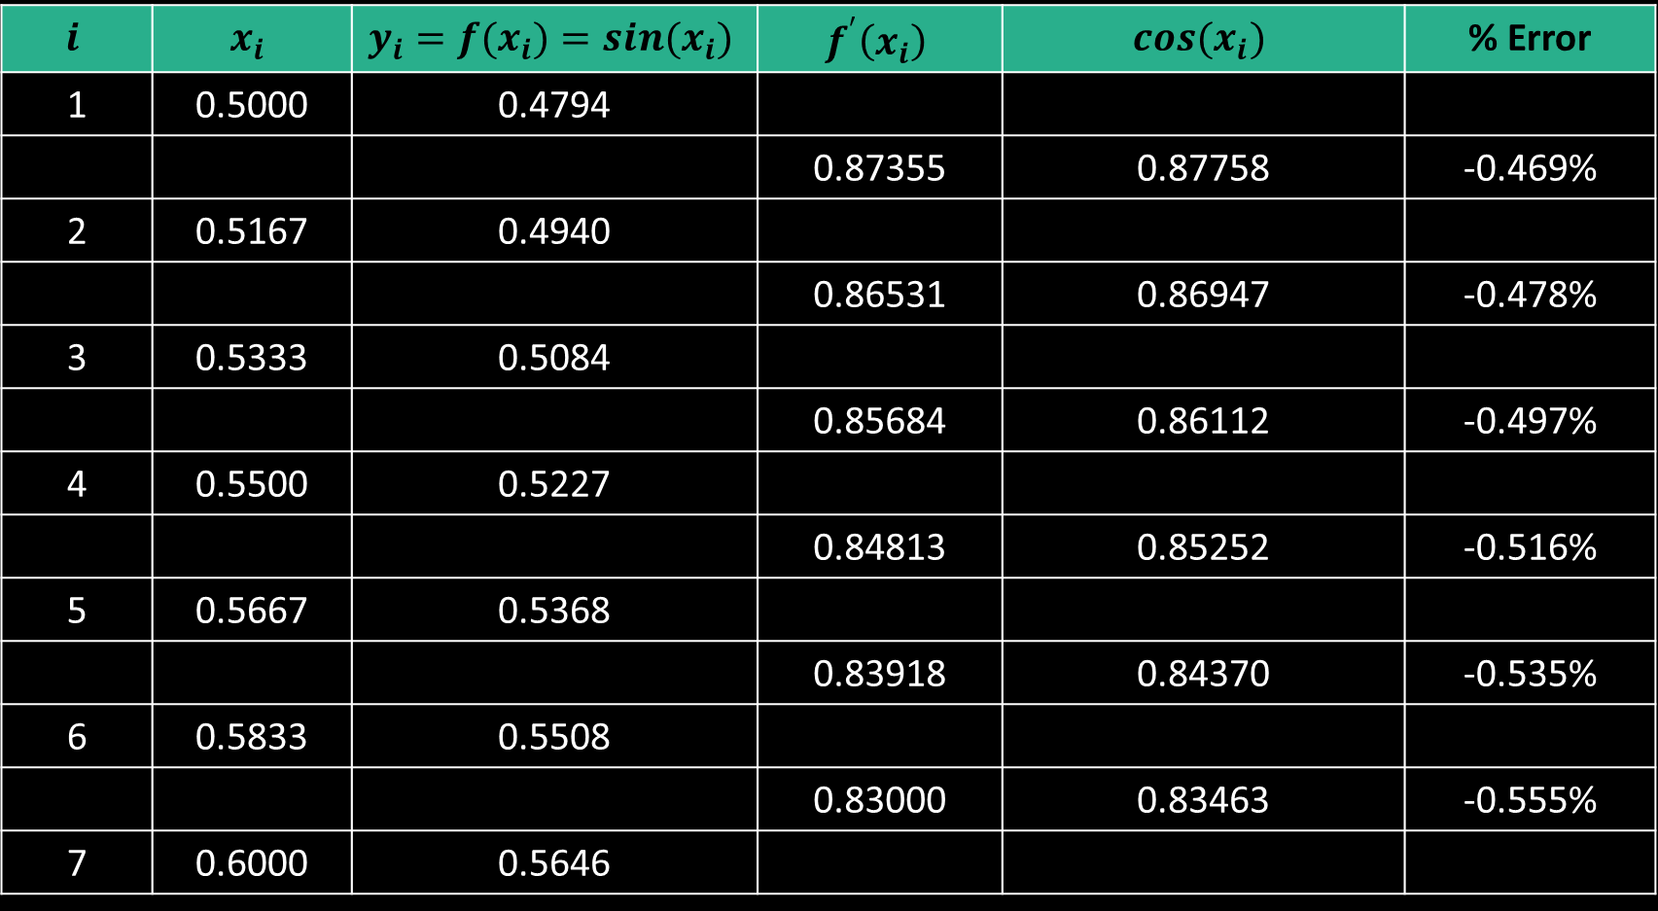

Ex: Forward Difference
Ex:
Compute $y_{i}=f\left(x_{i}\right)=\sin\left(x_{i}\right)$ for $n=7$ equally spaced values of $x∈[0.5, 0.6]$ , find derivative $f′(x_{i})$ using Newton’s Forward Difference Formula, and compare the results with the exact derivatives: $cos⁡(x_{i})$. Find %Error: $\left(f^{′}\left(x_{u}\right)−\cos\left(x_{i}\right)\right)×100/cos⁡(x_{i})$
.
$$i$$ | $$x_{i}$$ | $$y_{i}=f(x_{i})=sin(x_{i})$$ | $$f^{′}\left(x_{i}\right)$$ | $$cos(x_{i})$$ | % Error
1 | 0.5000 | 0.4794
 |  |  | 0.87355 | 0.87758 | -0.469%
2 | 0.5167 | 0.4940
 |  |  | 0.86531 | 0.86947 | -0.478%
3 | 0.5333 | 0.5084
 |  |  | 0.85684 | 0.86112 | -0.497%
4 | 0.5500 | 0.5227
 |  |  | 0.84813 | 0.85252 | -0.516%
5 | 0.5667 | 0.5368
 |  |  | 0.83918 | 0.84370 | -0.535%
6 | 0.5833 | 0.5508
 |  |  | 0.83000 | 0.83463 | -0.555%
7 | 0.6000 | 0.5646

Slide 8
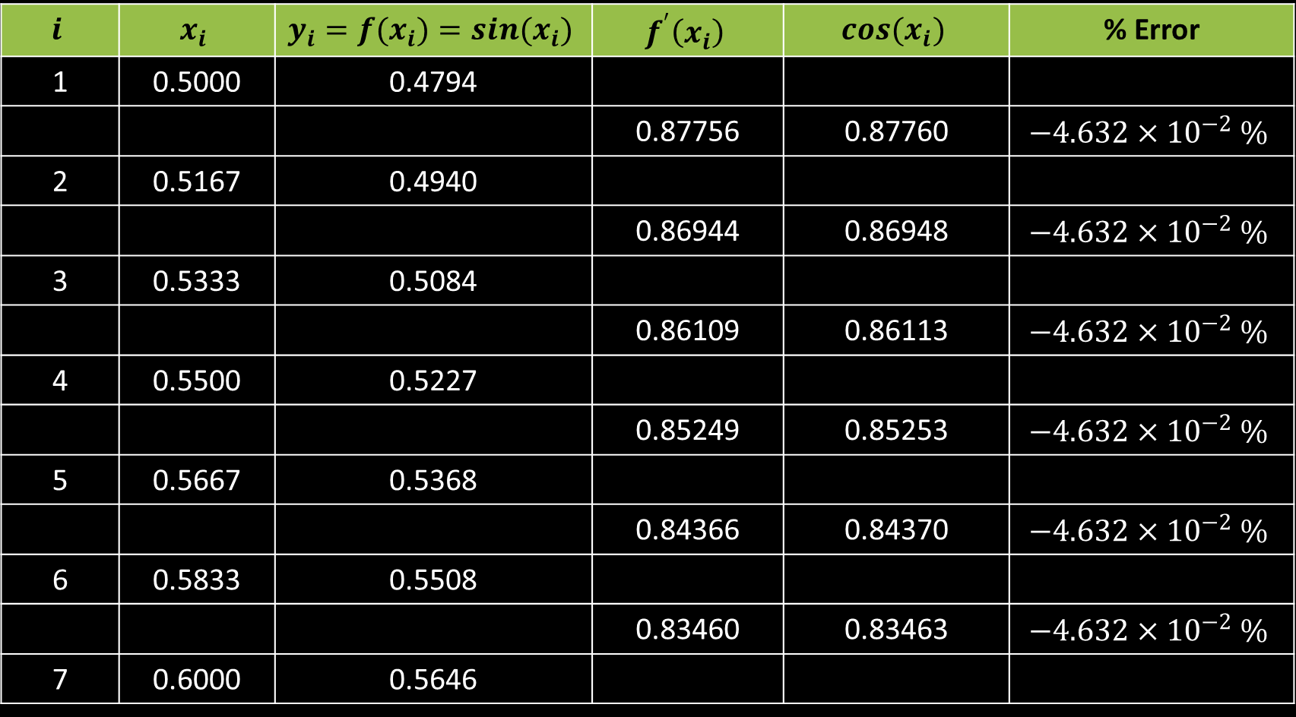

Example: Central Difference
Ex:
Compute $y_{i}=f\left(x_{i}\right)=\sin\left(x_{i}\right)$ for $n=7$ equally spaced values of $x∈[0.5, 0.6]$ , find derivative $f′(x_{i})$ using Newton’s Centeral Difference Formula, and compare the results with the exact derivatives: $cos⁡(x_{i})$. Find %Error: $\left(f^{′}\left(x_{u}\right)−\cos\left(x_{i}\right)\right)×100/cos⁡(x_{i})$
.
$$i$$ | $$x_{i}$$ | $$y_{i}=f(x_{i})=sin(x_{i})$$ | $$f^{′}\left(x_{i}\right)$$ | $$cos(x_{i})$$ | % Error
1 | 0.5000 | 0.4794
 |  |  | 0.87756 | 0.87760 | $$−4.632×{10}^{−2} \%$$
2 | 0.5167 | 0.4940
 |  |  | 0.86944 | 0.86948 | $$−4.632×{10}^{−2} \%$$
3 | 0.5333 | 0.5084
 |  |  | 0.86109 | 0.86113 | $$−4.632×{10}^{−2} \%$$
4 | 0.5500 | 0.5227
 |  |  | 0.85249 | 0.85253 | $$−4.632×{10}^{−2} \%$$
5 | 0.5667 | 0.5368
 |  |  | 0.84366 | 0.84370 | $$−4.632×{10}^{−2} \%$$
6 | 0.5833 | 0.5508
 |  |  | 0.83460 | 0.83463 | $$−4.632×{10}^{−2} \%$$
7 | 0.6000 | 0.5646

Slide 9
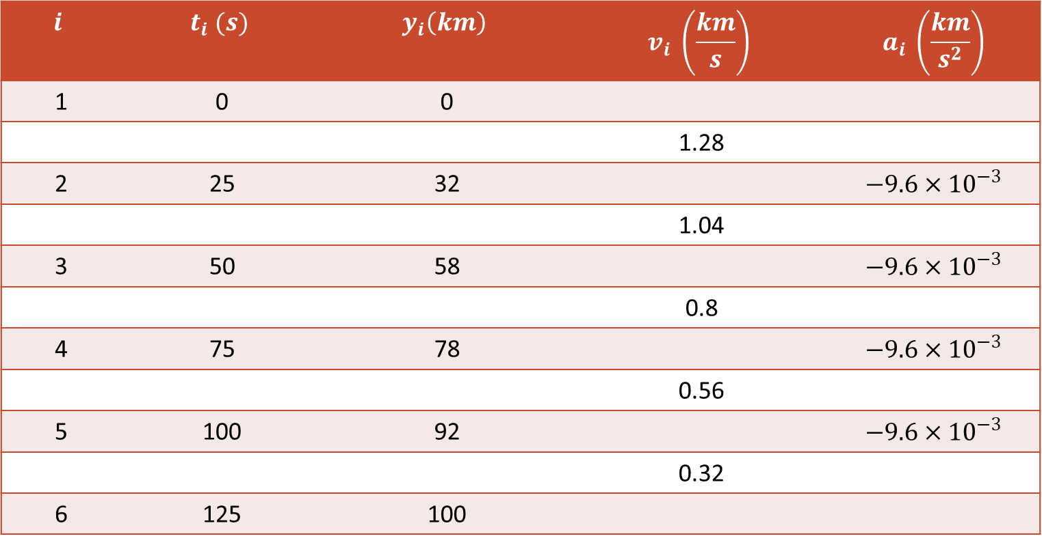
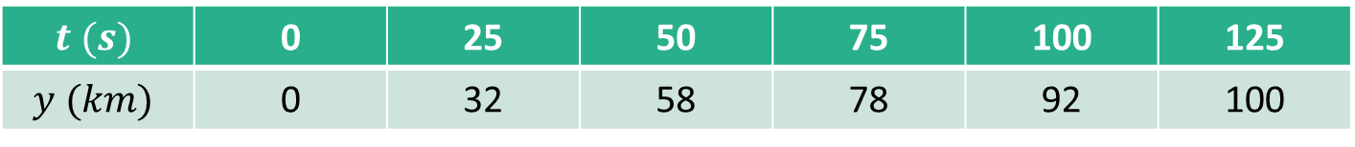
Example: Central Difference
Ex:
The following data was collected for the distance traveled versus time for a rocket. Use numerical differentiation to estimate the rocket’s velocity and acceleration at each time:
.
$$t (s)$$ | 0 | 25 | 50 | 75 | 100 | 125
$$y (km)$$ | 0 | 32 | 58 | 78 | 92 | 100
$$i$$ | $$t_{i} (s)$$ | $$y_{i}\left(km\right)$$ | $$v_{i} \left(\frac{km}{s}\right)$$ | $$a_{i} \left(\frac{km}{s^{2}}\right)$$
1 | 0 | 0
 |  |  | 1.28
2 | 25 | 32 |  | $$−9.6×{10}^{−3}$$
 |  |  | 1.04
3 | 50 | 58 |  | $$−9.6×{10}^{−3}$$
 |  |  | 0.8
4 | 75 | 78 |  | $$−9.6×{10}^{−3}$$
 |  |  | 0.56
5 | 100 | 92 |  | $$−9.6×{10}^{−3}$$
 |  |  | 0.32
6 | 125 | 100

Slide 10
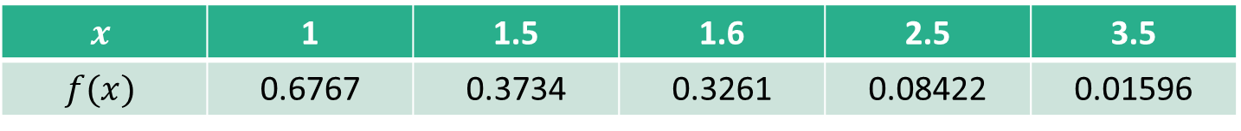

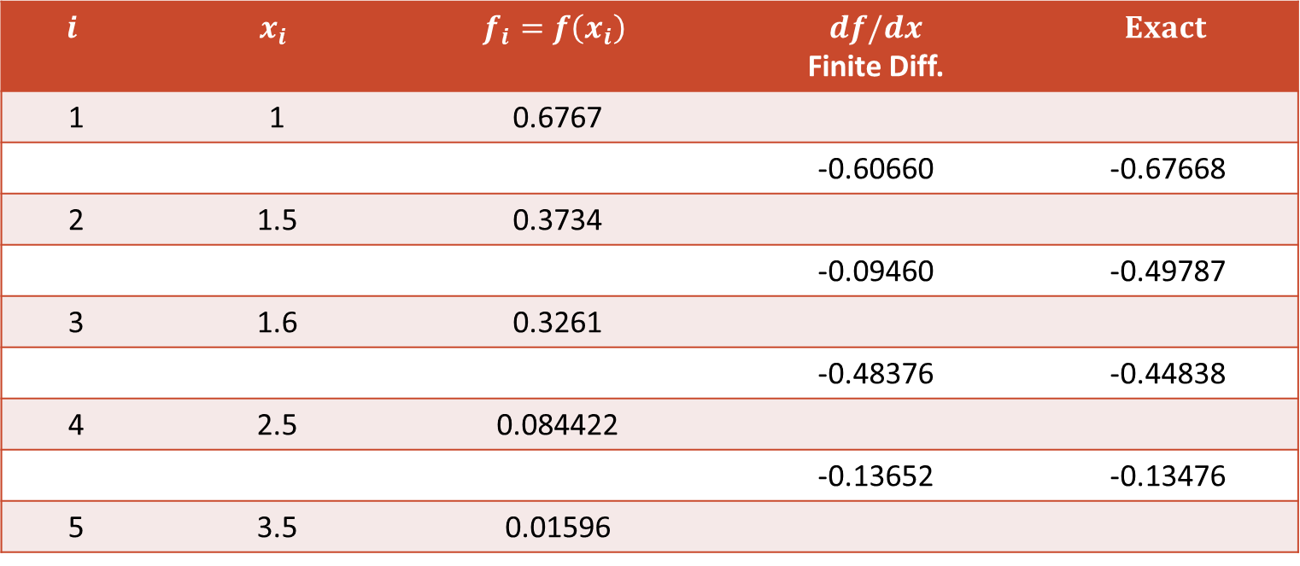
Example: Forward Difference
Ex:
Develop a user friendly program to obtain first-derivative estimates for unequally spaced data. Test it with the following data. Note that $f\left(x\right)=5x exp⁡(−2x)$. Compare the results with the exact: $f^{′}\left(x\right)=5\exp\left(−2x\right)−10x exp⁡(−2x)$:
.
$$x$$ | 1 | 1.5 | 1.6 | 2.5 | 3.5
$$f(x)$$ | 0.6767 | 0.3734 | 0.3261 | 0.08422 | 0.01596
$$i$$ | $$x_{i}$$ | $$f_{i}=f\left(x_{i}\right)$$ | $$df/dx$$ Finite Diff. | $$Exact$$
1 | 1 | 0.6767
 |  |  | -0.60660 | -0.67668
2 | 1.5 | 0.3734
 |  |  | -0.09460 | -0.49787
3 | 1.6 | 0.3261
 |  |  | -0.48376 | -0.44838
4 | 2.5 | 0.084422
 |  |  | -0.13652 | -0.13476
5 | 3.5 | 0.01596

Slide 11
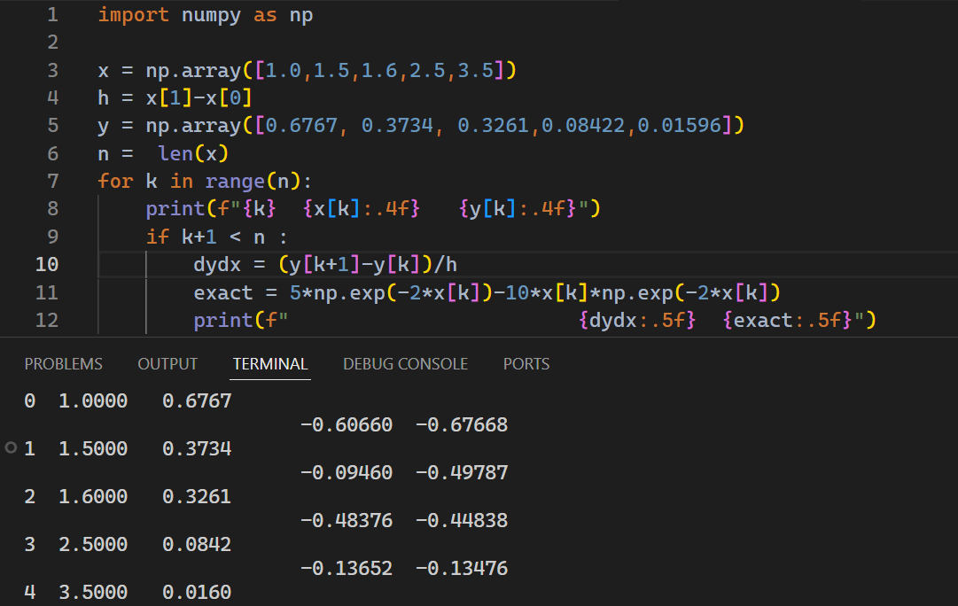
Example: Forward Difference
Ex:
.

Slide 12
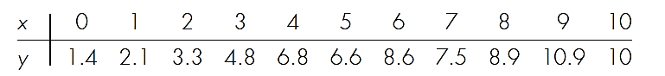


Example: Forward Difference
Ex: Use $diff$ function of numpy to compute the first derivatives for the following data. Also, show the results both numerically and graphically.
.
What happens when central difference (the $gradient$) is used in place of the $diff$ function?

Slide 13
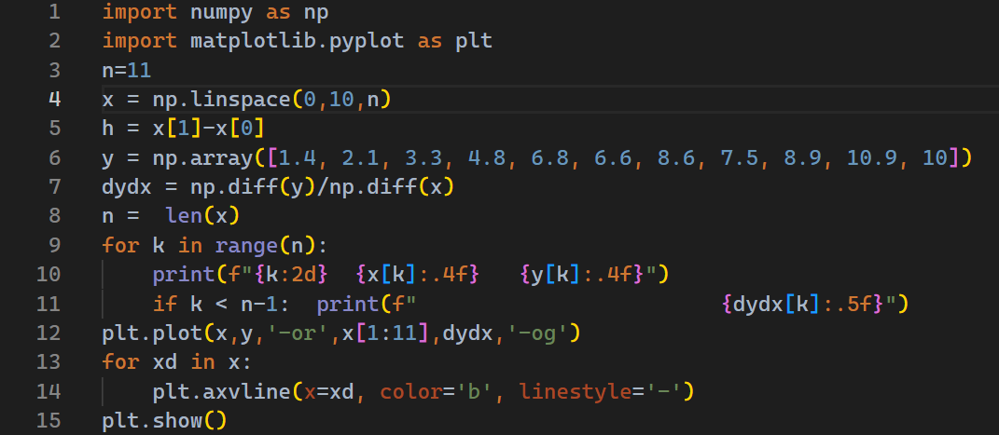
Example: Forward Difference
Solution:
.

Slide 14
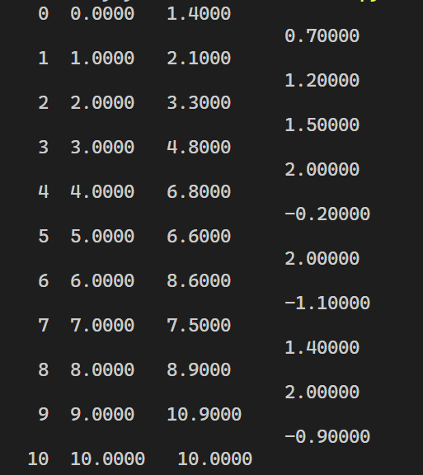

Example: Forward Difference
Solution:
$i$ $x_{i}$ $y_{i}$ ${\left(\frac{dy}{dx}\right)}_{i}$
.

Slide 15
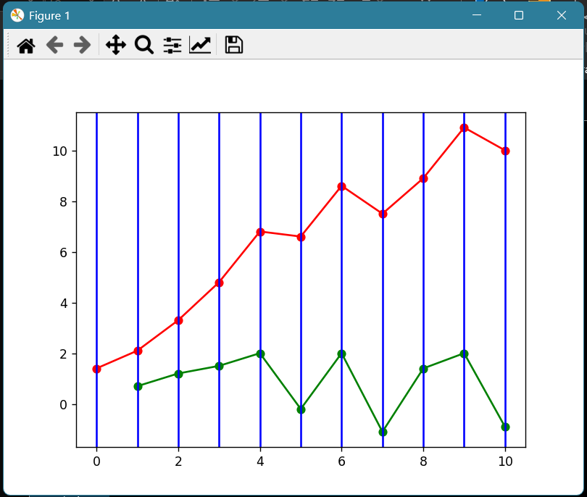


Example: Forward Difference
Solution:
.
First Derivatives using Forward Difference Formula
$$y(x_{i})$$
y-data
$${\left(\frac{dy}{dx}\right)}_{i}$$
x-data

Slide 16
Example: Forward Difference
Solution:
.
First Derivatives using Forward Difference Formula
$$y(x_{i})$$
y-data
$${\left(\frac{dy}{dx}\right)}_{i}$$
x-data

Slide 17
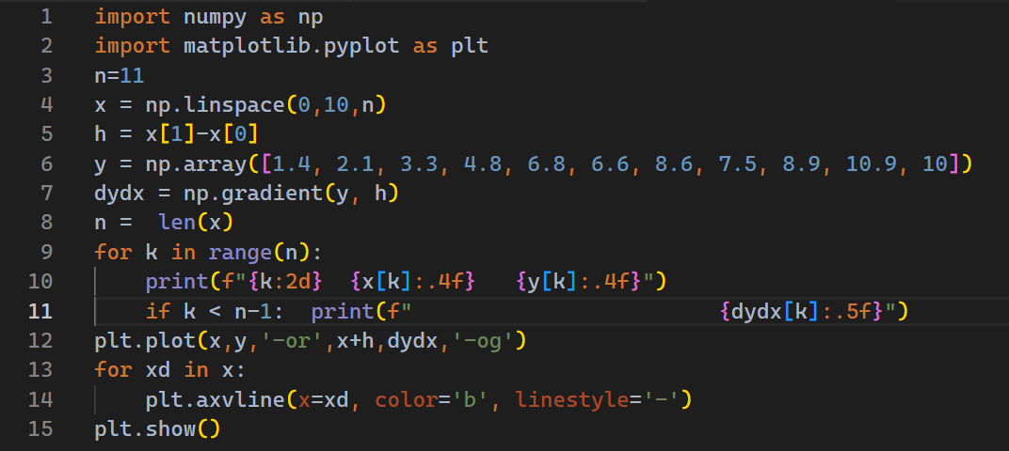
Example: Centeral Difference
Solution:
.

Slide 18
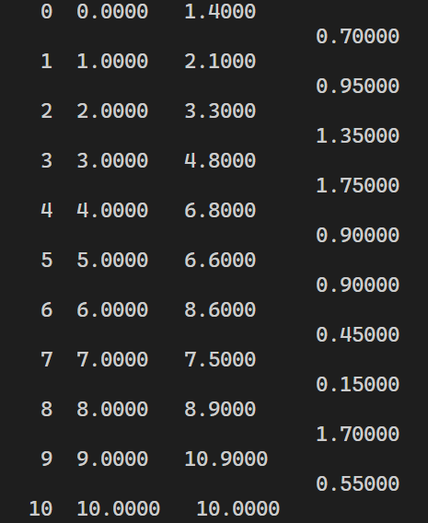

Example: Centeral Difference
Solution:
$i$ $x_{i}$ $y_{i}$ ${\left(\frac{dy}{dx}\right)}_{i}$
.

Slide 19
Example: Forward Difference
Solution:
.
First Derivatives using Centeral Difference Formula
$$y(x_{i})$$
y-data
$${\left(\frac{dy}{dx}\right)}_{i}$$
x-data

