Slide 1
Lecture-6(4): Curve Fitting– Direct Method

Slide 2
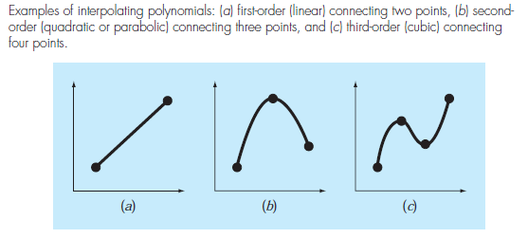
Introduction
Basics
to derive a polynomial curve that passes through all data points
Linear Fit
Quadratic Fit
Cubic Fit

Slide 3

Introduction
General Form of nth order Polynomial
The general form of such polynomial is:
The fitting polynomial is unique.
An $n^{th}$ order polynomial requires (n+1) data points.

Slide 4
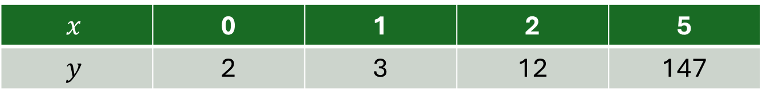
Introduction
Direct Method for Curve Fitting
Let us consider the following example: Fit a Cubic Polynomial to the following data, and find f(4):
$$x$$ | 0 | 1 | 2 | 5
$$y$$ | 2 | 3 | 12 | 147

Slide 5

Introduction
Linear System of Equations: $Au=b$

Slide 6
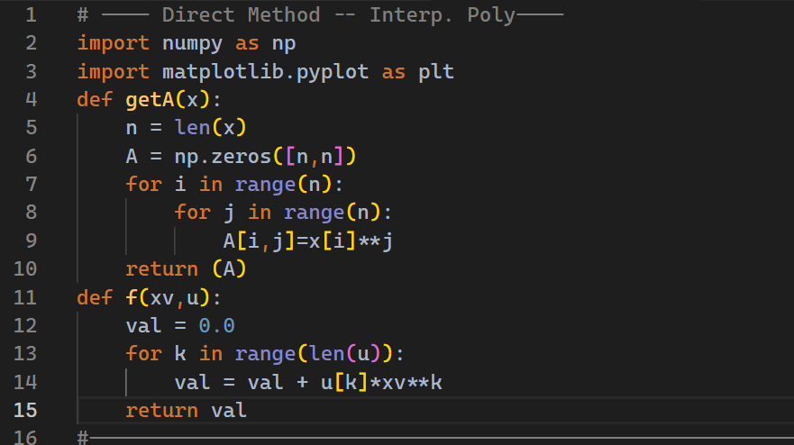
Introduction
Construct matrix A
Evaluation of Interpolation Polynomial

Slide 7
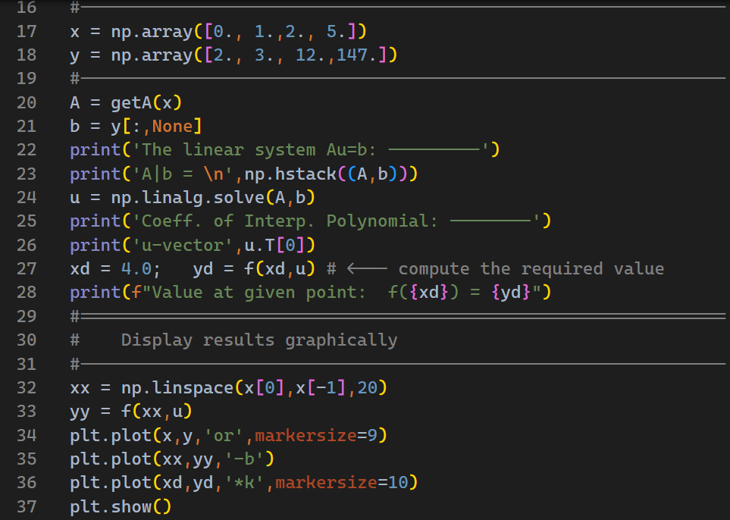
Introduction
Show results graphically

Slide 8
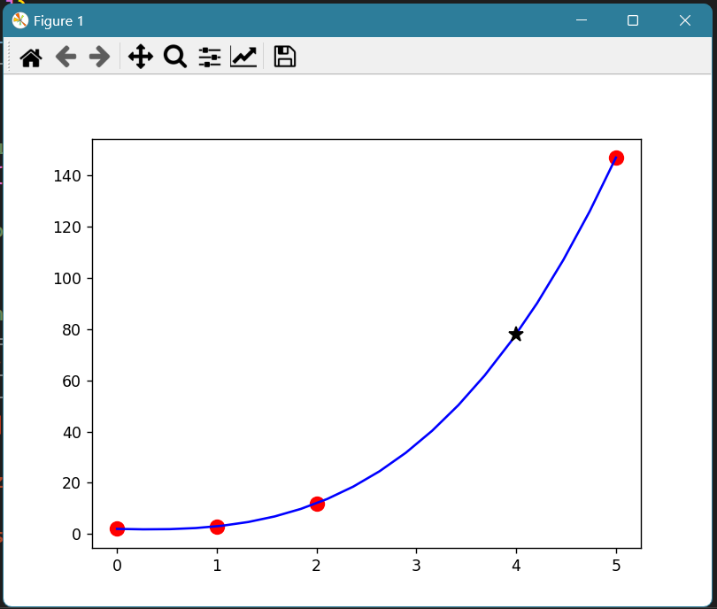

Introduction
i

