Slide 1
Lecture-1(4): Curve Fitting– Lagrange Interpolation

Slide 2
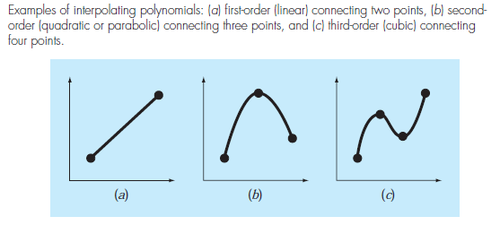
Introduction
Basics
to derive a polynomial curve that passes through all data points
Linear Fit
Quadratic Fit
Cubic Fit

Slide 3
Introduction
General Form of nth order Polynomial
The Lagrange interpolating polynomial is simply a reformulation of the Newton polynomial that avoids the computation of divided differences. It can be represented concisely as:

Slide 4
Introduction
Ex: Use a Lagrange interpolating polynomial of the second order to evaluate $ln⁡2$ on the basis of the data given

Slide 5
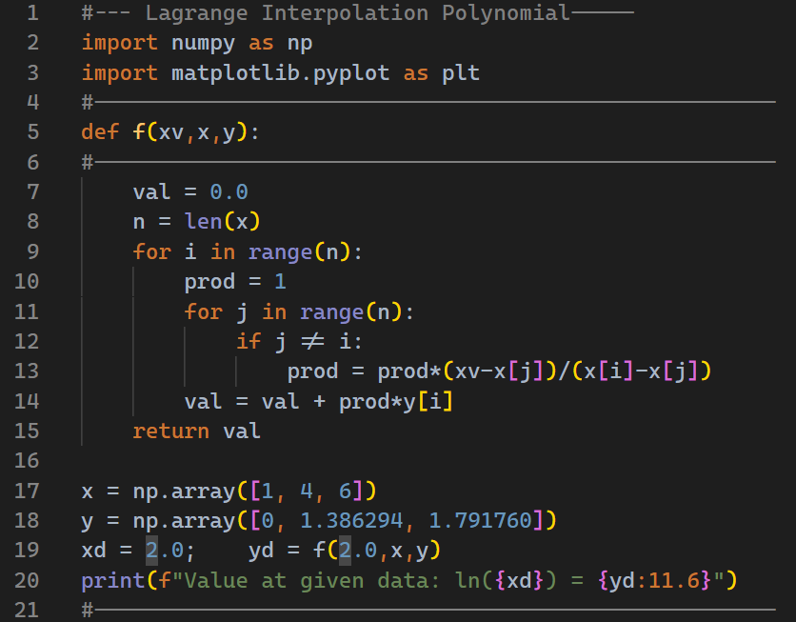
Introduction

Slide 6
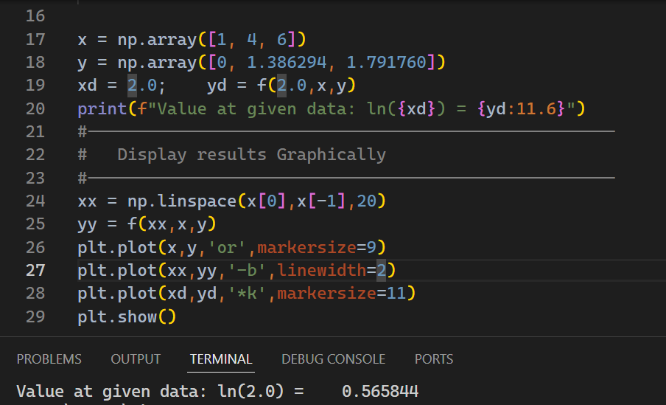
Introduction

Slide 7
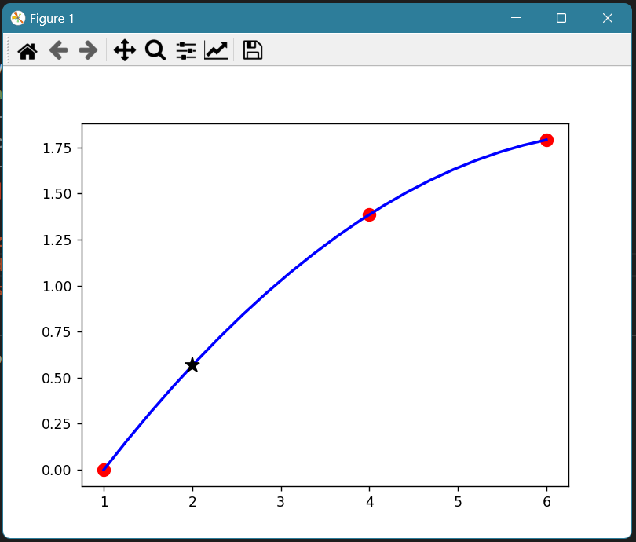
Introduction
i
Second order Lagrange Interpolation Polynomial for given data
y-values
0.565844
x = 2
x-values

Slide 8


Introduction
Ex: Using Lagrange Interpolation for the given data and compute $v(10).$

Slide 9
Introduction

Slide 10
Introduction

Slide 11
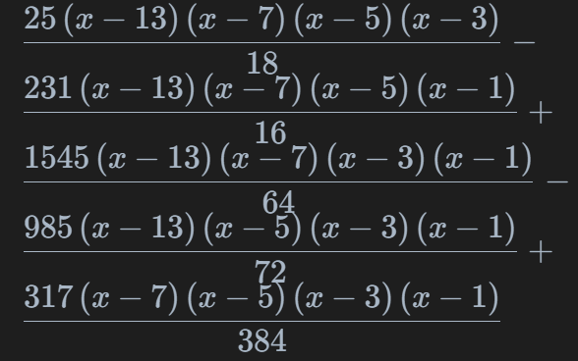



Introduction

Slide 12
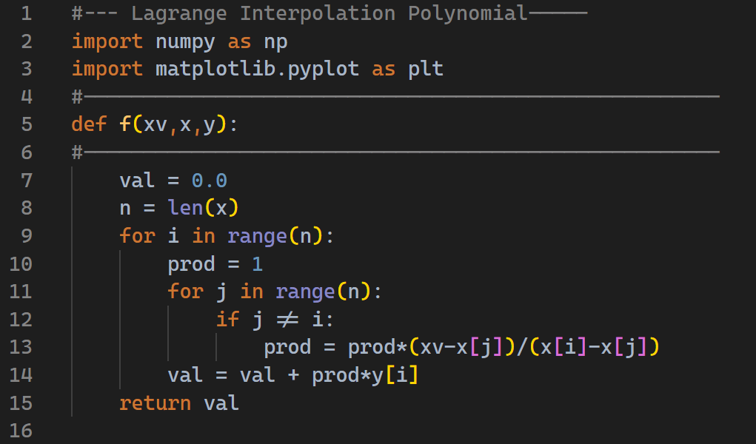
Introduction

Slide 13
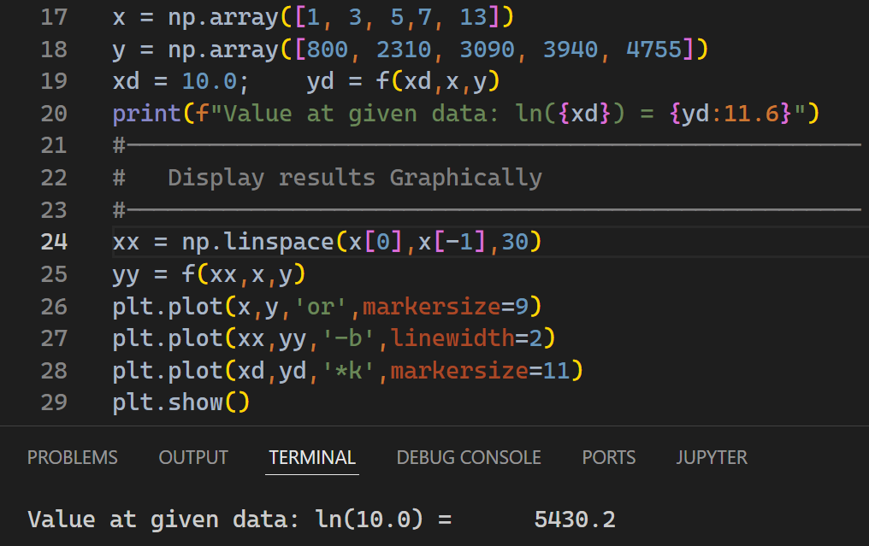
Introduction

Slide 14
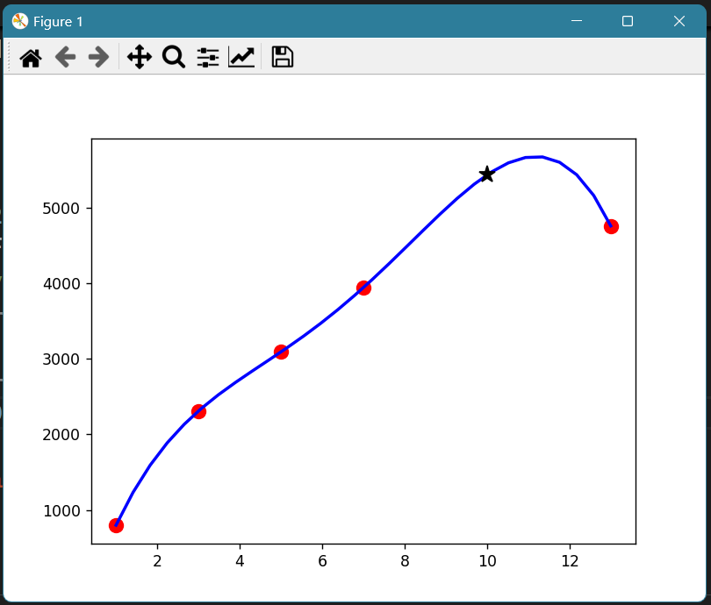


Introduction
Velocity of parachute interpolated using Lagrange Interpolation formula
$$y=5430.2$$
y-values
$$x = 10$$
x-values

