Slide 1
Lecture-1(4): Curve Fitting– Non-Linear - Newton’s Differences

Slide 2
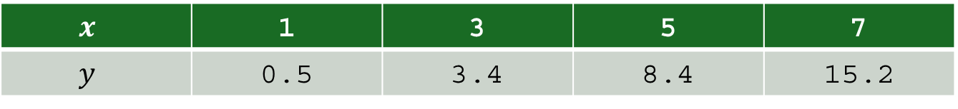
Introduction
Ex: Fit $y=a x^{b}$ to the following data:
$$x$$ | 1 | 3 | 5 | 7
$$y$$ | 0.5 | 3.4 | 8.4 | 15.2

Slide 3
Introduction

Slide 4
Introduction
2nd Method: Newton’s Divided Difference
Divided Differences

Slide 5
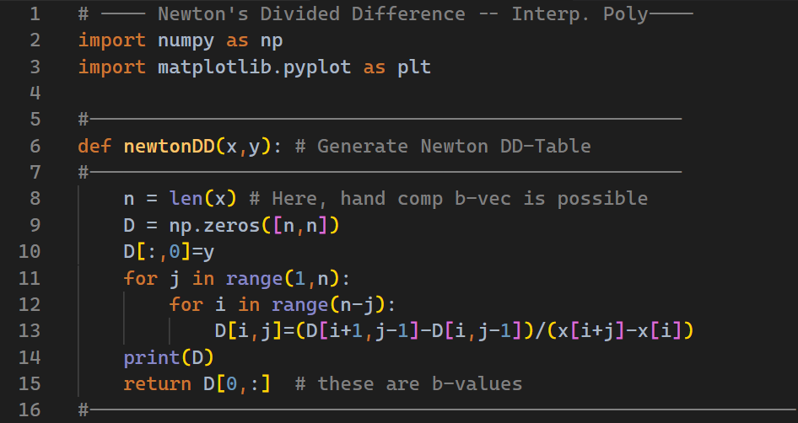
Introduction

Slide 6
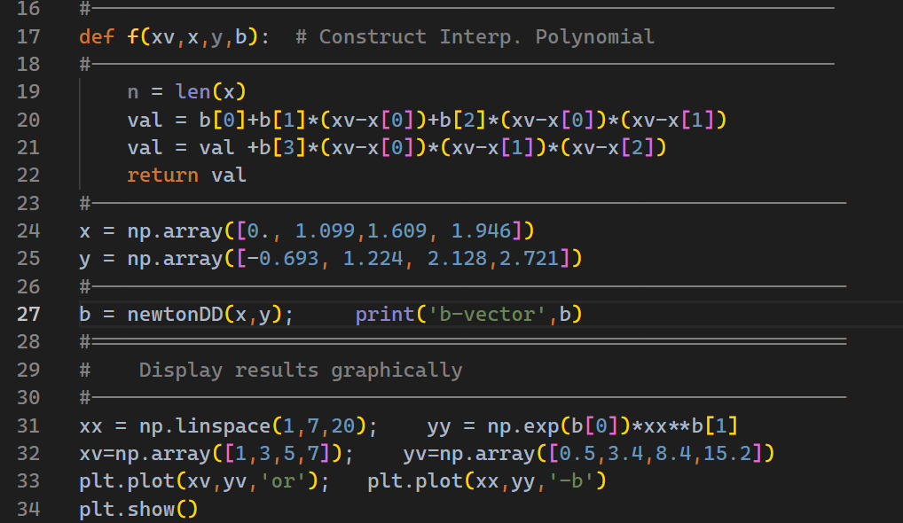
Introduction

Slide 7
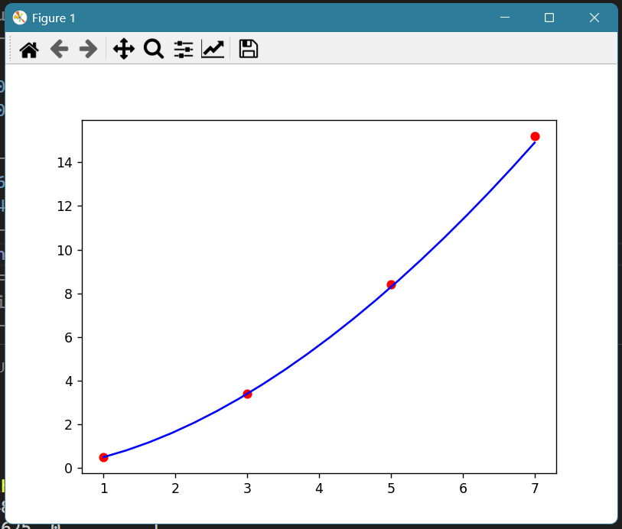
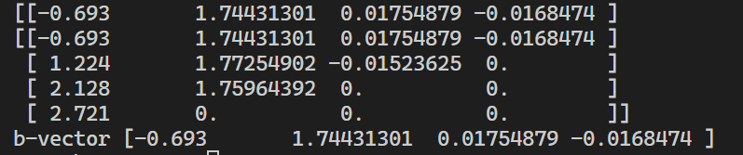
Introduction
y -values
x -values

