Slide 1
Lecture-1(4): Regression– Least Squares

Slide 2
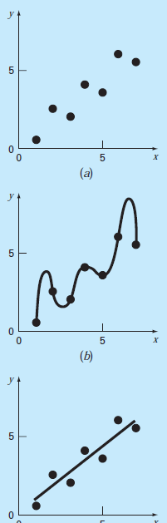
Introduction
Basics
to derive a curve that minimizes the discrepancy between the data points and the curve
Raw Data
Polynomial Fit
Least Square Fit

Slide 3
Introduction
Deviation Minimization
y-axis
Least Square Fit
x-axis

Slide 4
Introduction
Deviation Minimization
Deviation at ith point
y-axis
Least Square Fit
x-axis

Slide 5
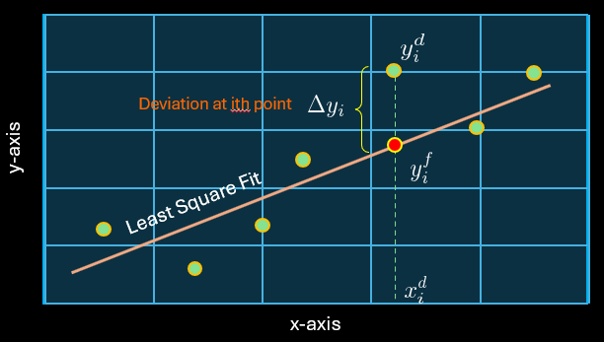
Introduction
Deviation Minimization
We note that deviation can be positive
or negative. So, let’s minimize sum of
squares of deviations: R
Linear Fitting (straight line)

Slide 6
Introduction
Minimization: set derivatives zero

Slide 7
Introduction
Example: Fit LSq. st. line ($y=a_{0}+a_{1}x$) to the following data:
For Least Square Line, we need to minimize the Residue or Error :

Slide 8
Introduction

Slide 9
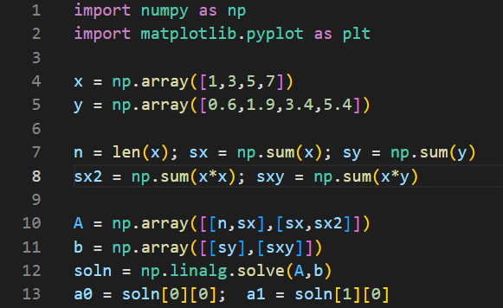
Introduction

Slide 10
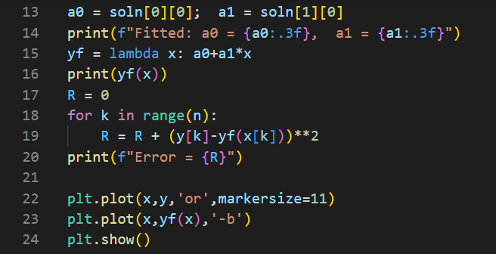
Introduction

Slide 11
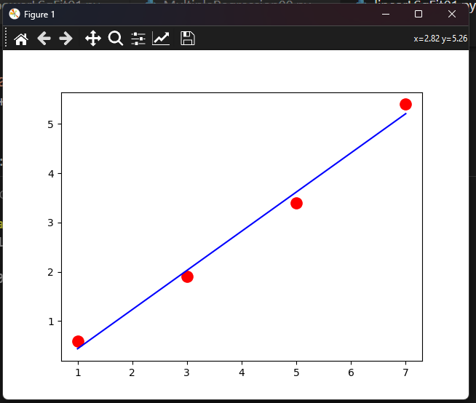
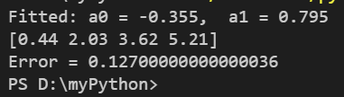
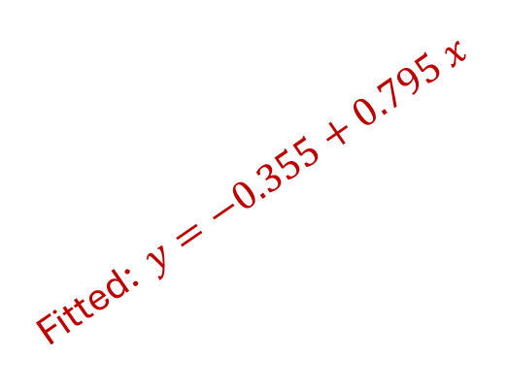
Introduction
Fitted: $y=−0.355+0.795 x$
y-values
x-values

Slide 12
Introduction
Example: fit power-law: $y=a_{0}x^{a_{1}}$ to the following data:
Let us first transform the fitting function:

Slide 13
Introduction
Solution:

Slide 14
Introduction
Error Analysis:

Slide 15
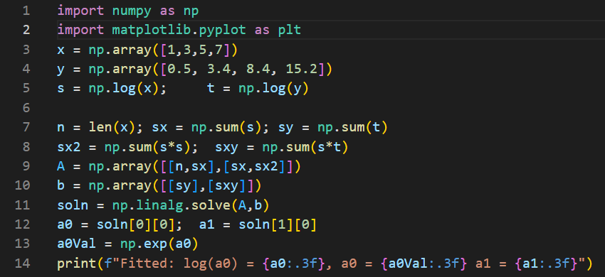
Introduction
i

Slide 16
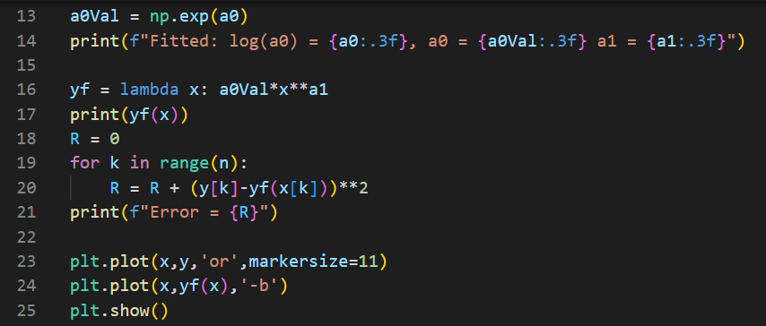
Introduction
i

Slide 17
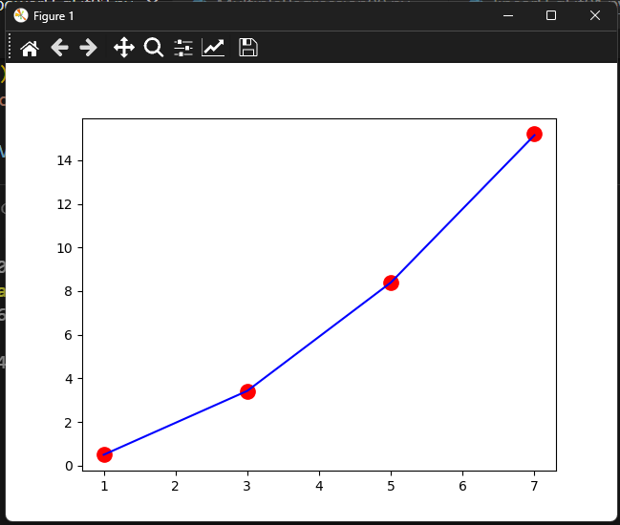

Introduction
i
y-values
x-values

