Slide 1
Initial Value Problems Euler Method
By
Dr. Sikander M. Mirza
Department of Physics & Applied Mathematics
Pakistan Institute of Engineering & Applied Sciences
Nilore, Islamabad 45650, Pakistan

Slide 2
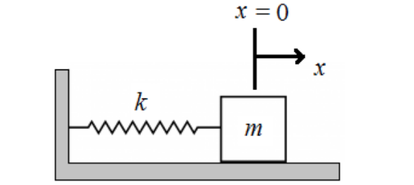
Introduction
Many problems in Physics have mathematical form of Initial Value Problems:

Slide 3
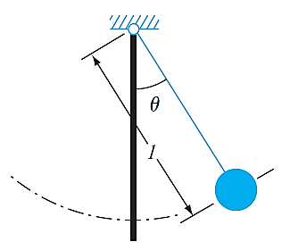




Introduction

Slide 4
Introduction
Conside the following first order ODE with the given initial condition:
Using Taylor expansion

Slide 5

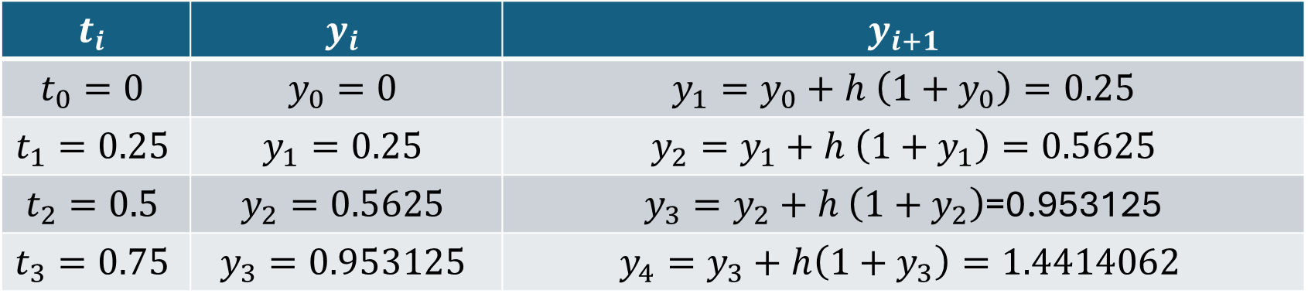
Example – 1
$$t_{i}$$ | $$y_{i}$$ | $$y_{i+1}$$
$$t_{0}=0$$ | $$y_{0}=0$$ | $$y_{1}=y_{0}+h \left(1+y_{0}\right)=0.25$$
$$t_{1}=0.25$$ | $$y_{1}=0.25$$ | $$y_{2}=y_{1}+h \left(1+y_{1}\right)=0.5625$$
$$t_{2}=0.5$$ | $$y_{2}=0.5625$$ | $y_{3}=y_{2}+h \left(1+y_{2}\right)$=0.953125
$$t_{3}=0.75$$ | $$y_{3}=0.953125$$ | $$y_{4}=y_{3}+h\left(1+y_{3}\right)=1.4414062$$

Slide 6



Example – 1

Slide 7
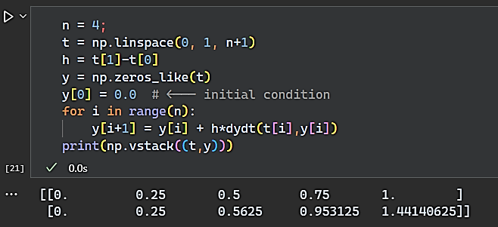
Example – 1

Slide 8
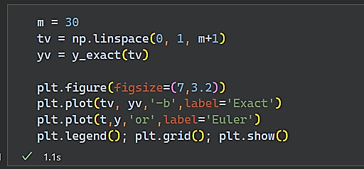
Example – 1

Slide 9
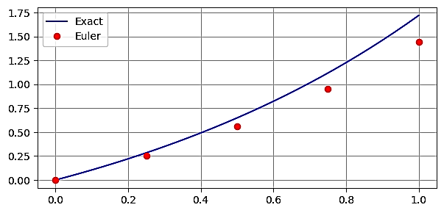
Example – 1

Slide 10
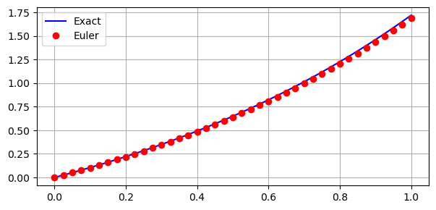
Example – 1

Slide 11
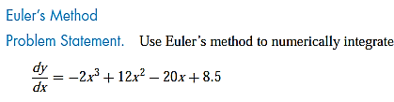

Example – 2

Slide 12

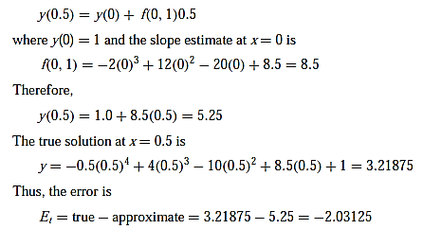
Example – 2

Slide 13
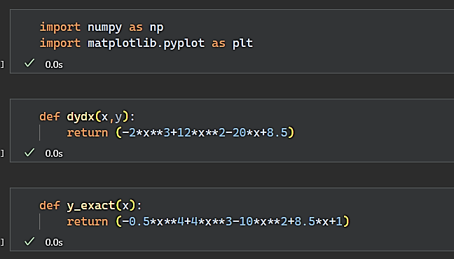
Example – 2

Slide 14
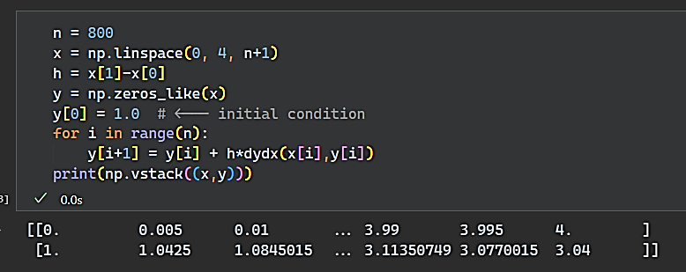
Example – 2

Slide 15
Example – 2

Slide 16
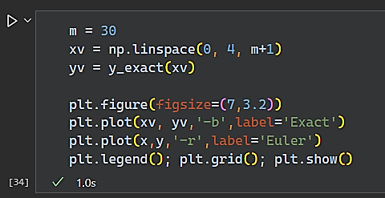
Example – 2

Slide 17
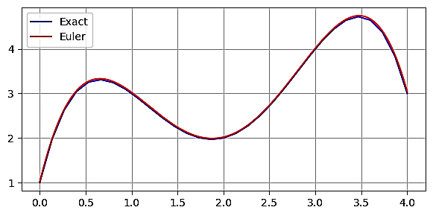
Example – 2

Slide 18
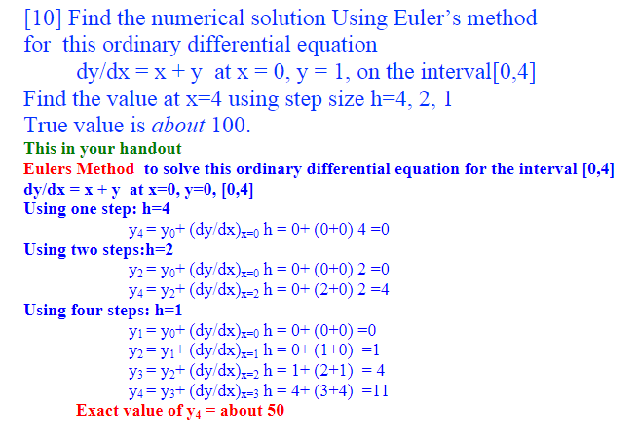
Introduction

