Slide 1
Root-Finding: Fixed Point Iterations
Fall 2024

Slide 2

Introduction
Fixed Point Iterations
open methods employ a formula to predict the root. Such a formula can be developed for simple fixed-point iteration (or, as it is also called, one-point iteration or successive substitution) by rearranging the function $f (x) = 0$so that x is on the left-hand side of the equation: $x=g(x)$
This transformation can be accomplished either by algebraic manipulation or by simply adding x to both sides of the original equation. For example:
Iterative Formula:

Slide 3
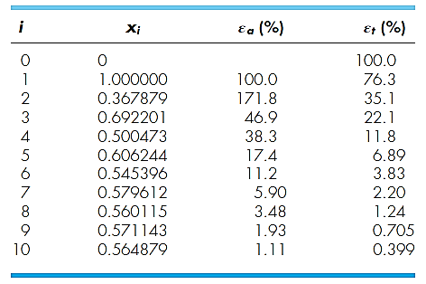

Introduction
Fixed Point Iterations: Example-1
Use simple fixed-point iteration to locate the root of $f (x) = e^{−x} − x$., Use initial guess: x = 0, Use percentage error estimate expression: $ε_{i}=\left|\frac{x_{i+1}−x_{i}}{x_{i}}\right|×100$
Root:

Slide 4
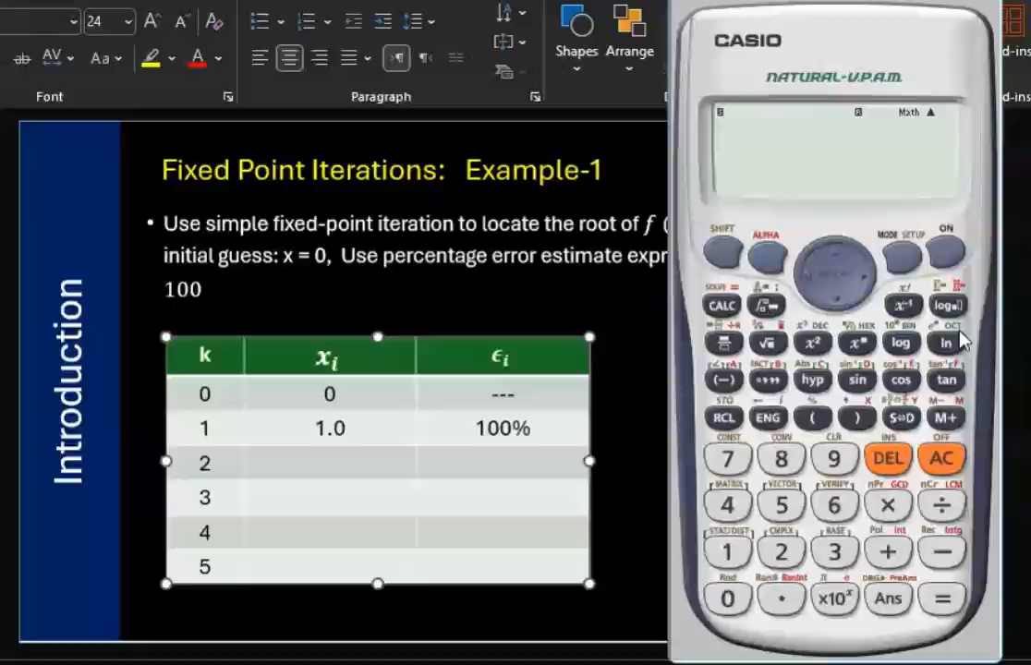
Introduction
Fixed Point Iterations: Example-1
Use simple fixed-point iteration to locate the root of $f (x) = e^{−x} − x$., Use initial guess: x = 0, Use percentage error estimate expression: $ε_{i}=\left|\frac{x_{i+1}−x_{i}}{x_{i}}\right|×100$

Slide 5
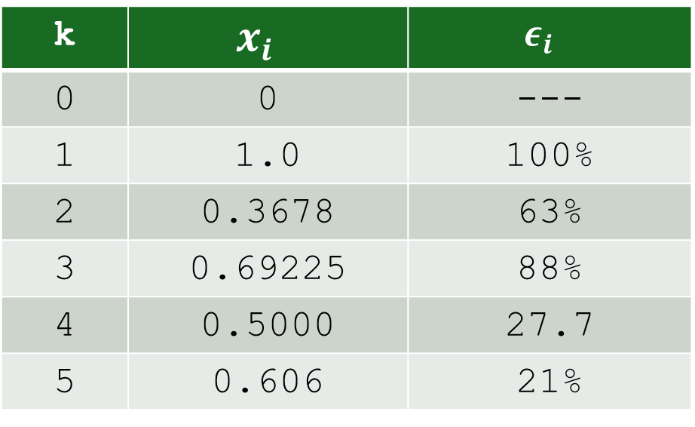

Introduction
Fixed Point Iterations: Example-1
Use simple fixed-point iteration to locate the root of $f (x) = e^{−x} − x$., Use initial guess: x = 0, Use percentage error estimate expression:
$$ε_{i}=\left|\frac{x_{i+1}−x_{i}}{x_{i}}\right|×100$$
k | $$x_{i}$$ | $$ε_{i}$$
0 | 0 | ---
1 | 1.0 | 100%
2 | 0.3678 | 63%
3 | 0.69225 | 88%
4 | 0.5000 | 27.7
5 | 0.606 | 21%
The iterations are NOT converged yet.
More Iterations are required.

Slide 6

Python Code…
Fixed Point Iterations: Example-1
Use simple fixed-point iteration to locate the root of $f (x) = e^{−x} − x$., Use initial guess: x = 0, Use percentage error estimate expression: $ε_{i}=\left|\frac{x_{i+1}−x_{i}}{x_{i}}\right|×100$
g(x)
$$x=g\left(x\right)=exp⁡(−x)$$
Import numpy as np
def g(x):
return (np.exp(-x))
x=0.0; eps=1.0e-2
while np.abs(g(x)-x) > eps:
xnew = g(x)
perr = np.abs(xnew-x)*100
print(f”k={k:2d} x={x:6.3f} \ xnew={xnew:6.3f} per={per:10.3e}”)
x = xnew

Slide 7
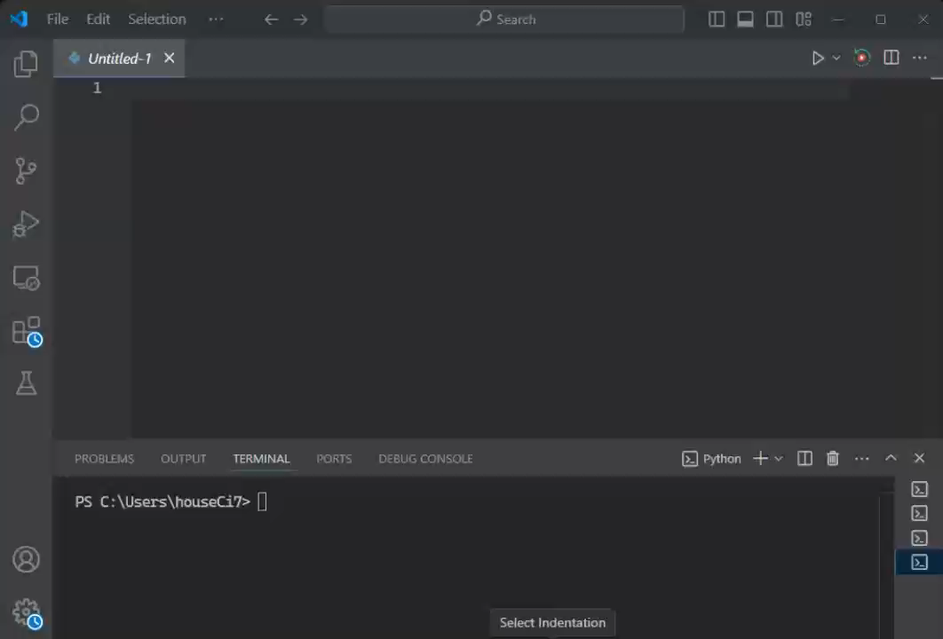
Fixed Point: Python Code
F
U

Slide 8
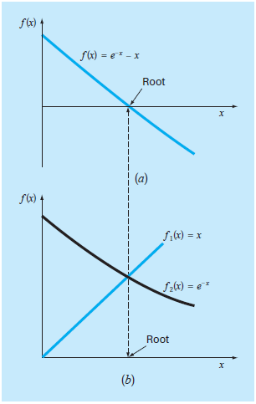
Introduction
F
U

Slide 9
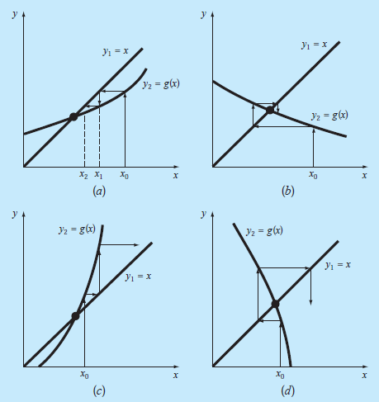
Cobweb Diagrams
F
U

Slide 10
Introduction
Convergence Condition
it should be clear that fixed-point iteration converges if, in the region of interest,
|g′(x)| < 1.
In other words, convergence occurs if the magnitude of the slope of g(x) is less than the slope of the line f(x)=x.

Slide 11
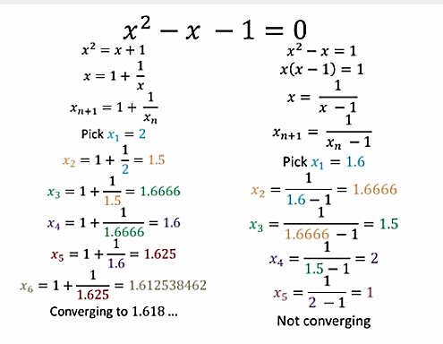
Introduction
.
.

Slide 12
Introduction
Convergence
Let us check the value of $\left|g′(x)\right|$ for $x = 1.618$

Slide 13
Introduction
Pros and Cons
Simplicity
Ease of Use
Ease to Program
Generic approach
Has Potential for fast convergence
Can be extended for higher dimensions
Can work for both real and complex data
Convergence not guaranteed for all cases.
Competing methods do have faster convergence!
May not converge to root “closest” to the initial guess.
Merits
De-Merits

