Slide 1

ML & AI Project EL01 Group 5
Tay Yuyang U2121493L
Apichart Yapakdee U2121244G
Wai Yan Myint U2121943F

Slide 2
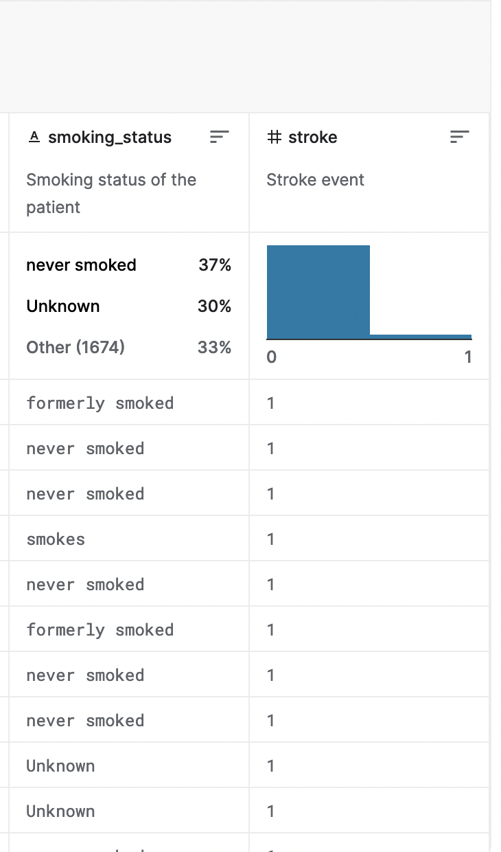
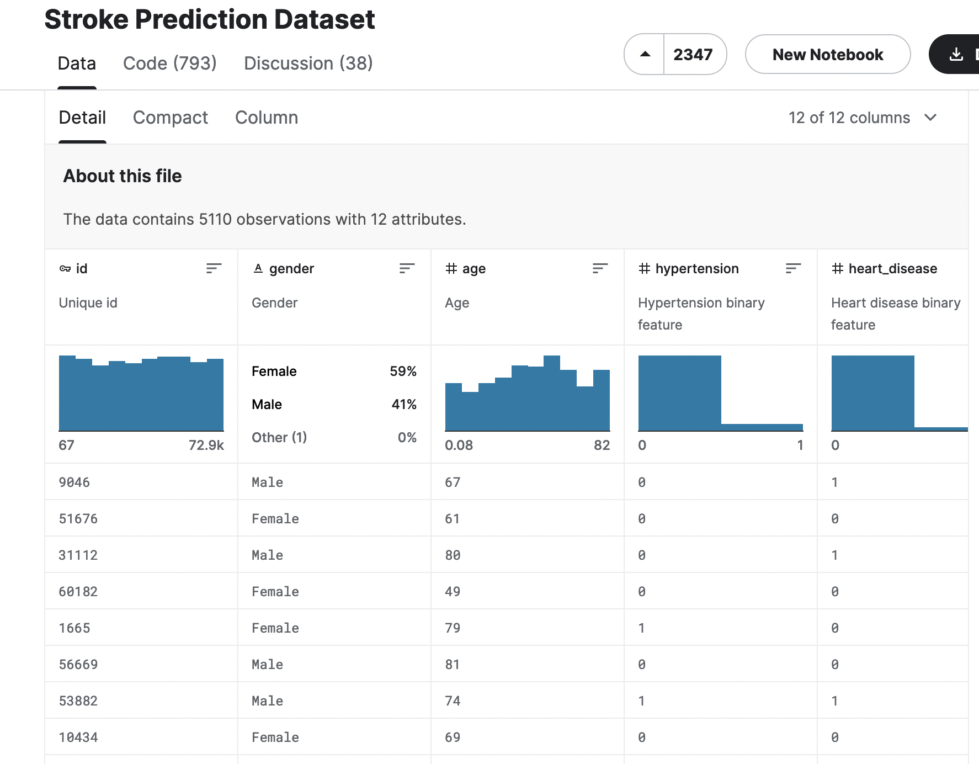
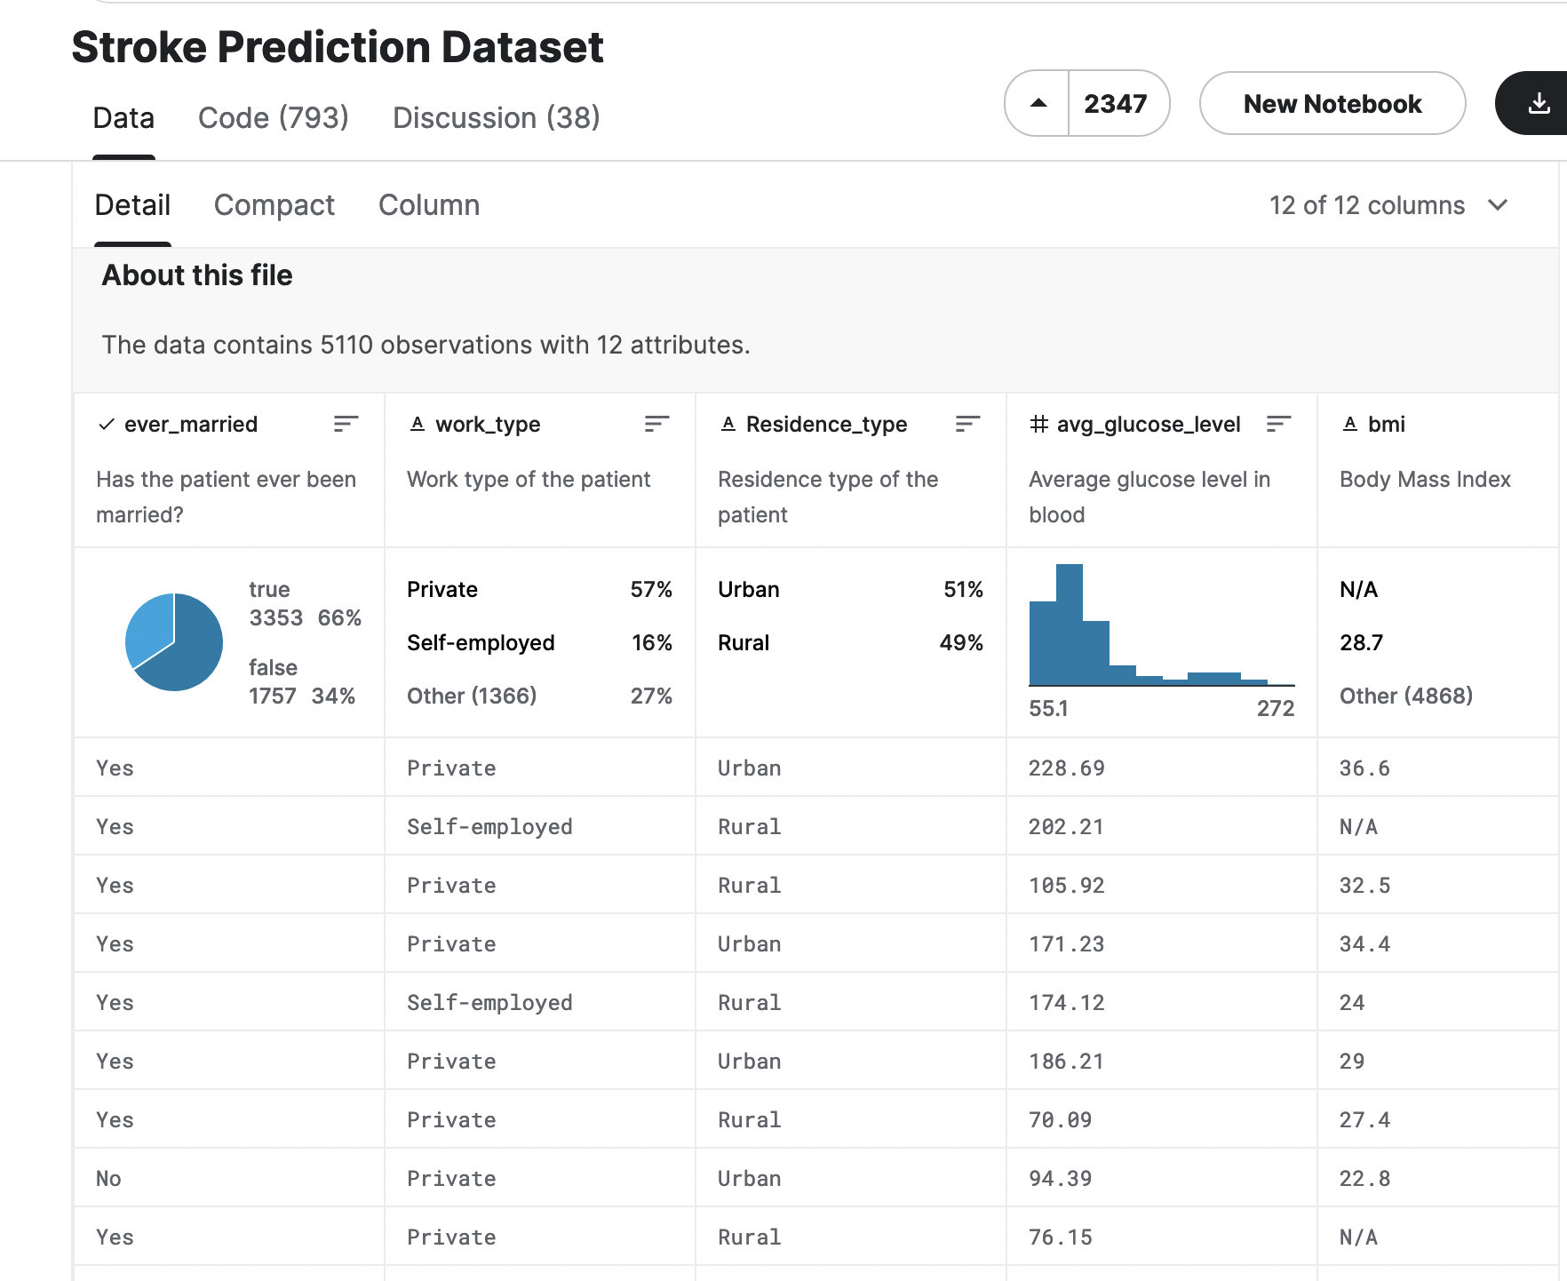
Dataset
Objective
Determine whether demographical data or health data is better for predicting outcome of stroke, and creating model for predicting stroke.
Split into,
Problem 1: From Demographic perspective
Problem 2: From Health perspective

Slide 3
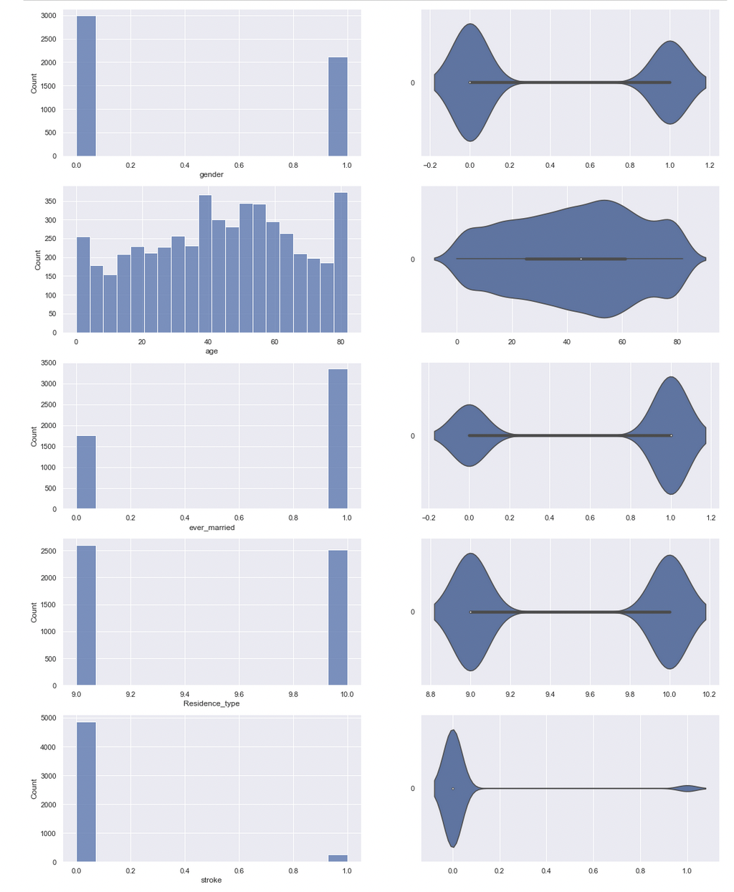
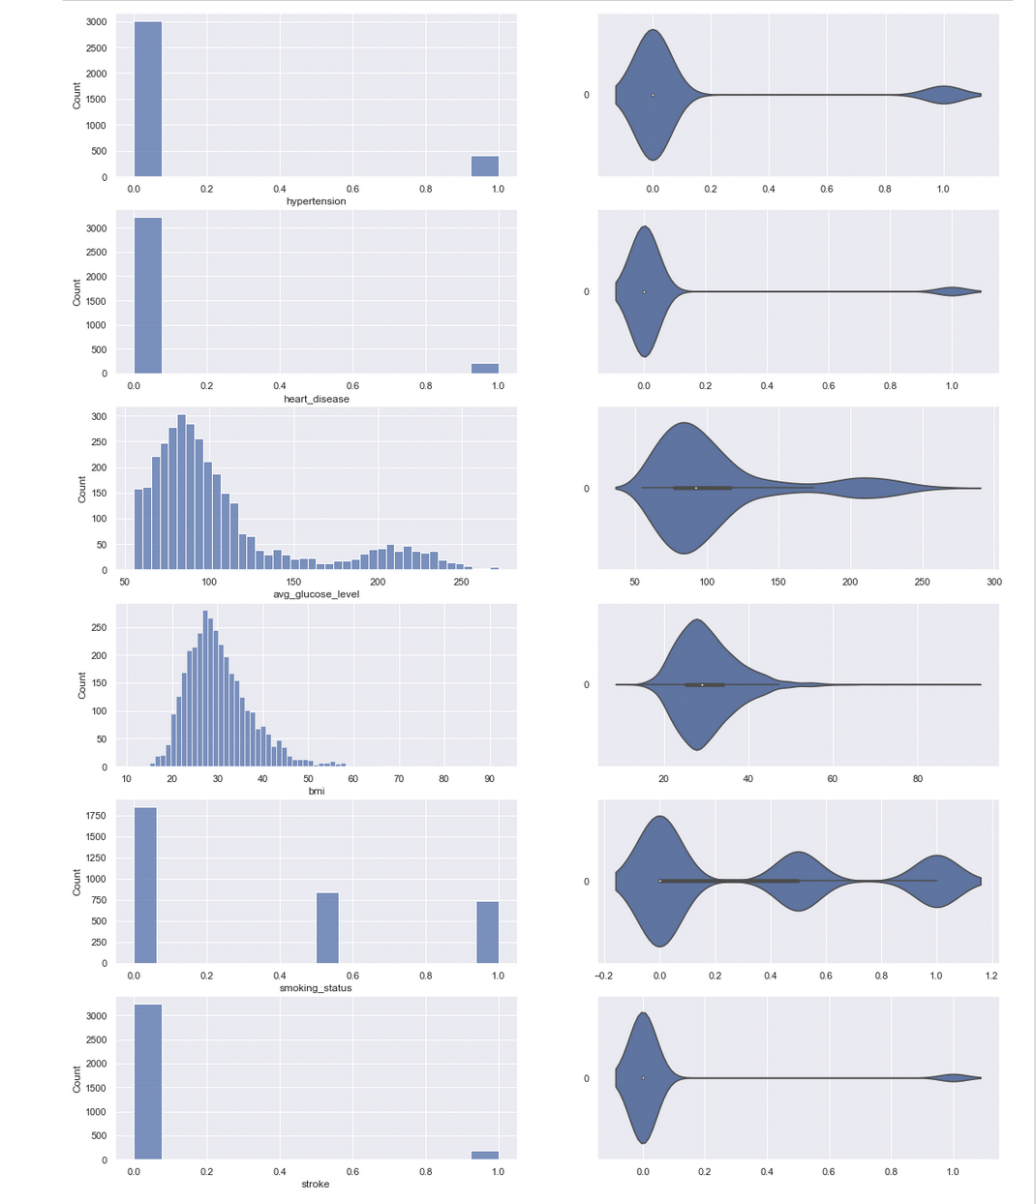
Exploratory Analysis
Problem 1
Problem 2
We decided on logistic regression
Outcome or dependent variable is binary
Logistic regression is used to predict binary outcomes
Independent variable fairly linearly with log odd
Hence log regression can help us create a model or models to predict stroke
Notes:
So these are graphs for problem 1 and (next slide)

Slide 4
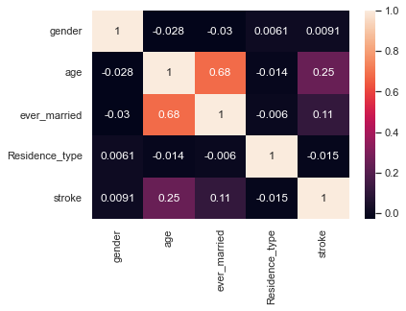
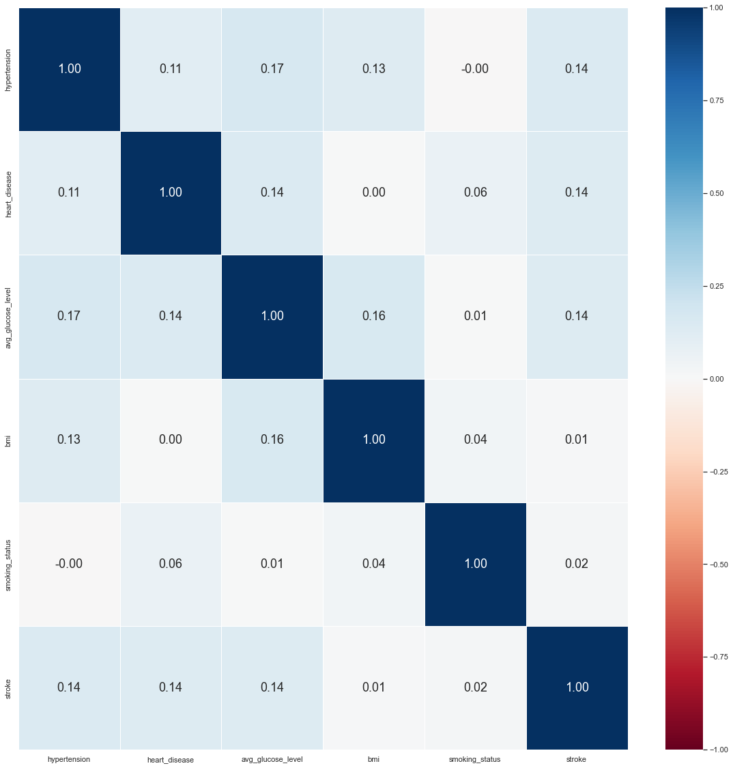
Exploratory Analysis
Problem 1
Problem 2
For demographics,
we decided to focus on:
Age: 0.25
Married: 0.11
For health,
we decided to focus on:
Hypertension
Heart Disease
Average glucose level
Each at 0.14
Notes:
This is the heat map for prob 1. So using heatmap, the relationship are a bit clearer. In this case, age and marriage are the two factors with highest correlation

Slide 5
Preparing the dataset: Tackling the unbalanced data
From Exploratory Analysis
The reason for low correlation :
The number of data with stroke is low compared to without stroke. (249 vs 4860)
Resulted in the algorithms to be biased
Therefore, there is a need to make sure the dataset is balanced.
The minority (stroke) is too few in comparison to majority (without stroke)
Oversampling of the minority
  Synthetic Minority Oversampling Technique (SMOTE)
Clean the dataset: Dataset was already unique, only needed to remove missing values no duplicates
Notes:
Clean the dataset —> removed parts with null data, and weird data ( others for gender)

Slide 6
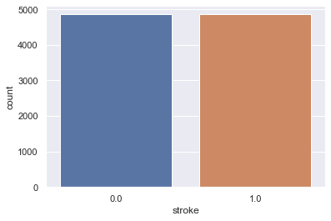
Preparing the dataset: Tackling the unbalanced data
Notes:
Now, we have achieved the same number of count for both cases.

Slide 7
Preparing the dataset
Problem 1
Before
After
precision recall f1-score support
0.0 0.95 1.00 0.97 1944
1.0 0.00 0.00 0.00 100
accuracy 0.95 2044
macro avg 0.48 0.50 0.49 2044
weighted avg 0.90 0.95 0.93 2044
precision recall f1-score support
0.0 0.80 0.71 0.75 1944
1.0 0.74 0.82 0.78 1944
accuracy 0.77 3888
macro avg 0.77 0.77 0.76 3888
weighted avg 0.77 0.77 0.76 3888
Notes:
As you can see for the problem 1, by oversampling, the recall rate for the minority increases drastically and the data is still accurate enough to use

Slide 8
Preparing the dataset
Problem 2
Before
After
precision recall f1-score support
0.0 0.95 1.00 0.97 1299
1.0 0.00 0.00 0.00 72
accuracy 0.95 1371
macro avg 0.47 0.50 0.49 1371
weighted avg 0.90 0.95 0.92 1371
precision recall f1-score support
0.0 0.65 0.77 0.70 1298
1.0 0.72 0.59 0.65 1299
accuracy 0.68 2597
macro avg 0.68 0.68 0.68 2597
weighted avg 0.68 0.68 0.68 2597
Notes:
The same can be said for problem 2. Now, we can use the data to determine the factors for prediction.

Slide 9
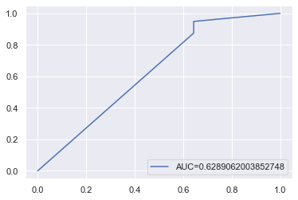
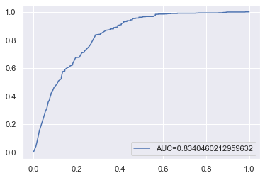
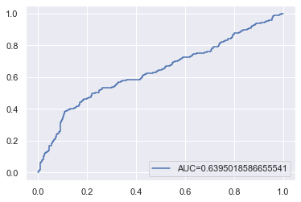
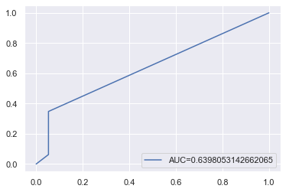
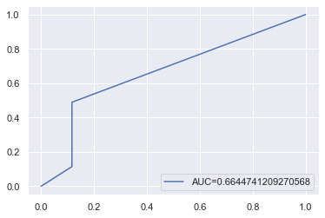
Use of data science/ machine learning to solve the problem
Univariate independent variables against stroke (dependent)
Problem 1
Age:
accuracy 0.83 (2 d.p)
Marriage:
accuracy 0.63 (2 d.p)
Problem 2
Hypertension: accuracy 0.66 (2 d.p)
Average Glucose Level:
accuracy 0.64 (2 d.p)
Heart disease
accuracy 0.64 (2 d.p)

Slide 10
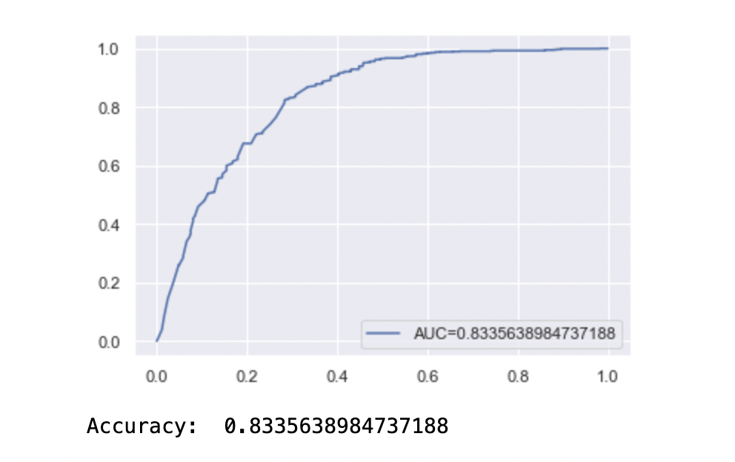
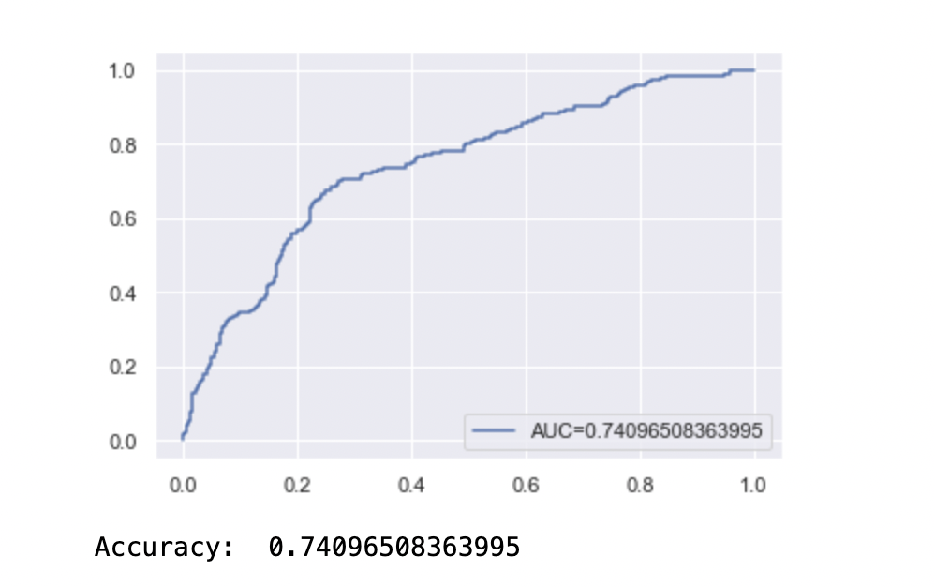
Use of data science/ machine learning to solve the problem
For multivariate logistic regression
Both health and demographic factors are good predictors, with both exceeding the 70% mark:
Health : 74%
Demographic :83%

Slide 11
Outcomes
Age remains the most accurate at 83.40%
Demographic perspective has a higher accuracy compared to health perspective
Multivariate logistic regression for health factors creates a more accurate model than its univariate counterparts.
Hence,
We managed to determine demographic to be a better predictor, and create 3 models that are accurate, multivariate health, multivariate demographic, univariate age
Tools used:
Out of course: SMOTE for data prep, Logistic Regression for models
In course techniques: to remove missing data, and data visualisation
Roles
Yu Yang: Slides and data visualisation
Wai Yan: Problem 1 data preparation, SMOTE for both problem 1 & 2
Apichart: Problem 2 data preparation, all of the logistic regression

Slide 12
References
Data we used:
https://www.kaggle.com/datasets/fedesoriano/stroke-prediction-dataset?resource=download
For logistic regression:
https://realpython.com/logistic-regression-python/#logistic-regression-in-python-with-scikit-learn-example-1
https://towardsdatascience.com/logistic-regression-for-binary-classification-56a2402e62e6
https://www.nickmccullum.com/python-machine-learning/logistic-regression-python/
https://www.statology.org/logistic-regression-python/
SMOTE technique:
https://www.geeksforgeeks.org/introduction-to-resampling-methods/\
https://towardsdatascience.com/5-smote-techniques-for-oversampling-your-imbalance-data-b8155bdbe2b5\
https://imbalanced-learn.org/stable/over_sampling.html
https://machinelearningmastery.com/random-oversampling-and-undersampling-for-imbalanced-classification/
Documentation:
https://pandas.pydata.org/docs/
https://scikit-learn.org/stable/user_guide.html
https://imbalanced-learn.org/stable/
https://numpy.org/doc/
https://matplotlib.org/stable/index.html
https://docs.python.org/3/library/re.html
https://docs.python.org/3/library/collections.html
https://docs.python.org/3/index.html

