Slide 1
Ingress
Traffic
LoadBalancer
Push
Node-Red
Instances

Slide 2
Ingress
Traffic
Broker
Pull
Node-Red
Instances

Slide 3
REST
ApiFlows
API
flow
CLI

Slide 4
Vertical scalability
Horizontal scalability

Slide 5
Bus
Node-RED
instance
More people to transport
More tasks to handle
Vertical
scalability
Horizontal scalability
Horizontal scalability

Slide 6
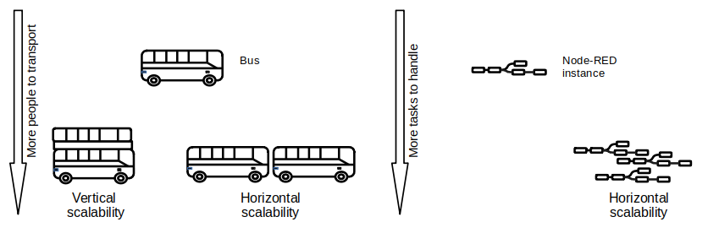

Slide 8
External
Injection
Injector message OUT
Injector message IN
ApiFlows messaging service

Slide 10
