Slide 1

Team Apical_4
Event: Datathon2023
Member: Frank Sun, Wenqi Zeng, Xiangxuan Yu, Jiayi Pan
Theme: Illini Blue and Orange

Slide 2
1
Context
CONTENTS
2
Data Cleaning & Transformation
3
Survival Analysis
4
Model Forecasting
5
Conclusion

Slide 3
1
Context

Slide 4
1. Context
1
1. Context
2. Data
3. Survival Analysis
4. Model Forecasting
5. Recom-mendation
Background
• Measuring credit charge-off is vital
• Customer defaults → Business loss
• Charge-off information → decision-making
2
Goal
Predict the number of charge-offs from Feb 2020 to Jan 2021

Slide 5
2
Data Cleaning & Transformation

Slide 6
2.1 Data Cleaning & Transformation
01
Data Cleaning
1. Context
2. Data
3. Survival Analysis
4. Model Forecasting
5. Recom-mendation
• Change Variables Format
• Drop NAs
02
Data Cleaning
Groupby mth_code.
Find out how many charge-offs happened in that month
Combine macro, training, and forecast starting dataset
Create new variables

Slide 7
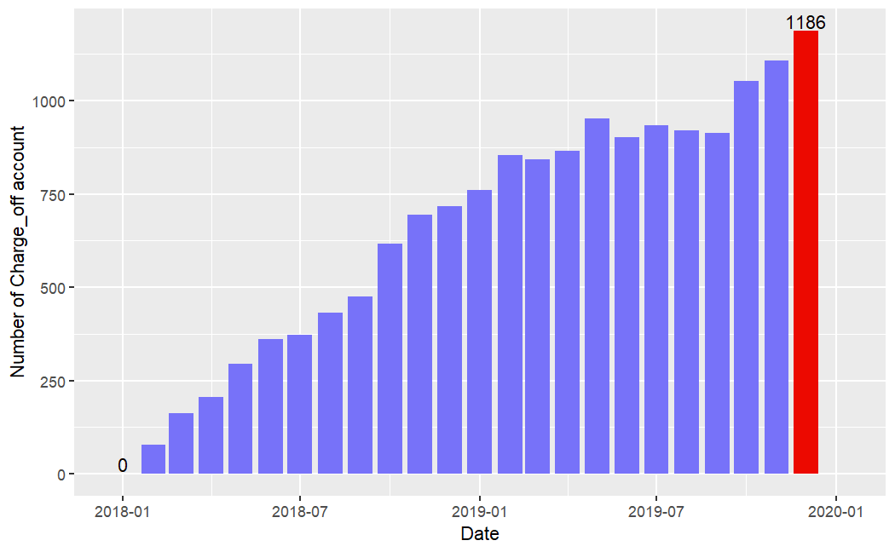
2.1 Data Cleaning & Transformation
1. Context
2. Data
3. Survival Analysis
4. Model Forecasting
5. Recom-mendation
History data of number of charge-off accounts (2018 - 2020)

Slide 8
3
Survival Analysis
3.1 Model Selection
3.2 Significant Variables

Slide 9
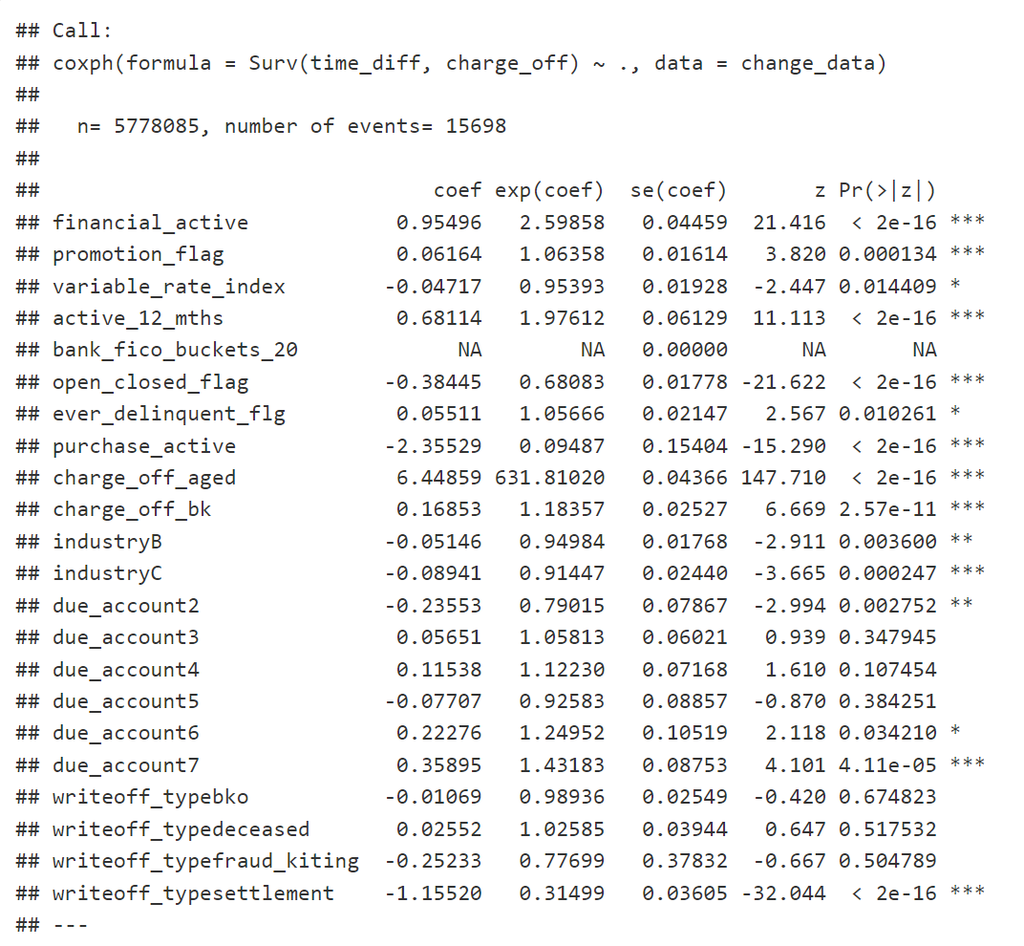
3.1 Model Selection
1. Context
2. Data
3. Survival Analysis
4. Model Forecasting
5. Recom-mendation
Full Model: drop all the continuous variables
Step 1: drop all variables that doesn’t make sense
Step2: drop all insignificant variables or NAs
Final Model
Notes:
Continuous_variable: we can’t use the continuous_variable because we have no information about them for period after 2020. We keep and group by categorical variables as they only have several levels.

Slide 10
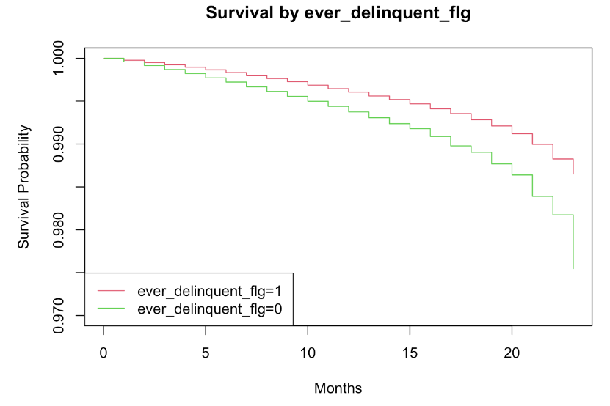
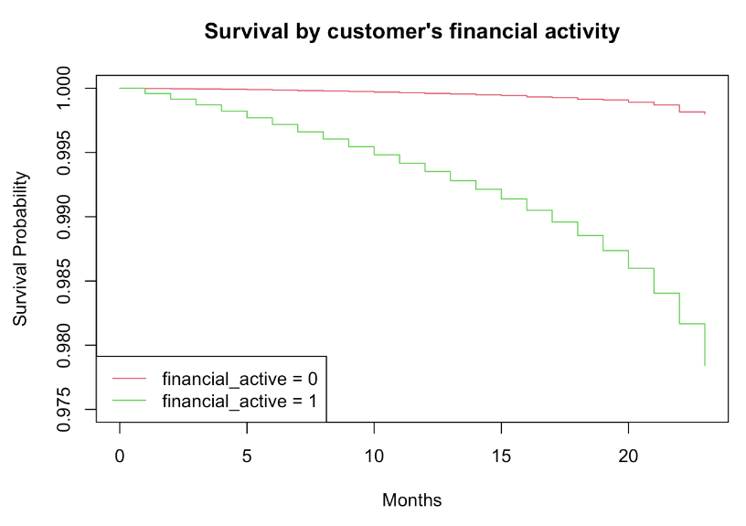
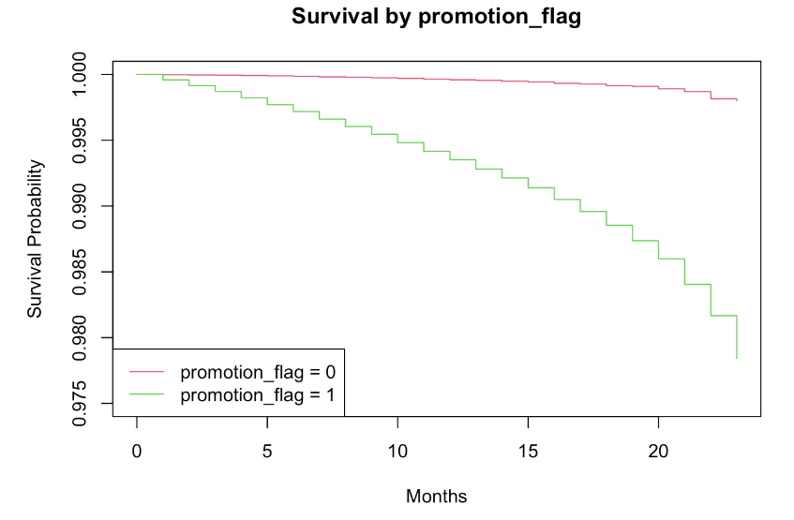
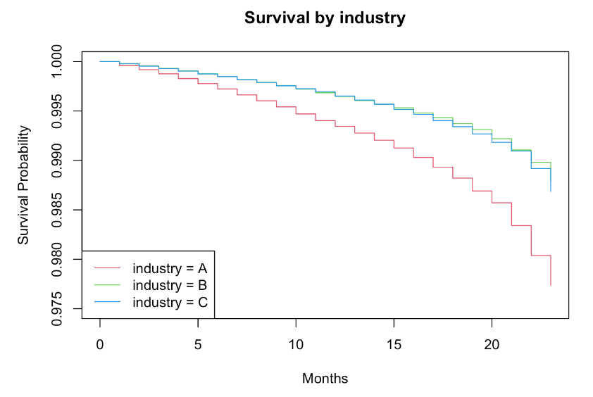
3.2 Significant Variables
1. Context
2. Data
3. Survival Analysis
4. Model Forecasting
5. Recom-mendation
Notes:
Continuous_variable: we can’t use the continuous_variable because we have no information about them for period after 2020. We keep and group by categorical variables as they only have several levels.

Slide 11
4
Model Forecasting
4.1 Time Series Forecasting
4.2 Training the Model
4.3 Making Predictions
4.4 Model Accuracy

Slide 12
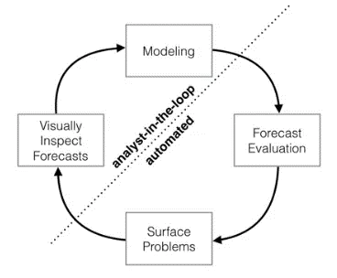
4.1 Time Series Forecasting - Intro to Prophet (R)
Time series model Using Prophet:
y(t) = g(t) + s(t) + h(t) + e(t)
y(t): trend models non-periodic changes; linear or logistic
g(t): seasonality represents periodic changes; i.e. weekly, monthly, yearly
h(t): ties in effects of holidays; on potentially irregular schedules ≥ 1 day(s)
e(t): error rate
Why do we use Prophet?
• Accurate and fast, fully automatic, very robust to outliers, and dramatic change
“Time series forecasting is the use of a model to predict future values based on previously observed values.”
1. Context
2. Data
3. Survival Analysis
4. Model Forecasting
5. Recom-mendation

Slide 13
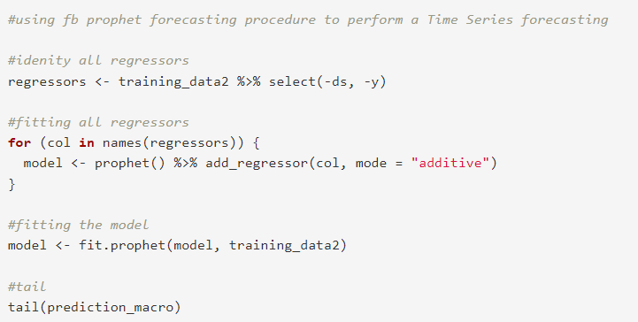
4.2 Training the Model
1. Context
2. Data
3. Survival Analysis
4. Model Forecasting
5. Recom-mendation
• Identify all regressors
• Fitting all regressors
• Fitting the model
• Tail

Slide 14
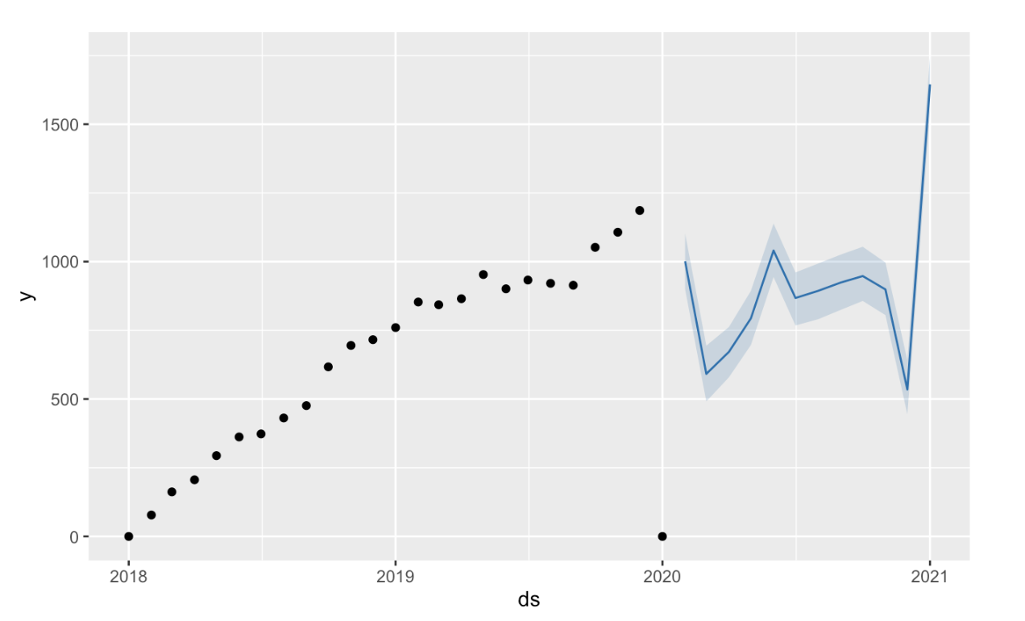
4.3 Making Predictions
1. Context
2. Data
3. Survival Analysis
4. Model Forecasting
5. Recom-mendation
Prediction of charge-off counts from 2020 – 2021 (based on history data from 2018 - 2020)

Slide 15
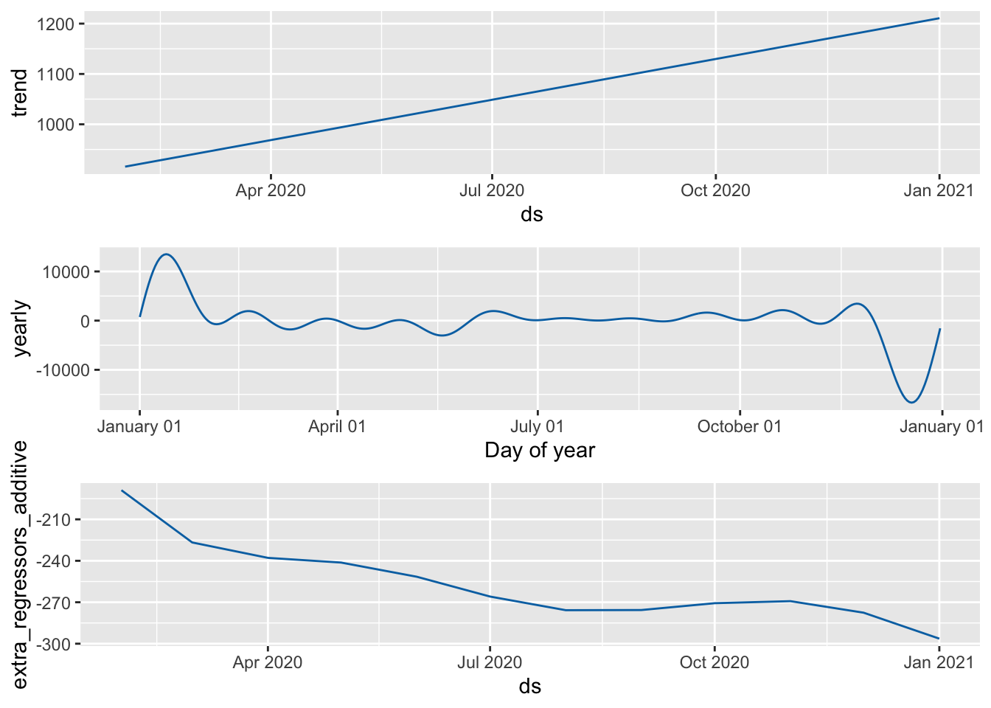
4.4 Model Accuracy
1. Context
2. Data
3. Survival Analysis
4. Model Forecasting
5. Recom-mendation
month
month

Slide 16
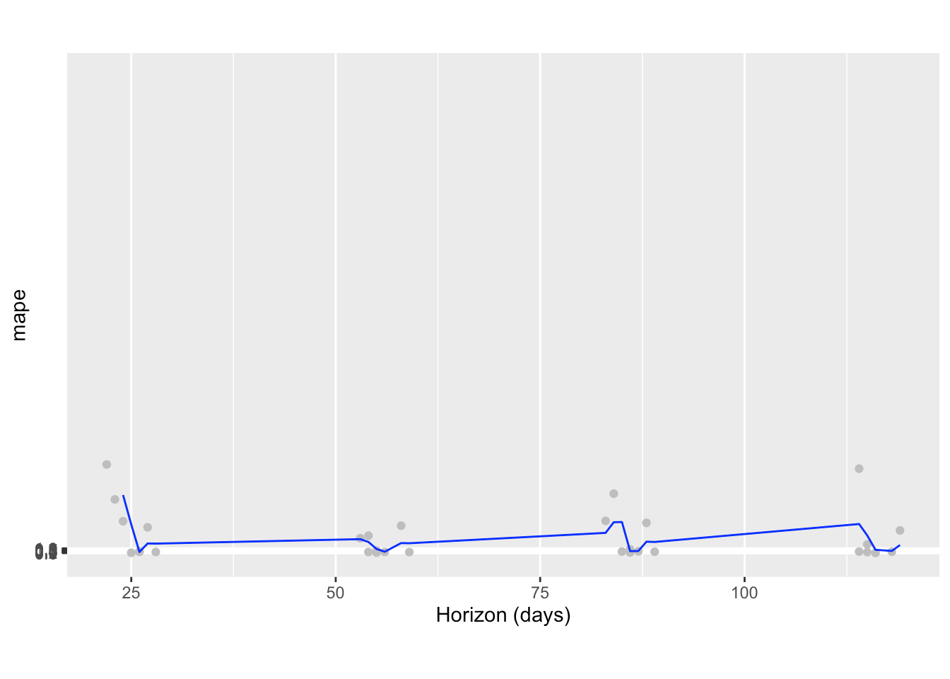
4.4 Model Accuracy
1. Context
2. Data
3. Survival Analysis
4. Model Forecasting
5. Recom-mendation

Slide 17
5
Recommendation
5.1 Key Term: Industry level
5.2 Key Term: Financial active level
5.3 What We Learn

Slide 18
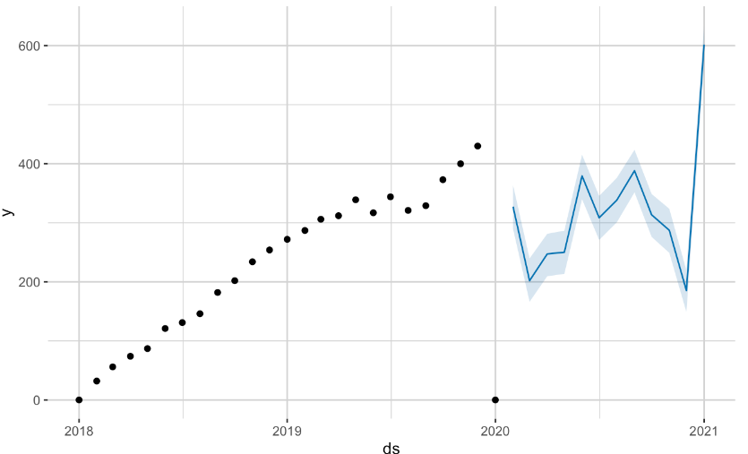
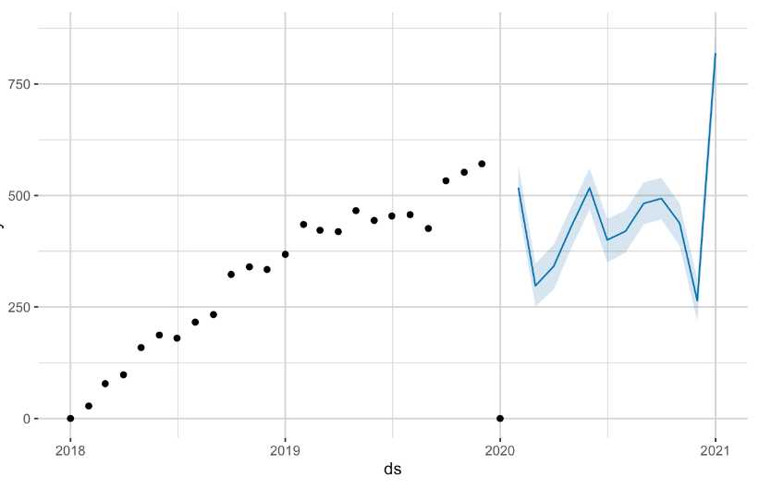
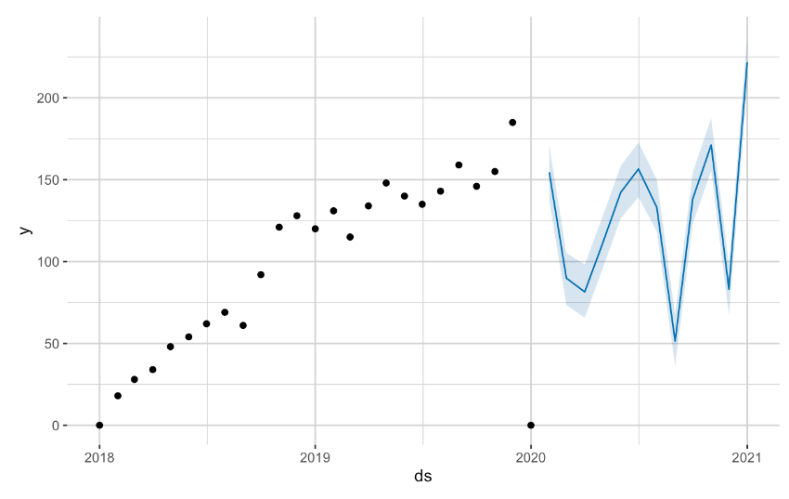
5.1 Key Term: Industry level
1. Context
2. Data
3. Survival Analysis
4. Model Forecasting
5. Recom-mendation
Industry A vs. charge-off counts
Industry B vs. charge-off counts
• Industry level (A, B, C)
• Group by industry → When given a specific industry, focusing on an industry level model.
• More accurate on a specific model
[economic meaning]
Industry C vs. charge-off counts

Slide 19
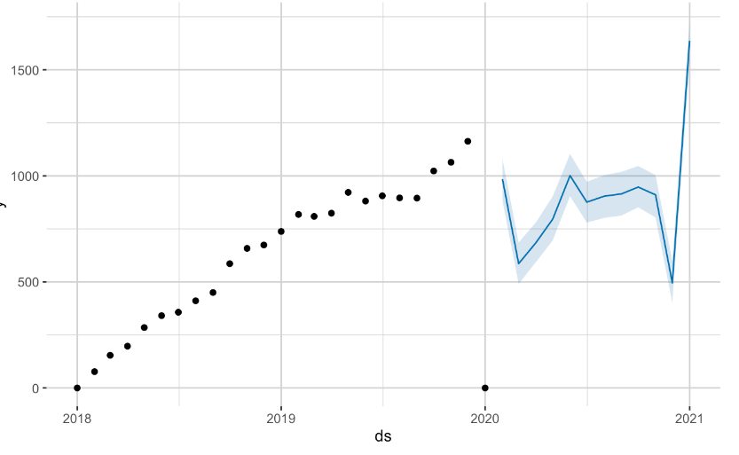
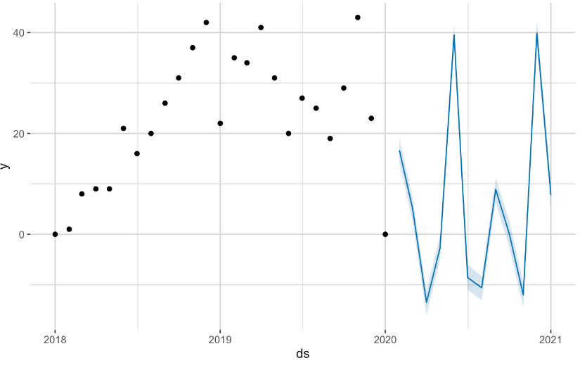
5.2 Key Term: Financial active level
1. Context
2. Data
3. Survival Analysis
4. Model Forecasting
5. Recom-mendation
Financial active (1) vs. charge-off counts
Financial active (0) vs. charge-off counts
• Financial active level (0, 1)
• Group by financial level → When given a specific financial active, focusing on a corresponding financial level model.
• More accurate on a specific model [economic & statistical model]

Slide 20
5.3 What We Learn
Statistical Models & Methods: Big Data Analysis, Time Series Forecasting, and Survival Analysis
Charge-off rate is low in the big scale overall
Combine statistical and economic perspectives:
• The charge-off rate is closely related to the economic situation.
• The number of charge-offs increased continuously during the global outbreak of COVID-19 from 2019 to 2020. When the pandemic began to ease in 2020, a significant dip in the charge-off rate was discovered.
1. Context
2. Data
3. Survival Analysis
4. Model Forecasting
5. Recom-mendation

Slide 21
THANKS

