Slide 1
Public Health Informatics and Technology Bootcamp Capstone Presentation Group X
Group Member 1 First and Last Name
Group Member 2 First and Last Name
Group Member 3 First and Last Name
Group Member 4 First and Last Name
Group Member 5 First and Last Name
Jul 29, 2022

Slide 2
Executive Summary (Abstract) finish this slide last
Introduction: add one paragraph introducing your report/analysis; briefly mention what is this project about (e.g., surveillance of reportable diseases); make sure to include the project’s aims (e.g., comparing the prevalence of two reportable diseases; measuring the effect of race on utilization outcome in two reportable diseases)
Methods: add one paragraph about the methodology used in your analysis; items to cover very briefly: data source used; data cleaning process used in the analysis; population represented in the analysis; statistical methodology used to measure and compare prevalence; and statistical methodology used to measure the effect of race on hospital length of stay
Results: add one paragraph about the results that you have generated in your analysis; items to cover very briefly: population spec (number of encounters; mean age; percentage of females; percentage of White, Black and Asian), prevalence of the two reportable diseases (and if they are statistically different or not), and measured effect of race on hospital length of stay in each of the two reportable diseases
Discussion: add one paragraph about what conclusions can be made based on the results that you have generated in the analysis; items to cover very briefly: what can be concluded from the difference in prevalence rates; what can be concluded based on the race effect on hospital length of stay in each of the reportable diseases

Slide 3
Introduction
Background
Use bullet points and short sentences
Sample content to cover on this slide:
general background about the topic of your project (i.e., what is surveillance of reportable diseases)
why the topic of this project is important (i.e., why surveillance of reportable diseases is important)
provide examples of existing systems (e.g., state or federal surveillance systems for reportable diseases)
make sure to use proper citations/references as needed; here is one example ¹
1. Center for Disease Control and Prevention. Nationally notifiable disease surveillance system. Retrieved Jul 2022. Available at: https://www.cdc.gov/nndss/index.html.

Slide 4
Introduction (cont.)
Prior Research/Practice in this Domain
Use bullet points and short sentences
Sample content to cover on this slide:
what is the rate of example reportable diseases in the population (e.g., prevalence of COVID in the US population in 2020; prevalence of sample reportable diseases specially that one that you have analyzed)
what prior research has found regarding the racial disparities in outcomes of patients with COVID and/or other reportable diseases (focusing on healthcare utilization outcomes is preferred)
make sure to use proper citations/references as needed; here is one example ¹
make sure to use proper citations/references as needed; here is another example ²
Center for Disease Control and Prevention. Nationally notifiable diseases – annual summaries of notifiable diseases. Retrieved Jul 2022. Available at: https://www.cdc.gov/healthywater/statistics/surveillance/notifiable.html.
Lee H, Andrasfay T, Riley A, Wu Q, Crimmins E. Do social determinants of health explain racial/ethnic disparities in COVID-19 infection? Soc Sci Med. 2022 Aug;306:115098. doi: 10.1016/j.socscimed.2022.115098. Epub 2022 Jun 3. PMID: 35759973.

Slide 5
Introduction (cont.)
Project Aims
Use bullet points and short sentences
Sample content to cover on this slide:
Aim 1: what is the first aim of the project? (e.g., compare prevalence of two reportable diseases)
Aim 2: what is the second aim of the project? (e.g., measuring racial disparities on healthcare utilization between two reportable diseases)
how does this project add to our knowledge (e.g., are the results novel? how can it inform the local public health agency?)

Slide 6
Methodology
Data Source
Use bullet points and short sentences
Sample content to cover on this slide:
where is the source of this dataset? (e.g., HCUP)
what population and healthcare setting is being represented in this dataset?
what types of variables are included in this dataset (briefly)?
what years of data are covered in this data?
make sure to use proper citations/references as needed; here is one example ¹
1. Agency for Healthcare Research and Quality. Healthcare cost and utilization project (HCUP). Retrieved Jul 2022. Available at: https://www.hcup-us.ahrq.gov/.

Slide 7
Methods (cont.)
Data Cleaning
Use bullet points and short sentences
Sample content to cover on this slide:
what methods did you use to clean the data (and deal with the missing data)?
what variables were cleaned?
Population Denominator and Numerator
what exclusion criteria did you use to limit your population denominator? (e.g., residing in a specific state)
what inclusion criteria did you use to identify the population of interest (e.g., COVID patients)? make sure to include the ICD codes that you used to find patients with the reportable disease

Slide 8
Methods (cont.)
Variables – Predictors
Use bullet points and short sentences
Sample content to cover on this slide:
Aim 1: what variables did you compare between the two reportable diseases?
Aim 2: what variables did you use as predictors in the regression models?
Explain if you transformed any of these variables?
Variables – Outcomes
Aim 1: what variable did you use to measure prevalence on an encounter level?
Aim 2: what variable did you use as the outcome in the regression models?
Explain if you transformed any of these variables?

Slide 9
Methods (cont.)
Statistical Analysis
Use bullet points and short sentences
Sample content to cover on this slide:
Aim 1: what statistical methods did you use? (e.g., summary statistics; t-test; Chi-squared)
Aim 2: what statistical methods did you use? (e.g., linear regression; logistic regression)
what statistical application/program did you use? (e.g., R, Python)
what special packages/libraries did you use? (e.g., data.table) – make sure to cite them properly¹
1. R CRAN. Data.table: an extension of data.frame. Retrieved Jul 2022. Available at: https://cran.r-project.org/web/packages/data.table/index.html.

Slide 10
Results
Data Cleaning
The original dataset had XXX encounters/rows and XXX unique patients.
After cleaning the data, XXX encounters/row remained (XXX unique patients).
The data cleaning removed X% of the total population.
Population Selection – Exclusion Criteria
Encounters that did not originate in Florida were excluded. XXX encounter/rows (XXX patients) remained in the dataset after excluding encounters/patients not originating/residing in Florida.
Patients who were ... were excluded. XXX encounters/rows (XXX patients) were left in the dataset after these exclusion criteria were applied. These encounters constituted the denominator of the study.
Population Selection – Inclusion Criteria
The denominator population were further marked and selected based on two reportable diseases.
After applying the inclusion diagnoses codes, XXX encounters/row (XXX patients) were identified having … and XXX encounters/row (XXX patients) were identified having COVID. These population were treated as the numerator populations in the study.

Slide 11
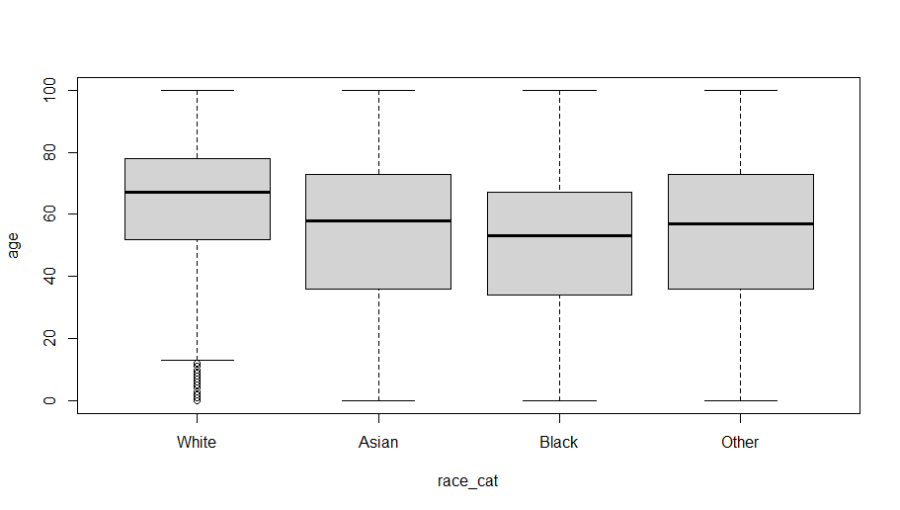
Results (cont.)
Population Denominator Specs
The following shows the boxplots of age across racial groups. (replace the diagram below with yours!)

Slide 12
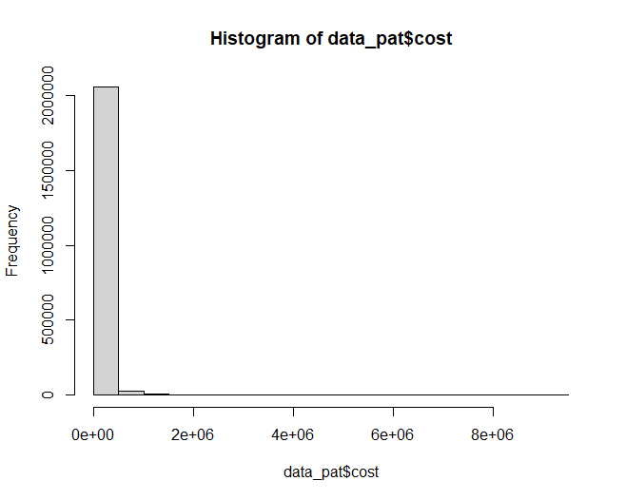
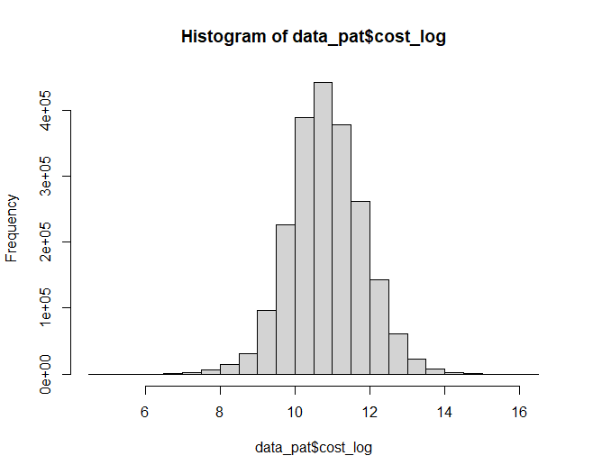
Results (cont.)
Population Denominator Specs (cont.)
The following shows the histogram of cost (left) and log of cost (right) for all patients. (replace the diagrams below with yours!)

Slide 13
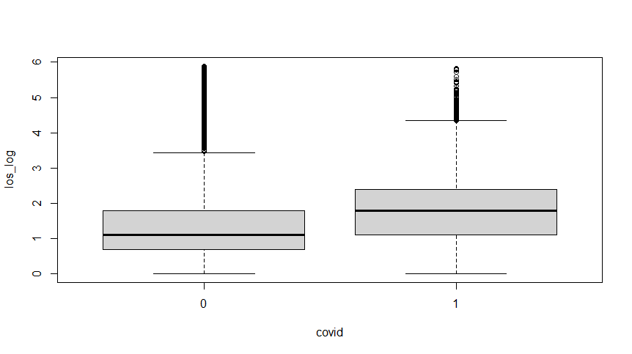
Results (cont.)
Population Numerator #1 Specs (COVID)
The following boxplots show the spread of hospital length of stay (log converted) across the numerator #1 population (COVID) vs. the rest of the population (non-COVID). (replace the diagram below with yours!)

Slide 14
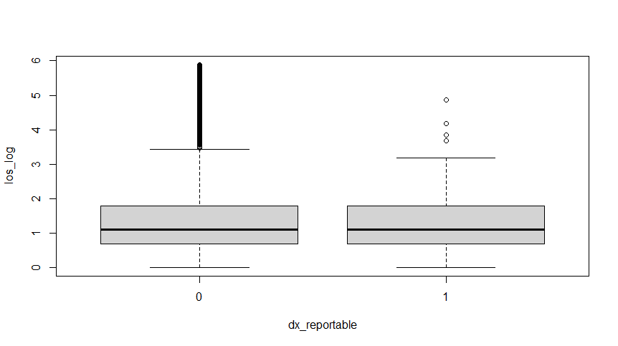
Results (cont.)
Population Numerator #2 Specs (your group-specific reportable disease)
The following boxplots show the spread of hospital length of stay (log converted) across the numerator #2 population (with reportable disease) vs. the rest of the population (without reportable disease). (replace the diagram below with yours!)

Slide 15
Results (cont.)
Aim 1: Comparing LOS of Population Numerator #1 and #2
Mean of hospital length of stay among COVID patients was XXX, which was (or was not) significantly different from the mean of hospital length of stay among non-COVID patients (p-value = XXX).
Mean of hospital length of stay among patients with the reportable disease was XXX, which was (or was not) significantly different from the mean of hospital length of stay among patients without the reportable disease (p-value = XXX).
Mean of hospital length of stay among COVID patients was XXX, which was (or was not) significantly different from the mean of hospital length of stay among patients with the reportable disease (p-value = XXX).

Slide 16
Results (cont.)
Aim 2: Regression Results of Denominator Population
The following output summarizes the regression examining the effect of race on hospital LOS in the denominator population (all patients).
The Black patients had a coefficient of XXX in predicting hospital LOS compared to White patients.
Estimate Std. Error t value Pr(>|t|)
(Intercept) 0.4008087 0.0238931 16.775 < 2e-16 ***
race_catAsian 0.6987520 0.0532417 13.124 < 2e-16 ***
race_catBlack 0.8208621 0.0137831 59.556 < 2e-16 ***
race_catOther 0.7338743 0.0134046 54.748 < 2e-16 ***
sex_catM 0.4891362 0.0101101 48.381 < 2e-16 ***
age -0.0189662 0.0003548 -53.449 < 2e-16 ***
dx_count 0.3511685 0.0007028 499.644 < 2e-16 ***
insurance_catMedicaid 0.6522890 0.0202835 32.159 < 2e-16 ***
insurance_catMedicare 0.1004589 0.0183317 5.480 4.25e-08 ***
insurance_catPrivate 0.5402355 0.0182156 29.658 < 2e-16 ***
address_rural_catRural -0.3144092 0.0392475 -8.011 1.14e-15 ***
---
Signif. codes: 0 ‘***’ 0.001 ‘**’ 0.01 ‘*’ 0.05 ‘.’ 0.1 ‘ ’ 1
Residual standard error: 7.151 on 2083850 degrees of freedom
Multiple R-squared: 0.1187
Adjusted R-squared: 0.1187
F-statistic: 2.807e+04 on 10 and 2083850 DF,
p-value: < 2.2e-16

Slide 17
Results (cont.)
Aim 2: Regression Results of Numerator #1 Population
The following output summarizes the regression examining the effect of race on hospital LOS in the numerator #1 population (COVID patients).
The Black patients had a coefficient of XXX in predicting hospital LOS compared to White patients.
Estimate Std. Error t value Pr(>|t|)
(Intercept) 0.4008087 0.0238931 16.775 < 2e-16 ***
race_catAsian 0.6987520 0.0532417 13.124 < 2e-16 ***
race_catBlack 0.8208621 0.0137831 59.556 < 2e-16 ***
race_catOther 0.7338743 0.0134046 54.748 < 2e-16 ***
sex_catM 0.4891362 0.0101101 48.381 < 2e-16 ***
age -0.0189662 0.0003548 -53.449 < 2e-16 ***
dx_count 0.3511685 0.0007028 499.644 < 2e-16 ***
insurance_catMedicaid 0.6522890 0.0202835 32.159 < 2e-16 ***
insurance_catMedicare 0.1004589 0.0183317 5.480 4.25e-08 ***
insurance_catPrivate 0.5402355 0.0182156 29.658 < 2e-16 ***
address_rural_catRural -0.3144092 0.0392475 -8.011 1.14e-15 ***
---
Signif. codes: 0 ‘***’ 0.001 ‘**’ 0.01 ‘*’ 0.05 ‘.’ 0.1 ‘ ’ 1
Residual standard error: 7.151 on 2083850 degrees of freedom
Multiple R-squared: 0.1187
Adjusted R-squared: 0.1187
F-statistic: 2.807e+04 on 10 and 2083850 DF,
p-value: < 2.2e-16

Slide 18
Results (cont.)
Aim 2: Regression Results of Numerator #2 Population
The following output summarizes the regression examining the effect of race on hospital LOS in the numerator #2 population (group-specific reportable disease).
The Black patients had a coefficient of XXX in predicting hospital LOS compared to White patients.
Estimate Std. Error t value Pr(>|t|)
(Intercept) 0.4008087 0.0238931 16.775 < 2e-16 ***
race_catAsian 0.6987520 0.0532417 13.124 < 2e-16 ***
race_catBlack 0.8208621 0.0137831 59.556 < 2e-16 ***
race_catOther 0.7338743 0.0134046 54.748 < 2e-16 ***
sex_catM 0.4891362 0.0101101 48.381 < 2e-16 ***
age -0.0189662 0.0003548 -53.449 < 2e-16 ***
dx_count 0.3511685 0.0007028 499.644 < 2e-16 ***
insurance_catMedicaid 0.6522890 0.0202835 32.159 < 2e-16 ***
insurance_catMedicare 0.1004589 0.0183317 5.480 4.25e-08 ***
insurance_catPrivate 0.5402355 0.0182156 29.658 < 2e-16 ***
address_rural_catRural -0.3144092 0.0392475 -8.011 1.14e-15 ***
---
Signif. codes: 0 ‘***’ 0.001 ‘**’ 0.01 ‘*’ 0.05 ‘.’ 0.1 ‘ ’ 1
Residual standard error: 7.151 on 2083850 degrees of freedom
Multiple R-squared: 0.1187
Adjusted R-squared: 0.1187
F-statistic: 2.807e+04 on 10 and 2083850 DF,
p-value: < 2.2e-16

Slide 19
Discussion
Reflection on Aim # 1 results
Use bullet points and short sentences.
What conclusion can be made by comparing the prevalence of COVID vs. the group-specific reportable disease?
What conclusion can be made about the output of the t-tests comparing basic demographics, disease count, and LOS in COVID vs. group-specific reportable disease patients? =
T-test comparing disease count of COVID vs Gonorrhea showed COVID patients with a higher dx_count of 15.9 versus 10.05, indicating COVID increases chances for comorbidity (concurrent medical conditions) in patients.
When using t-test to examine age of patients with COVID vs Gonorrhea, the average age for COVID was found to be 65.59, whereas it was 30.02 for Gonorrhea; this seems to show that COVID has a disproportionately-high impact on the elderly.
As for the t-test comparing LOS of COVID vs Gonorrhea, COVID patients were found to have significantly higher LOS, of 8.77 vs 3.84, meaning they spent far more time in the hospital and that would reduce how much time/attention/resources that other kinds of patients could receive.

Slide 20
Discussion (cont.)
Reflection on Aim # 2 results
Use bullet points and short sentences.
Compare the three regressions and see if racial disparities were higher in the denominator population, COVID population, or the group-specific reportable disease
What conclusions can be made based on the observed different in coefficient of race variable?

Slide 21
Discussion (cont.)
Limitations
List the limitation of the study
Think about limitation of the data source, population denominators, population numerators, methods used in the study, and conclusions made.
Include comments about interoperability of EHR data, lack of outpatient data, and issues in generalizing the results to other states.

Slide 22
Policy Recommendations
Public health policy recommendation based on Aim # 1 results
Use bullet points and short sentences.
Public health policy recommendation based on Aim # 2 results
Use bullet points and short sentences.

Slide 23
Lessons Learned
What did you learn by completing the capstone?
Use bullet points and short sentences.
Learning point #1
Learning point #2

Slide 24
List of References
Use this slide if you like to list all your reference at the end of the slide deck (instead of the bottom of each slide).
This slide will not be presented and will not be counted toward the total count of slides (which is limited to 25 slides).

Slide 25
Thank You! Any questions from the audience?

