Slide 1
Get PHIT UTPB BOOTCAMP: real public health data analytics
Report has been prepared by
George Umachi,
Gladys Paul-chisoro
Oluwaseyi Olajuwon
Taiwo Adegunleye Ojo
Daisy Perez
Kseniia De Melo
Notes:
The objectives for this session are to:

Slide 2
Get PHIT UTPB BOOTCAMP: real public health data analytics
Introduction
Public health informatics and technology (PHIT) is an emerging field that blends techniques from computer science, statistics, and epidemiology, among other domains. Public health informatics approaches show promise in addressing critical public health needs, including analysis of outbreaks and emergences. These approaches can help improve the timeliness of health information, respond to public health threats earlier, and increase the efficiency and effectiveness of prevention campaigns.
Notes:
The objectives for this session are to:

Slide 3
Methods
The methods we used in this project include:
1) Python programming for data cleaning and visualization
2) application of statistical methods for data analytics (max, min, mean, variance, regression)
3) Tableau platform for multi featured visualization and correlation analysis
Notes:
The objectives for this session are to:

Slide 4
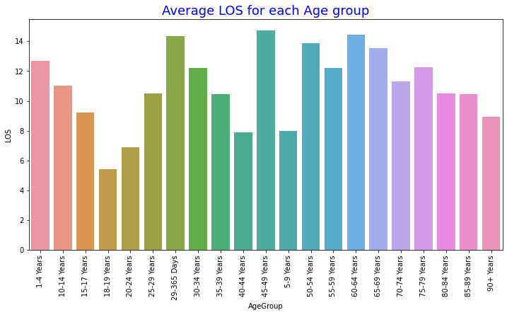
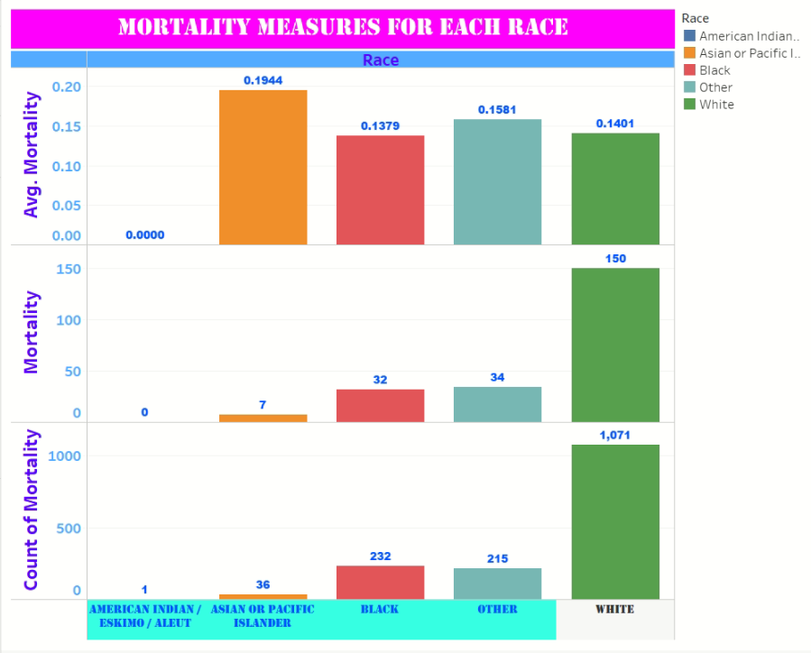
Results
We found that
The data set can be presented by a 2-D matrix (26430, 33)
However, the data set after cleaning has been reduced to
the 2-D matrix of the (1555, 32) size basically to missing values. Detailed analysis using Python (left) and Tableau (right) was made
Notes:
“Public health promotes and protects the health of people and the communities where they live, learn, work and play” (American Public Health Association, 2021).
As we many of the terms we will seek to define in this lecture, there is no shortage of definitions about what public health is or is not.
Public health is the United States is commonly thought of as a complex system, a social enterprise that provides essential public health services, with an underlying social justice philosophy.
But what sets public health apart from other social movements is its grounding in science.
There are five basic sciences integrated throughout the field of public health.
Epidemiology
Biostatistics
Environmental science
Management science
Behavioral science
Public health is often thought to be synonymous with prevention. And although prevention is considered by many to be the purpose of public health – prevention interventions vary widely. Prevention can target deaths, hospital admissions, days lost from school, and many others. There are as many targets for prevention as there are health outcomes.
Public health professionals are unique in that they do not have a common educational background but have a common goal or outcomes toward which to work.

Slide 5
Discussion
Our study shows that public health informatics can be a useful tool for the public data understanding , knowledge extraction and data interpretation. The data cleaning using Python substantially shrinked the data while the data visualization using Tableau demonstrated the features dependency due to high covariance between the features utilities. Statistical analysis allowed to calculate the main features and build regression models.
Notes:
Work together to prevent diseases and keep people safe and healthy
Both Public Health and Population Health are impacted by technology
Both use information system to glean health outcome measures
PoH outcomes include such measures as mortality, morbidity, quality of life utilization, and cost.
Health determinants are comprised of many elements such as genetic, behavior, clinical, social, and environmental determinants.
To date, the operations of PoH have been biased towards clinical determinants of health, but recently have increasingly expanded to include social and environmental determinants of health.

Slide 6
Introduction: frame the importance of the problem
The Texas Health Care Information Council (THCIC) was created by Chapter 108 of the Texas Health and Safety Code (THSC) and was responsible, under Sections 108.011 through 108.0135, for collecting hospital discharge data from all state licensed hospitals except those that are statutorily exempt from the reporting requirement.
The data represents a great deal of information and it is very important to understand the data using fundamental algorithms prior to process the data with advanced IT methods including predictive modeling tools.
Notes:
“Epidemiology is the study of the distribution and determinants of health-related states or events in specified populations, and the application of this study to the control of health problems” (CDC, 2016).
Epidemiology refers to the methods used to find the causes of health outcomes and diseases in populations. In epidemiology the patent is the community and individuals are viewed as a group.
An epidemiologist working for a public health department might be called upon to investigate the cause of a disease and to identify who is at risk. They also play a part in controlling, stopping, or preventing a disease from reoccurring.
Epidemiologists are often called disease detectives.
As disease detectives, epidemiologists track patterns in environmental exposures such as lead and heavy metals or air pollution. They also track infectious disease like foodborne illness, flu, and pneumonia. The work of epidemiologists has also led to the discovery of new diseases like Legionnaire’s disease, SARS, and COVID-19.

Slide 7
Literature review
Health Informatics: Practical Guide Seventh Edition
by William R. Hersh and Robert E. Hoyt
Public Health: What It Is and How It Works
by Guthrie S. Birkhead, Cynthia B. Morrow
These books provide the fundamentals of public health analytics including insights into public health data management
Notes:
The public health informaticist has multiple roles in the planning and designing of the information systems used in public health.
The public health informaticist serves as the liaison between all of the stakeholders that will be using the public health information system to develop a system that will meet everyone’s needs including the clinicians and patients.
The public health informaticist is also responsible for the implementation, maintenance, and evaluation of information systems used in public health.

Slide 8
State goal of the study
“Original: the goal of the sudy is:
to understand the data,
To estimate the data quality
To clean the data
To visualize the data
To perform fundamental statistical analysis
Including variance and covariance estimates

Slide 9
State goal of the study
Rooted in what group learned from Literature
Fundamentals of public and population health analytics
Public health data management

Slide 10
State goal of the study
Strive to make the project about what is not known versus what you don’t know.
We do not know: various artificial intelligence and machine learning algorithms used in decision support systems, prediction modeling, integration of public health information systems, etc.
What is not known: how to develop and use a new generation of information technologies, such as the internet of health things (loHT), big data, cloud computing, and low biased artificial intelligence, to make the traditional public health to more efficient, more convenient, and communities oriented.

Slide 11
Methods
Inclusion exclusion criteria for participants
Typical inclusion criteria include demographic, clinical, and geographic characteristics. In contrast, exclusion criteria are defined as features of the potential study participants who meet the inclusion criteria but present with additional characteristics that could interfere with the success of the study or increase their risk for an unfavorable outcome.
Notes:
Security standards – The HIPAA Security Rule was developed to protect health information and implement reasonable safeguards. Prior to HIPAA, there were no generally accepted standards for protecting patient health information.

Slide 12
Methods
Participant’s demographic characteristics
Pursuant to the THSC, DSHS excludes all direct personal and demographic identifiers (e.g., name, address, social security number, patient identifiers, admission and discharge dates) that might lead to the identification of a specific patient from the PUDF.
Notes:
Security standards – The HIPAA Security Rule was developed to protect health information and implement reasonable safeguards. Prior to HIPAA, there were no generally accepted standards for protecting patient health information.

Slide 13
Methods
Sampling procedures
Sample: a portion of the entire group (called a population)
Sampling procedure: choosing part of a population to use to test hypotheses about the entire population. Used to choose the number of participants, interviews, or work samples to use in the assessment process. used, e.g. random or stratified sampling
We used random sampling (age group) for regression analysis (polynomial regression) to predict LOS for other age groups
Notes:
Security standards – The HIPAA Security Rule was developed to protect health information and implement reasonable safeguards. Prior to HIPAA, there were no generally accepted standards for protecting patient health information.

Slide 14
Sample Size
AgeGroup LOS 0 1-4 Years 12.692308 1 10-14 Years 11.000000 2 15-17 Years 9.200000 3 18-19 Years 5.400000 4 20-24 Years 6.913043 5 25-29 Years 10.476190 6 29-365 Days 14.357143 7 30-34 Years 12.193548 8 35-39 Years 10.451613 9 40-44 Years 7.900000 10 45-49 Years 14.744681 11 5-9 Years 8.000000 12 50-54 Years 13.875000 13 55-59 Years 12.222222 14 60-64 Years 14.420513 15 65-69 Years 13.517949 16 70-74 Years 11.306667 17 75-79 Years 12.247368 18 80-84 Years 10.511811 19 85-89 Years 10.455357 20 90+ Years 8.950000
Notes:
Security standards – The HIPAA Security Rule was developed to protect health information and implement reasonable safeguards. Prior to HIPAA, there were no generally accepted standards for protecting patient health information.

Slide 15
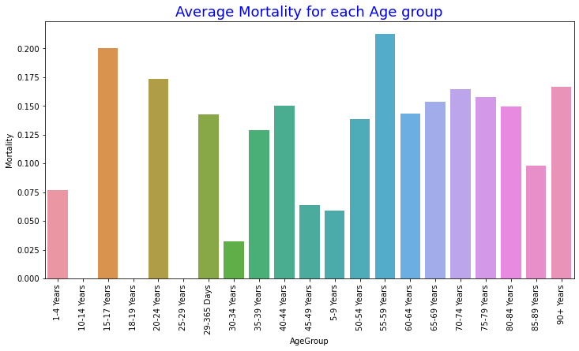
Measures and covariates (race)
Notes:
Security standards – The HIPAA Security Rule was developed to protect health information and implement reasonable safeguards. Prior to HIPAA, there were no generally accepted standards for protecting patient health information.

Slide 16
Methods
Data Collection
Hospitals submitted data no later than 60 days after the close of a calendar quarter. Depending on hospitals’ collection and billing cycles, not all discharges may have been billed or reported. This can affect the accuracy of source of payment data, particularly self-pay and charity that may later qualify for Medicaid or other payment sources.
Notes:
Security standards – The HIPAA Security Rule was developed to protect health information and implement reasonable safeguards. Prior to HIPAA, there were no generally accepted standards for protecting patient health information.

Slide 17
Results
Statistics and Data Analysis
Understand the nature of the data to be analyzed.
Explore the relation of the data to the targeted population.
Create a model to summarize an understanding of how the data relates to the underlying population.
Prove (or disprove) the validity of the model.
Employ predictive analytics to run scenarios that will help guide future actions.
Notes:
Security standards – The HIPAA Security Rule was developed to protect health information and implement reasonable safeguards. Prior to HIPAA, there were no generally accepted standards for protecting patient health information.

Slide 18
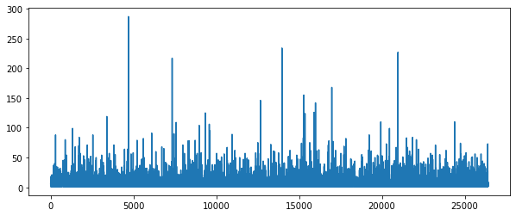
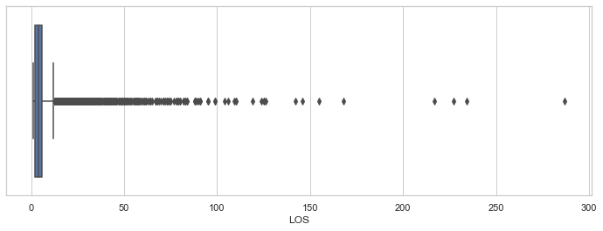
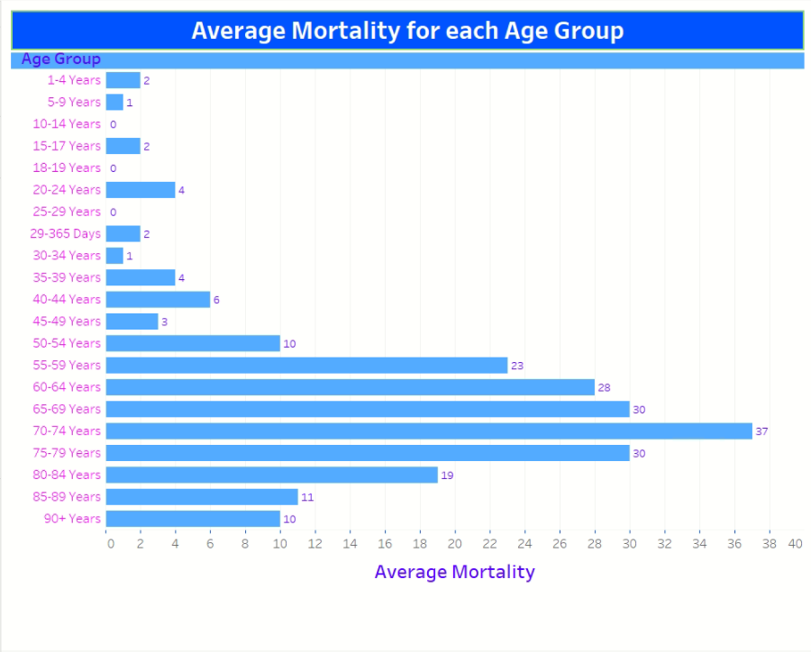
Results
Notes:
Security standards – The HIPAA Security Rule was developed to protect health information and implement reasonable safeguards. Prior to HIPAA, there were no generally accepted standards for protecting patient health information.

Slide 19
Results
Common stats in public health
Odds ratios (OR was calculated for each age group showing “protective exposure”
Chi squared test was applied to race and risk
of mortality (minor, average, major and extreme). The results support the null hypothesis
Correlations (The performed correlation analysis demonstrates a strong correlation between mortality and LOS
Logistic Regression
Notes:
Security standards – The HIPAA Security Rule was developed to protect health information and implement reasonable safeguards. Prior to HIPAA, there were no generally accepted standards for protecting patient health information.

Slide 20
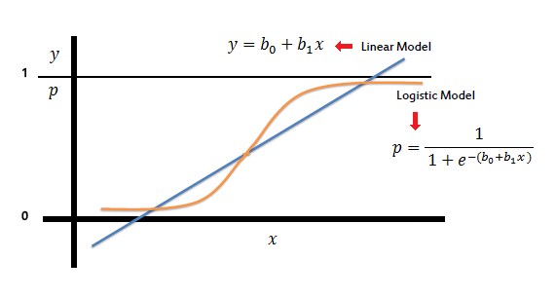
Logistic regression
Logistic regression (to estimate the risk (probability of mortality under the assumption of linear model)
Notes:
Security standards – The HIPAA Security Rule was developed to protect health information and implement reasonable safeguards. Prior to HIPAA, there were no generally accepted standards for protecting patient health information.

Slide 21
Discussion
Support of hypothesis
Interpretation
Implications
Correlations
Notes:
Security standards – The HIPAA Security Rule was developed to protect health information and implement reasonable safeguards. Prior to HIPAA, there were no generally accepted standards for protecting patient health information.

Slide 22
Thank you to organizers
It was an excellent bootcamp and we learned a lot!
Notes:
Now that we have discussed the need for standards and vocabulary for information systems to talk to one another, let’s discuss commonly used terms among health informatics professionals.
Listed on this slide are some key terms and acronyms each of you will want to be familiar with as a health care consumer and as someone interested in pursuing a career in public health informatics.

