Slide 1

GLOBAL AI HACKATHON | TEAM VISIONARIES
FreshCheck
Catch stale AI answers before they mislead you
AI often states old facts with full confidence. FreshCheck re-verifies every time-sensitive claim on the live web, shows the proof and fixes the answer. It works as a website, as an OpenAI-compatible layer in front of the Bifrost gateway, and as a tool inside Bifrost’s MCP Gateway.
Tavily #1 Stale-answer detector
Bifrost #4 Gateway integration
Dream . Innovate . Build
Team Members: Yogesh Mondhe, Khushi Wanjari, Ayush Kakulte

Slide 2




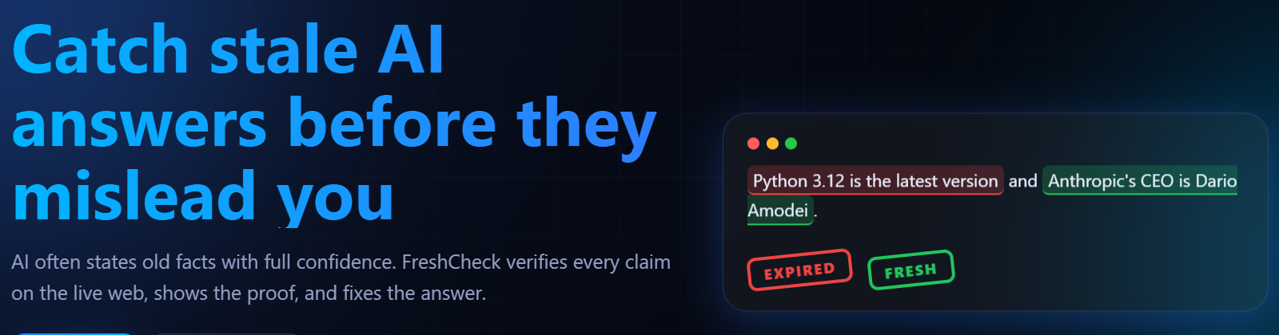
AI answers go stale, and still sound sure
Prices
Versions
AI models
Laws
“The latest iPhone is the iPhone 14.”
“Python 3.12 is the latest version.”
“ChatGPT runs on GPT-3.5.”
“The IPC is India’s main criminal law.”
Facts that change are the facts that hurt
These are real claims FreshCheck flagged in our tests. A user can’t tell which part of a confident answer is out of date.

Slide 3



FreshCheck verifies every fact that can change
STALE
For every claim you get
Outdated. Shows the correct current value and a source link.
A verdict: stale, fresh or unclear
A freshness score from 0 to 100
The correct, current value
An evidence quote and source link
A best-before date
A fixed version of the answer
FRESH
Confirmed current by a live source, with the proof quote.
UNCLEAR
Not enough evidence, so it is flagged instead of guessed.
Red = outdated Green = current Amber = unclear

Slide 4
Why FreshCheck is different
NOT ENOUGH
PARTIAL
OUR APPROACH
Plain AI answer
Normal web search
FreshCheck
Sounds sure, shows no proof
Knowledge stops at its training date
Cannot tell which facts have changed
Gives links, you do the reading
Old pages often rank above new ones
No verdict and no score
Finds only facts that can change
Recency probe looks for the update
Verdict, score, proof quote and a fix
FreshCheck checks an answer after it is written, and shows proof for every claim.

Slide 5







How FreshCheck works
STEP 1
STEP 2
STEP 3
STEP 4
STEP 5
Input
Extract
Search
Verify
Fix
Paste any AI answer, or ask a question.
Finds only facts that can change: prices, versions, leaders, laws.
Tavily live search plus a recency probe that looks for updates.
Proof quote checked inside the source. Score from 0 to 100.
Highlights, correct value, source link and a one-click fix.
A verdict without proof is never trusted. The evidence quote must really appear inside the source page.

Slide 6
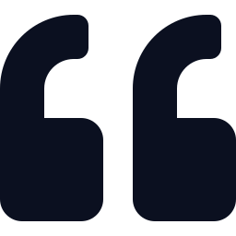







What you get in the app
Source proof
Explainable score
Time machine
Best-before date
Evidence quote and source link, checked inside the page.
0 to 100 with a “Why this score?” breakdown.
See how a fact changed over the years.
Each fact gets a shelf life: prices 30 days, laws 180.
Fix my answer
Compare models
Voice + languages
Share and export
Rewrites the answer using the current facts.
Which AI is the most outdated? Ask several at once.
Voice chat and read aloud in English, Hindi, Marathi, Hinglish.
Share link, PDF, copy or .txt. One-click demo traps.

Slide 7
Tavily #1: Stale-answer detector
What the problem statement asks, and what FreshCheck does
Takes any LLM answer
Paste text on the website, or call /v1/chat/completions with any model.
Flags claims likely to have gone stale
Extracts prices, versions, leaders and laws, and marks each STALE, FRESH or UNCLEAR.
Re-verifies against live sources
Tavily live search plus a recency probe. The proof quote is checked inside the source.
Freshness score per claim
A 0 to 100 score on every claim, with a “Why this score?” breakdown.

Slide 8


Bifrost #4: a feature for the gateway
MCP tool server
Freshness layer
Compare via gateway
FreshCheck is registered in Bifrost’s MCP Gateway as check_freshness, so models behind Bifrost can verify their own facts.
An OpenAI-compatible endpoint in front of Bifrost. Every reply carries x-freshcheck score and status headers.
One question to several models, all through Bifrost, to show which AI is the most outdated.
Bifrost MCP Catalog: freshcheck is Healthy, 1/1 tools enabled, 1/1 auto-execute
Bifrost MCP Logs: a model called check_freshness through the gateway and the call succeeded

Slide 9





Architecture: two ways into Bifrost
Flow 1 Freshness layer in front of Bifrost
Any app or website
FreshCheck
Bifrost gateway
Groq models
Paste an answer, or call the API
FastAPI: extract, verify, score
OpenAI-compatible, virtual key
gpt-oss-120b and gpt-oss-20b
Tavily live web search
Flow 2 Freshness tool inside Bifrost (MCP)
Model behind Bifrost
Bifrost MCP Gateway
FreshCheck /mcp
Tavily live web
asks to verify its own facts
tool: check_freshness
MCP server over HTTP
sources and proof quotes
Every LLM call in both flows goes through Bifrost, so the gateway keeps control of keys, models and logs.

Slide 10
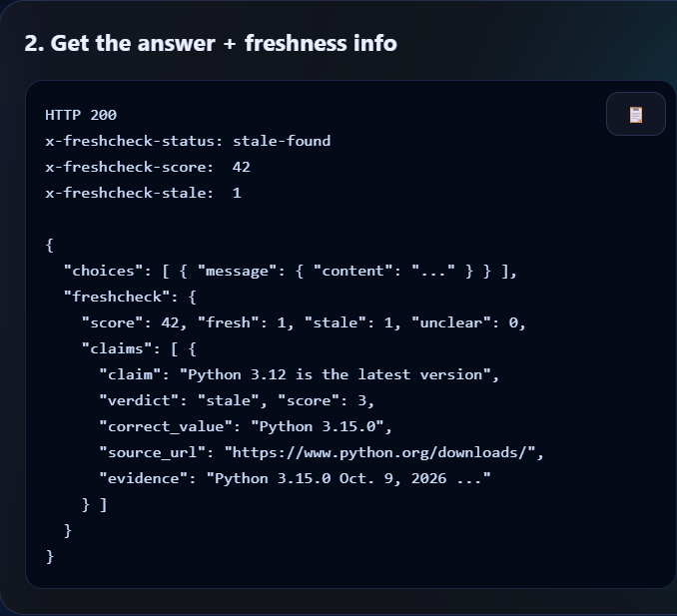
Drop-in for any app
1. Send a normal chat request
import requests
r = requests.post(
"http://127.0.0.1:8000/v1/chat/completions",
json={
"model": "groq/openai/gpt-oss-120b",
"messages": [{"role": "user",
"content": "What is the latest Python?"}]
},
timeout=180,
)
print(r.headers["x-freshcheck-status"])
print(r.json()["freshcheck"]["claims"])
2. Get the answer plus freshness info

Slide 11
Challenges we faced, and how we solved them
Old pages outrank new ones
Search often shows outdated pages first.
A recency probe: a second search aimed at updates and replacements, so the new fact appears in the results.
1
AI can invent proof
A model may quote evidence that is not there.
The evidence quote must really appear inside the source page, or the verdict is not trusted.
2
Live search credits are limited
Every check calls the Tavily API.
Search results and full checks are cached in files, so a repeated claim costs no new credits.
3
Some claims cannot be proven
A guess would mislead the user.
Those claims are marked UNCLEAR instead of guessed, and every score shows its plus and minus points.
4

Slide 12



Technology used
Languages
Frameworks and libraries
APIs and platforms
Python 3 (backend, evaluation)
JavaScript, HTML, CSS (web app)
Batch script (one-click start)
JSON (file cache and stats)
FastAPI and Uvicorn
Pydantic
OpenAI Python SDK (talks to Bifrost)
tavily-python
python-dotenv, requests
Tavily Search API
Bifrost AI gateway
Groq models: gpt-oss-120b, gpt-oss-20b
Model Context Protocol (MCP)
Browser Web Speech API

Slide 13
Project structure and endpoints
freshcheck/
+-- server.py web server, all endpoints
+-- extractor.py finds facts that can go stale
+-- verifier.py live search, verdict, score
+-- config.py Bifrost client, Tavily, cache
+-- mcp_server.py MCP tool: check_freshness
+-- index.html website, 4 languages, voice
+-- eval.py 12-case accuracy test
+-- run.bat starts Bifrost + FreshCheck
+-- test_*.py gateway, Tavily, MCP tests
API endpoints
POST /check
POST /ask
POST /fix
POST /history
POST /compare
GET /stats
POST /v1/chat/completions
POST /mcp
/v1/chat/completions is the gateway layer. /mcp is the Bifrost MCP tool.

Slide 14
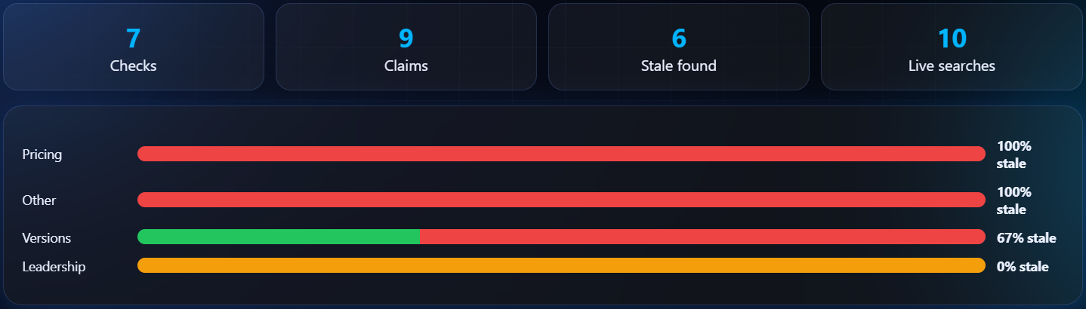
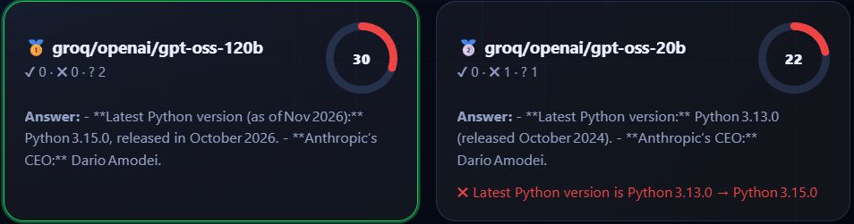
Results and proof
12/12
4
0-100
internal test cases correct (9 stale, 2 fresh, 1 timeless)
languages: English, Hindi, Marathi, Hinglish
explainable freshness score on every claim
Dashboard: which kinds of facts go stale most often. In our test checks, pricing and versions were the most often outdated.
Compare models: gpt-oss-120b scored 30 and gpt-oss-20b scored 22. FreshCheck flagged the 20b answer, which named Python 3.13.0.

Slide 15
Demo walkthrough: try it in 60 seconds
1
Pick a demo trap
One click loads a classic outdated AI answer.
REAL RESULT FROM OUR TEST
STALE
2
FreshCheck extracts the claims
Only facts that can change, like laws and versions.
15/100
3
Live search and verify
Tavily search plus recency probe, proof checked.
“Indian Penal Code (IPC) is the main criminal law in India”
Read the verdict
STALE flag, correct value and source link.
CURRENT VALUE
4
Bharatiya Nyaya Sanhita, 2023 (effective July 1, 2024) replaced the IPC.
5
Fix it or compare models
Rewrite the answer, or rank several AIs.
Proof: source link and evidence quote

Slide 16






Who uses it, and why it helps
Who will use it
Benefits
AI app builders
Add a freshness check to any chatbot through the gateway.
Trust
Any model
Students and researchers
Proof for every claim, not just a score.
Works with any model that runs through Bifrost.
Check AI answers before using them in work.
Businesses and support teams
Avoid wrong prices, rules and versions.
Lower cost
Explainable
Fact-checkers and everyday users
Result and search cache save Tavily credits.
Every score shows exactly why it was given.
Voice and Hindi, Marathi, Hinglish support.

Slide 17
Limits today, and what we build next
Honest limits today
What we build next
!
Needs internet and API keys
Live search and the gateway need Tavily and Groq keys.
1
Host it online
A public link so anyone can try it without setup.
!
Small test set
12 internal cases so far, so a bigger benchmark is next.
2
Browser extension
Check an AI answer right where you read it.
!
Depends on what search finds
If no source proves a claim, it is marked UNCLEAR.
3
Bigger benchmark
Hundreds of claims, more languages and fact types.
!
Runs locally for now
Start run.bat and open 127.0.0.1:8000.
4
Auto re-check
Re-verify a fact when its best-before date passes.

Slide 18



Thank you
Team Visionaries
Yogesh Mondhe
FreshCheck: catch stale AI answers before they mislead you
Team Member
yogeshmondhe84@gmail.com
Khushi Wanjari
github.com/yogeshx21/freshcheck
Team Member
khushiwanjari10@gmail.com
Ayush Kakulte
Run locally: start run.bat, then open 127.0.0.1:8000
Team Member
ayushkakulte818@gmail.com
Global AI Hackathon | Tavily #1 + Bifrost #4

