Slide 1

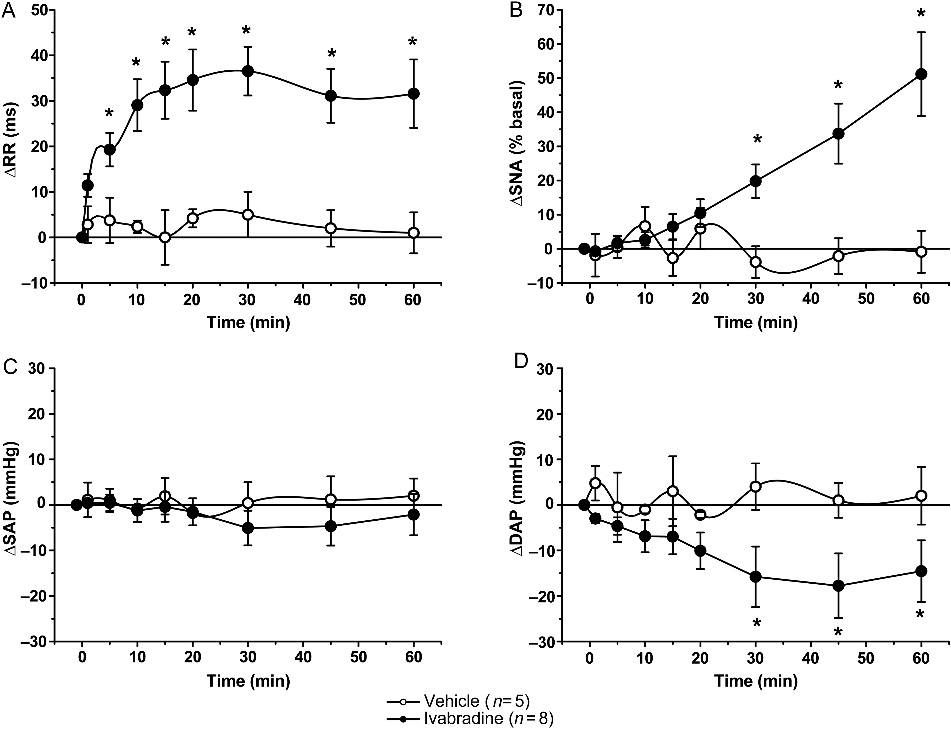

Figure 1 Mean values (±SEM) of IVA- (closed circles, n = 8) or VEH-induced (open circles, n = 5) changes in RR (A), ...
Notes:
Figure 1 Mean values (±SEM) of IVA- (closed circles, n = 8) or VEH-induced (open circles, n = 5) changes in RR (A), SNA (B), and SAP (C) and DAP (D) from animals with intact baroreceptor innervation. IVA or VEH administration started at time 0. Changes in sympathetic activity were expressed as % of the activity (in spikes/s) recorded under baseline conditions. *P < 0.05 vs. control VEH group.
Unless provided in the caption above, the following copyright applies to the content of this slide: Published on behalf of the European Society of Cardiology. All rights reserved. © The Author 2015. For permissions please email: journals.permissions@oup.com.

