Slide 1
Haptic Fitness CSED404 Final Presentation
Team TCPs / Member Chan-ki Hwang & Taeyeon Kim

Slide 2


Vibration feedback to user’s action
Real-time
No delay between vibratory feedbacks
Directive
set proper Vibration patterns according to range
Dynamic feedback on specific event, interval…
Attach on the body to fetch user’s position

Slide 3


Current Implementations
VibrationEffect
For various strength of feedback
Modular
Baseline had implemented!
(Acceleration Condition) → (Vibration Pattern?)

Slide 4
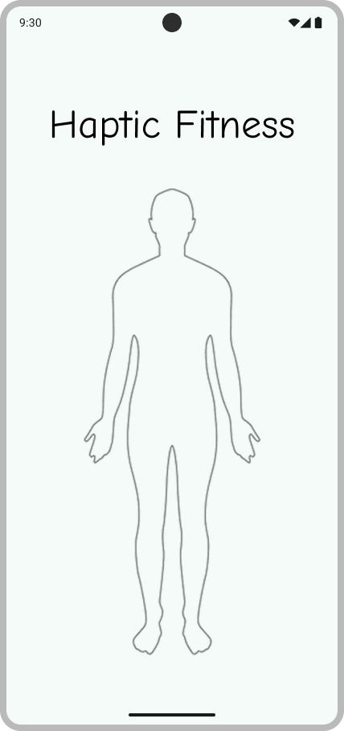
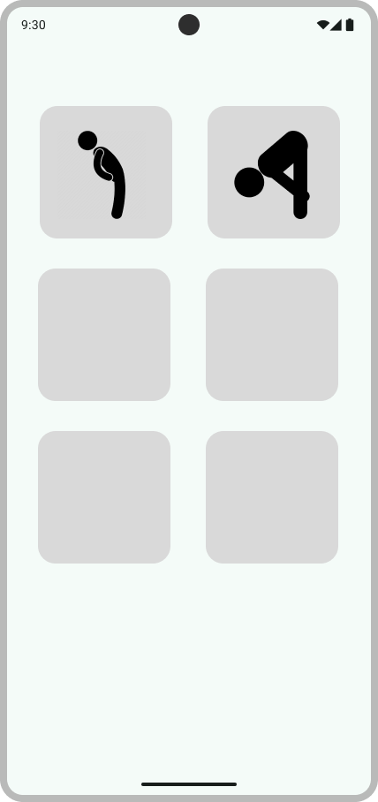
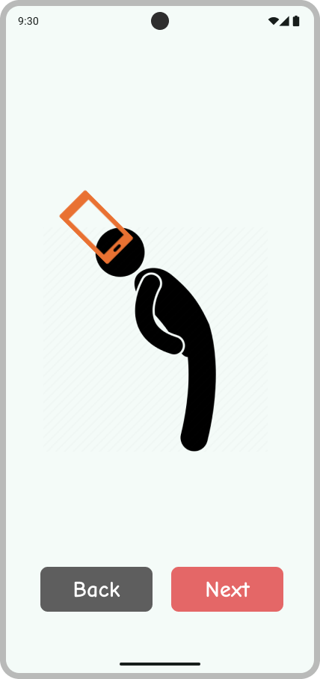
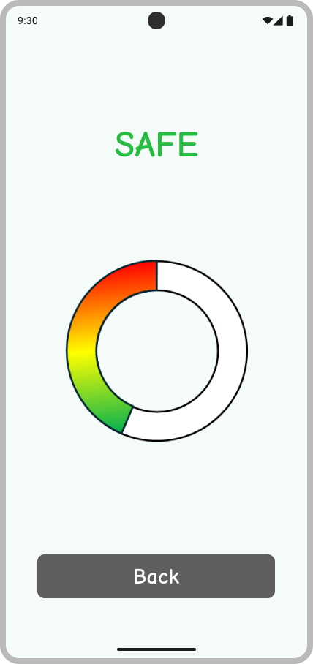
Basic UI

Slide 5
Code Implementation
CreateView
Sensor Init
S
S
Vibrator Init
V
V
Thread Init
Th
Th
DestroyView

Slide 6
Code Implementation
CreateView
Sensor Handling
Looper
Vibration Generate
Looper
Sensor Init
Vibrator Init
onSensorChanged
post
post
Array<> .forEach
VibratorManager. vibrate
Thread Init
Array<(Int) -> CombinedVibration?>
pattern
DestroyView

Slide 7
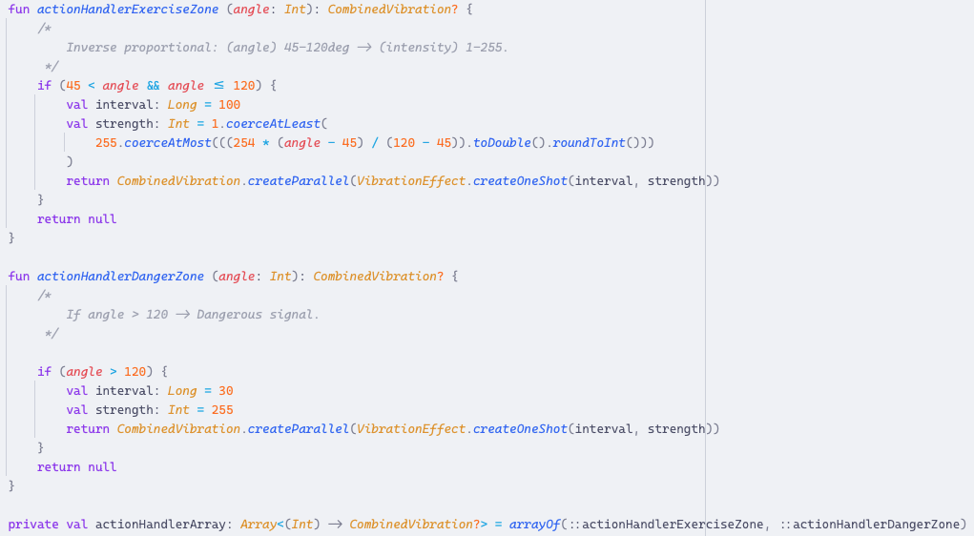
Code Implementation
Modularity!

Slide 8



Examples
TOGGLE_ON
TOGGLE_OFF
TOGGLE_ON
TOGGLE_OFF
REJECT
“SAFE”
“MORE”
REJECT
“MORE”
“SAFE”
Start/Stop Exercise
Start/Stop Exercise
REJECT
“DANGER”
REJECT
“DANGER”

Slide 9

Examples
TOGGLE_ON
TOGGLE_OFF
REJECT
“SAFE”
“MORE”
REJECT
“DANGER”
Start/Stop Exercise

Slide 10

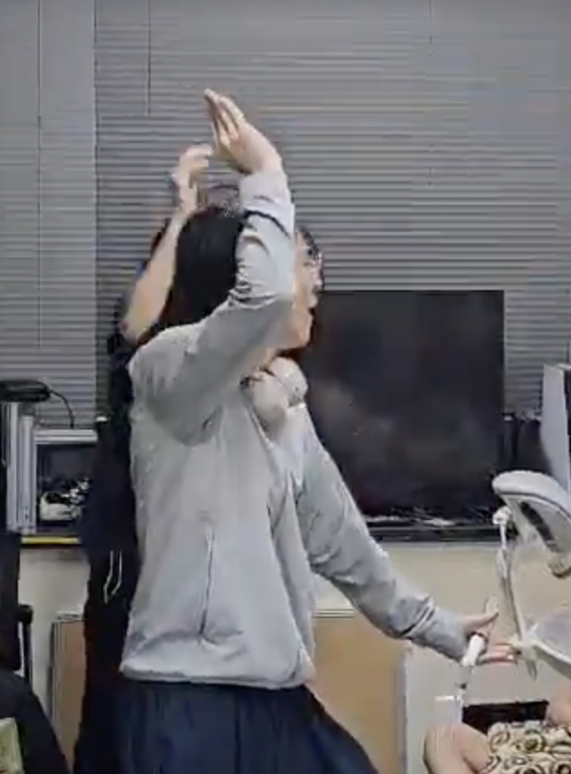

Rhythm Fitness?
APTIC
WE DID IT!

Slide 11
Rhythm Fitness

Slide 12
Demo Video

Slide 13
Thanks for Listening!

