Slide 1
CSED404 Proposal Presentation
Team TCPs 20200854 Hwang Chanki / 20220140 Kim Taeyeon

Slide 2
Contents
Ideation
Basic Concepts
How?
Effects

Slide 3
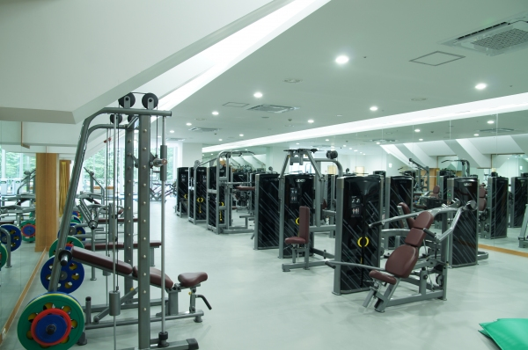

Ideation
Notes:
There are two big ways to exercise for us. One is going to gym offline, and another one is just watching related videos and follow them at home.

Slide 4
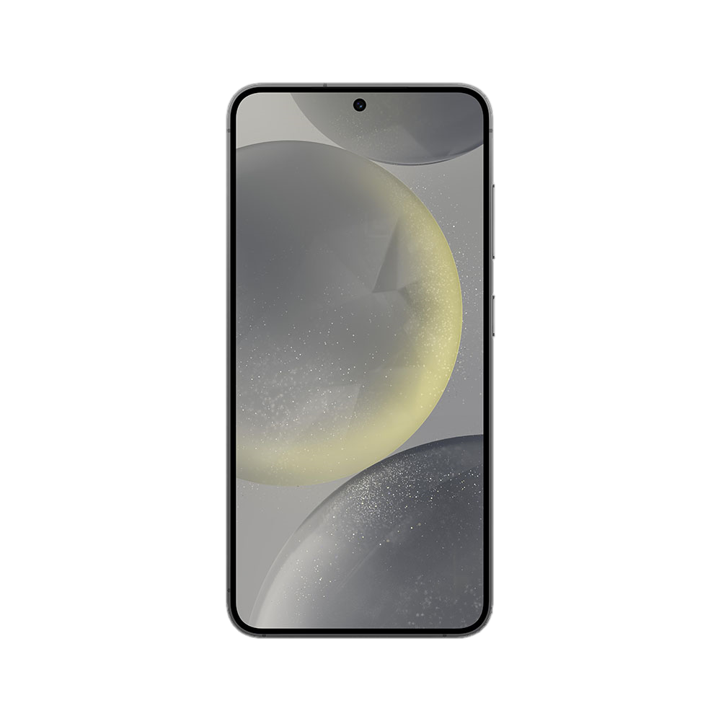


Ideation
Notes:
In case when we watch videos to exercise, there are two ways, listening sounds or watching the screen. However, both methods have disadvantages. We can’t concentrate on the screen while exercising, and we can’t check whether we are doing right only listening sounds.

Slide 5
Ideation
(대충 Wii Fit / Wii Sports 하는 사진)

Slide 6
Basic Concepts

Slide 7
How?

Slide 8
Effects

