Slide 1
Haptic Fitness CSED404 Mid-term Presentation
Team TCPs / Member Chan-ki Hwang & Taeyeon Kim

Slide 2
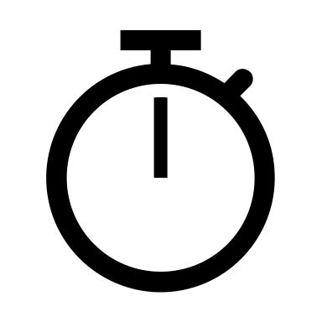

Haptic feedback to user’s action
Real-time
No delay between vibratory feedbacks
Directive
Various haptic patterns provided by system
Dynamic feedback on specific event, interval…
Attach on the body to fetch user’s position

Slide 3
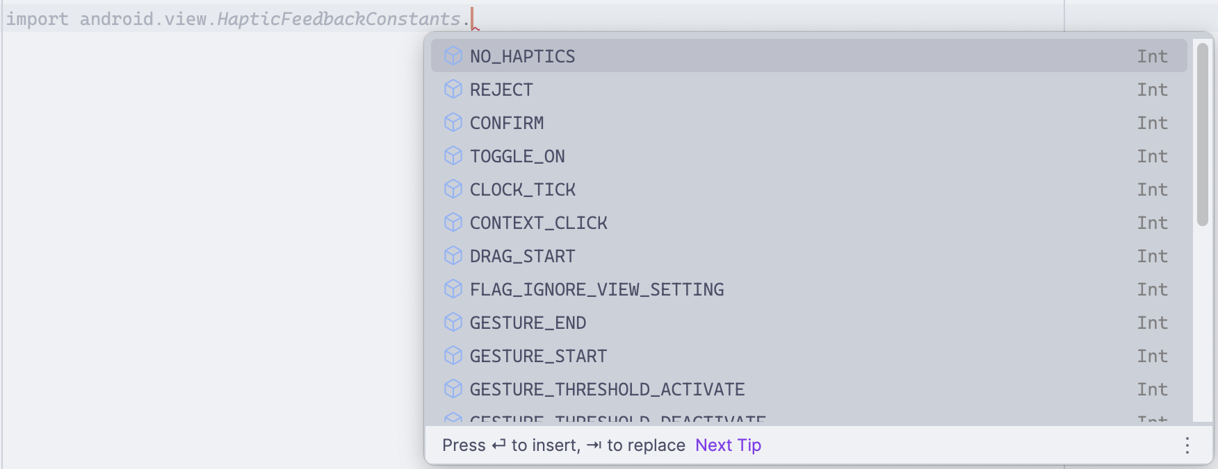

Haptic feedback to user’s action
Haptics
Pre-“designed” Haptic Patterns
- Available at android.view.HapticFeedbackConstants

Slide 4
Haptic feedback to user’s action
Supposed to implement haptic with
android.view.performHapticFeedback → Failed!

Slide 5
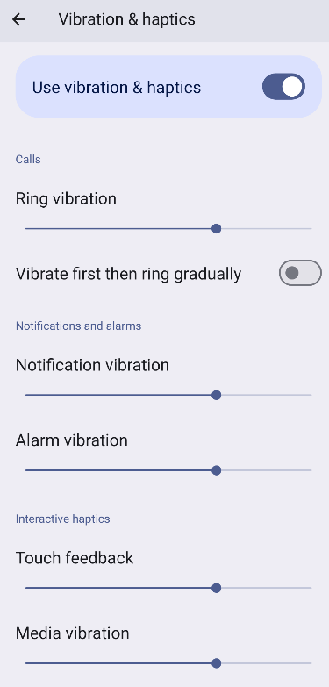
Vibration feedback performHapticFeedback Failure
Strength of haptic feedback is globally controlled.
(Cannot apply various strength of haptic feedback)
↓
Use Vibration instead of Haptics!

Slide 6
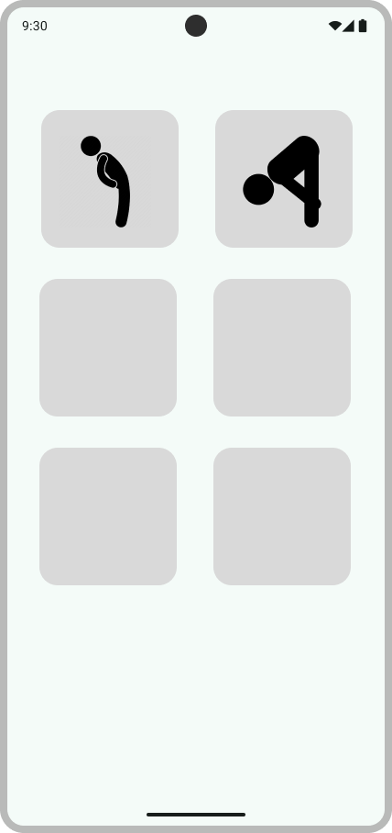
Code Implementation
CreateView
Sensor Init
S
S
Vibrator Init
V
V
Thread Init
Th
Th
DestroyView

Slide 7
Code Implementation
CreateView
Sensor Handling
Looper
Vibration Generate
Looper
Sensor Init
Vibrator Init
onSensorChanged
post
post
Array<> .forEach
VibratorManager. vibrate
Thread Init
Array<(Int) -> CombinedVibration>
pattern
DestroyView

Slide 8
Code Implementation
CreateView
Sensor Handling
Looper
Vibration Generate
Looper
Sensor Init
Vibrator Init
onSensorChanged
post
post
Array<> .forEach
VibratorManager. vibrate
Thread Init
Array<(Int) -> CombinedVibration?>
pattern
DestroyView

Slide 9
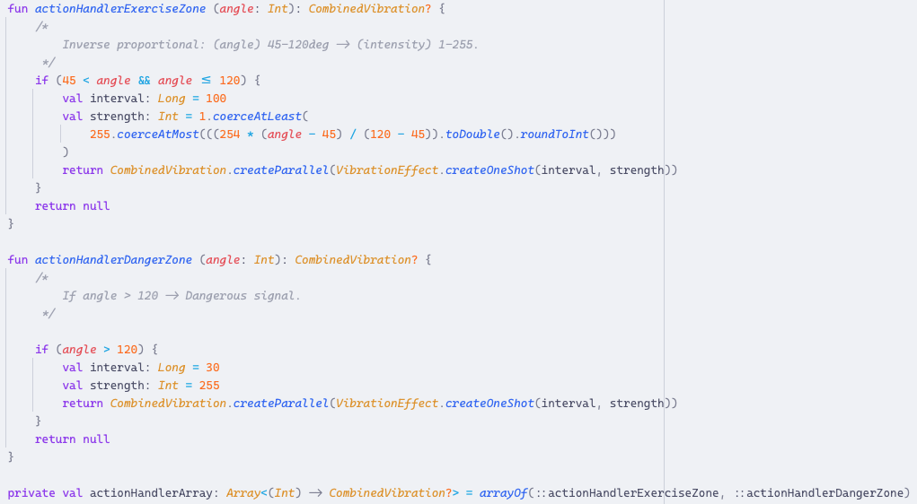
Code Implementation
Modularity!

Slide 10


Example – Back Stretch
TOGGLE_ON
TOGGLE_OFF
REJECT
“MORE”
“SAFE”
Feedback on Event
Between “SAFE” & “MORE” zone
Start/Stop Exercise
REJECT
Dynamic Feedback on Interval
Stronger REJECT pattern as back goes deeper
“DANGER”

Slide 11
Next Plan
Apply on various Fitness Activities and Vibration Patterns
Implement various functions of type (Acceleration Condition) → (Vibration Pattern?)
Implement Basic UI
Adding Sound – Rhythm Haptic?

Slide 12


Current Implementations
HapticFeedback to VibrationEffect
For various strength of feedback
Modular
Baseline had implemented!
(Acceleration Condition) → (Vibration Pattern?)

Slide 13

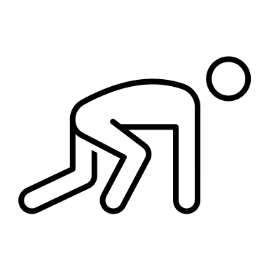

Apply on Activities
Accelerations
Vibration Pattern
Int
createOneShot()
CURRENT
FloatArray
createWaveForm() /
startComposition().addPrimitive()
POSSIBLE
3D Angle, 3D Acceleration ….

Slide 14
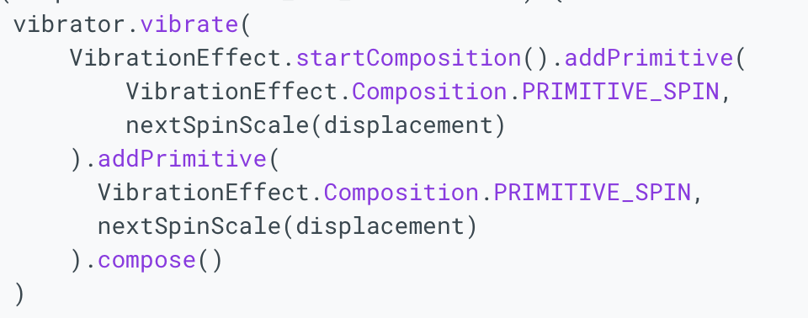
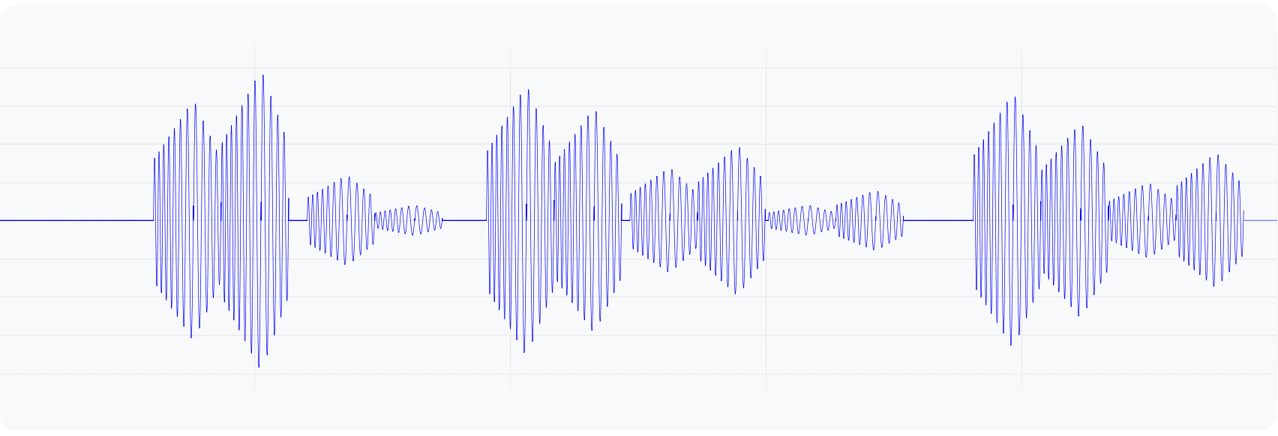
Apply on Activities Vibration Pattern Creation
createWaveForm(
timing: LongArray,
amplitudes: IntArray
)
startComposition().addPrimitive()
“Wobble” Effect of Android Example

Slide 15
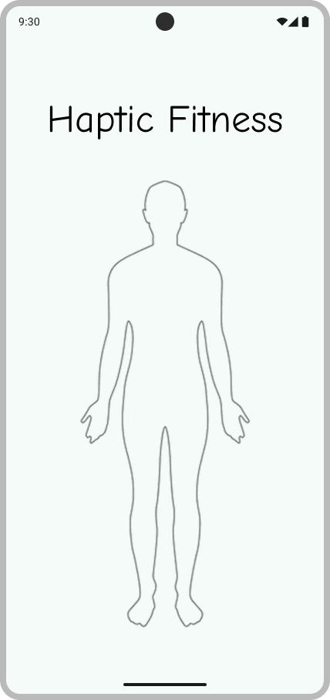
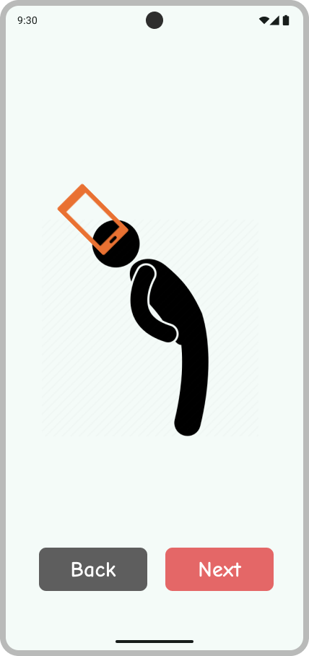
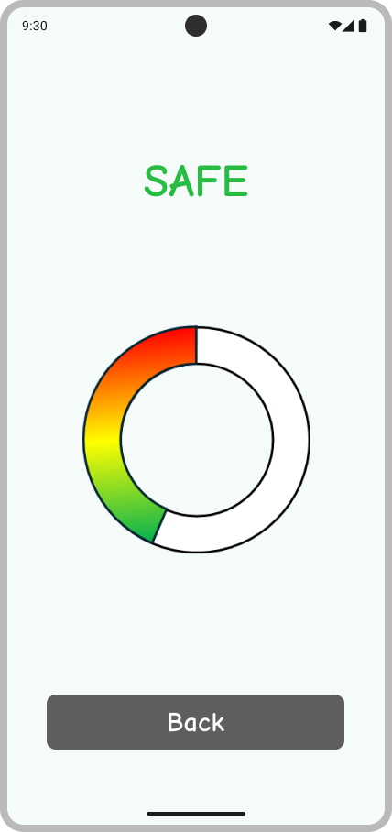
Basic UI

Slide 16
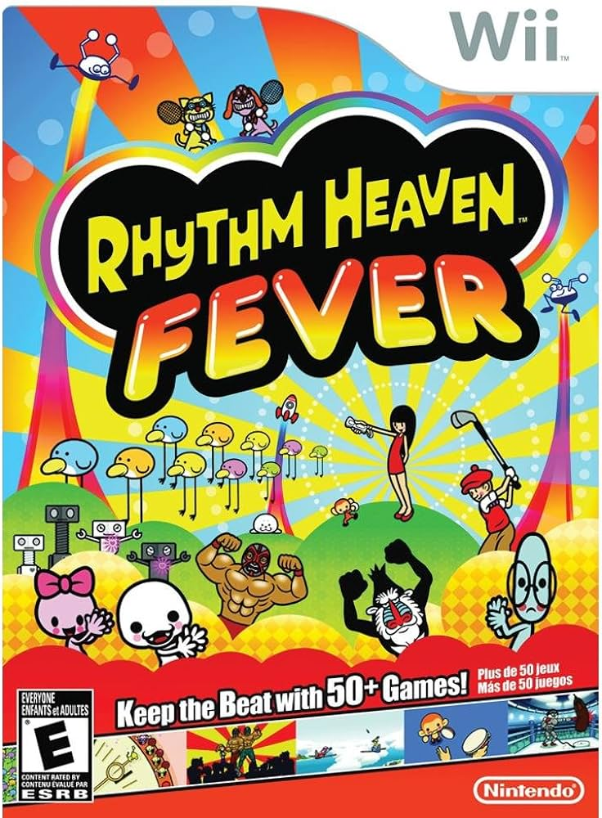
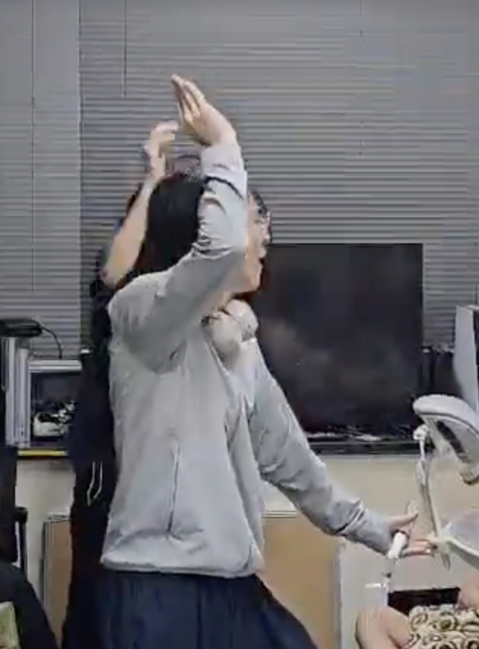

Rhythm Fitness?
APTIC

Slide 17
Demo with device!

Slide 18
Thanks for Listening!

