Slide 1
Haptic Fitness CSED404 Mid-term Presentation
Team TCPs / Member Chan-ki Hwang & Taeyeon Kim

Slide 2


Haptic feedback to user’s action
Real-time
No delay between vibratory feedbacks
Directive
Various haptic patterns provided by system
Dynamic feedback on specific event, interval…
Attach on the body to fetch user’s position

Slide 3
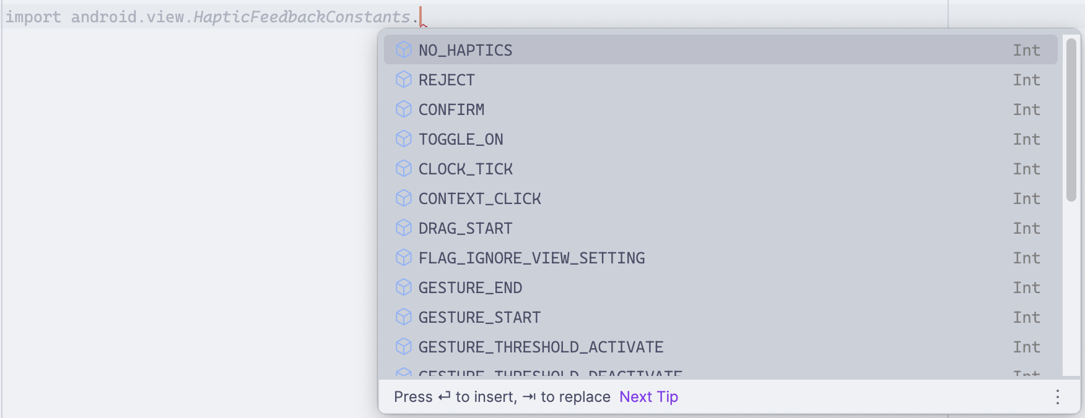

Haptic feedback to user’s action
Haptics
Pre-“designed” Haptic Patterns
- Available at android.view.HapticFeedbackConstants

Slide 4
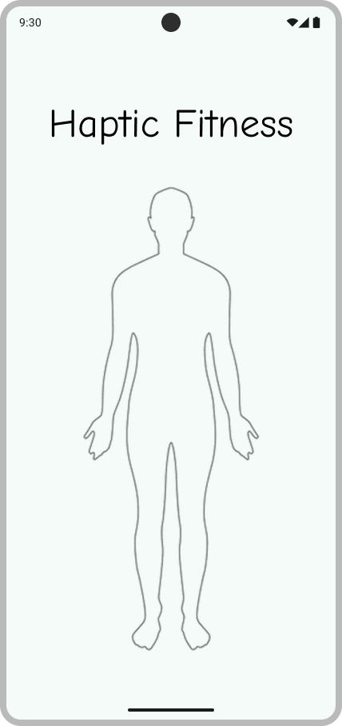
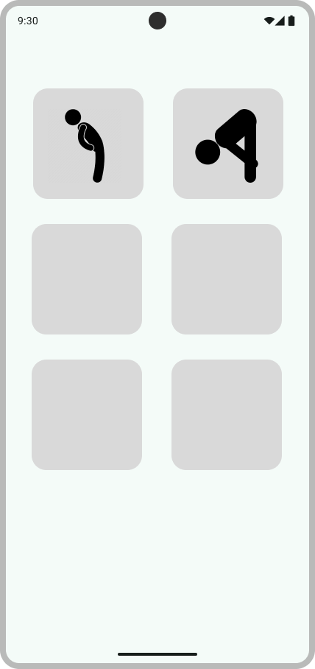
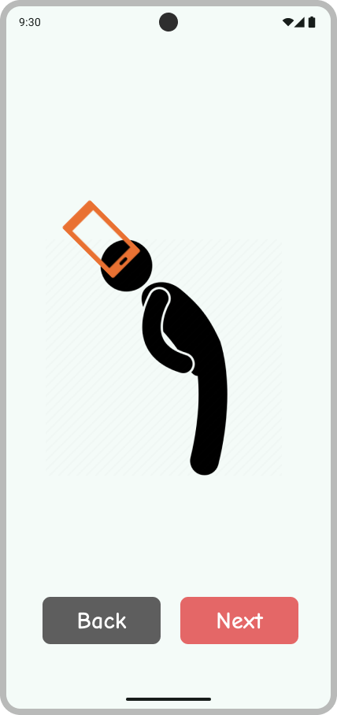
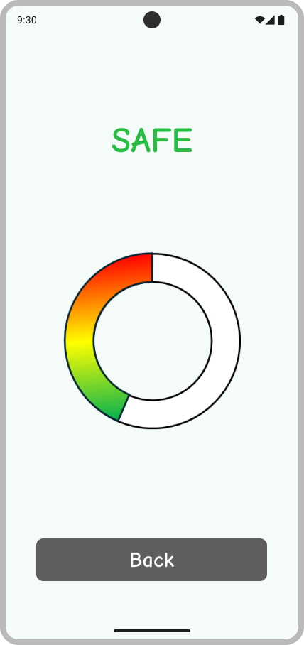
Basic UI

Slide 5
Code Implementation

Slide 6
Code Implementation

Slide 7
Code Implementation

Slide 8


Example – Back Stretch
TOGGLE_ON
TOGGLE_OFF
REJECT
“MORE”
“SAFE”
Feedback on Event
Between “SAFE” & “MORE” zone
Start/Stop Exercise
REJECT
Dynamic Feedback on Interval
Stronger REJECT pattern as back goes deeper
“DANGER”

Slide 9
Thanks for Listening!

