Slide 1
Haptic Fitness CSED404 Mid-term Presentation
Team TCPs / Member Chan-ki Hwang & Taeyeon Kim

Slide 2


Haptic feedback to user’s action
Real-time
No delay between vibratory feedbacks
Directive
Various haptic patterns provided by system
Dynamic feedback on specific event, interval…
Attach on the body to fetch user’s position

Slide 3
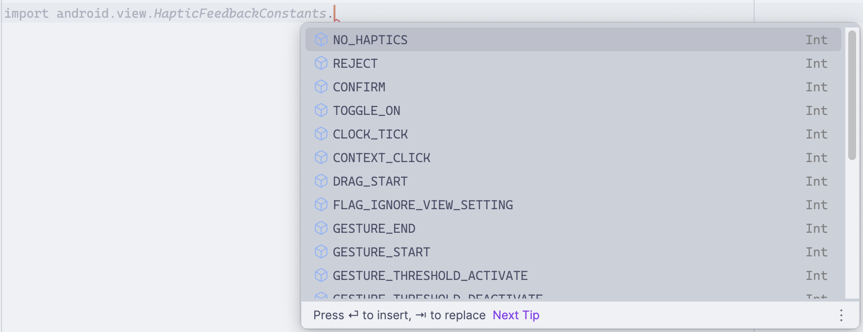

Haptic feedback to user’s action
Haptics
Pre-“designed” Haptic Patterns
- Available at android.view.HapticFeedbackConstants

Slide 4
Code Implementation
발표 흐름 1. 지난 번에 우리가 Haptic Fitness 한다고 했음
2. 그때 햅틱에 대해 이렇게이렇게 적용하겠다 했는데 그래서 구현한거 설명함
3. 구현 설명 끝나면 실제 예시 (허리피기 만든거) 보여주거나 직접 시키며 소개
4. Next Plan (앞으로 할 것들) – 이 때 Activity 추가 / UI 개선 / 음악 도입? 설명 예정
전체적인 구현 & Haptic 설명

Slide 5


Example – Back Stretch
TOGGLE_ON
TOGGLE_OFF
REJECT
“MORE”
“SAFE”
Feedback on Event
Between “SAFE” & “MORE” zone
Start/Stop Exercise
REJECT
Dynamic Feedback on Interval
Stronger REJECT pattern as back goes deeper
“DANGER”

Slide 6
Next Plan
Apply on various Fitness Activities
Implement Basic UI
Adding Sound – Rhythm Haptic?

Slide 7
Fitness Activities
이때까지 개발한거 적용 가능한 Activity icons

Slide 8
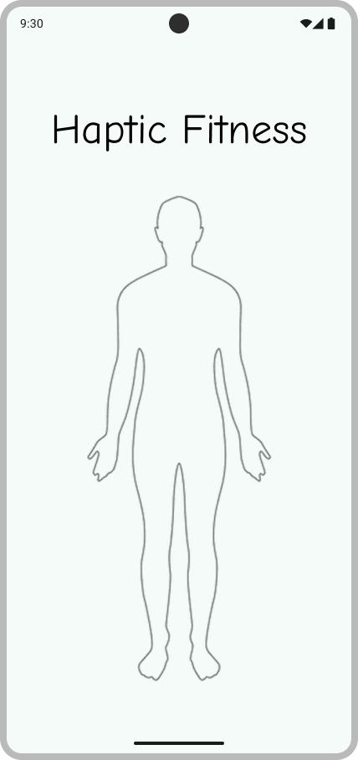
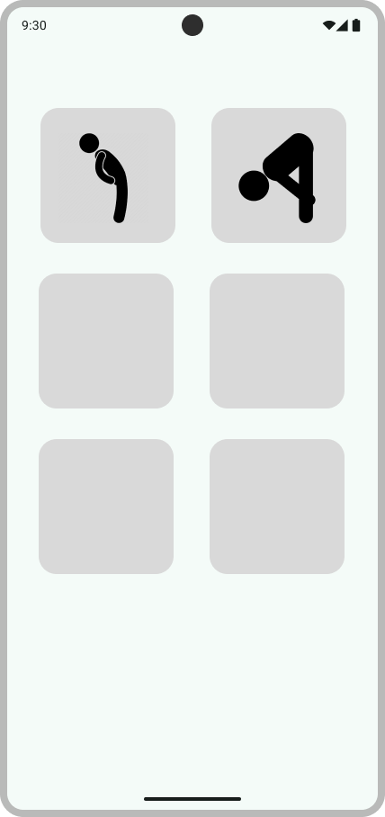
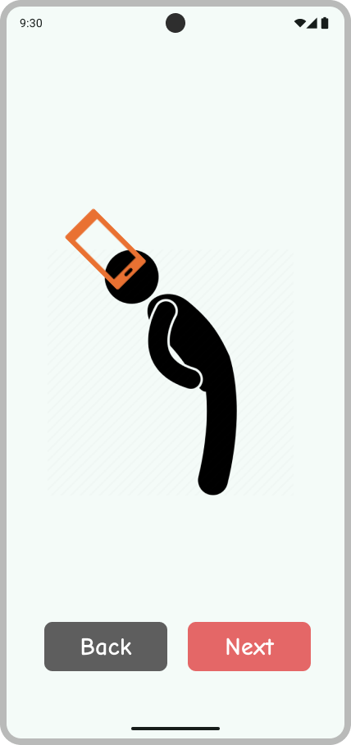
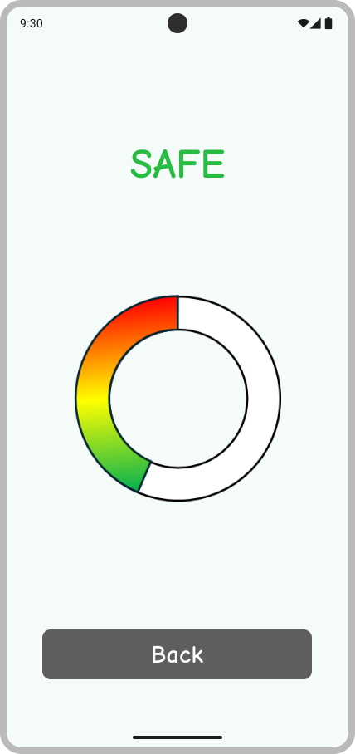
Basic UI

Slide 9

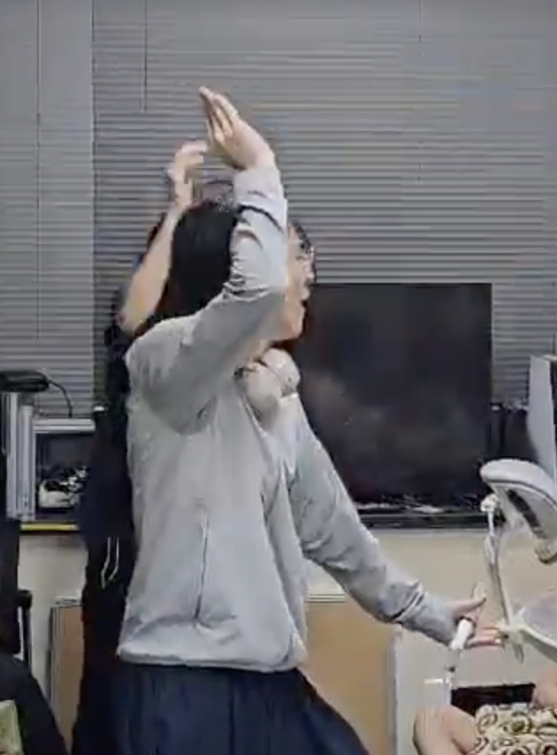

Rhythm Fitness?
APTIC

Slide 10
Thanks for Listening!

