Slide 1

GO! an ontology for the geographical knowledge contained in classical Latin texts
Maurizio Lana
A place for places Workshop
DH2016 Conference, Krakow

Slide 2


Geolat geography for Latin literature
Geolat is a research project aimed at offering access to a digital library* of the Latin literature (from its origins to the end of the Roman Empire) through a query interface of geographic/cartographic type representing the geographic knowledge expressed in the texts themselves
* see digilibLT- www.digiliblt.unipmn.it
the project is funded by Fondazione Compagnia di San Paolo
3

Slide 3
Geolat geography for Latin literature
the members of our research group:
historians (gabriella vanotti), philosophers of mind, of science and other (cristina meini, margherita benzi, timothy tambassi), computer scientists (diego magro), latin scholars (alice borgna), geographers (raffaella afferni), comparatists (fabio ciotti), library & information science (maurizio lana)
and last but not least we work with three professional ontologists: claudia corcione, paola de caro, silvia naro, who are the authors of the ontology
3

Slide 4
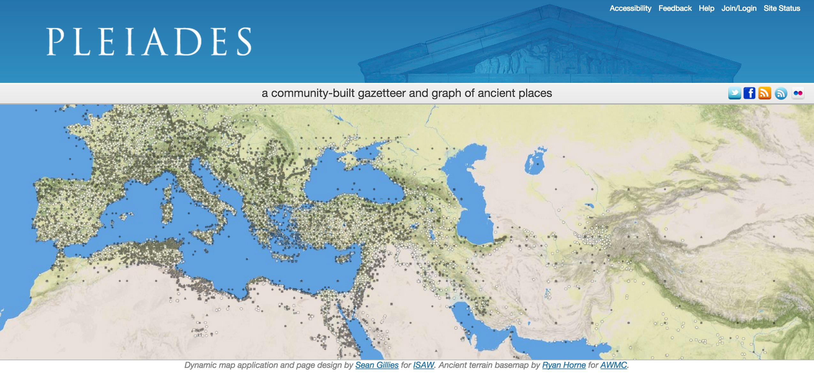

relevant similar projects
Pleiades
pleiades.stoa.org
Pelagios
pelagios-project.blogspot.co.uk
4
Notes:
Geolat adopts a geographical ontology for the human-made annotation of the placenames in the texts,ile Pelagis adopts an approach parsing+NER

Slide 5
why using ontologies ?
describing (aspects of) the content of a text using the categories (the classes) of an ontology allows:
to act in the text as interpreters (writing the annotation itself)
to do searches based on some type of mixed reasoning (“which are the fresh waters occurring in the works of Augustan writers?”)
to build factual connections among different texts – so putting them in relation beyond times (which places of Roman Antiquity are mentioned in French Renaissance texts?)
5

Slide 6
GO!: the Geolat Ontology
general aims:
accessibility (both for the scientific community and for general public);
informativeness;
completeness;
reuse and interoperability.
6

Slide 7
GO! the Geolat Ontology
find it here:
• https://w3id.org/geolit/ontologies/GO-TOP
• https://w3id.org/geolit/ontologies/GO-PHY
• https://w3id.org/geolit/ontologies/GO-HUM
• https://w3id.org/geolit/ontologies/GO-FAR
6

Slide 8
GO! reuse and interoperability
reuse:
the ontology is made of 4 different modules which can be used alone
there are horizontal modules collecting shared features (TOP) and vertical modules which go into detail of a given subdomain (HUM, PHY, FAR)
interoperability:
GeoSPARQL, which is an OGC (Open Geospatial Consortium) standard is imported and reused
the mapping with some of the most relevant geographical ontologies (or containing a relevant geographical part) is declared
7

Slide 9
GO!: the Geolat Ontology
specific aim:
describe geographical information contained in Latin texts – the first development started from the analysis of Caesar, Sallust, Tacitus, Lyvi, Ammianus Marcellinus;
provide an inventory of classes and relation in order to annotate semantically Latin texts
8

Slide 10
GO!: some necessities
GPS coordinates of the places; and actual names if any
evolution of a given place (e.g. from village to city)
historical events description
physical and geopolitical description of a given place
connection with places data in Pleiades
management of imaginary places
connection with the Open Annotation ontology to cite the passages
connection with the Barrington Atlas
9

Slide 11
GO! faces some problems
we can distinguish three different kinds of problems dealt with by ancient geographers, which share lack or vagueness of available data and information, and assume a central role in GO:
topological problems (we must correctly interpret the descriptions of the places – more correctly than ‘before’);
source problems (lack of reliability and homogeneity of some data, disagreement among different authors, etc.);
methodological problems (heterogeneity of aims, points of view, interpretations and perspectives, use of assumptions and models representing cosmos, attempts to make the data more consistent, etc.).
10

Slide 12
GO! modules (OWL2)
Top
Phy
Far
Hum
11

Slide 13
GO-TOP
contains the most general classes and properties, which would be repeated
in all the other modules
Imported Ontologies
Geosparql
12

Slide 14
Object Properties
about space: above, below, borderToTheEast, borderToTheNorth, borderToTheSouth, borderToTheWest, hasLocation, hasRealPlace, hasSRID, identify, inPlace, inSRID, isUnder, leftOf, nearby, rightOf, visibleFrom, beginningPlace, endingPlace, partOf.
about time: after, before, occurIn.
about names: deriveFrom (it describes how the meaning of a placename depends/is derived from another name or entity), hasNAme, nameOf.
about actors: becomes, wins, composedBy (it describes by which persons/parties/populations an alliance/formation/line-up is made), owns, foughtBetween (it connects a battle with the involved parties), hasPath, hasStopOver(it allows a journey path to be subdivided into legs), involves, isStopOverOf (it indicates a leg of a path/route), objectOf, subjectOf (see the external doc explaining the ontology, sect. 4.1.3), to, by, passesThrough, controls, belongsTo.
about measurement: hasLength; measuredBy (it connects a lenght to a unit of measure).
15

Slide 15
Data Properties
about space: latitude, longitude.
about time: beginningPeriod, temporalPeriod, endingPeriod, inDate, validSince, validUntil .
about names: etymology, name.
about measurement: hasValue.
16
Notes:
valid …: queste ultime due proprietà servono a legare un’entità geografica antropica, spesso a carattere istituzionale e convenzionale ad una data o un periodo in cui tale istituzione/convenzione è valida)
etymology serve a legare al nome delle entità la rispettiva definizione etimologica), name (è una proprietà molto generica, per la quale non è stato specificato né dominio né codominio, proprio perché può essere legata a qualsiasi classe e contenere valori diversi, sia numerici che non)
has value assigns connects an entity della classe lunghezza and a numeric value

Slide 16
GO-PHY
Include a taxonomy of all Geographic entities that can be found in nature
Imported Ontologies
GO-TOP, Geosparql
17

Slide 17
GO-HUM
Includes a taxonomy of all Geographic Features produced by humans
Imported Ontologies
GO-TOP, Geosparql
19

Slide 18
GO-FAR
describe all Geographic Features produced by humans during ancient times, especially by ancient Romans
Imported Ontologies
GO-TOP, Geosparql
21

Slide 19
growing Geolat: more ontologies / more literatures
the keywords are extending:
extending the ontology-based annotation of texts from the Latin one to other literatures;
and to expanding:
expanding the ontology from the domain of the geography to the domain of the persons and their roles; and to the domain of the events and times
24

Slide 20
thank you
26

