Slide 1




Extracting and visualising geographies in textual documents
Christopher Donaldson
University of Birmingham
c.donaldson@bham.ac.uk

Slide 2
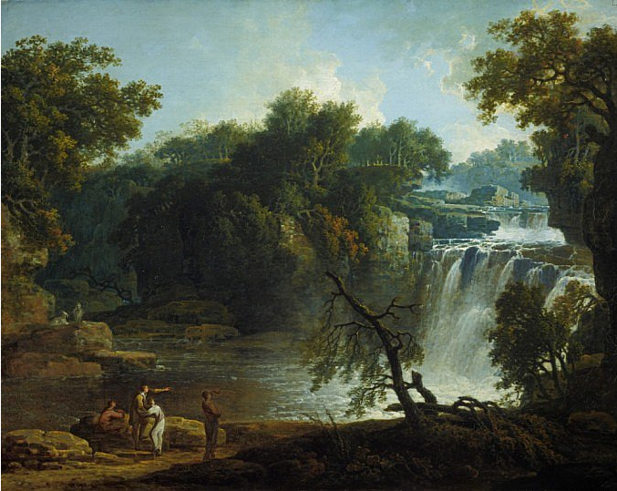
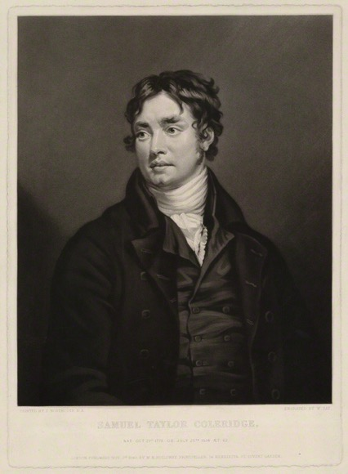
Falls of Clyde, Cora Linn
by Jacob More
Oil on canvas (1771)
National Galleries of Scotland: NG 1897
Samuel Taylor Coleridge
by William Say, after James Northcote
mezzotint (1840)
National Portrait Gallery: NPG D32122

Slide 3
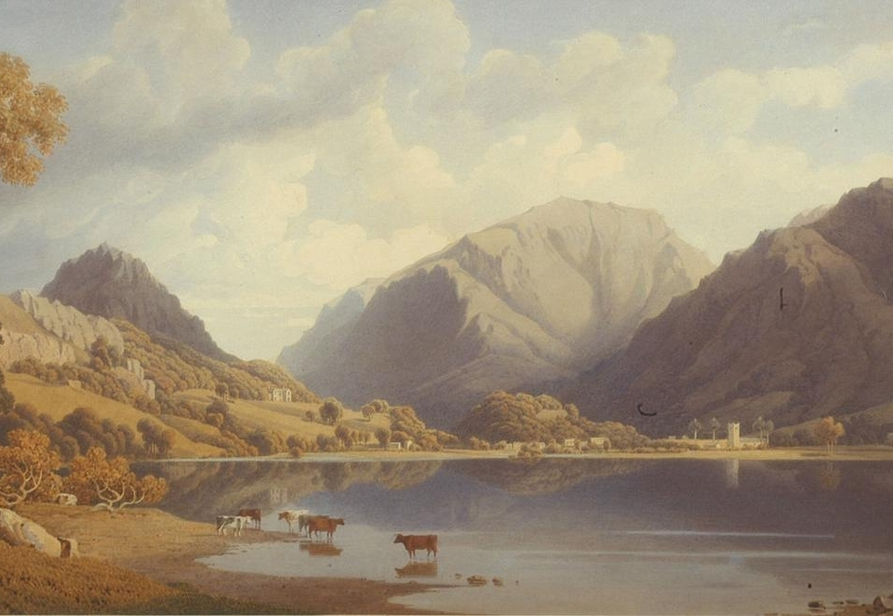
George Fennel Robson, Grasmere (1830) Wordsworth Trust: GRMDC.B179

Slide 4
Corpus of Lake District Literature
80 texts, comprising more than 1,500,000 words
Mixture of canonical and non-canonical literature about the Lake District, mainly from c18 and c19 (78 out of 80 works)
Mixture of genres, including guidebooks, travelogues, novels, poems, journals, and private letters
1688
←22 Texts→ 250K words
1789
←34 Texts→
650K words
1837
←22 Texts→
613K words
1901

Slide 5
Sample sentence collocation: beautiful
‘Again entering the boat, we passed up the channel between Lord’s Island the shore, from whence beautiful prospects are obtained of the majestic form of Skiddaw, with the woods of Castlehead and Cockshot Park in the foreground.’ (Edward Baines, A Companion to the Lakes [1829] 121.)
±5 tokens: No place-names identified
±10 tokens: 2 place-names identified – Lord’s Island & Skiddaw
Within sentence: 4 place-names identified – Lord’s Island, Skiddaw, Castlehead & Cockshot Park.
Average sentence length
Lake District corpus = 29.8 words
British National Corpus (BNC) = 16 words

Slide 6
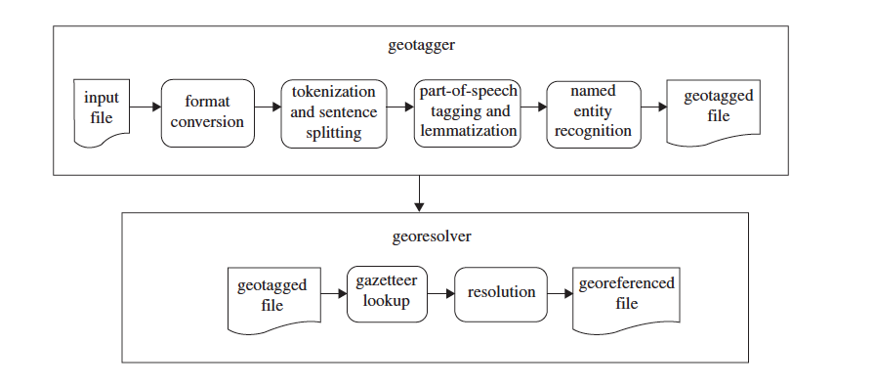
Diagram of the Edinburgh Geoparser System
from C. Grover, et al., ‘Use of the Edinburgh Geoparser for Georeferencing Digitized Historical Collections’, Phil. Trans. R. Soc. A 368 (2010) 3875–89.

Slide 7
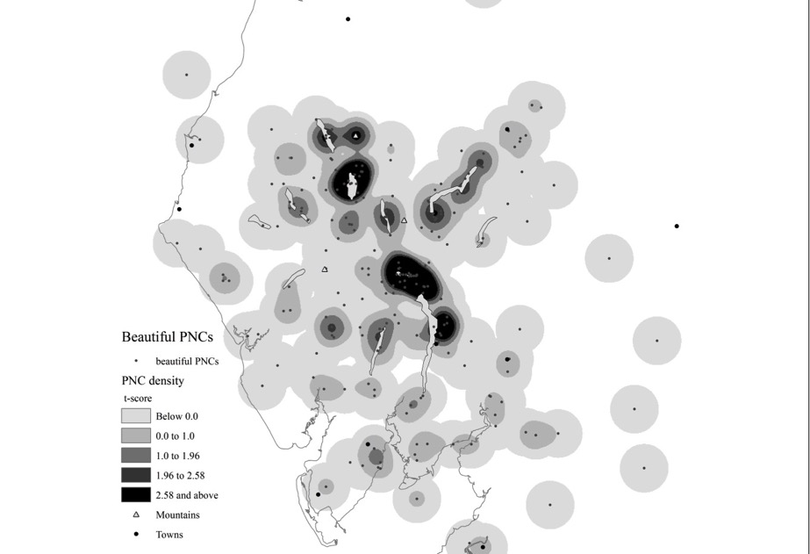
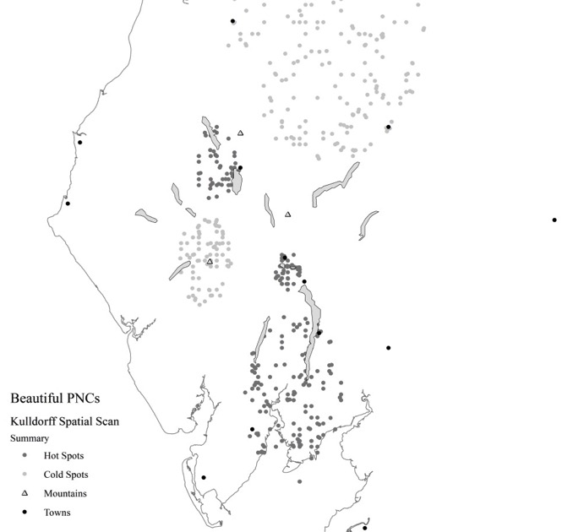
Density-smoothing
Kulldorff Spatial Scan
see C. D. Lloyd, Local Models for Spatial Analysis, 2 edn (2010) & M. Kulldorff, ‘A Spatial Scan Statistic’, Communications in Statistics: Theory and Methods 26 (1997) 1481–96.

Slide 8
beautiful PNC clusters (place-name collocates)
Density-smoothing
Kulldorff Spatial Scan
Bassenthwaite
Skiddaw
Keswick
Derwentwater
Grasmere
Ambleside
Windermere

Slide 9
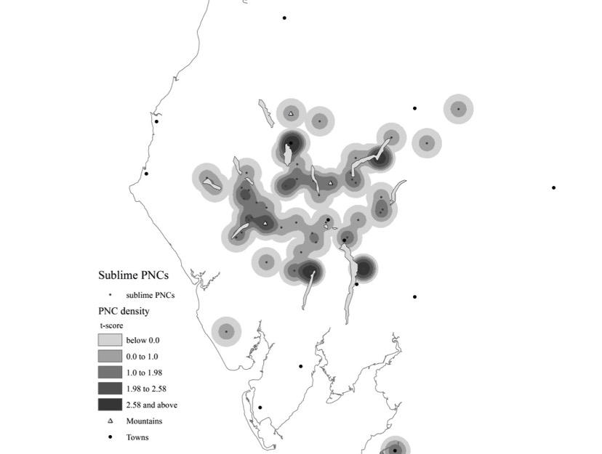
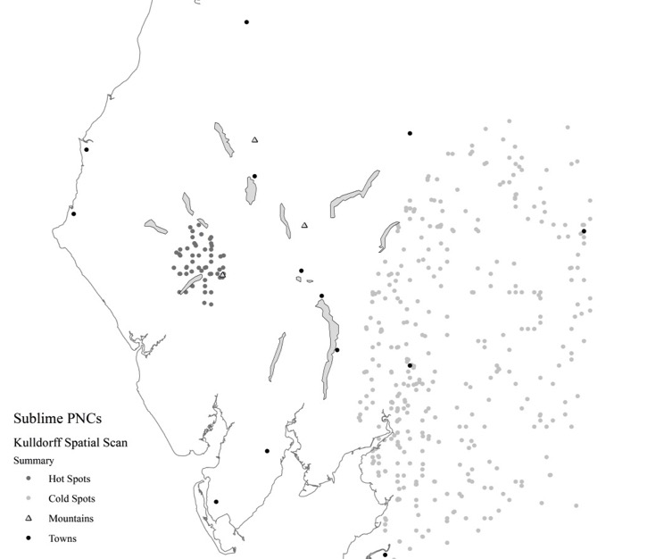
sublime PNC clusters
Density-smoothing
Kulldorff Spatial Scan
Keswick
Ullswater
Ennerdale
Wasdale
Coniston
Windermere

Slide 10
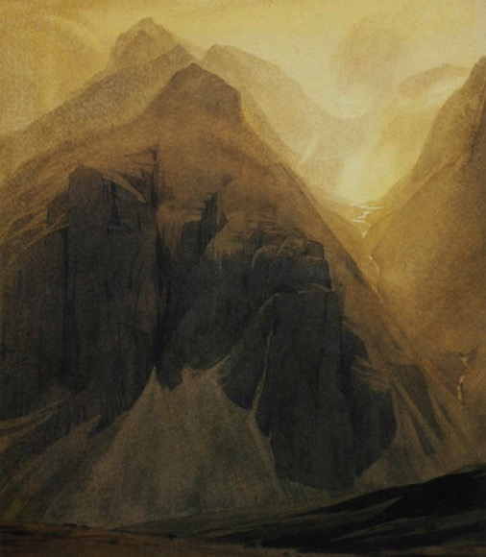
William Heaton Cooper Scafell Pike from Upper Eskdale (1936) <http://www.heatoncooper.co.uk/>

Slide 11
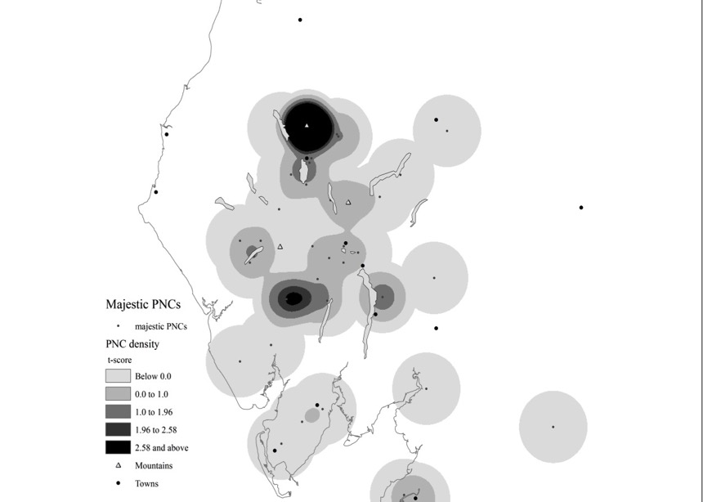
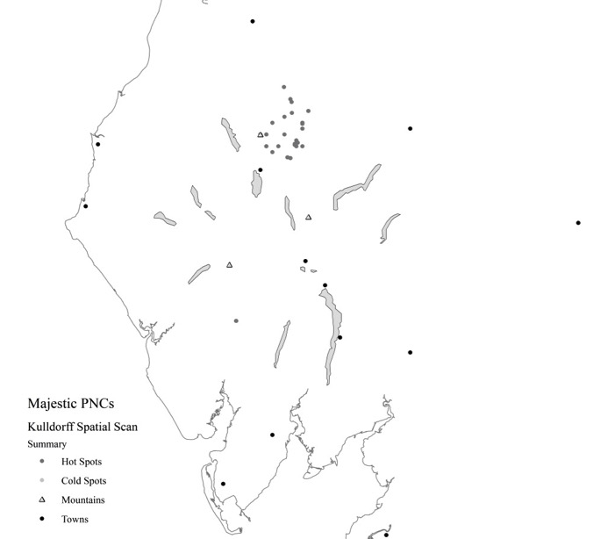
majestic PNC clusters
Density-smoothing
Kulldorff Spatial Scan
Skiddaw
River Duddon

Slide 12
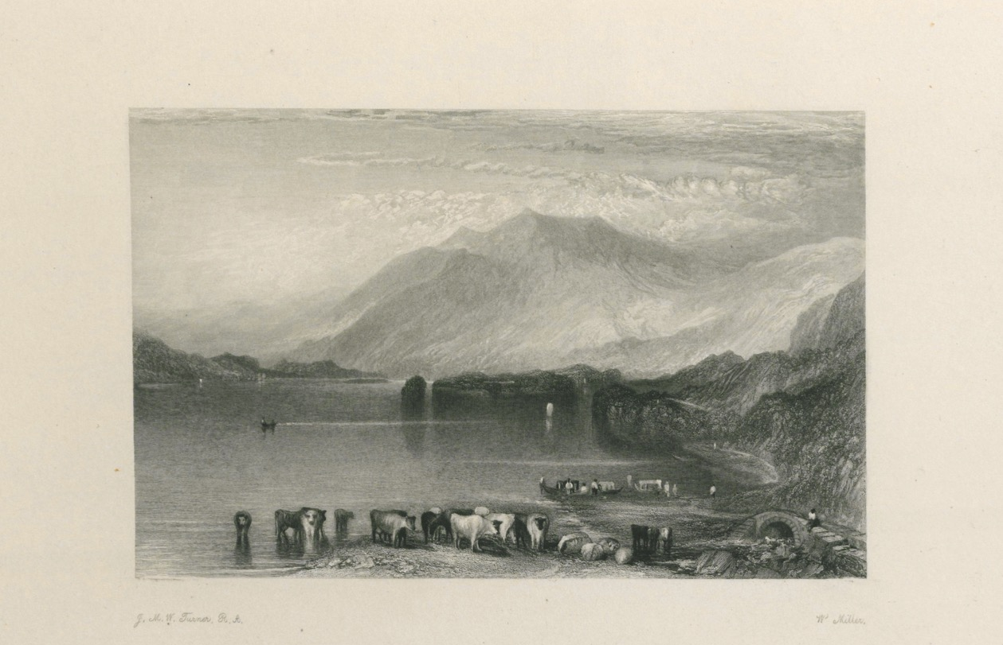
J. M. W. Turner’s Skiddaw, Seen from Derwentwater (1832).
Engraving by W. Miller (1834) Used with permission of the Cadbury Research Library, University of Birmingham, UK

Slide 13
