Slide 1
Advancing the spatial humanities:
http://www.chester.ac.uk/DHCentre
moving into the analysis of vague and imaginary place in medieval romance.
Dr. Patricia Murrieta-Flores
Digital Humanities Research Centre, University of Chester
Dr. Naomi Howell
English Department, University of Exeter

Slide 2
The background

Slide 3
The challenge
Great part of literary narratives and historical ones to certain extent, deal with places that are geographically vague.

Slide 4
How can we move forward into the analysis of space and place integrating holistically its full complexity?

Slide 5
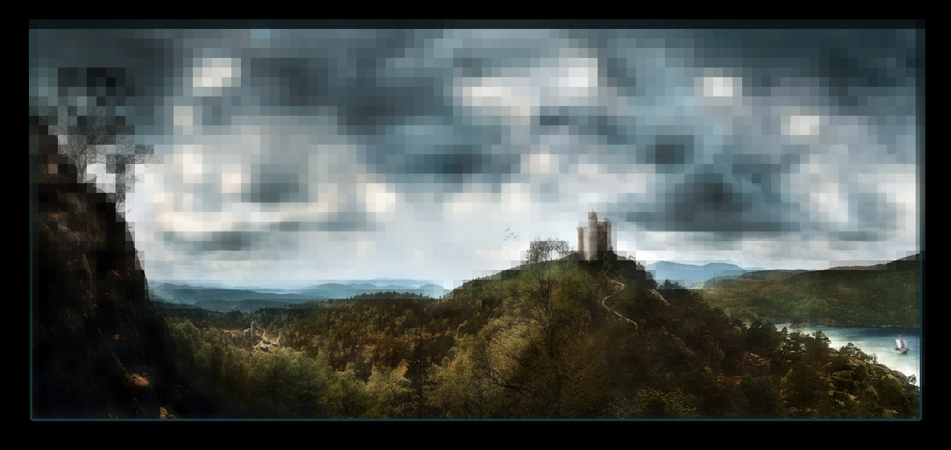
The medieval world

Slide 6
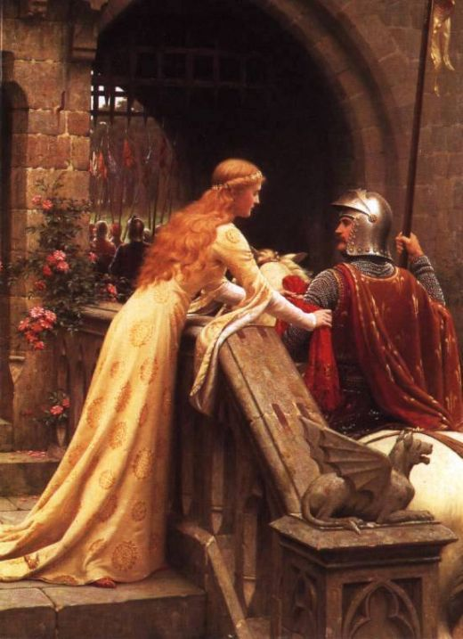
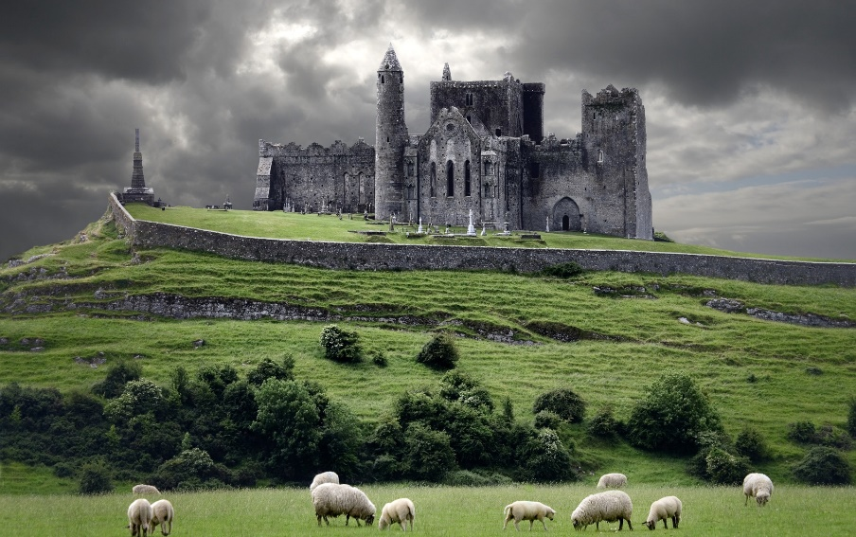
Romances
Folklore
History
Spirituality
Religious ritual
Travel writing
Classical antiquity

Slide 7
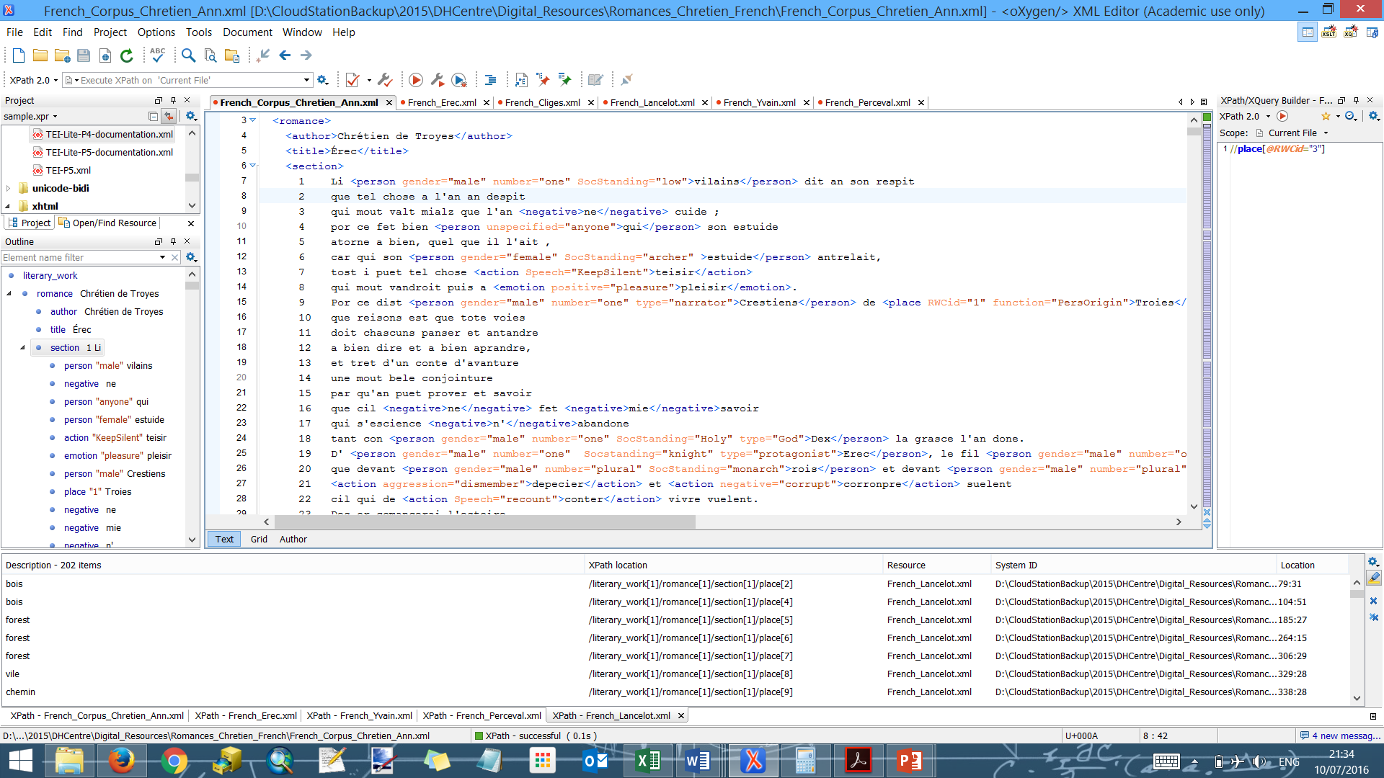
5 romances by chretién de troyes
Erec and Enide, Cliges,
Lancelot, Yvain and Perceval
12th century original
French versions

Slide 8
A first degree of real-world-correlation was assigned to places that exist in the real world.
A second degree of real-world-correlation was assigned to places that seem to belong to the real world, but which cannot be linked to a definite location.
A third degree of real-world-correlation was assigned to places which romance authors and audiences would understand as belonging to the romance world.

Slide 9
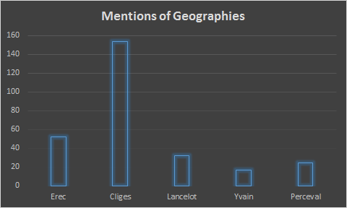
1640 mentions of places

Slide 10
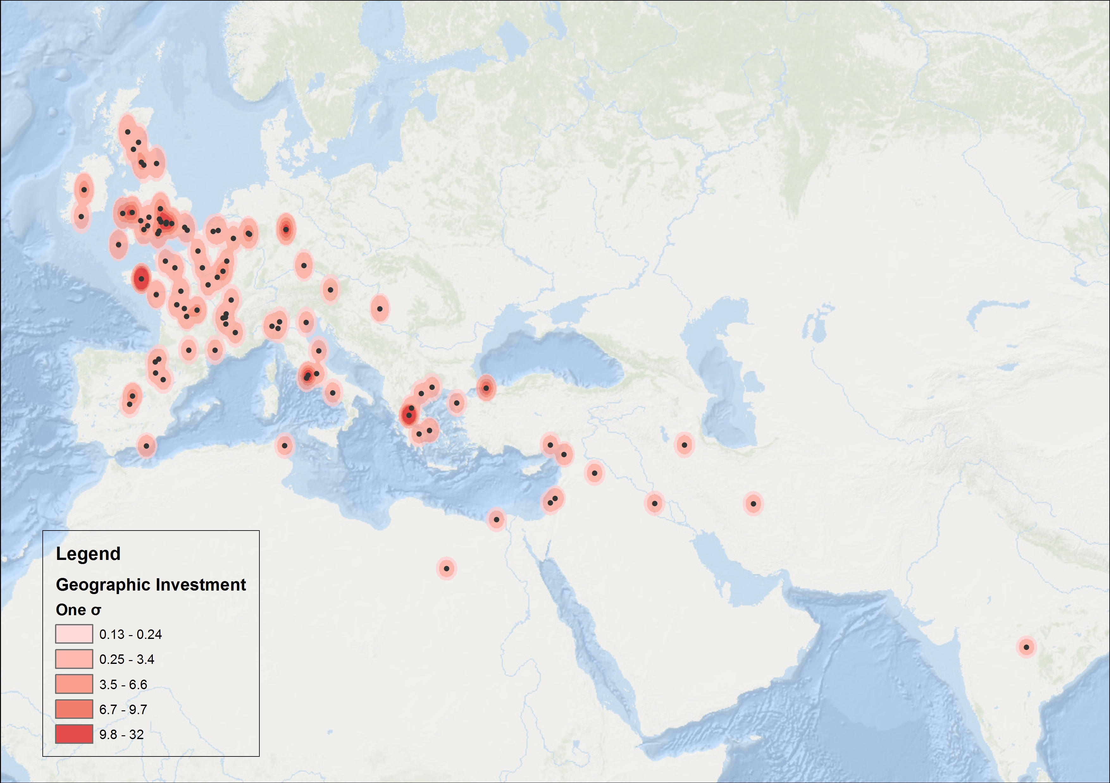

Slide 11
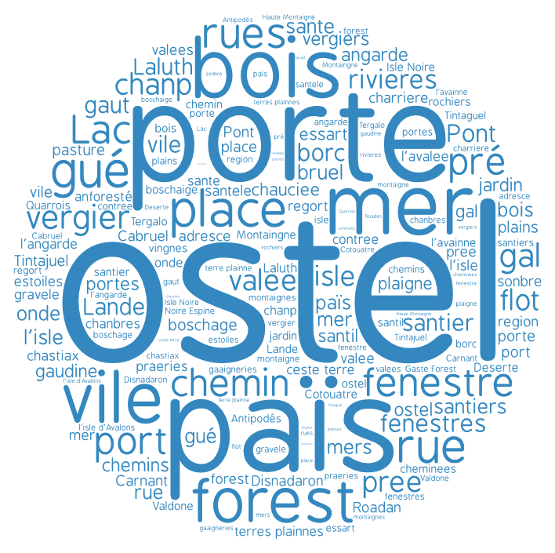
Cnt_ns1_de | ns1_description | ns1_translation
84 | ostel | hostal
81 | porte | door
73 | païs | country
70 | bois | wood
46 | forest | forest
44 | place | square
41 | mer | sea
38 | fenestre | window
36 | chemin | path
36 | vile | town
27 | vergier | OrchardÂ
25 | gué | ford
23 | fenestres | window
22 | rivieres | rivers
20 | port | Harbor
19 | chanp | battlefield
14 | rues | streets
11 | rue | street
10 | santier | small-path
9 | pré | Meadow
7 | pree | Meadow
7 | valee | valley
6 | vergiers | OrchardÂ
5 | angarde | high-hill-surveilance
5 | boschage | woodland
5 | Lac | Lake
5 | santiers | footpath

Slide 12
sonbre (fallow-land)
plaigne (plain, area of flat land)
lande (heath-uncultivated land)
gaaigneries (agricultural field-land under cultivation)
avainne (oat-field)

Slide 13
reflections
Our understanding of place changes with time and culture
Consider carefully all references to place and space in the corpora we analyse

Slide 14
What we are aiming to answer is:
Why, rather than how, are geographies constructed?

Slide 15
Thanks!
p.murrietaflores@chester.ac.uk
@patymurrieta
Digital Humanities Research Centre
University of Chester

