Slide 1
FITZSIGHT
QUESTION
Evidence-grounded Financial Operations Intelligence Agent
PLAN
TOOLS
Brokerage / FinTech Operations Analyst
EVIDENCE
Autonomous investigation. Human decision.
VERIFY
Not chat with a CSV. A bounded investigation you can audit.
GOAI 2026 · Boundless Agents · AI+金融
FitzSight · GOAI 2026 · Boundless Agents · AI+金融
1

Slide 2
INDUSTRY PROBLEM
Dashboards show what changed. The investigation behind why is still manual.
Primary user
Brokerage / FinTech Operations Analyst
01
Find tables
02
Define KPI
03
Compare periods
04
Drill drivers
05
Test significance
06
Inspect events
07
Reconcile evidence
08
Write report
A generic LLM can write a plausible explanation quickly. Financial operations needs a reproducible evidence chain before narrative.
acquisition
FTD conversion
client-fund flows
beachhead workflow
FitzSight · GOAI 2026 · Boundless Agents · AI+金融
2

Slide 3
PRODUCT
FitzSight converts a business question into a verified decision-support investigation
Question
Constrained plan
Deterministic tools
Evidence graph
Verifier
Verified answer
The model may select the next approved analytical branch. It never owns business arithmetic, arbitrary SQL, or high-impact financial actions.
Planner authority
Calculation authority
Answer authority
Approved actions only
Read-only SQL / Python
EvidenceClaimVerifier
Bounded adaptivity; local intent gate first
Every competition-facing number is executable
Verification failure → attribution withheld
FitzSight · GOAI 2026 · Boundless Agents · AI+金融
3

Slide 4
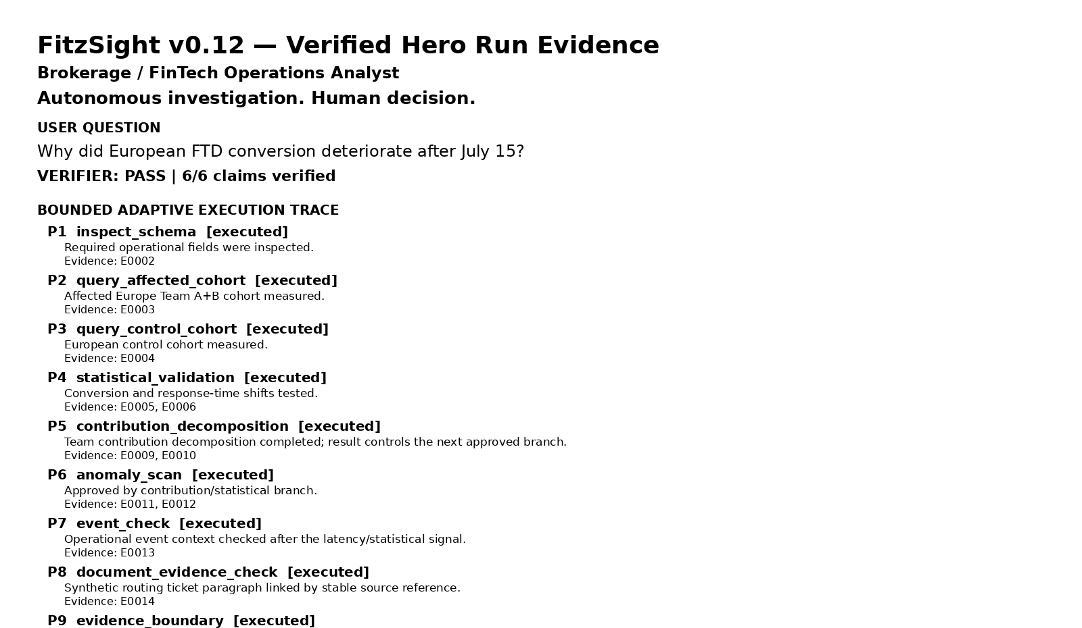
BOUNDED-ADAPTIVE AGENT
Hero journey — evidence selects the next approved step
Question: “Why did European FTD conversion deteriorate after July 15?”
Actual execution
9 approved steps
Rendered from the verified v0.12 run JSON
Contribution drilldown
executed
Latency / anomaly scan
executed
Operational event check
executed
Document evidence
CRM-CHANGE-2026-0715#p1
Result-driven branching ≠ unrestricted autonomy. Every next step remains inside the approved action catalog.
FitzSight · GOAI 2026 · Boundless Agents · AI+金融
4

Slide 5
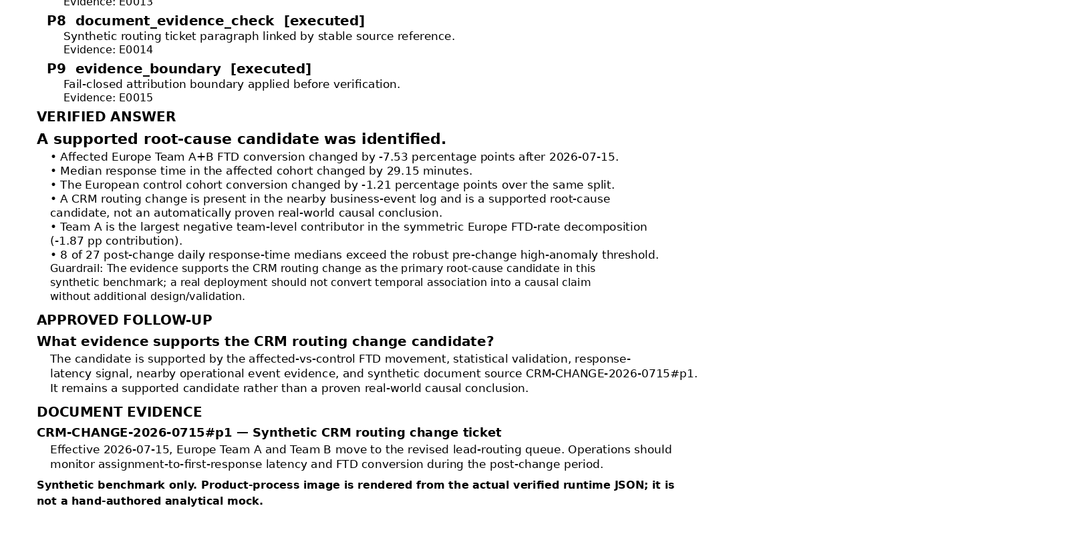
VERIFIED ANSWER
Hero finding — evidence supports a CRM routing candidate, not a proven causal conclusion
Affected FTD
Control
Response median
Top contributor
Root-cause status
-7.53 pp
-1.21 pp
+29.15 min
Team A
supported
Europe Team A+B
Other Europe teams
contribution -1.87 pp
candidate · not causal proof
Evidence chain
Quantitative shift
Affected -7.53 pp vs control -1.21 pp
Latency signal
Median response +29.15 minutes
Contribution
Team A is largest negative contributor
Robust anomaly
8 post-change high-anomaly days
Operational context
Nearby CRM routing event
Source-addressable doc
CRM-CHANGE-2026-0715#p1
FitzSight · GOAI 2026 · Boundless Agents · AI+金融
5

Slide 6
FAIL CLOSED
Failure branch — error evidence ends attribution, not the investigation
Tested dependency failure: the operational-event lookup raises an error Evidence record.
event_check
error Evidence
no document corroboration
insufficient_evidence
verified bounded answer
What fails
What still succeeds
Operational-event dependency is unavailable. The system records the error and does not manufacture event or document corroboration.
The evidence-backed metric findings remain valid; EvidenceClaimVerifier passes a guarded answer whose root_cause_status is insufficient_evidence.
Agent quality is not “always finding a cause.” It is completing the task with the correct uncertainty boundary.
FitzSight · GOAI 2026 · Boundless Agents · AI+金融
6

Slide 7
1 + 1 TRUST STORY
Refusal story — temporal proximity is not evidence of causality
Question: “Asia conversion fell after July 20. Did the nearby office relocation cause it?”
Asia FTD
Affiliate FTD
Affiliate p
Nearby event
Event causal support
-8.13 pp
-15.81 pp
0.00463
Office Relocation
FALSE
Tempting narrative
Measured driver
Office relocation
Asia FTD ↓
Affiliate quality ↓
Supported driver
REJECTED
false-correlation rejection = true
FitzSight is evaluated on explanations it refuses to make — not only the answers it produces.
FitzSight · GOAI 2026 · Boundless Agents · AI+金融
7

Slide 8
BREADTH PROOF
Three additional workflows prove reuse — without diluting the hero narrative
01
Client-fund flows
Net-deposit / withdrawal concentration
Net change -$187.8k
Observed driver only; no customer-motive inference
02
Customer Intelligence
Behavioral-value segmentation
Coverage 100%
Descriptive only; no AML / credit / eligibility decisions
03
Acquisition quality
Volume vs mix vs within-channel quality
Leads +315% · FTD -10.84 pp
Separates more leads from better leads
Main pitch = one complete investigation + one refusal. These workflows are reusable breadth, not five equal demo stories.
FitzSight · GOAI 2026 · Boundless Agents · AI+金融
8

Slide 9
ARCHITECTURE
Technical depth comes from explicit authority boundaries, not more Agent labels
01
Local intent gate
02
Constrained planner
03
Deterministic analytics
Unsupported questions are refused before an external model call.
Only approved high-level actions. No planner-generated SQL or arbitrary tool parameters.
Read-only SQL / Python own KPI calculations, tests, decompositions and anomaly checks.
04
Source-addressable evidence
05
EvidenceClaimVerifier
06
Human decision boundary
Tool outputs and synthetic operational documents enter one append-only Evidence Registry.
Checks evidence integrity, _gt boundary and causal language before result delivery.
No trading, AML, credit, suitability or other high-impact financial decisions.
Verification failure is a product state: FitzSight may finish with a guarded answer or withhold the unsupported attribution.
FitzSight · GOAI 2026 · Boundless Agents · AI+金融
9

Slide 10
EVALUATION & REPRODUCIBILITY
Evaluation v2 asks whether the system generalizes — and whether the safety architecture matters
Fixed benchmark
Holdout runs
Routing stability
Evidence coverage
Supported
5 / 5 PASS
8 / 8
100%
100%
75%
Unseen seeds + question paraphrases
1 CRM seed correctly insufficient
Adversarial release gate
Controlled architecture ablation
8 / 8 PASS
Full FitzSight
100%
adversarial refusal
scope refusal
planner policy
No verifier/evidence gate
100%
unsafe-answer rate
evidence integrity
causal overclaim
_gt leak
false correlation
This is a controlled architecture ablation — not a Generic LLM baseline.
One unseen CRM seed returning insufficient_evidence is retained as a robustness success, not hidden to make the metric look perfect.
FitzSight · GOAI 2026 · Boundless Agents · AI+金融
10

Slide 11
AI + FINANCE
Safety, traceability and open reuse are explicit product boundaries
Implemented today
Production blueprint — not claimed as implemented
• Synthetic benchmark data; no real customer PII
Identity / RBAC
• Read-only analytical path with deterministic fallback
Row- and field-level policy
• Evidence Registry + source/paragraph document evidence
PII masking
• Causal-language guardrail and fail-closed verifier
Retention / enterprise audit controls
• No investment advice, trading or account actions
Approved business-system connectors
• No automated AML, credit or suitability decisions
• MIT license + public repo + tests + benchmark catalog
Financial boundary: evidence-grounded decision support. The authorized analyst or institution retains the final judgment.
FitzSight · GOAI 2026 · Boundless Agents · AI+金融
11

Slide 12
FITZSIGHT
BI tells you what changed. FitzSight investigates what the evidence supports — and what it does not.
Autonomous investigation. Human decision.
Hero
Trust case
Holdout
Evidence coverage
CRM / FTD
False correlation
8 / 8
100%
bounded-adaptive investigation
refuses unsupported causality
routed + verified
synthetic benchmark scope
A reproducible financial investigation you can inspect, verify, challenge — and sometimes refuse.
FitzSight · GOAI 2026 · Boundless Agents · AI+金融
12

