Slide 1
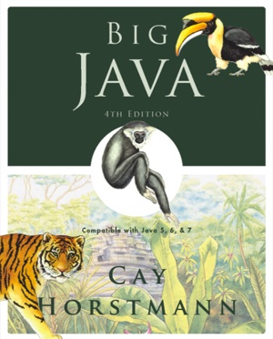
ICOM 4015: Advance Programming Laboratory 1
TA: Antonio Tapia Maldonado – antonio.tapia@upr.edu
Section: 037

Slide 2
Laboratory Goals
Review Psedo-Code, Flowcharts and Algorithms.
Get Familiar with Eclipse
Explore the Java swing, swt and swt libraries.

Slide 3
Pseudo Code and Flow Charts
A Pseudocode
is an informal high-level description of the operating principle of a computer program or other algorithm.[1]
Pseudocode typically omits details that are not essential for human understanding of the algorithm, such as variable declarations, system-specific code and some subroutines. [1]
A Flowchart
It is a type of diagram that represents an algorithm or process, showing the steps as boxes of various kinds, and their order by connecting them with arrows. [1]

Slide 4
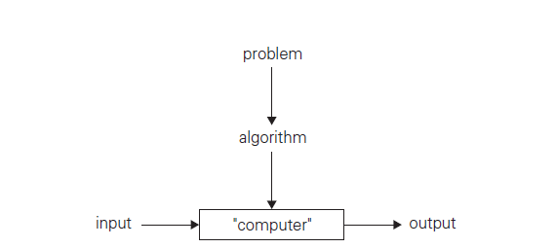
Algorithm
An algorithm is a sequence of unambiguous instructions for solving a problem, i.e., for obtaining a required output for any legitimate input in a finite amount of time. [2]

Slide 5
Exercise 1
Problem: To receive an integer number between 10 and 250 and determine if it is a prime number or not.
Read number
checkIfValidNumber(number)
for i=2 in sqrt(number) then
modulus = mod(number,divider)
if (modulus == 0) then
print (“Not prime”)
end program
end if
end for
print (“Yeah, a Prime”)
end program

Slide 6
Exercise 1: Flowchart
Start
number
i <- 2
End
“Prime”
i < sqrt(number)
i <- i+1
Modulus <- number % i
“Not a prime”
Modulus == 0

Slide 7
Eclipse IDE
In contrast to your previous programming experience we will be using an Integrated Development Environment called Eclipse. Because it’s an IDE it does way more than compile your code; it automates tasks and make your life easy. Eclipse sole purpose in life is to organize you and get you a workflow.
A workspace is a folder that eclipse creates to group all of projects related to a single application/product.
Create project with reverse DNS: “edu.uprm.ece.icom4015.project”
See reference 3.

Slide 8
Hello World
Window => Cheat Sheets

Slide 9
Hello World SWT
Window => Cheat Sheets

Slide 10
From Scratch for the Do it Your-selfer
Follow TA

Slide 11
Draw a Car , Motorcycle, Human or pet!

Slide 12
After Lab
Investigate what Widgets are and what features the Swt package has.
Investigate important features of the Swing Pack age.
Investigate important features of the Awt package.
Optional:
git clone https://github.com/Apo45ty/ICOM4015LABS.git
Evaluation Sheet

Slide 13
References
Wikipedia
Introduction to The Design and Analysis of Algorithms.
http://www.vogella.com/tutorials/Eclipse/article.html

