Slide 1
DinoDodger
Razan Abujarad
Shrey Mittal
Zhiwen Yang
S.R.A Squad

Slide 2
Overview
Google Chrome’s famous game T-rex Runner has become a necessity when there is a lack of internet connection
Since T-rex runner can only be played without an internet connection, playing requires to switch off the WIFI which may not be ideal.
Goal is to make T-rex runner installable and executable with a WIFI connection

Slide 3
Differences between T-rex Runner and DinoDodger
DinoDodger is:
Available as an executable game which does not require a Google Chrome web browser.
Available with different characters.
Available with different landscapes
Written in Java and JavaFX to ensure the ability to download the game onto a device.

Slide 4
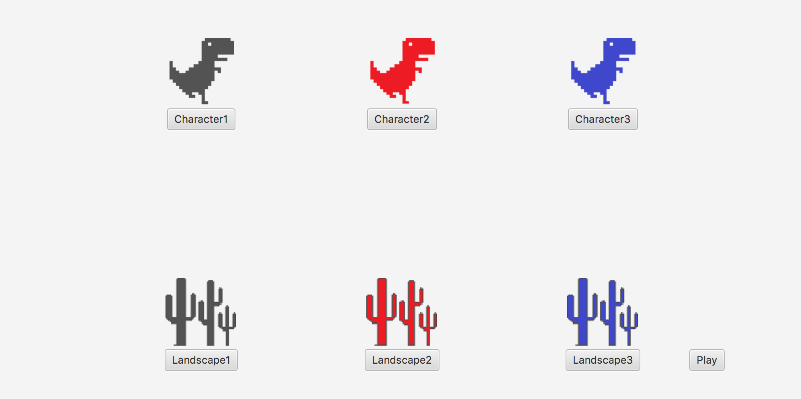
Demo

Slide 5
Testing
Since DinoDodger is mainly user input based, the most effective method of testing is Manual.
Manual testing was done with 10 users selected randomly in Thode Library.
Testing
Range from 1(lowest) to 5(highest) for usability
Range from 1(lowest) to 5(highest) for learnability

Slide 6
Testing Results
Person | Usability Rating | Learnability Rating
1 | 5 | 5
2 | 5 | 5
3 | 4 | 5
4 | 5 | 5
5 | 4 | 4
6 | 5 | 5
7 | 5 | 5
8 | 4 | 5
9 | 5 | 4
10 | 5 | 5
Average | 4.7 | 4.8

Slide 7
Key Qualities
Learnablity and usability :
DinoDodger is easy to use by users of ages 5 and above
DinoDodger can be used without prior training.
Installability :
DinoDodger is available for installing on any desktop or laptop
DinoDodger is available to play with or without an internet connection.

Slide 8


Future Features
Pixelated Dinosaur meets Bowser From Super Mario
Plan to extend the game further to include some end of level fight scenes between Dave the pixelated dinosaur and a villain boss.

