Slide 1
openSCHC LPWAN WG IETF Hackathon
IETF 115
5-6 Nov 2022
London, UK

Slide 2
openSCHC background
SCHC is Header Compression and Fragmentation for LPWAN (low datarate, small payloads)
specification work done at the LPWAN WG (Int Area)
RFCs 8376, 8724, 8824, 9011, +more coming
openSCHC is Python3 open source implementation of RFC 8724 + 8824
openSCHC adopted by the LoRa Alliance as certification reference for IPv6 over LoRaWAN

Slide 3
Hackathon Plan
Clean up the GitHub repo
merge branches, remove dead code
increase pytest coverage
Interop testing with libSCHC/RiOT
Improve documentation
YANG model validation (pyang)
Discuss specification understanding, implementation assumption

Slide 4
What got done
Cleaned up the openSCHC GitHub repo
Clean-slate micropython implementation of SCHC compression (dubbed “microSCHC”)
Proof-read openSCHC tutorial (“The Book of SCHC”)
Designed connector between openSCHC and Sigfox Network Server
Interop testing between openSCHC and libSCHC
compression on RiOT/libSCHC, decompression on openSCHC
compression on openSCHC, decompression on RiOT/libSCHC
transport over UDP between two computers
Interop between microSCHC and openSCHC
compression on microSCHC, decompression on openSCHC
work to be continued during the IETF week

Slide 5
What we learned
clean slate implementation by newcomer led to
lots of good questions on RFC8724 wording, design choices, implementation recommendations
ideas for other ways of doing Header Compression using the same SCHC toolbox
might lead to YANG model extension, protocol variants
feedback to the LPWAN Working Group

Slide 6
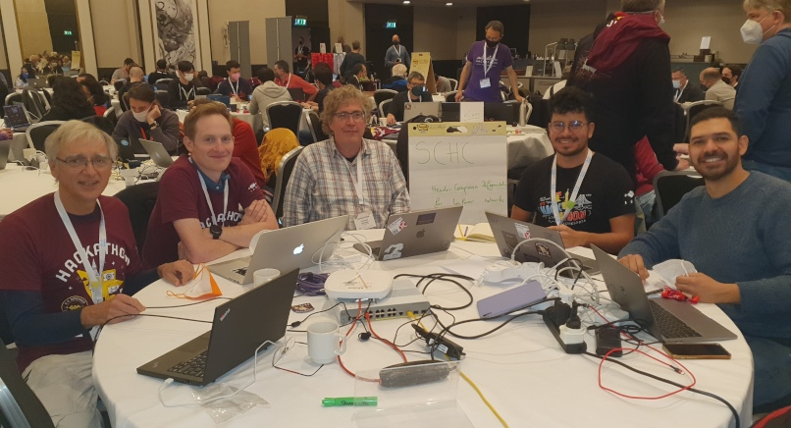
Wrap Up
Team members:
Laurent Toutain
Ivan Martinez
Quentin Lampin*
Sergio Aguilar Romero+
Martine Lenders
Dominique Barthel
* First timer @ IETF/Hackathon
+ First timer onsite @IETF/Hackathon
https://github.com/openschc
https://book.openschc.net
https://github.com/quentinlampin/microschc

