Slide 1
IETF Hackathon Attested TLS
IETF 115
5-6 November 2022
London, UK

Slide 2
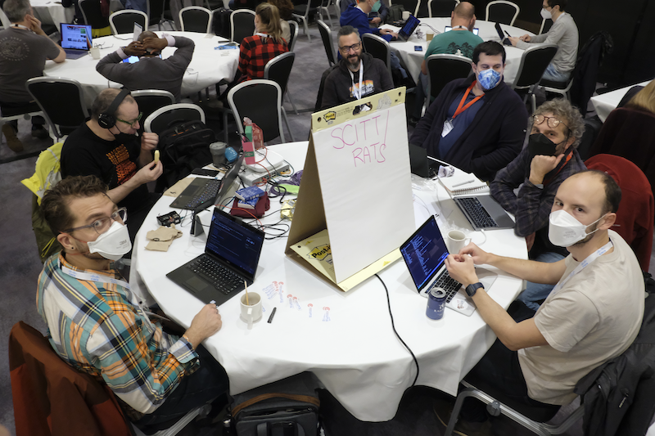

Slide 3
Hackathon Plan
TLS extensions to support attestation evidence (and results) as first-class authentication credentials
Relevant I-Ds
draft-fossati-tls-attestation
draft-bft-rats-kat
draft-ftbs-rats-msg-wrap

Slide 4
What got done
Extend TLS handshake in mbedTLS
Extend Attestation Verifier to handle TPM-based Key Attestation
Verification and endorsement path
Extend Attester to produce endorsements and evidence in the correct formats accepted by the Verifier
Code
https://github.com/veraison/services/tree/ietf-115-hackathon
https://github.com/ionut-arm/parsec-se-driver/tree/attested-tls
https://github.com/hannestschofenig/mbedtls/tree/tls-attestation

Slide 5
What we learned
Integration highlighted
The need to modify slightly the evidence format to include an in-band reference to the verification key
The need to modify the attestation result format to embed the verified identity key

Slide 6
Wrap Up
Team members:
Ionut Mihalcea
Hannes Tschofenig
Thomas Fossati
First timers @ IETF/Hackathon: Ionut
Confidential Computing Consortium:
Attestation SIG POC

