Slide 1
IETF Hackathon
IETF 115
5-11 November 2022
London UK

Slide 2
Hackathon Plan
https://www.rfc-editor.org/rfc/rfc8996.html
Experiment with PQ crypto

Slide 3
What got done
Nmap PR for tls 1.0 and tls 1.1
https://github.com/nmap/nmap/pull/2561
Docker container with ngtcp2 and OQS tls library.

Slide 4
What we learned
Challenges due to custom TLS stack in nmap.
Building issues with OpenSSL.

Slide 5
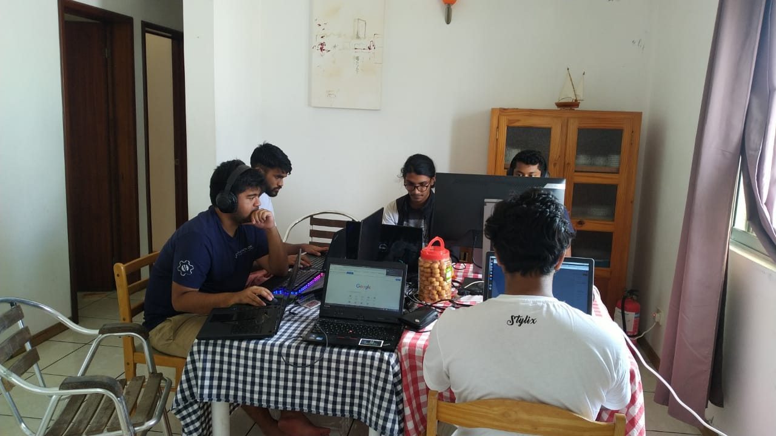
Wrap Up
Team members:
Nathan Mangar
Jeremie Daniel
Jagveer Loky
Loganaden Velvindron
First timers @ IETF/Hackathon:
Darshan N
Jeevesh “Sarvesh” Dindyal
Keelan Cannoo

