Slide 1

SRv6 Data-Plane Visibility OPSAWG WG
IETF 115
July 5-6th, 2022
Hackathon

Slide 2
Hackathon - Plan
Establish multivendor SRv6 network topology with network telemetry data collection and processing pipeline.
Validate and visualize two IPFIX implementations of draft-ietf-opsawg-ipfix-srv6-srh in FD.io VPP and on Huawei VRP.

Slide 3
Hackathon – Software
Software
Huawei Versatile Routing Platform Software Version 8.220
VPP extended by INSA Lyon
Wireshark IPFIX dissector for packet analysis
pmacct nfacctd for IPFIX and BMP data collection
Confluent Apache Kafka as message broker
Apache Druid as timeseries DB
Imply Pivot as user interface

Slide 4
Hackathon – Network (1/2)
SRv6 network topology with two vendors and IPFIX data processing pipeline.
Huawei with four P and two PE nodes exposing SRH provider data-plane as described in draft-ietf-opsawg-ipfix-srv6-srh.
Cisco with two PE nodes exposing customer data-plane.
SRv6 TE Policy with SID List 1..3

Slide 5
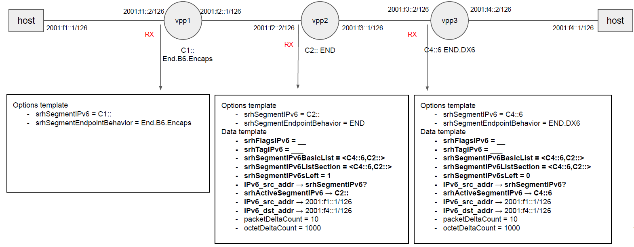
Hackathon – Network (2/2)
FD.io VPP Open Source Code published: https://github.com/insa-unyte/vpp-srh-onpath-telemetry

Slide 6
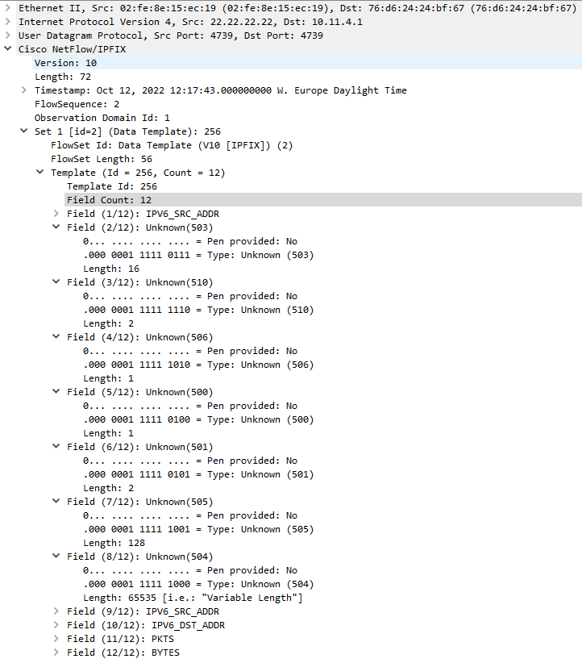
IETF 115 Hackathon - VPP Implementation Status Records exposed
srhActiveSegmentIPv6
128-bit IPv6 address that represents the active SRv6 segment.
srhSegmentEndpointBehavior
16-bit unsigned integer that represents a SRv6 Endpoint behavior as per Section 4 of [RFC8986].
srhSegmentIPv6sLeft
8-bit unsigned integer defining the number of route segments remaining to reach the end of the segment list.
srhFlagsIPv6
8-bit flags defined in the SRH.
srhTagIPv6
16-bit tag field defined in the SRH that marks a packet as part of a class or group of packets sharing the same set of properties.
srhSegmentIPv6ListSection
Exposes the SRH Segment List as defined in section 2 of [RFC8754] as series of n octets.
srhSegmentIPv6BasicList
Ordered basicList [RFC6313] of zero or more 128-bit IPv6 addresses in the SRH that represents the SRv6 segment list. The Segment List is encoded starting from the active segment of the SR Policy.
1
2
3
4
5
6
7

Slide 7
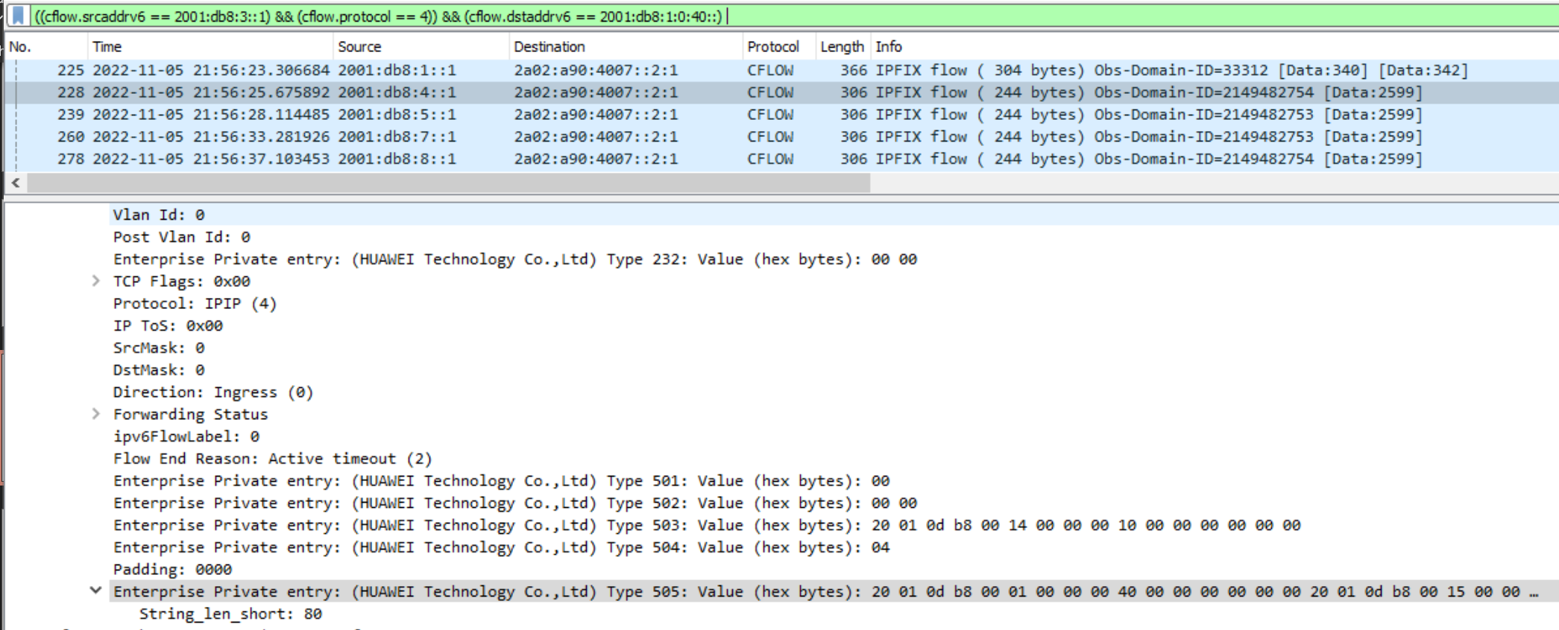
IETF 115 Hackathon - Huawei Implementation Status IPFIX IE Private Enterprise Number

Slide 8
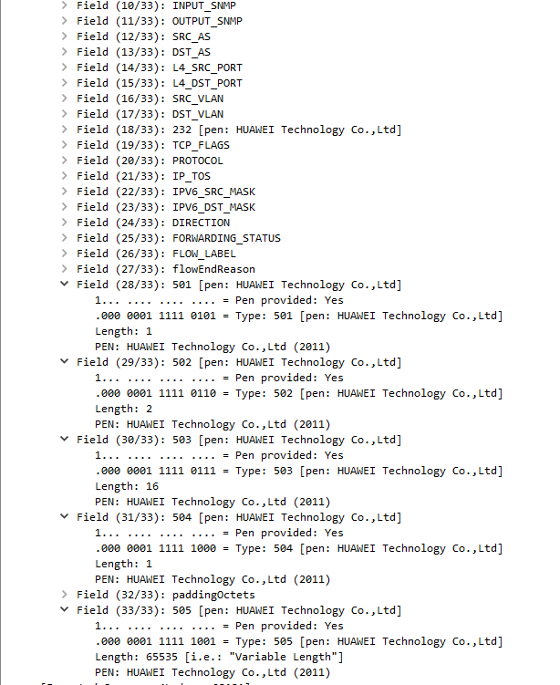
IETF 115 Hackathon - Huawei Implementation Status Records exposed
srhFlagsIPv6
8-bit flags defined in the SRH.
srhTagIPv6
16-bit tag field defined in the SRH that marks a packet as part of a class or group of packets sharing the same set of properties.
srhActiveSegmentIPv6
128-bit IPv6 address that represents the active SRv6 segment.
srhSegmentIPv6ListSection
Exposes the SRH Segment List as defined in section 2 of [RFC8754] as series of n octets.
srhSegmentIPv6sLeft
8-bit unsigned integer defining the number of route segments remaining to reach the end of the segment list.
According to A.1.2. Template Record and Data Set with Segment List Section
1
2
3
4
5

Slide 9

Pmacct Integration
{
"event_type": "purge",
"peer_ip_src": "33.33.33.33",
"ip_src": "2001:f4::1",
"ip_dst": "2001:f4::1",
"srv6_seg_ipv6_list": ["c4::6-0", "c2::-1"],
"packets": 20, "bytes": 10560
}
IPFIX packet
JSON

Slide 10
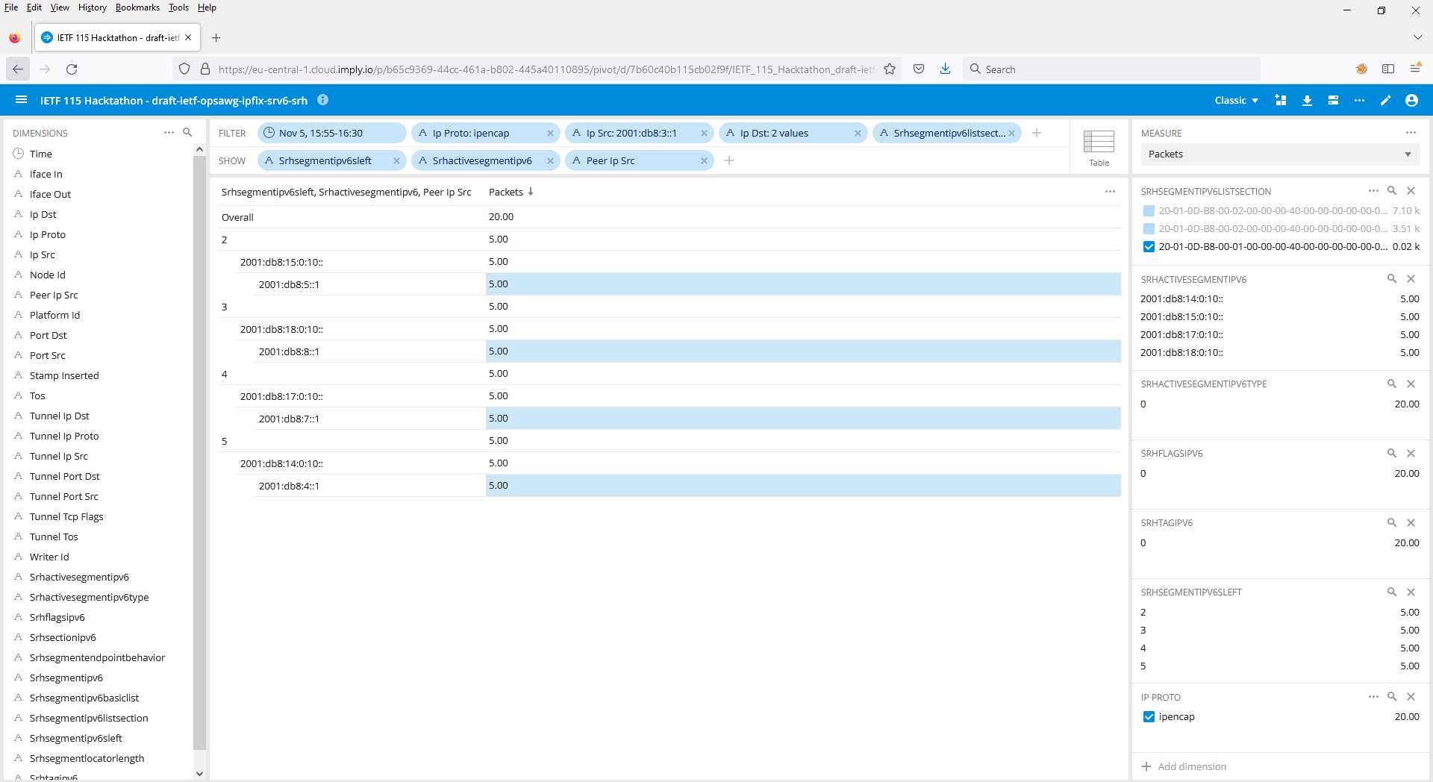
Visualization
With Segment List Section we can select the traffic engineered path.
Segments Left shows where we are in the forwarding path.
Active Segment where we forward next to.
Peer IP Src from where the metrics were exported.
2
3
4
1

Slide 11

Conclusion
Achievements
Running SRv6 multivendor network topology with traffic engineering
Validating two interoperable implementations of draft-ietf-opsawg-ipfix-srv6-srh
Decompose srhSegmentIPv6ListSection in pmacct data collection
Suddenly realizing that on one desk we are changing a traffic engineered path and on the other desk observing the change in the observed path.
Next Steps
Adding support for draft-tgraf-opsawg-ipfix-on-path-telemetry in VPP
Validate customer data-plane visibility in SRv6 for L2 and L3 EVPN
Posting new draft version with minor updates today

Slide 12


What we learned (again)
Good
Thanks to our hackathon neighbors, our crowded hackathon group could slowly invade their tables to obtain power and space.
As always… the beers were most welcome!
Bad
Lab access was trickier to troubleshoot then the IPFIX implementation we planned to.

Slide 13
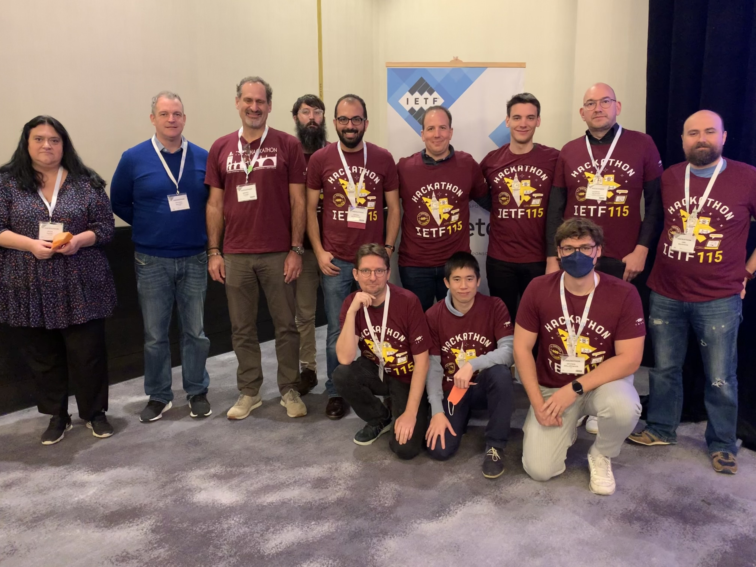
Thanks to…
Alex Huang Feng – INSA
Pierre Francois – INSA
Severin Dellsperger - OST University
Urs Baumann - OST University
Paolo Lucente – NTT
Benoit Claise – Huawei
Michael Mackey - Huawei
Jean Quilbeuf - Huawei
Olga Havel – Huawei
Marco Tollini - Swisscom
Yannick Buchs – Swisscom
Ahmed Elhassany - Swisscom
Thomas Graf - Swisscom
….and Huawei, INSA Lyon and Pmacct for the network environment, software and test cases.

