Slide 1
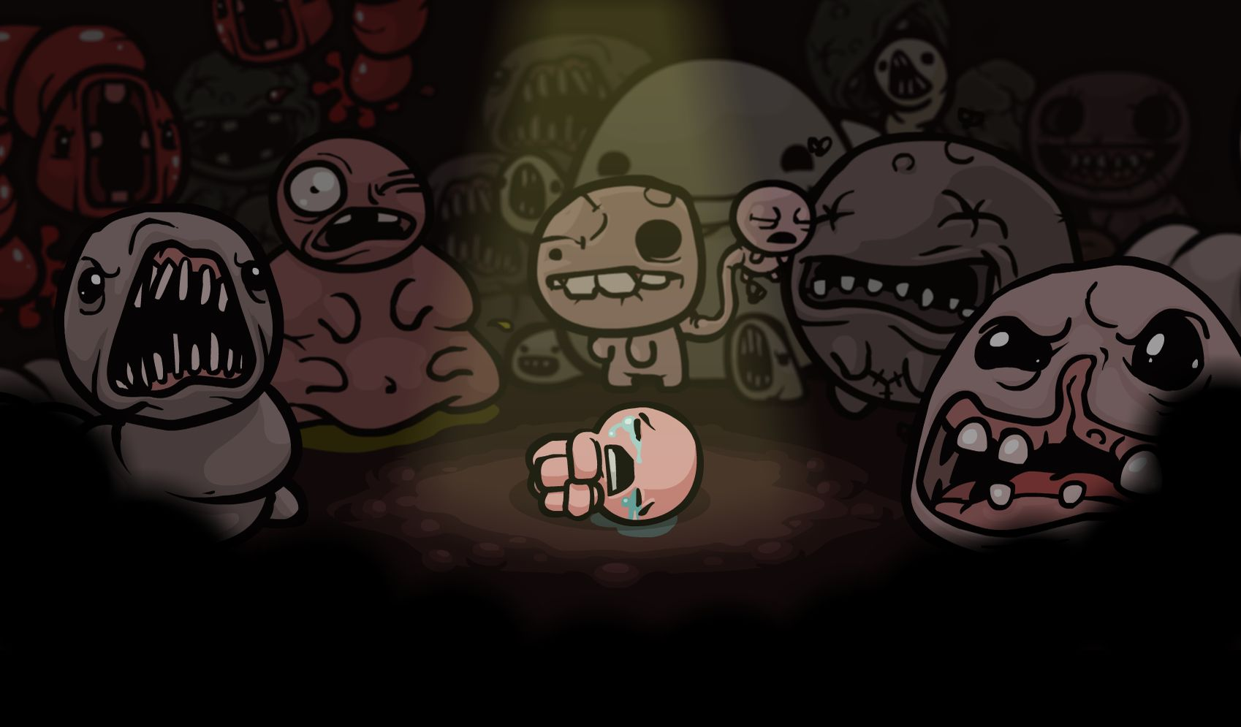

Notes:
Présentation : Edmund McMillen, Tommy Refenes

Slide 2
Presentation
What is it ?
Why is it a future hit ?
Notes:
What is our game ?
How we can sell it ?

Slide 3
Game Description

Slide 4
Game-Design
2D dungeon crawler game
Random and procedurally-generated levels
Inspired by the Biblical story
Main objective : kill your mom !
Notes:
a labyrinthine environment. You have to explore to find the way out. But there are monsters in there
It's never the same map, monsters and secrets.
Lot of references of the Bible and the myth of Isaac.
And you have to kill your mom before she kills you.

Slide 5
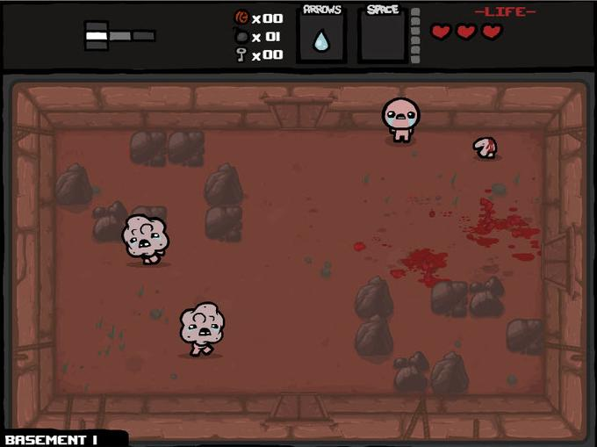
Notes:
We can see isaac, and monsters, in a room with blood and stones. You must to defeat them to continue to explore. The doors stay closewhile a foe stay alive

Slide 6
How to success ?
Fight with yours tears
Avoid the enemy blood tears
Keys, bombs, coins and objects for help
Notes:
Almost always a distant fight. Blood tears and contact with ennemy hurt you.
Key opens locked doors and treasure, bombs can kill ennemys and destroy rocks and walls (you can find a secret room, using this way), and coins can be used to buy objects to the merchants.
The effects of the objects you find are cumulative.

Slide 7
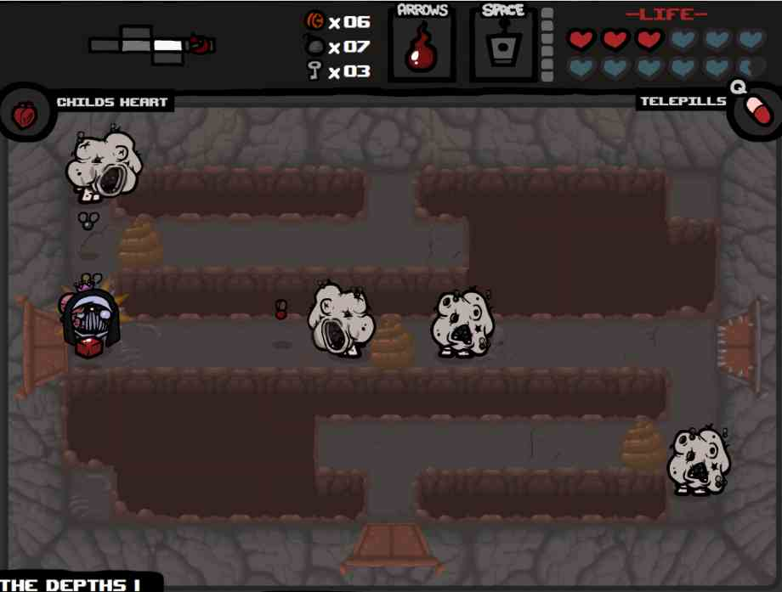
Notes:
We can see a different isaac regard to the former because he has find a few objects. This objects change the skins of your caracter.
Two kind of objects : passive and active object (with the spacebar)

Slide 8
Selling strategy

Slide 9

Experimented developers
A recognized Team Meat !
Last game, huge success
Coming elements in B.o.I.
Notes:
TeamMeat Edmund and tommy
The last game developped : super meat boy, which is known as the perfect running game. Fans' big community.
Fan service : sound of keys, boss, objects like meat boy or dr fetus.

Slide 10
Game with atmosphere
Dark universe, adult themes : murder, infanticid, religion affectivement
Alarming music, by Danny Baranowsky
Cartoon style graphics and funny effects objects
Notes:
People remembered game with atmosphere, so we created a new atmosphere, withreligion and adults themes.
Music strengthen this atmospher. We try to stick in people's mind !
To avoid being a serious game, Cartoon style like super meat boy !
Everyoe, even children, can play our games, without fears or nightmares !

Slide 11
Light and Addicting
Multi-platforms
Developed in Flash
Random levels, monsters and rewards
real objective : unlock all secrets
Notes:
ON Windows linux mac
For all computer configuration
High life game, no boring, and diificult. You always have a new challenge to accomplish ! Ex : find all obj, discovers new mix of objects, unlock new chararcter…
We talk about tens of game hours

Slide 12
Price and Selling Place
Launch price : 4, 99 $/€
Steam and his famous sales
The Humble Bundles and his hugh packs of games
Notes:
Cheap price to attract new customers
You can spend 5 dollars for an unknown game, it's not a big deal.
Steam = 100 millions active accounts = 100 millions customers. The steam sales to attract more potential players
The humble bundles, to promote our game in a pack. If you buy a pack for an other game, you can have the BoI include in this, and you can want to test it.

Slide 13
Ready to die ?

