Slide 1
Regular expression to FSA Converter
Apolinar Ortega
Notes:
13s

Slide 2
Parts
DFA Minimizer
NFA To DFA Converter
Regular Expression Parser
Notes:
30s

Slide 3
Implementation Details
C#
Mono
LINQ Query Operations
FinalStates = States
.Where(x => x.Value.IsEndState)
.ToDictionary(x => x.Key, x => x.Value);
newNames = Enumerable.Range(0, States.Count)
.Select(n => $"q{n}").ToArray();
Notes:
30s
Language Integrated Query Operations

Slide 4
DFA Minimizer
ab
>q0,q1,q2,q3,q4,*q5
q0|a:q1,b:q3
q1|a:q1,b:q2
q2|a:q2,b:q5
q3|a:q3,b:q4
q4|a:q4,b:q5
q5|a:q5,b:q5
Revamped code from Assignment 4
DFA machine = MachineUtilities.ParseFileToDFA(file);
var diff = machine.GetDistinguishableElements();
var minimized = machine.Minimize(diff);
Notes:
2:00

Slide 5
NFA To DFA
ab
>q0,q1,q2,q3,q4,*q5
q0|λ:q1;q3
q1|a:q2,b:q1
q2|a:q1,b:q2,λ:q5
q3|a:q3,b:q4
q4|a:q4,b:q3,λ:q5
q5|λ:q5
Parser file into NFA
Compute NFA λ-closures and t-table
Build DFA from t-table
var m = MachineUtilities.ParseFileToNFA(file);
var tTrans = new TFunction(m);
var mDFA = tTrans.ConstructDFA();
Notes:
1:00

Slide 6
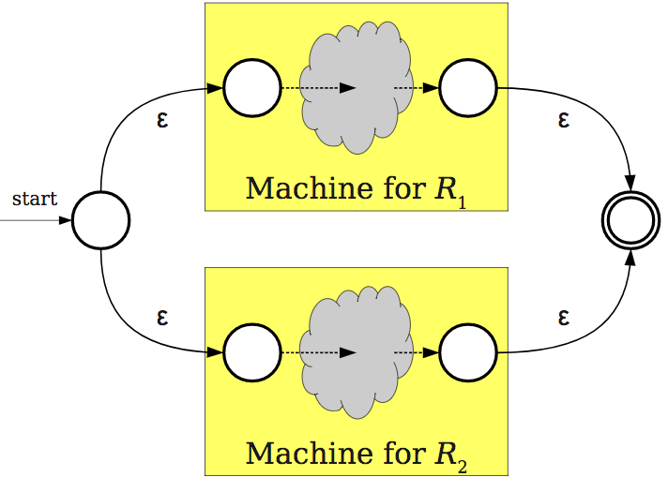
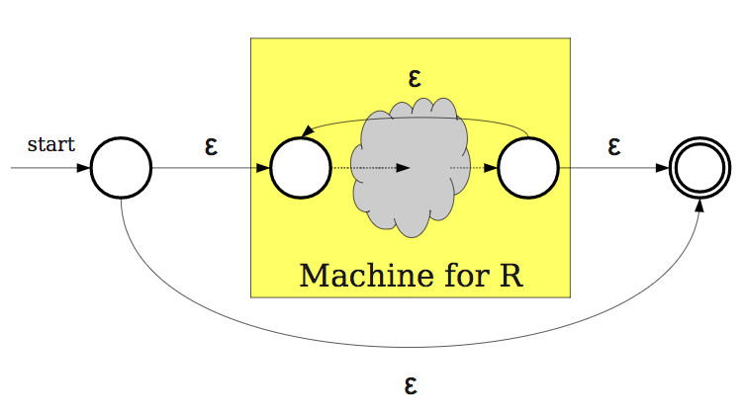
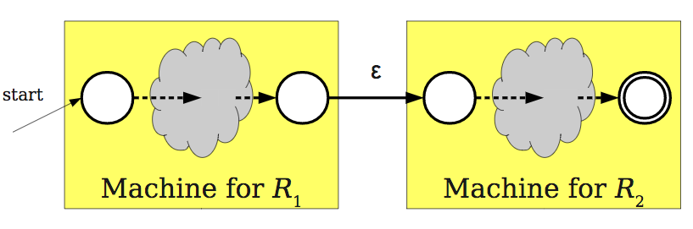
Regex Parser
Components
Parser: ANTLR
Visitor
Links together NFA components
Notes:
2:00
What I don’t have…
https://web.stanford.edu/class/archive/cs/cs103/cs103.1142/lectures/15/Small15.pdf

Slide 7
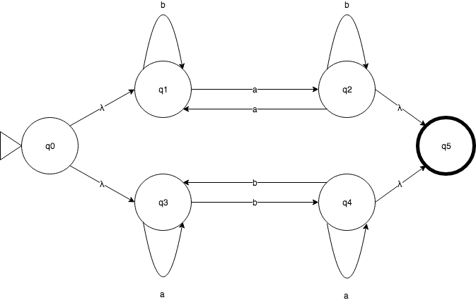
NFA To DFA Example
Exam II, Question 3c:
“Construct an NFA-λ that accepts the strings of a’s and b’s with an odd number of a’s or an odd number of b’s”
Part d:
“Convert the NFA-λ (in part (c) of the question to a DFA)”

Slide 8
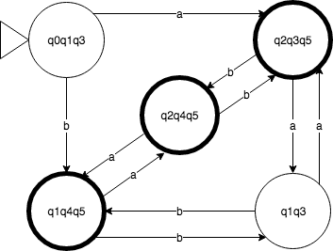
NFA To DFA Example - Answer
Exam II, Question 3d:

Slide 9
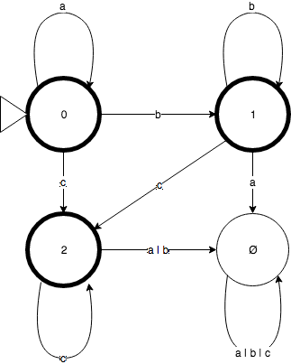
Regex Parse Example
From Exam II, Question 4:
a*b*c*

