Slide 1
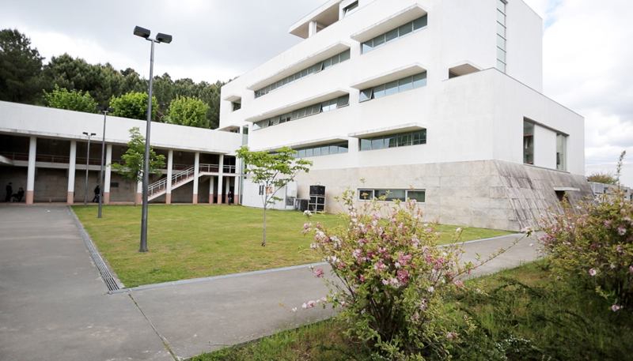



Development of methane mitigation strategies using the microalga Chlorella vulgaris
Project in Bioinformatics
Gonçalo Apolinário Cardoso
Orientador: Óscar Dias, PhD; Pedro Geada, PhD
Emanuel Cunha, MSc
June 1 - 2023

Slide 2
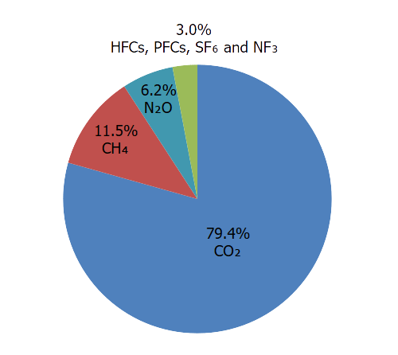
PROBLEMATIC
Methane
Due to its structure, methane traps more heat in the atmosphere per molecule than CO2, meaning that it has 80 times more warming power
Methane mitigation strategies are difficult to implement
Plants only contribute between 3-6% of fossil fuel emissions mitigation

Slide 3
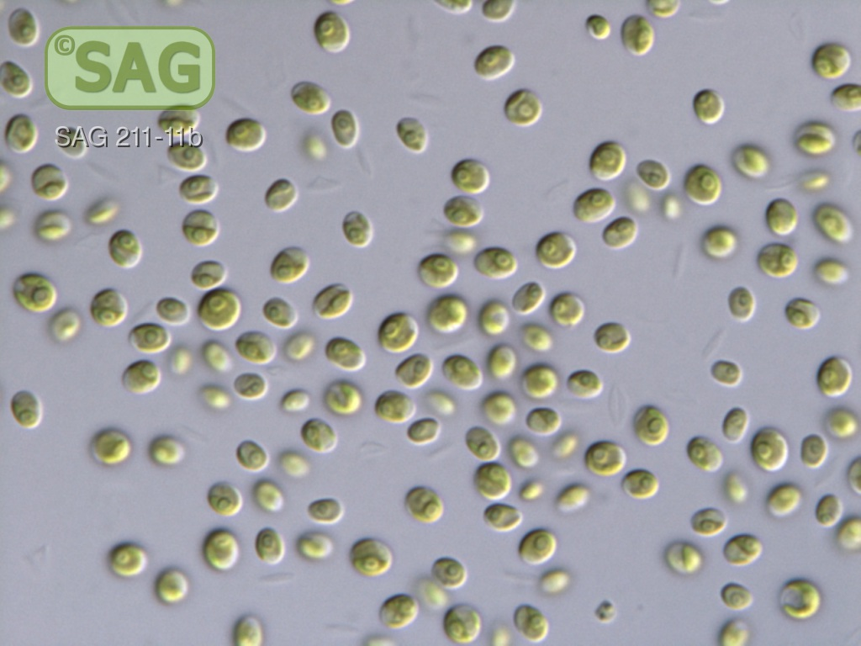
Chlorella vulgaris
Early experiments indicate that Chlorella vulgaris might be able to mitigate a great amount of CH4
Eukaryotic green alga
Biotechnological application
Strain 211/11B
Department Experimental Phycology and Culture Collection of Algae (EPSAG)

Slide 4

Objective
Development of a genome-scale metabolic (GSM) model for Chlorella vulgaris using Merlin
Evaluate the viability of the microalga Chlorella vulgaris as an ecological and cost-effective solution for mitigating methane
4

Slide 5

Other models
In 2016 a GSM model for Chlorella vulgaris was published
Strain: UTEX-395
Software: RAVEN Toolbox
RAVEN Toolbox
Why should we reconstruct a model for a organism that already has a model?
Uptaded genomic information
Methane metabolism was not incorporated in the model

Slide 6
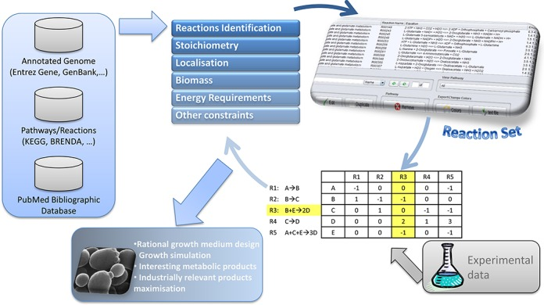

Methodology
Chlorella vulgaris
strain 211/11P
Inserir ref; referir ferramentas.. Blast e assim

Slide 7
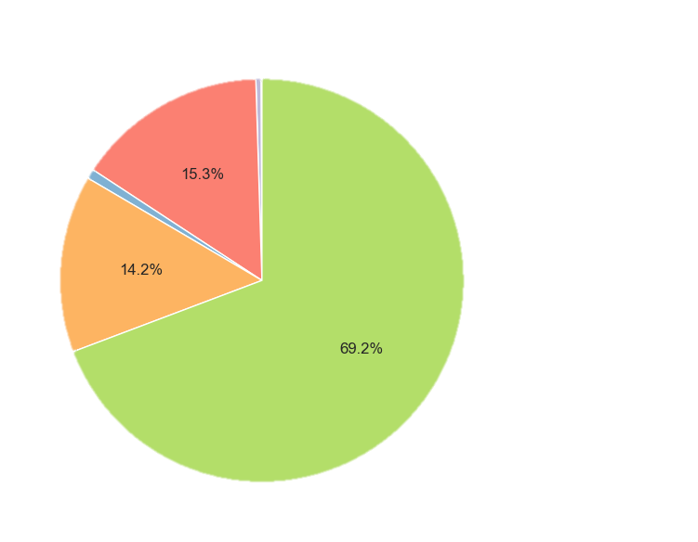
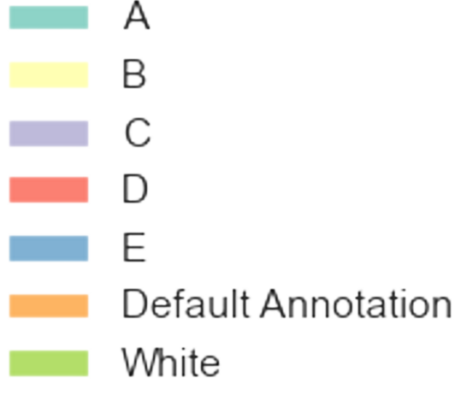
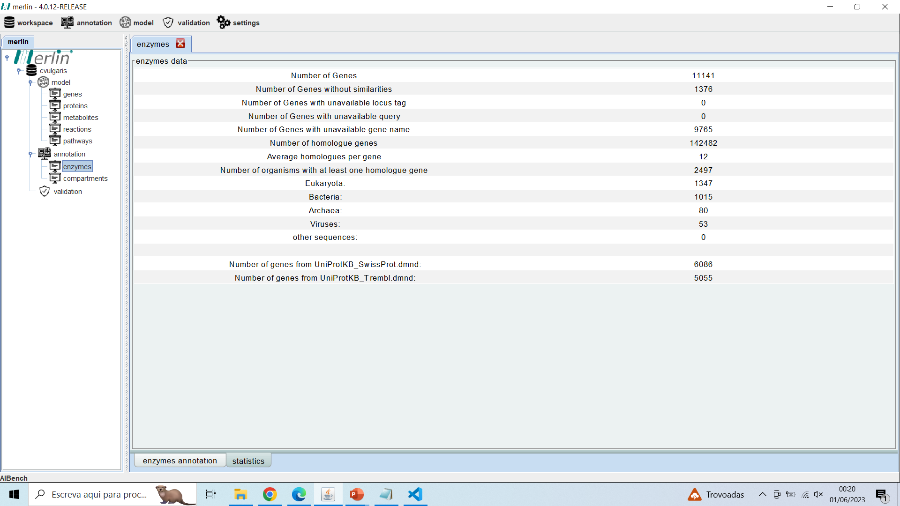
Annotation
Automatic Workflow
species | Chlorella vulgaris | A
genus | Chlorella | B
species | Chlamydomonas reinhardtii | C
species | Arabidopsis thaliana | D
species | Oryza sativa subsp.japonica | E
Automatic Annotation

Slide 8
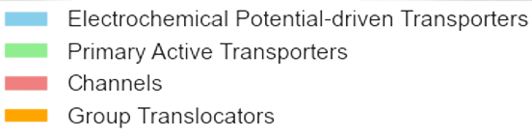
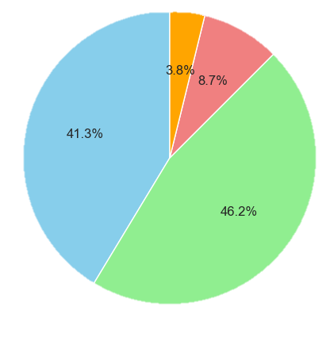
Transport Reactions
Transport mechanism
TranSyT: 468
Manually added: 4
Drains to define the medium:
- H20
- Oxygen
- Orthophosphate
- CO2
- Sulfate
- H+
- Photon
- Nitrate
- Magnesium cation
- Fe2+

Slide 9
Biomass Composition
e-Metabolite | Chlorella vulgaris 211/11P | Chlamydomonas reinhardtii | Chlorella vulgaris UTEX-395
e-Protein | 0,457 | 0,46 | 0,48
e-DNA | 0,001 | 0,003 | 0,006
e-RNA | 0,032 | 0,087 | 0,08
e-Lipids | 0,18 | 0,126 | 0,163
e-Carbohydrates | 0,274 | 0,295 | 0,248
e-Pigments | 0,045 | 0,027 | 0,026
e-Cofactors | 0,011 | 0,002 | -
Source | * | Chlamydomonas reinhardtii model | RAVEN model
mass % (g MM/gDW)
* https://doi.org/10.1371/journal.pone.0262500; 10.1007/s11120-013-9943-x; DOI: DOI: https://doi.org/10.1590/fst.37320; 10.1007/s10529-009-9975-7

Slide 10

Gap-filling
Pathways manually curated so far:
Purine metabolism – 16 reactions added
Pyrimidine metabolism – 5 reactions added
Alanine, aspartate and glutamate metabolism – 0 reactions added
Glycine, serine and threonine metabolism – 2 reactions added
Cysteine and methionine metabolismo – 7 reactions added
Reference organisms:
Chlorella variabilis
Chlamydomonas reinhardtii

Slide 11
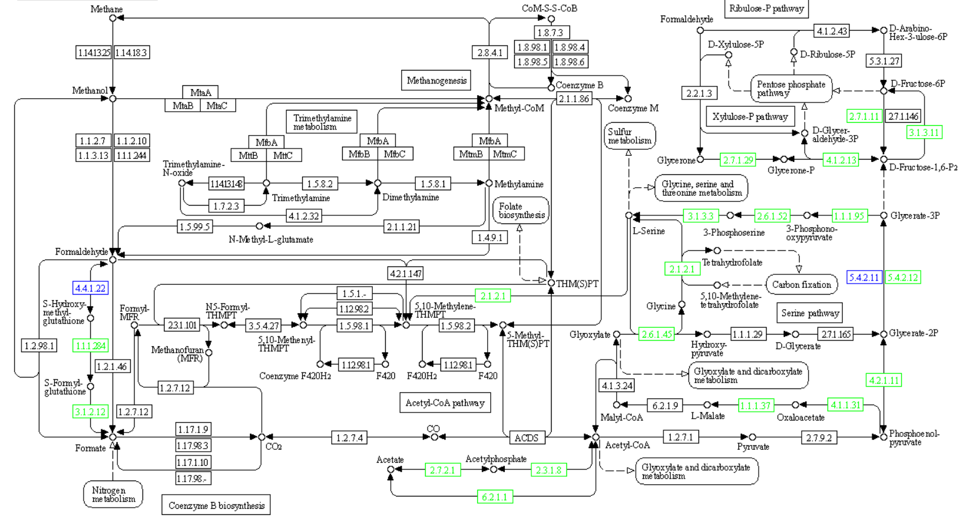
Methane Metabolism

Slide 12

Future work
Gap-filling
Compartmentalization
GPR associations
Finish gap-filling all the pathways
Compartments annotation using loctree
Assemble GPR relationships of different complexities

Slide 13
THANK YOU
Questions?
BY CLAUDIA ALVES
Thesis Defense Presentation Template

