Slide 1


Development of methane mitigation strategies using the microalga Chlorella vulgaris
CH4Green Methane mitigation strategies based on photosynthetic microorganisms
Flash update – january 2024

Slide 2
Rationale and purpose
Wet-lab experiments:
Chlorella dies upon the depletion of CO2
Chlorella exhibits neither growth nor mortality in the presence of CH4
Develop a genome-scale metabolic model for the microalga Chlorella vulgaris

Slide 3
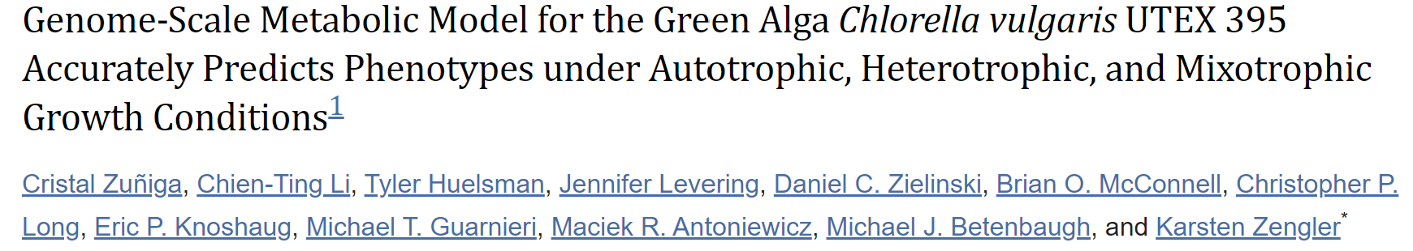
Why should we reconstruct a model for an organism that already has an established model?
Updated genomic information
Methane metabolism was not incorporated in the model

Slide 4
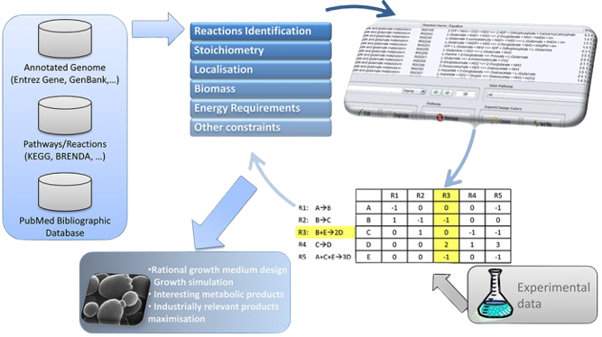


Methodology
Chlorella vulgaris
strain 211/11P

Slide 5

Biomass composition
e-Metabolite mass % (g MM/gDW) | Chlorella vulgaris 211/11P (My model) | Chlamydomonas reinhardtii | Chlorella vulgaris UTEX-395
e-Protein | 0,457 | 0,46 | 0,48
e-DNA | 0,001 | 0,003 | 0,006
e-RNA | 0,032 | 0,087 | 0,08
e-Lipids | 0,18 | 0,126 | 0,163
e-Carbohydrates | 0,274 | 0,295 | 0,248
e-Pigments | 0,045 | 0,027 | 0,026
e-Cofactors | 0,011 | 0,002 | -

Slide 6
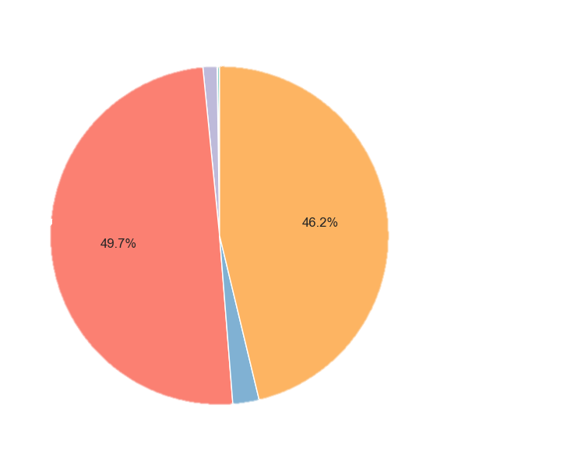
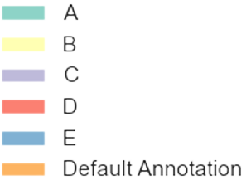
Enzymes Annotation
Homology search using BLAST: SwissProt/TrEMBL
Automatic Workflow
species | Chlorella vulgaris | A
genus | Chlorella | B
species | Chlamydomonas reinhardtii | C
species | Arabidopsis thaliana | D
species | Oryza sativa subsp.japonica | E

Slide 7
Transport reactions and Compartments
TranSyt automatically retrieved information from TCDB
TranSyt: 1428 reactions
Manually: 241 reactions
Compartmentalization was performed using LocTree
11 compartments

Slide 8
Manual Curation
Unbalanced reactions were corrected
Add H⁺ and H2O
Add/correct metabolites formulas
Remove generic reactions
Reversability and directionality
BRENDA, METACYC
Transport reactions
Uptake reactions for metabolites in the medium
Transport mechanisms described in literature
Metabolites crossing the mebrane through simple diffusion
Pathway-by-pathway analysis
Comparison with previous Chlorella and Chlamydomonas reinhardtii models
Generic and redundant pathways were removed

Slide 9
Model Validation
Spontaneous growth
Growth Rate under different conditions
Comparison with experimental uptake values

Slide 10
Photoautotrophic growth
Photon flux: spectral decomposition of solar light measured from Earth’s surface
CO₂ uptake rate
Photosynthetic oxygen evolution: limits the biomass production over 8.31 CO₂ uptake
R_PRISM_solar_litho (646, 646)
EX_C00011(-13.54, 10000)
DM_o2D (0, 8.31)

Slide 11
Heterotrophic growth
Glucose Exchange: experimental data
No photon flux
Additional constraints: RNA sequencing data
EX_C00267 (-0.3025, 10000)
EX_C000205 (0, 0)
Reactions with the enzymes ribulose bisphosphate carboxylase (EC 4.1.1.39), phosphoribulokinase (EC 2.7.1.19), and NADP-dependent phosphorylating glyceraldehyde-3-phosphate dehydrogenase (EC 1.2.1.13) were set to 0.

Slide 12
Mixotrophic growth
Glucose Exchange
Photon flux
CO2 uptake rate
R_PRISM_solar_litho (646, 646)
EX_C00011(-13.6, 10000)
EX_C00267 (-0.3025, 10000)

Slide 13
Growth rates
 | Predicted Growth Rate |  | Experimental
 | My model | iCZ843
Photoautotrophy | 0.245 | 0.0252 | 0.014–0.025
Heterotrophy | 0.0236 | 0.0168 | 0.018–0.025
Mixotrophy | 0.27 | 0.0407 | 0.02–0.03
Units: h⁻¹

Slide 14
Growth rates
Heterotrophic conditions | iCZ843 | My model | Experimental
Glucose + Tryptophan | 0.040 | 0.0239 | 0.040
Glucose + Methionine | 0.032 | 0.0239 | 0.032
Glucose + Acetate | 0.017 | 0.0236 | 0.017
Units: h⁻¹
Assuming an uptake rate of 1 mmol g⁻¹ h⁻¹

Slide 15
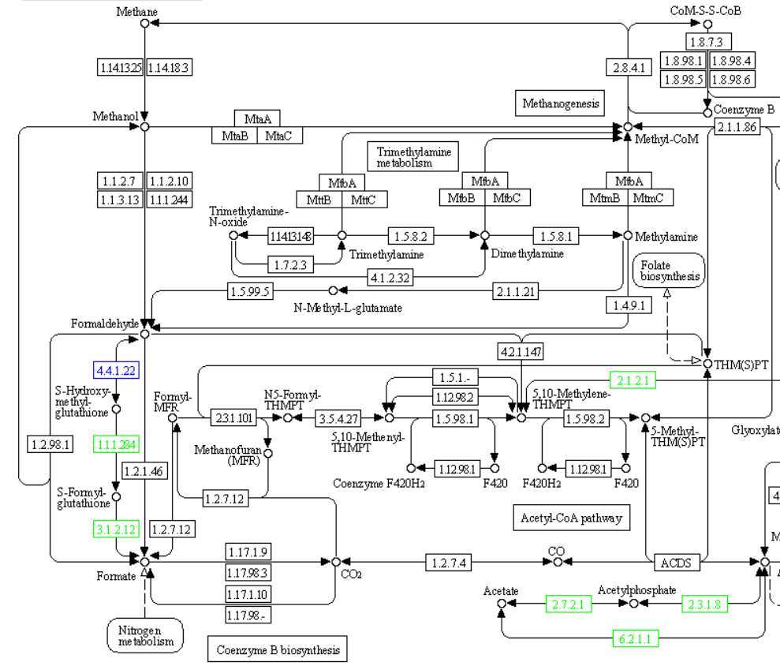

Next steps
Review literature regarding consumption/production of methane
Look for alkanes degrading enzymes

