Slide 1
Title : NEXTRON ECG Using BlockChain
Designed and Developed BY
V Sujatha
S Bhaskar Acharya
Raghavendra K

Slide 2
PROBLEM STATEMENT
How to monitor and Manage heart patients by using Blockchain TechnologyIn countries like India where elderly patients had apparently suffered a heart attack.They managed to restart his heart but the problem persists with the logistical problem of safely getting the gentleman to hospital. All their monitoring devices are heavy and impossible to carry when lifting a patient down stairs. They were forced to disconnect for the lengthy process of moving to the ground floor leaving the patient vulnerable during this time.So our project focuses on building a Mobile application for ECG. A Portable heart monitoring device connected to mobile/tablet via Bluetooth with Web application created using Blockchain.

Slide 3
Project Introduction:
Project Objective,motive and purpose is to design,develop a mobile application focused on rewarding users for good heart health. Below is an executive summary further detailing the project at a highlevel.The Salient features and Qualitative factors are mentioned below
What is the core problem? Describe the pain or need that you are solving
Doctors recommending cardiac rehab and patients not sticking to it
What is the service/product?
A mobile/web dashboard using blockchain technology to incentivize positive heart health
What is your big vision?
Precision/Personalized Medicine -> Tailored care & Incentivized digital cardiac rehabilitation programs to create a heart healthy economy
Incentivized Medicine
Why you and Why Now?
Digital assets (i.e. Bitcoin/Dogecoin) & Machine Learning are hot topics
Family history of heart conditions
Can I change health habits of family members?
What can I build to give me the power to take control of my heart health?

Slide 4
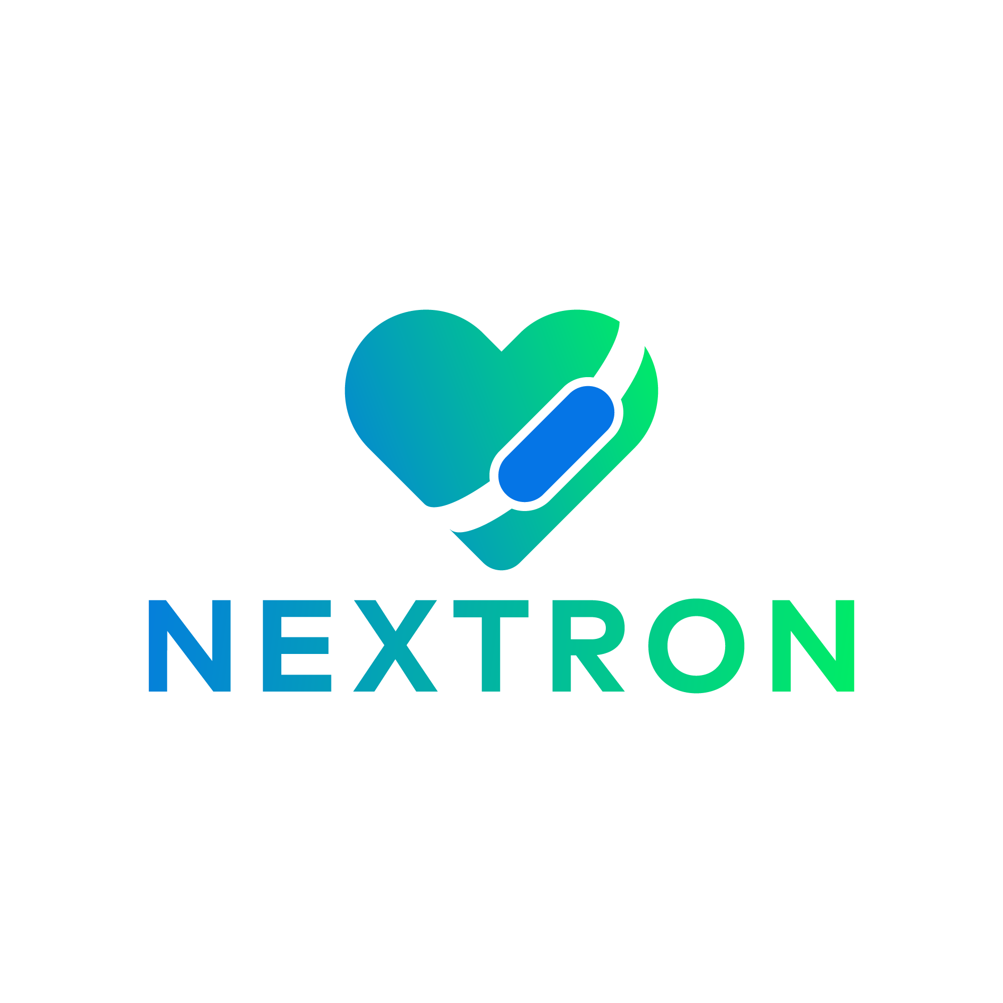
PROJECT Overview:
The Nextron ECG Project explanation done as follows
A web dashboard using gamification & blockchain technology to incentivize positive heart health
User's “mint” their ECG data to earn an exclusive non-fungible token named Heart NFT.
If they so choose, this digital token and the encrypted data it represents can be held or “burned” for future discounts on healthcare services or insurance premiums

Slide 5
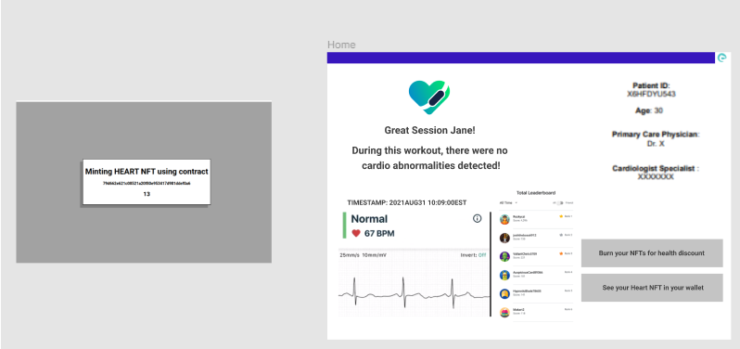
Project Demo
Our demo provides a simulation of reading signals of an ECG using an USB port and "minting" this data into a non-fungible token or NFT.
As this data contains the heart rate/ECG data of an individual more specifically, we will capture 640 images each NFT acts as a "proof of health" creating an exclusive token/point system that we can either use to ensure adherence of patients for doctors or create a similar "competitive leaderboard".

Slide 6
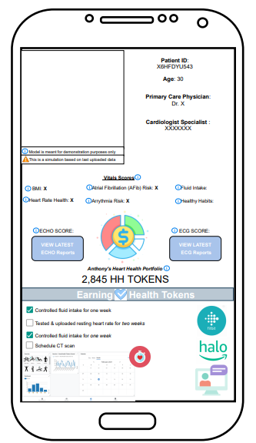

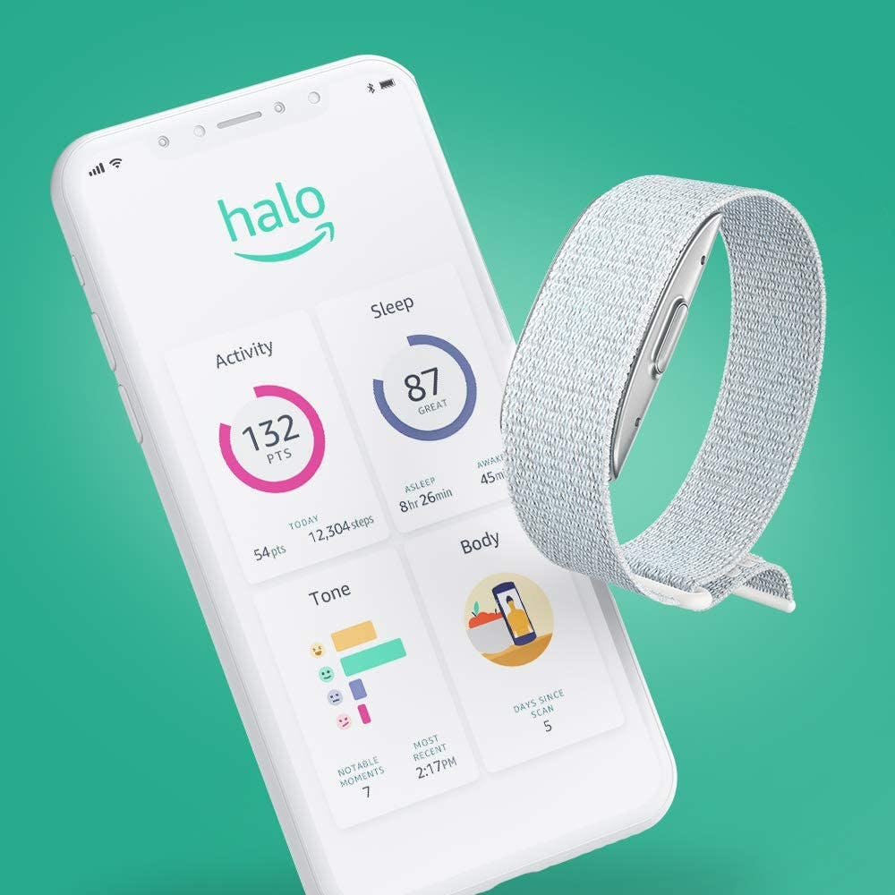
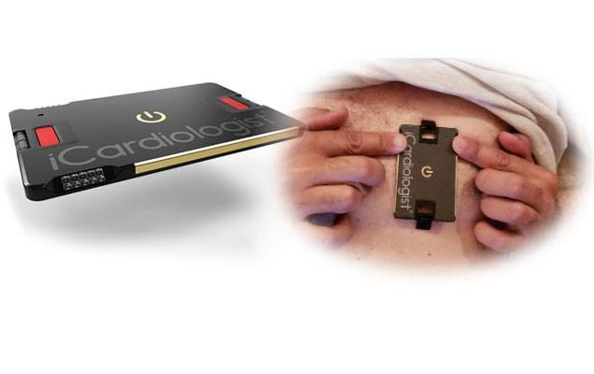
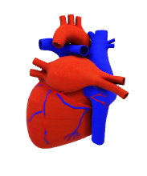
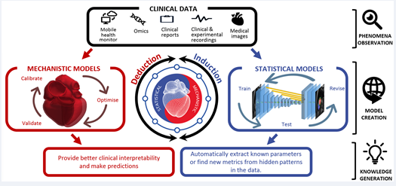




Architecture Diagram:
Here comes the proof of our Mobile Application workflow depicted as follows
Patients
Smarter diagnostics and personalized metrics
Primary Physicians
Cardiologists
Professional Trainers
Dietary Specialists

Slide 7
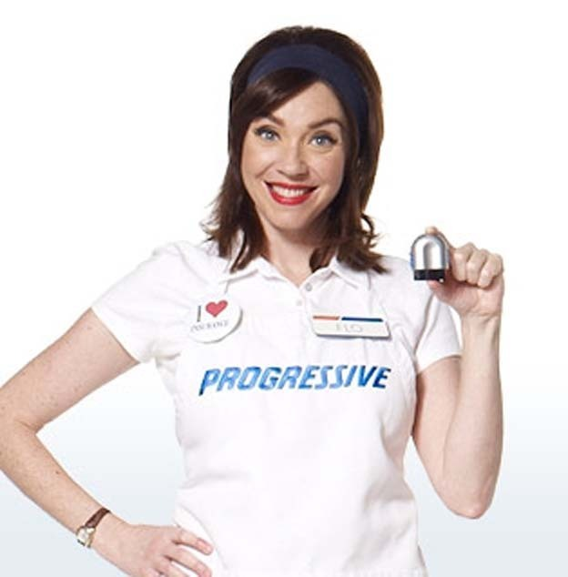




Value Proposition = Heart Healthy Economy
Patients
Professional Trainers
Personalized cardiac therapy
Digital incentives to be healthy
Improving quality of life
Reducing time in cardiac rehab programs*
Primary Physicians
Cardiologists
Tailor and measure effectiveness of recommended cardiac rehabilitation programs
Efficiently manage patient population with heart issues
Dietary Specialists
Leverage client heart health scores & tokens to draft more personalized programs
Pharmaceuticals
Work with to advertise?
Gym
Businesses
Insurance
Draft personalized policies/discounts-CSAT
Lower costs associated with cardiological treatments
Progressive Safe Driving Insurance
Notes:
REFINE
ACO: https://www.ncbi.nlm.nih.gov/pmc/articles/PMC4984671/
Interactive
Iterative
Incentivized
How can we incentivize them to stick with cardiac rehab
Provide patients the power to take control of their heart
How is your solution better, faster, or cheaper than the existing solutions for your customer and other stakeholders?
How is it better in terms of:
Cost savings/ Operational Efficiency
Decreased risks
Improving quality of patient care
Explain how the market is changing and why?
Customer, pricing, competition, new technology?

Slide 8
Track 1 Use data as a trigger: If-This-Then-That (IFTTT) Link to GitHUB Front-end: ReactJS Built on the Zilliqa blockchain (Scilla smart contract) Uses IPFS (nft-stroage) to store and mint user Heart NFTs
Technology Stack

Slide 9
Thank you

