Slide 1
EDTechOnline
Team Name -Elixir

Slide 2
PROLOGUE
Theme: Ed-Tech
Team Name:Elixir
Team Members:
Shailesh
Sreeram
Kiran
Dhirendra

Slide 3
PROBLEM STATEMENT
In the midst of COVID-19, the whole world has realized the power of online learning and the impact it can have on millions of students. We are forced to rethink over how we impart knowledge online and thus need for a platform which helps a teacher to reach every student, regardless the geographic or economic conditions

Slide 4
01
Elixir
What is it? And how does it solve the problem?

Slide 5
INTRODUCTION
Our solution to the problem is EDTECH or EDTECHPortal. It is an online learning platform where teachers can conduct virtual classes, quizzes and can even generate automatic notes for distribution.
EDTECH also caters to the students living in the harsh geographical locations or slow internet with ‘Low Bandwidth Lecture Streaming’ feature

Slide 6
02
Our USP
What makes us different?

Slide 7
01
02
Automatic Notes Generator
Low Bandwidth Mode
Using Azure Cognitive services, transcripts are generated by analysing the teacher’s audio. These transcripts are then passed to an Azure Function that runs a python script to generate an auto-formatted class notes pdf that is stored on Azure Blob Storage.
DALP provides inbuilt support of low bandwidth by replacing live stream with still images from lecture and providing transcript in place of audio

Slide 8
ALL FEATURES
Real time
Notes
Proctoring
Quizzes
Bandwidth
Transcript
Real Time WebRTC based teaching solution
Automatic lecture notes generation
In built proctoring support
Support to take real time quizzes for class
Caters for students with low bandwidth using low bandwidth mode
Real time transcript generation

Slide 9
03
Working
Sneak peek to behind the scenes

Slide 10
TECH STACK
NodeJS
ReactJS
Python 3
WebRTC & Socket.io
Backend
Frontend
Automatic notes generator
Live Streaming of classes and support of low bandwidth mode

Slide 11
AZURE SERVICES USED
AZURE
Azure Functions
Speech Cognitive Services
Module to generate automated notes is hosted using Azure functions
Azure Virtual Machines
Used to convert speech to text for transcript and automatic notes generation
The website and the backend is hosted on Azure Virtual Machines
Azure Blob Storage
Store generated class notes pdf files dynamically in Azure Blob Storage containers

Slide 12
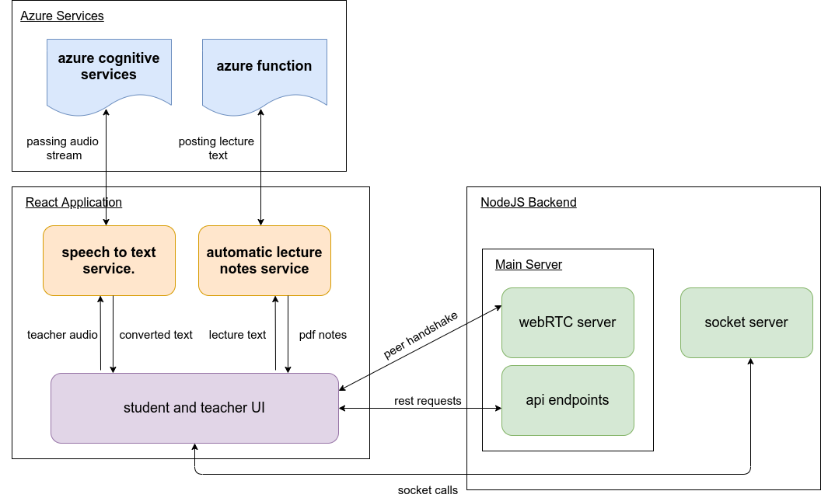
WORKING

Slide 13
04
Business Impact

Slide 14
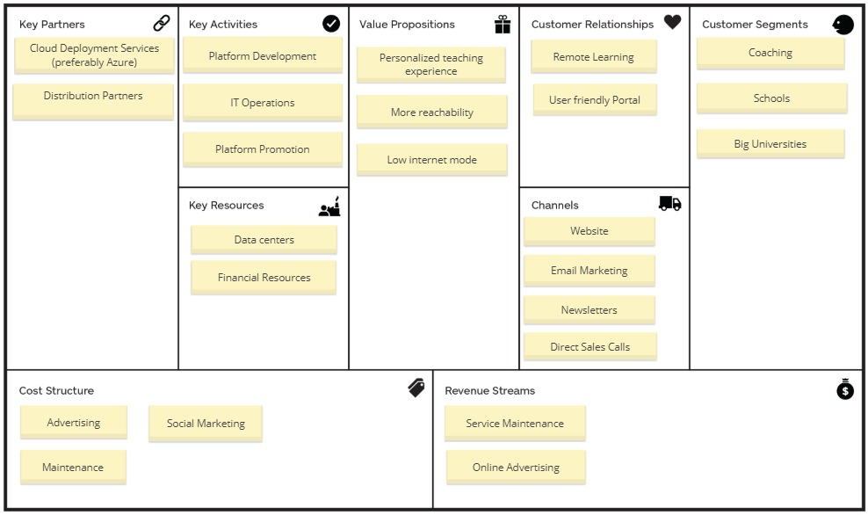
BUSINESS IMPACT
Insert business impact here

Slide 15
Advanatges
Fully Automatic
Enhance Creativity & Visualization
Improve Student-Teacher Collaboration
Incessant Learning

Slide 16
THANK
YOU

