Slide 1
EDTechOnline
Team Name -Elixir

Slide 2
PROLOGUE
Theme: Ed-Tech
Team Name:Elixir
Team Members:
Shailesh
Sreeram
Kiran

Slide 3
PROBLEM STATEMENT
In the midst of COVID-19, the whole world has realized the power of online learning and the impact it can have on millions of students. We are forced to rethink over how we impart knowledge online and thus need for a platform which helps a teacher to reach every student, regardless the geographic or economic conditions

Slide 4
01
Elixir
What is it? And how does it solve the problem?

Slide 5
Feasibility Analysis
Due to covid19 pandemic situation the governments across the world looking for ways to shift education to online platforms due to the pandemic situation. As a result of this, many platforms have emerged which provide interaction between teachers and students. Though online teaching culture is gaining widespread attention, they are not infallible and the government is giving out surveys to validate the effectiveness of these tools. EDtech possesses the capability of coupling with any of these platforms and providing an accurate analysis of student/teacher engagement.
education administration: It becomes difficult for the administration like schools, colleges,etc to have an unbiased feedback of the students for the faculty. This leads to incompetence, posing threat to the quality of education. Our product is capable of taking the attentiveness statistics of the whole class and using mathematical calculations to analyse the effectiveness of a faculty. For example, let’s say we calculate the average attentiveness for the whole class and if it is low, we can conclude that either the faculty is not putting enough effort or his/her pedagogy is a bit screwed. Accordingly, further actions can be taken.
Teaching faculty: Virtually, it becomes impossible for the faculty members to track every student. Although it doesn’t affect other students’ performance, it certainly results in casual behaviour and short attention span of students. Using this tool faculty members can see reports of individual students and their performance during the lecture. Consistently poor performing students can be identified and necessary actions maybe taken.

Slide 6
INTRODUCTION
Our solution to the problem is EDTECH or EDTECHPortal. It is an online learning platform where teachers can conduct virtual classes, quizzes and can even generate automatic notes for distribution.
EDTECH also caters to the students living in the harsh geographical locations or slow internet with ‘Low Bandwidth Lecture Streaming’ feature

Slide 7
02
Our USP
What makes us different?

Slide 8
01
02
Automatic Notes Generator
Low Bandwidth Mode
Using Azure Cognitive services, transcripts are generated by analysing the teacher’s audio. These transcripts are then passed to an Azure Function that runs a python script to generate an auto-formatted class notes pdf that is stored on Azure Blob Storage.
DALP provides inbuilt support of low bandwidth by replacing live stream with still images from lecture and providing transcript in place of audio

Slide 9
ALL FEATURES
Real time
Notes
Proctoring
Quizzes
Bandwidth
Transcript
Real Time WebRTC based teaching solution
Automatic lecture notes generation
In built proctoring support
Support to take real time quizzes for class
Caters for students with low bandwidth using low bandwidth mode
Real time transcript generation

Slide 10
03
Working
Sneak peek to behind the scenes

Slide 11
TECH STACK
NodeJS
ReactJS
Python 3
WebRTC & Socket.io
Backend
Frontend
Automatic notes generator
Live Streaming of classes and support of low bandwidth mode

Slide 12
AZURE SERVICES USED
AZURE
Azure Functions
Speech Cognitive Services
Module to generate automated notes is hosted using Azure functions
Azure Virtual Machines
Used to convert speech to text for transcript and automatic notes generation
The website and the backend is hosted on Azure Virtual Machines
Azure Blob Storage
Store generated class notes pdf files dynamically in Azure Blob Storage containers

Slide 13
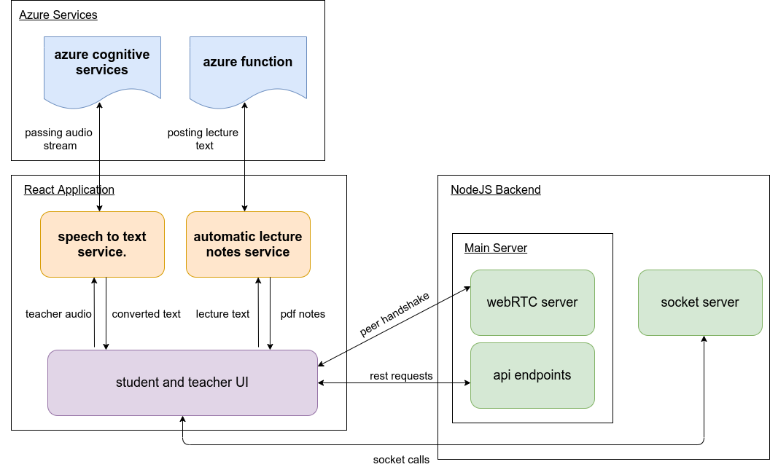
WORKING

Slide 14
04
Business Impact

Slide 15
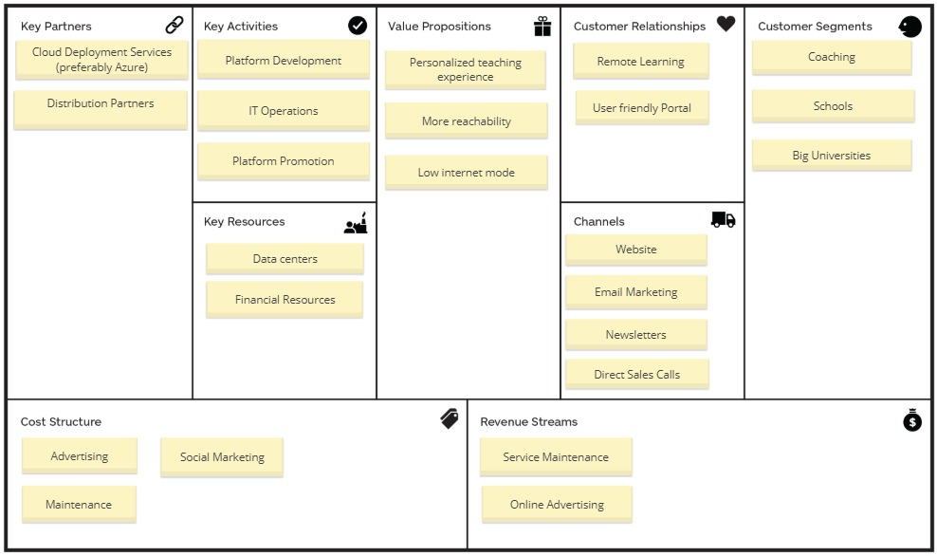
BUSINESS IMPACT
Insert business impact here

Slide 16
Advanatges
Fully Automatic
Enhance Creativity & Visualization
Improve Student-Teacher Collaboration
Incessant Learning

Slide 17
THANK
YOU

