Slide 1
HealthCare
Team name:
Elixir
Team member names:
Pradeep
Kiran

Slide 2

PROJECT TITLE
ELECTRONIC
HEALTH
RECORD
A Blockchain based decentralised healthcare application

Slide 3

PROBLEM STATEMENT
EHR generally contain highly-sensitive and critical data related to patients, which is frequently shared among clinicians, radiologists, healthcare providers, pharmacists, and researchers, for effective diagnosis and treatment. Hence may use blockchain technology for accessing and managing the privacy and security of patient data and history in clinical practices.

Slide 4
Problem overview
The number of healthcare data breaches in 2020 seems to have doubled in recent weeks, and the HIPAA Breach Reporting Tool website of the Department of Health and Human Services lists a total of 105 breaches affecting more than 2.5 million individuals, adding to the tally of 2020.Apr 6, 2020
The industry has fallen trap to new forms of cyber hacking due to the nature of customer information they handle, and the relative lack of knowledge on the industry’s end in terms of security awareness.
IBM reported that cybercriminals are more likely to steal data from hospitals’ databases because their security systems are usually outdated, despite the fact that the data they handle are vulnerable.
The consequences of healthcare security breaches may cost up to Rs. 15,000 per patient record, including post-breach losses like organizational reputational damage and consequent business lost.

Slide 5
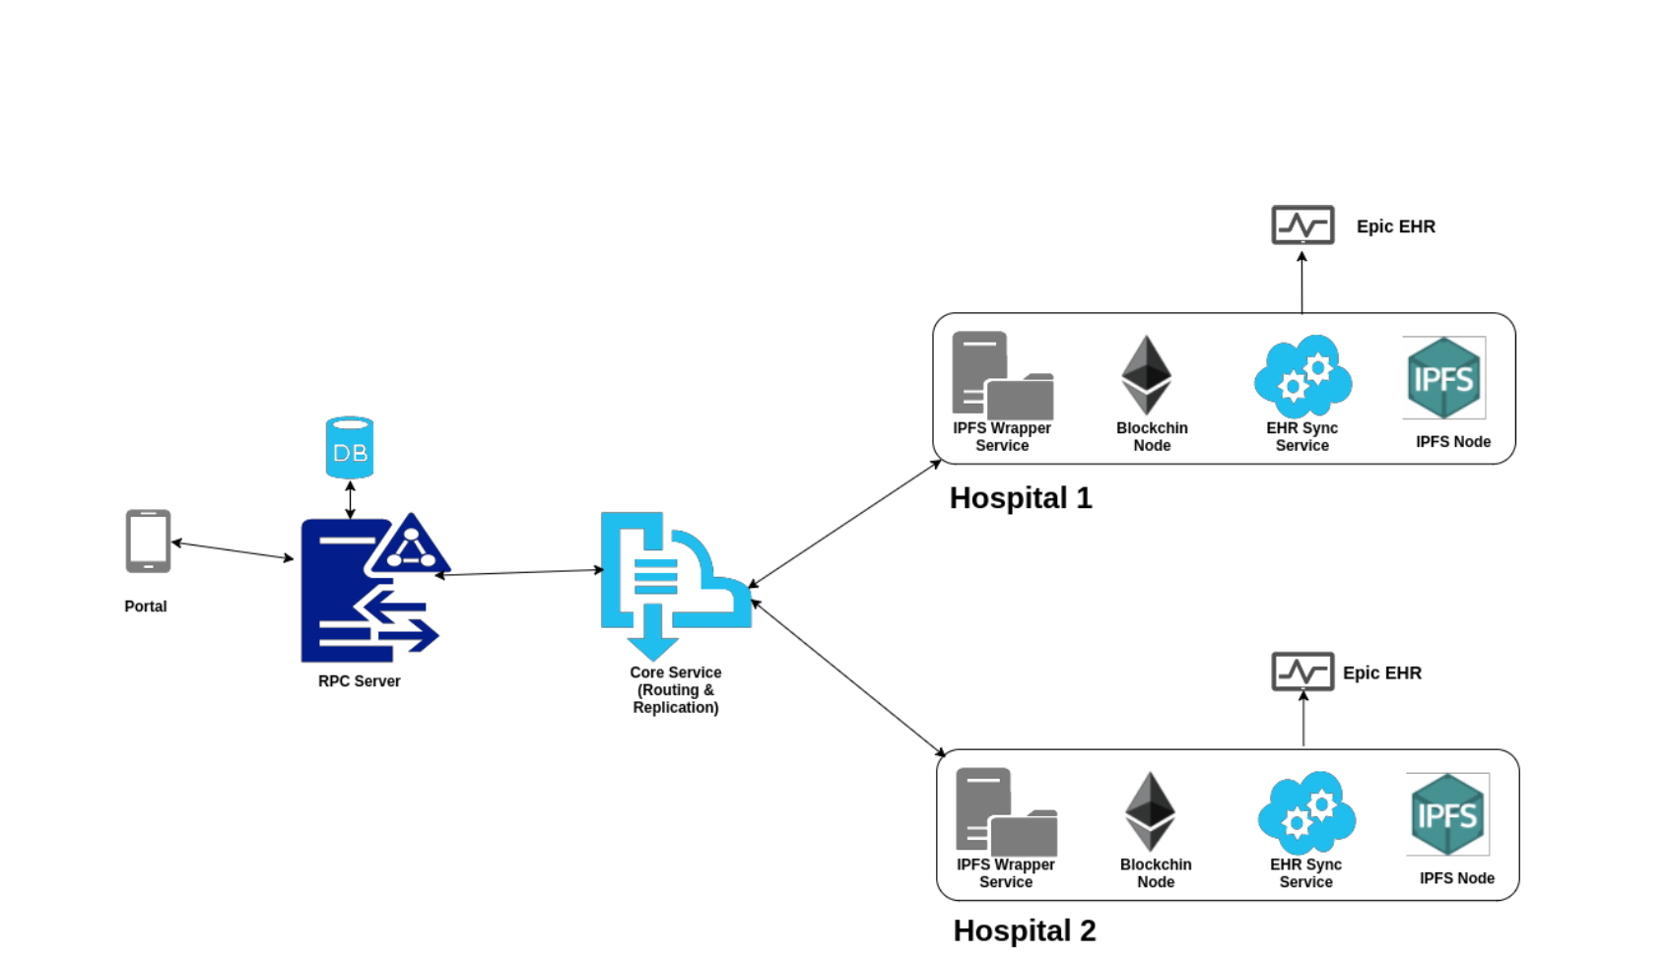
We aim to build blockchain based decentralised web application which will provide privacy and security to the patients’ health record using RSA encryption algorithm,Access Control and IPFS. The system gives appropriate scope over a health record only on patient’s permission.
APPROACH

Slide 6
SOLUTION
Building a blockchain-based decentralized web app that will provide privacy and security to the patients’ health record and reduce the expenditure caused by data breaches and third party involvement unlike other centralised web-apps.
Our application secures the initial stage of registration of hospital staff and patients. This is done by Access Control using OpenZeppelin, thus making the network private.
We have an one-click login through Metamask Wallet which removes the hassle of remembering the private key and cumbersome form-filling.
Our second stage of security is given by multi-level encryption (on strong cryptography of ethereum) of both patient’s report and the AES key encrypting it. This satisfies the main function of our Dapp i.e the patient controlling who can view his records, thus removing third-party involvement. The user is unaware of the complex encryption/decryption going on in the background.

Slide 7
SOLUTION
Our third stage of security is storing the encrypted report in a decentralised storage i.e IPFS (InterPlanetary File System) and the encrypted AES key on blockchain. Thus removing any centralisation in our Dapp.
We have used IPFS because the major issue with the HTTP protocol is its client-server model. The main concept is to address the content by the content itself instead of the server it is stored on, with the content retrieved from the nearest computer.
The Dapp also includes a demo-bot which provides guided tutorials to first-time users.

Slide 8
USE CASE
The public key is the identification of every user in the network. It keeps changing dynamically.
A user can only be registered by the hospital admin from the Dapp. After being registered, users can log in to the Dapp from the browser by one-click login through Metamask Wallet.
The Doctor/ Lab technician can then send the report to the patient by just uploading the file in the input field and entering patient’s public key. In the background, this file will be encrypted with a random AES key and sent to IPFS for storage. The AES key encrypted with the patient’s public key will be stored on the blockchain.
The Patient can log in and enter the “View Records” page and can download his report. In the background, the file will be decrypted by first decrypting the encrypted AES key by the patient’s private key and then decrypting the file .After decryption, the file automatically gets downloaded.
Every hash in the patient’s “View Records” page has a permit and revoke button attached to it, using which the patient can permit or revoke the permission granted to a particular practitioner.

Slide 9
USE CASE
The doctor/ the lab technician can enter a particular IPFS hash and view the record only if he has the permission given by the patient (AES key of the file encrypted with the doctor’s/lab technician’s public key is attached to that IPFS hash).
Demo bot is used to make the web app more user friendly by giving a demo run. This is implemented by selenium service.

Slide 10
Why Blockchain?
Cybercriminals attacked the healthcare industry at a higher rate than any other sector in 2020, and more than 2.5million healthcare records compromised upto April 2020 according to a report published by IBM.
Since there is no third party involved in fetching the patient data or in transferring the data from one party to another, there is greater cost-effectiveness attached with employing Blockchain technology in Healthcare than in a scenario where a decentralized system is missing.
Transparent and highly secure ledger with minimum chances of misplacement.
A single place for all the parts of the healthcare system to access records securely.
Peer to peer sharing; patient-centric system.
Global Unique Identifiers(address) for every Patient in the network of Healthcare Industry.
Global Database System for entire Healthcare Industry.
Built on top of Ethereum platform that has built in data integrity based on strong cryptography.

Slide 11
Unique and user friendly features
Demo Bot to give a guided tutorial to the novice users.
User friendly front-end which is similar like other app but has inbuilt blockchain and encryption features.
One click metamask login system.
Access control - which is not implemented in other EHR based blockchain.
Multilevel encryption on inbuilt Ethereum’s strong cryptography.
Super admin has supreme control.

Slide 12

ReactJS
Bootstrap
Web3js
Blockchain (Ethereum)
IPFS for decentralised file storage
RSA for asymmetric encryption
OpenZeppelin for Access Control
Selenium for Demo Bot
Truffle-react framework.
Metamask Wallet
TECHNOLOGICAL STACK

Slide 13
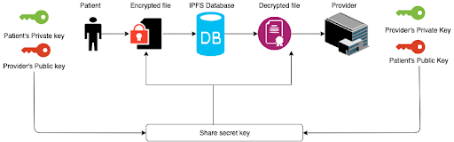
Encryption-Decryption flow

Slide 14
OUTCOME
Transparent and highly secure ledger with minimum chances of misplacement.
A single place for all the parts of the healthcare system to access records securely.
Peer to peer sharing; patient-centric system.
Global Unique Identifiers(address) for every Patient in the network of Healthcare Industry.
Global Database System for entire Healthcare Industry.
Built on top of Ethereum platform that has built in data integrity based on strong cryptography.
It will permit other network members to obtain and interact with EHRs with the patient’s permission.
Since there is no third party involved in fetching the patient data or in transferring the data from one party to another, there is greater cost-effectiveness attached with employing Blockchain technology in Healthcare than in a scenario where a decentralized system is missing.
The flow of the record is monitored thus keeping the track of the people accessing it.

Slide 15
FUTURE SCOPE
The web app can be turned into a complete healthcare app supported by privacy and security given by blockchain technology.
Hospital supply chain management can be done through blockchain thereby solving the issues with traditional supply chain management.
Data generated by the IOT devices connected with the app can be secured with blockchain technology.
A mobile app using cloud storage can be made for better user experience.
Storing user data(.json file) on RFID patient cards.

Slide 16
THANK YOU

