Slide 1
Dare in Reality Challenge
High Confidence OCR Subsystem

Slide 2
Approach
The main approaches to accomplish this task: classifying words directly and character segmentation. Convolutional Neural Network (CNN) with various architectures is used to train a model that can accurately classify words and Long Short Term Memory networks (LSTM) with convolution is used to construct bounding boxes for each character. Later segmented characters to a CNN are passed for classification, and then reconstruct each word according to the results of classification and segmentation.

Slide 3
Work Flow Components
A. Supervised Learning Supervised learning algorithms are trained using labeled examples, such as an input where the desired output is known. For
example, a piece of equipment could have data points labeled either “F” (failed) or “R” (runs). The learning algorithm receives a set of inputs along with the corresponding correct outputs, and the algorithm learns by comparing its actual output with correct outputsto find errors. It then modifies the model accordingly. Through methods like classification, regression, prediction and gradient
boosting, supervised learning uses patterns to predict the values of the label on additional unlabeled data.
B. OpenCV(Open Computer Vision)
OpenCV (Open Source Computer Vision) is a library of programming functions mainly aimed at real-time computer vision.Originally developed by Intel, it was later supported by Willow Garage then Itseez (which was later acquired by Intel). The library
is cross-platform and free for use under the open-source BSD license. OpenCV supports the deep learning frameworks TensorFlow,Torch/PyTorch and Caffe
C. OCR(Optical Character Recognition)
OCR (Optical Character Recognition) also called Optical Character Reader is a system that provides a full alphanumeric recognition of printed or handwritten characters at electronic speed by simply scanning the form. More recently, the term Intelligent Character Recognition (ICR) has been used to describe the process of interpreting image data, in particular alphanumeric text. Function of OCR Forms containing characters images can be scanned through scanner and then recognition engine of the OCR system interpret
the images and turn images of handwritten or printed characters into ASCII data (machine-readable characters). Therefore, OCRallows users to quickly automate data capture from forms, eliminate keystrokes to reduce data entry costs and still maintain the high level of accuracy required in forms processing applications. Features of OCR The technology provides a complete form processing
and +documents capture solution. Usually, OCR uses a modular architecture that is open, scaleable and workflow controlled. It includes forms definition, scanning, image pre-processing, and recognition capabilities. What is ICR Intelligent Character Recognition (ICR) is the module of OCR that has the ability to turn images of hand written or printed characters into ASCII data. Sometimes OCR is known as ICR.
D. Tesseract with Python: pytesseract
It will recognize and read the text present in images. It can read all image types - png, jpeg, gif, tiff, bmp etc. It’s widely used to process everything from scanned documents.Tesseract works best when there is a (very) clean segmentation of the foreground text from the background. In practice, it can be extremely challenging to guarantee these types of segmentations.

Slide 4
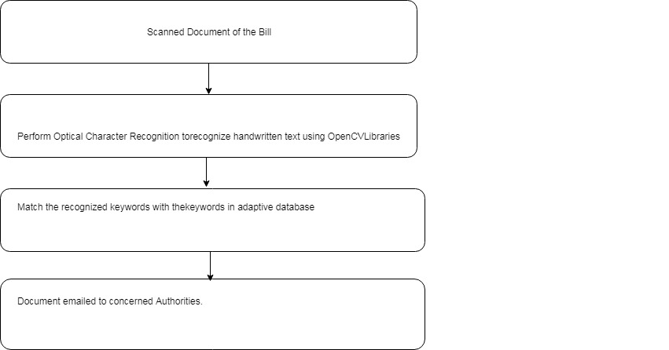
Proposed System Details
Main Objective of the proposed system is to evaluate the scanned images .
The Proposed System works as follows. Firstly images of any type are scanned using scanner. OpenCV is used for reading the scanned image. As a part of OCR, image is first converted to greyscale and then OpenCV applies two morphological operations on the converted greyscale image i.e., dilation and erosion to remove noise, Isolation of individual elements and joining disparate elements
in an image and finding of intensity bumps or holes in an image. Then perform Image segmentation by using threshold function toget image in black and white background. Threshold function of OpenCV separates out the regions of an image corresponding to
objects which we want to analyze. This separation is based on the variation of intensity between the object pixels and the background pixels. This thresholding is a critical step in Optical Character Recognition (OCR).Tesseract, A Google’s OCR Library is applied for precise character and word identification from the image. A programming language python is used in this process.
The keyword recognizer software then asks the user for evaluation scheme and pattern and fetches respective answers from the adaptive database. Then it finds a match between written keywords and database. Based on the number and rate of matches, awarded for every answer

Slide 5
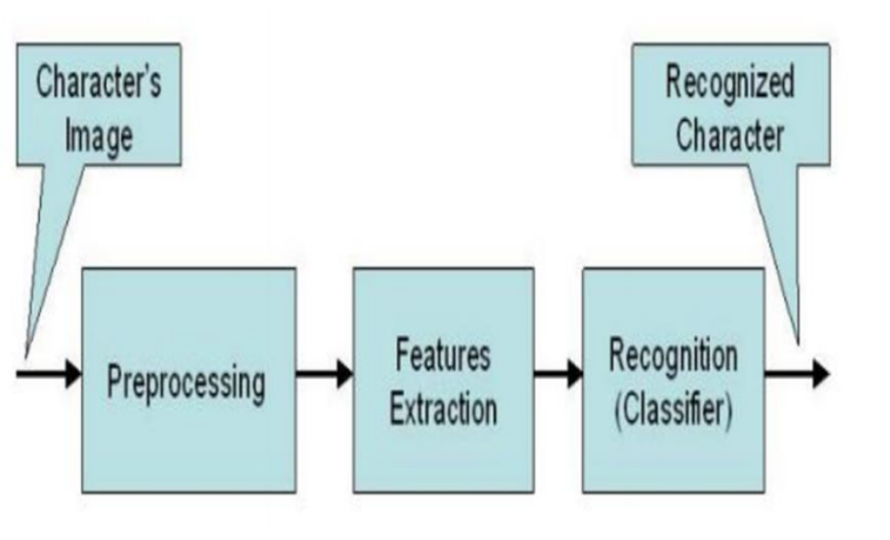
Structure of Character Recognition in an Image

Slide 6
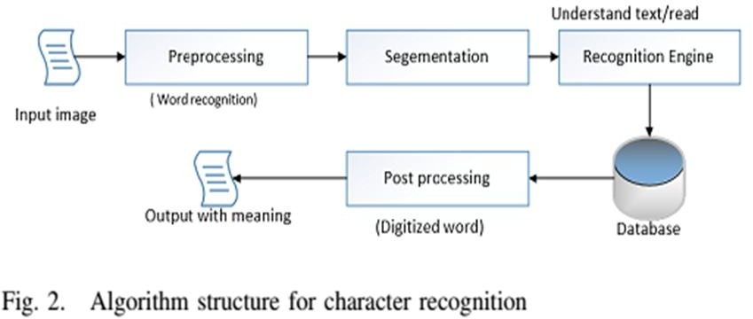
Algorthmic Structure for Character Recognition

Slide 7
End of the Document

