Slide 1

Smart Kirana
Making things easier for shopkeepers

Slide 2
TEAM MEMBERS
Kiran Kumar
Aakanksha Tewari
Namisha Goyal
Parul Bansal

Slide 3
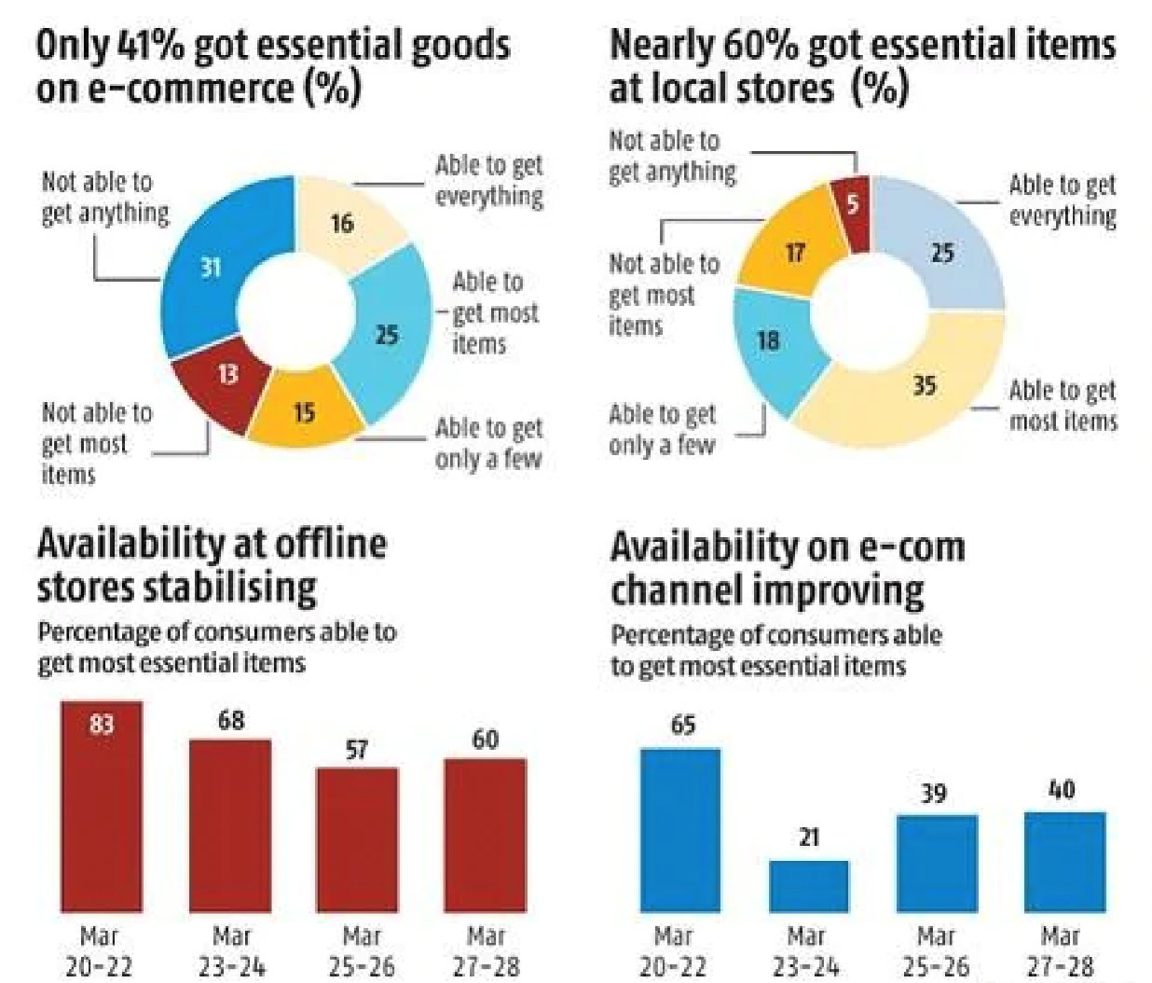
Growth of Kirana Stores in India
India's expanding retail landscape is changing fast, with global and domestic consumer and retail behemoths fighting tooth and nail to woo shoppers, as many choose large, clean supermarkets over crowded local stores and ordering online.
Data from Forrester Research shows India's retail market was worth an estimated $883 billion last year, of which grocery retail accounted for $608 billion. By 2024, the market is expected to grow to $1.3 trillion.
India - population 1.3 billion - has over the years become a sought-after retail destination with a growing base of young and affluent shoppers. The sector contributes 10% to India's gross domestic product and accounts for 8% of India's employment, according to Invest India, the country's investment promotion arm.

Slide 4
Problems
Varying Requirements
Dynamic change in interest
Customers interest changes very frequently according to the current market. Hence, a system is required which keep track of items whose sale increases suddenly
Ex. Clothing has strong seasonal pricing trends and is heavily influenced by brand names.
Marketplace giants tend to take tremendous commissions using undisclosed terms. Also, its difficult for local shopkeepers to understand the market trend.
There is change in requirement of products every month/season. Eg: people tend to buy cold drinks more in summers and warm things in winters. Hence, its important for a store owner to keep track of this data.
Exploitation

Slide 5
Solution & Social Benefits
We will provide a solution to the storekeeper which will suggest them required and important items for each month or customized duration using past history of items
We will also keep a dynamic suggester which will inform storekeeper about items whose demand increased suddenly i.e. the items which are bought in large number from the store.
Our solution would not be based on past history of store, instead past history of market of the place which will not limit the storekeeper to known items, instead storekeeper will understand about the required demand.

Slide 6
Business Benefits
Our idea would be based on active learning i.e. the model will train itself on the new data along with the previous dataset.
Since, we are analyzing data of the whole market instead of particular shop, shopkeepers can get to know about the items which people wants rather than items which the shop owns.
Analyzing data of past 10-20 years is difficult to do manually. Hence, our ML Model will prove out to be trustworthy and efficient to predict relevant goods.

Slide 7
Revenue Model
The portal can work either in a freeware upselling model or a SaaS subscription model.
As our focus is to help the small sellers, we aim to maximize their profits as much as possible by use of Aurora.
By use of Aurora, we aim to provide sellers with real time price prediction which cannot be done otherwise.

Slide 8
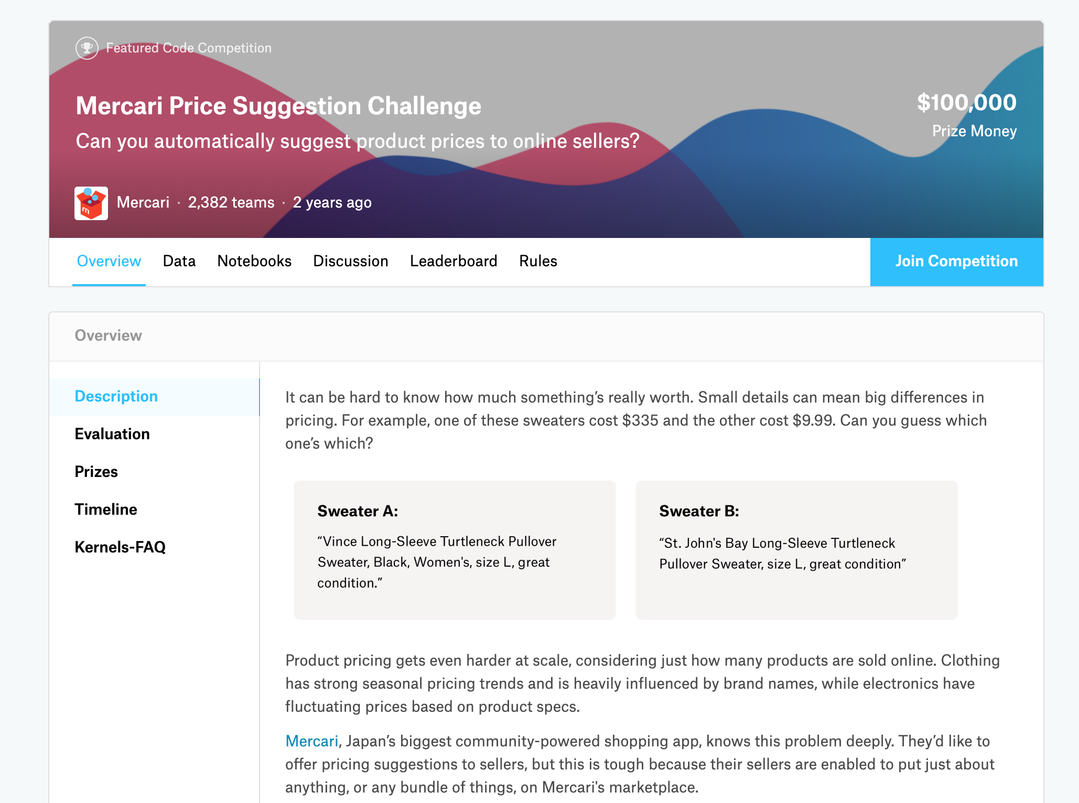

Data-Set
Mercari Price Suggestion Challenge(Kaggle) was used to simulate our use case.
It consists of following factors:
Item Name
Condition
Shipping
Brand Name
Category Name
Item description
Price (Target Variable)

Slide 9
Technology Stack
python
bash
scikit-learn
ARIMA model with Framework of vectorized and distributed data analytics

Slide 10
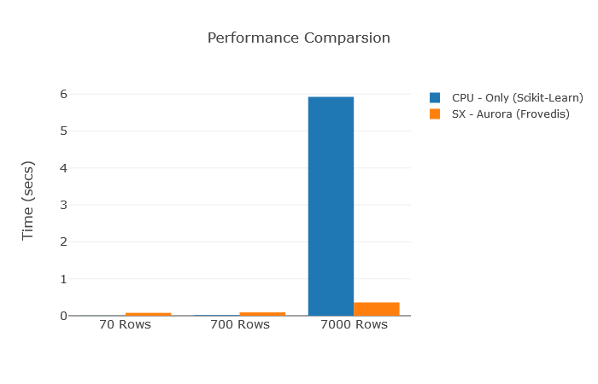
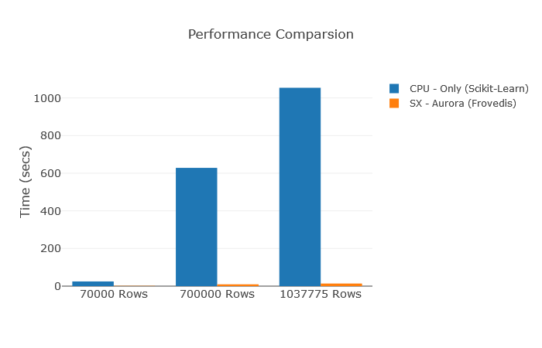
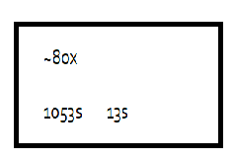
Performance Analysis with Graphs In the Project
Key Findings and Observations Made in Before and After Deploying the Arima Model Chart1 vs Chart2 The Performance Comparision difference we received in large datasets was phenomenally faster.When we extrapolate this to include other factors like other seller rates, time of year, etc., the speed becomes a critical part which solves our bottleneck for the use case.

Slide 11
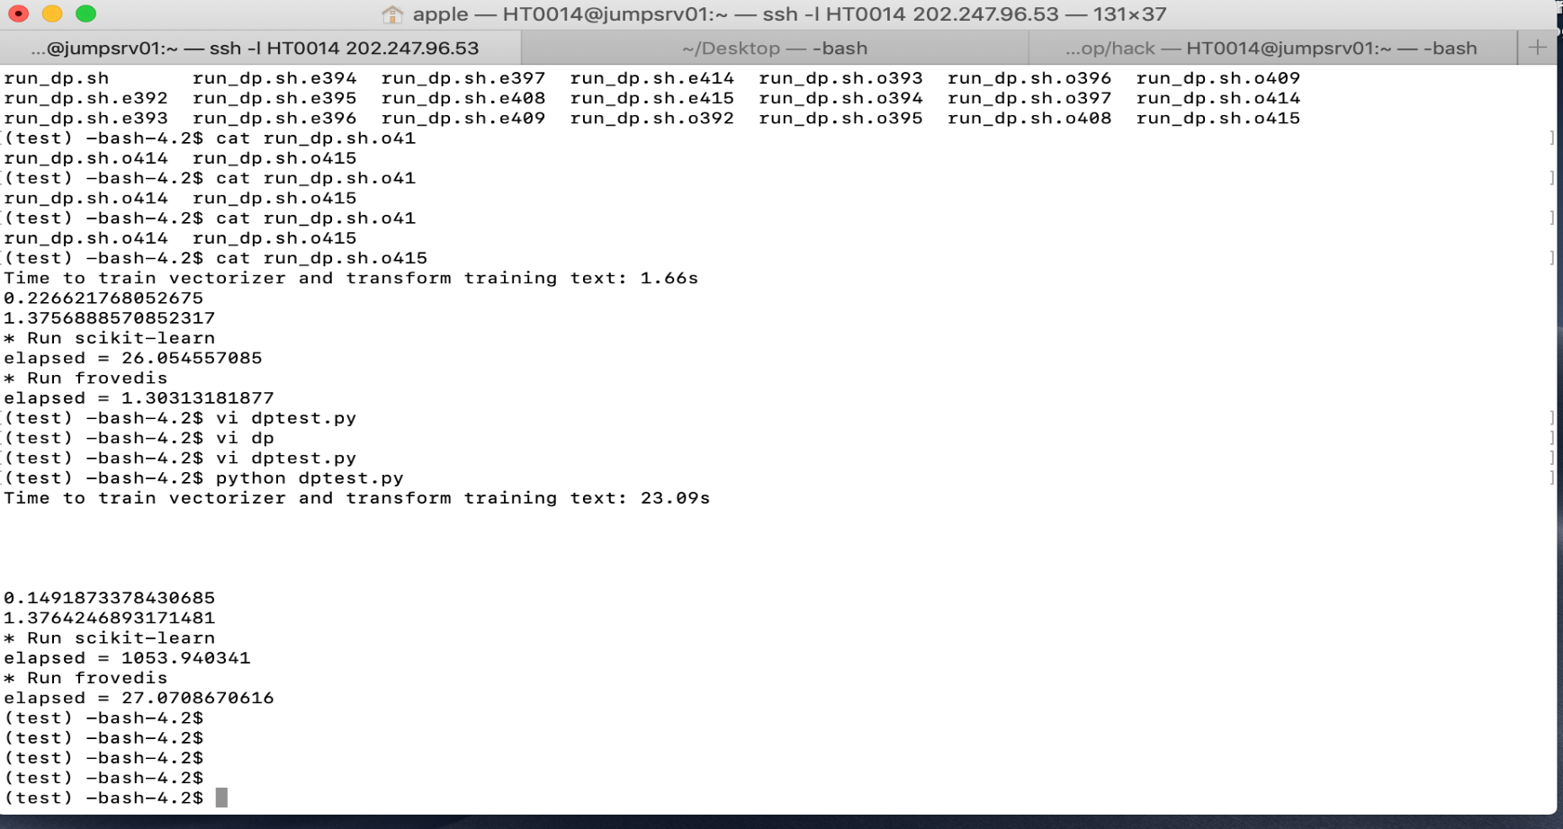
Results with Python Code

Slide 12
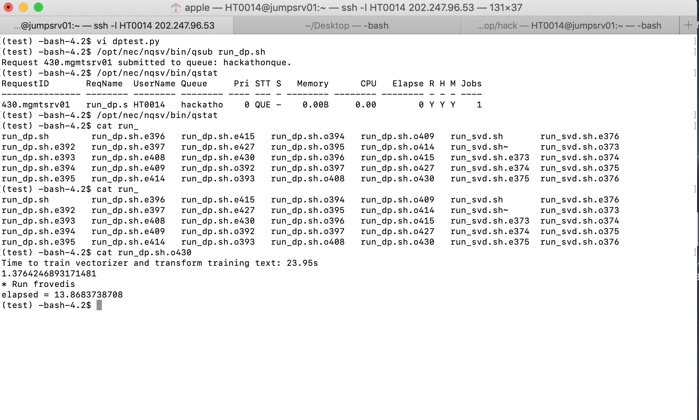
Results with Python Code

Slide 13
Use of Supercomputer
A normal price prediction dataset takes more than 20 minutes to process using scikit.
To achieve our purpose, we need to provide faster and real-time price predictions to sellers in our portal.
Supercomputer speeds up the model by ~80 times which not only makes our solution available real-time but makes us much more resilient towards dynamic changes.

Slide 14
Thank You :) Questions?

