Slide 1




A resource manager and batch scheduler for large clusters
OAR

Slide 2
Overview
Batch scheduler / resource manager
Clusters / Grids
Open Source

Slide 3
Technical Overview
Perl
SSH
DataBase: MySQL / Postgres

Slide 4
Features
Batch and Interactive jobs
Reservations
Besteffort jobs
Job dependencies

Slide 5
Features
Environment deployment (taktuk)
Good nodes cleaning after a job (cpuset feature)
Multi-scheduler (one of these provided is Fair-Sharing)
Gantt scheduling
Two web interfaces

Slide 6
Advantages
No specific daemon on nodes
No dependence on specific computing libraries (like MPI)
Upgrades are made on the servers, nothing to do on computing nodes
Manages heterogeneous clusters

Slide 7
Advantages
Checkpoint / resubmit jobs
Licences servers management support
Hierarchical resource requests
(heterogeneous clusters)
Dynamic nodes support

Slide 8
Principles
Database
Contains all the OAR’s cluster knowledge
OAR’s communications nerve center
Everything is a resource
Compute nodes, cpus, cores, licences, memory…
Flexible resources hierarchy

Slide 9
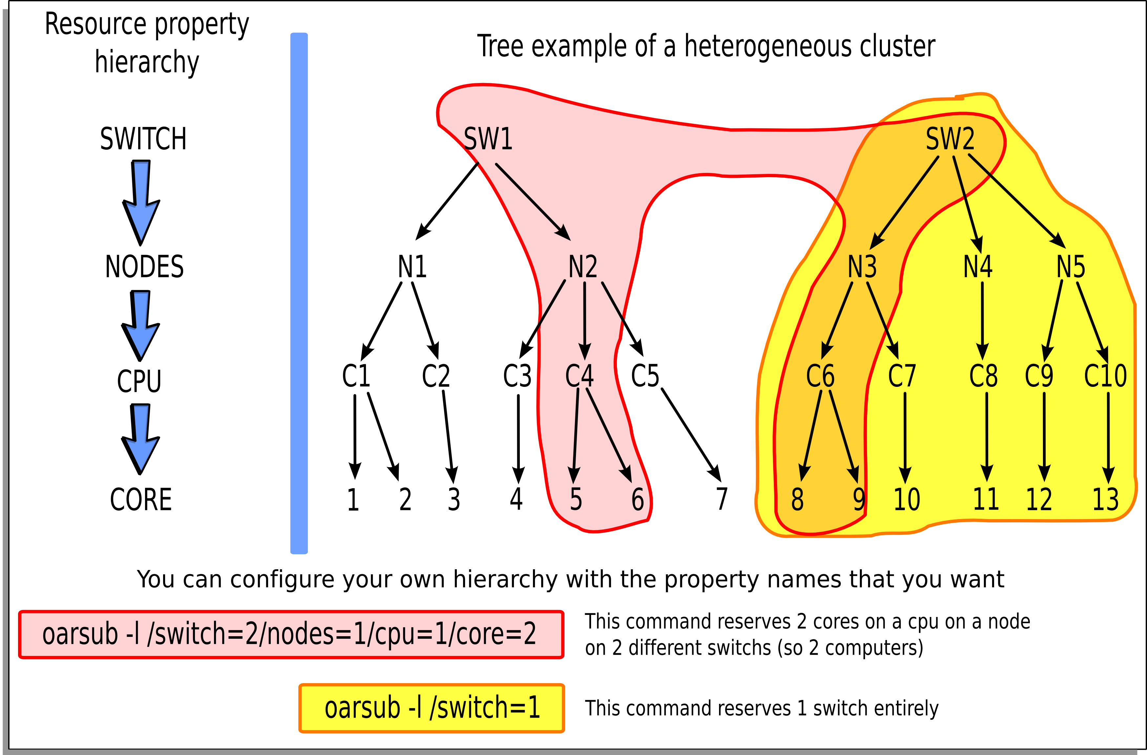
Resources hierarchy example

Slide 10
Principles
SSH wrapper OARSH: only way to connect a node
Use of cpuset: enhances job cleaning
Temporary users: better isolation

Slide 11
Principles
Taktuk based: (http://taktuk.gforge.inria.fr)
Large scale remote execution deployment
Used for nodes management
Scheduling implementation language is free

Slide 12


Partners

Slide 13
Contact
http://oar.imag.fr

Slide 14
Demos

