Slide 1
Project：CoLA
TA: 周俊儒
zhoujunru@sjtu.edu.cn

Slide 2
Task Setup
1. Convert SQuAD (Rajpurkar et al. 2016) into sentence pair classification by forming a pair between each question and each sentence in the corresponding context.
2. The task is to determine the acceptability (grammaticality) by their original authors. (0 (unacceptable) / 1(unacceptable))
3. Task formation
Column 1: the code representing the source of the sentence.
Column 2: the acceptability judgment label (0=unacceptable, 1=acceptable).
Column 3: the acceptability judgment as originally notated by the author.
Column 4: the sentence.
Example:
Clc95 0 * In which way is Sandy very anxious to see if the students will be able to solve the homework problem?
c-05 1 The book was written by John.
c-05 0 * Books were sent to each other by the students.
Swb04 1 She voted for herself.
Swb04 1 I saw that gas can explode.

Slide 3
Data Statistics
Download: https://gluebenchmark.com/tasks (CoLA)
Train: 85.5k
Dev: 1.0k
Test: 1.1k
Evaluation metric: Matthew's Corr

Slide 4
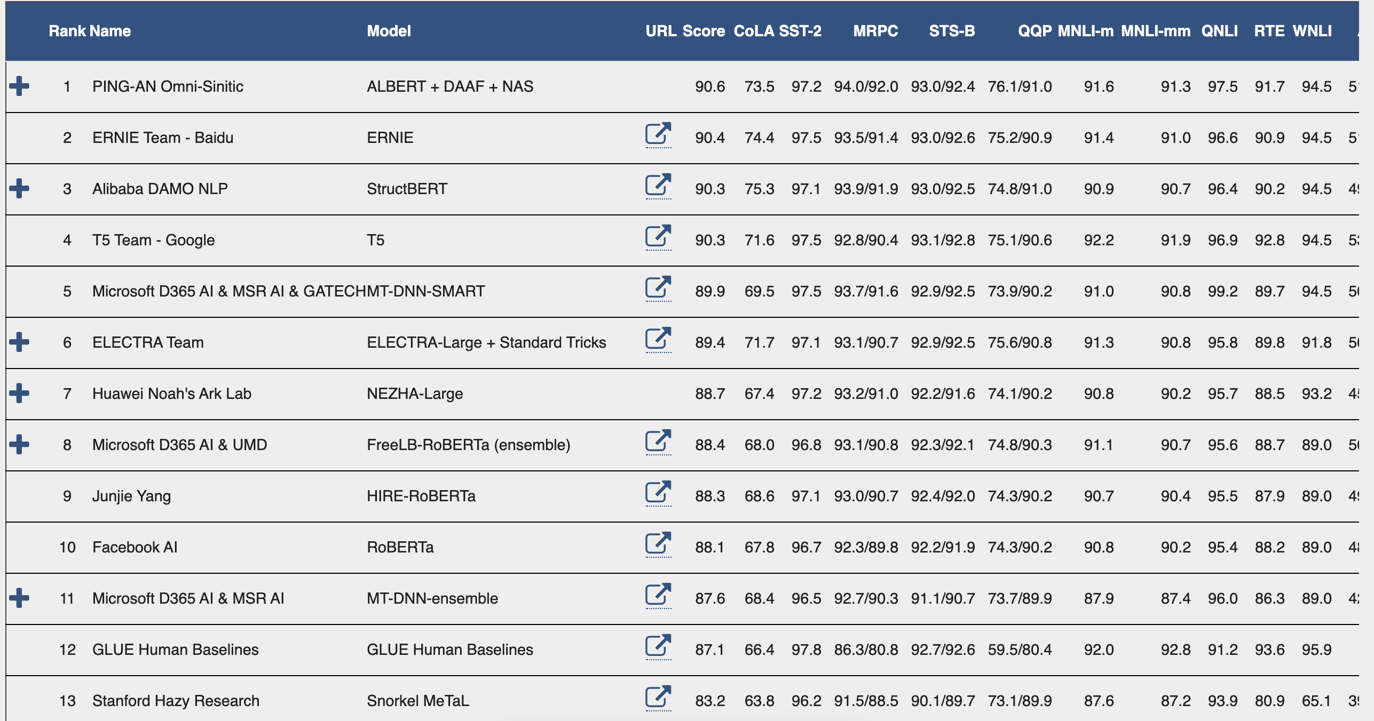
Benchmark
Leaderboard: https://gluebenchmark.com/leaderboard

Slide 5
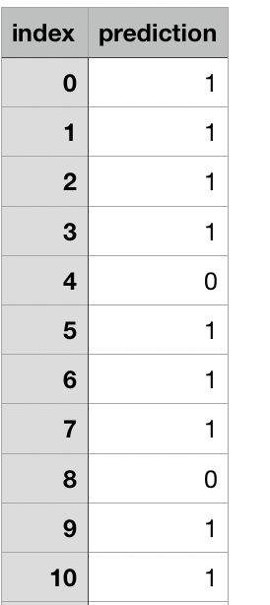
Instructions
Get data for all tasks (with the exception of MRPC, see below) from the 'Tasks' section.
Use the IDs and labels present in the unlabeled test TSVs to generate one TSV of predictions for each of the eleven TSVs (separate test split for MNLI matched and mismatched), where each TSV has a header and each line follows the format 'id [TAB] label'.
Make sure that each prediction TSV is named according to the following (the sample submission can be accessed here https://goo.gl/aYbxjR You can simply replace the CoLA.tsv to evaluate the CoLA task (You are required to submit all the eleven files).
Corpus of Linguistic Acceptability: CoLA.tsv
Stanford Sentiment Treebank: SST-2.tsv
Microsoft Research Paraphrase Corpus: MRPC.tsv
Semantic Textual Similarity Benchmark: STS-B.tsv
Quora Question Pairs: QQP.tsv
MultiNLI Matched: MNLI-m.tsv
MultiNLI Mismatched: MNLI-mm.tsv
Question NLI: QNLI.tsv
Recognizing Textual Entailment: RTE.tsv
Winograd NLI: WNLI.tsv
Diagnostic: AX.tsv
Create a zip of the prediction TSVs, without any subfolders, e.g. using 'zip -r submission.zip *.tsv'.
Upload this zip using the 'Submit' section, filling in details of the method used to generate the predictions.
Do not select “public” so as not to show your results on the leaderboard.

Slide 6
Submission
Each group consists of up to 1 students.
Each group is allowed to upload the formatted predictions for the test set to the GLUE website (https://gluebenchmark.com/submit) to obtain an evaluation score (two times per day).
Each group is asked to submit a short paper describing the system and analyzing the performance before 2020/06/24.
Baseline：60.5%
How to score: 60 + 40 * (yours – baseline) / (best – baseline)

Slide 7
Submission
Submission package：
A report describing the system and analyzing the performance （clearly show the test results and the screenshot in the first part.）
The codes and trained model to reproduce the result.
Randomly select 20 students to show the leaderboard at 2020/06/24 20:00.
If cheated, you will get 0 point.

Slide 8
FAQ
FAQ: https://gluebenchmark.com/faq
If you can not open the Glue website, you might need to use VPN.

Slide 9
谢 谢！

